Slide 1

Hackathon – Python
Team – Tech Titans
Team Members – Kavya Kotagiri

Slide 2
Problem Statements:
Separate excel sheets data into different CSV files
Cleaning of data
Separate Modules for each Department data for integrity.
Savings Account
Loan Account
Credit Card
Utilize OOPS principles
Financial Summary Data
Transaction History Data using Linked List Data Structure
NPA Identification
Credit Card Offering
High Missed EMI’s Customers
Monthly Spends of each customer
Data Visualization

Slide 3
GIT Repository Path : https://github.com/kavyakotagiri/GrowDataApplication
Files details :
Data File – GrowDataBank.xlsx
GrowDataBankApplication.py – Python code file that has all the application logic to get insights of data
GrowDataBankApplication.ibynp – Jupyter notebook code file with same logic as in above file
GrowDataBank_Application.ppt – PPT with all the details
README.md – Contains details of each class and its methods in the application code.

Slide 4
GrowDataApplication can be run using Visual Studio code or using Jupyter Notebook.
Separate files for VSCode and Jupyter Notebook are provided.
Run the below file to run the application in VS Code :
GrowDataBankApplication.py
Run the below file to run the application in Jupyter Notebook:
GrowDataBankApplication.ipynp
Make sure DataGrowBank.xlsx file is available in the same folder the above code files are placed.
Also make sure all the required libraries are installed on VSCode/Jupyter Notebook

Slide 5
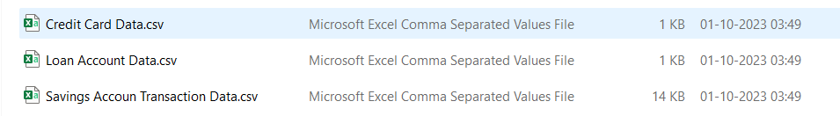
Now let us explore the data.
Separate excel sheets data into different CSV files
Cleaning of Data
class ExcelToCSV is created to perform this task.
Excel file D=GrowData.xlsx file, sheet “Savings Accoun Transaction Data “ data is cleaned using dropna() and str.strip() funtions.
Each sheet data creates new CSV file in the same folder as below:

Slide 6
3. Separate Modules for each Department
4. Utilize OOPS principles
Class SavingsTransaction – For Savings Account Transaction Data
Class LoanTransaction – For Loan Account Data
Class CreditCardTransaction – For Credit Card Data

Slide 7
5. Financial Summary Data
This can take user id as input or a month as input.
Created separate classes methods based on the argument passed.
Created a centralized class FinancialSummary which calls the modules of each department and gets the financial summary based on the argument passed.
when customer id is passed as argument:
Class SavingsTransaction Method get_current_balance_cid is used to calculate the Current Balance of savings account.
Class LoanTransaction Method get_loan_rem_cid is used to calculate the Current Balance of savings account.
Class CreditCardTransaction Method get_credit_rem_cid is used to calculate the Current Balance of savings account.
when month is passed as argument:
Class SavingsTransaction Method get_current_balance_month is used to calculate the Current Balance of savings account.
Class LoanTransaction Method get_loan_rem_month is used to calculate the Current Balance of savings account.
Class CreditCardTransaction Method get_credit_rem_month is used to calculate the Current Balance of savings account.

Slide 8
6. Transaction History Data using Linked List Data Structure
Class Node is created for Linked List Node
Class LinkedList_SavingsTransaction is created for storing savings account transactions.
append() method is used to add each row of the file data to LL data structure.
filter_by_column_value() is used to filter the transactiosn based on customer id argument. This method is dynamic and can be used to filter any column. Here I used it to filter data based on customer_id
getlength() is used to find the legth of the LL datastructure.

Slide 9
7. NPA Identification
Class NPAIdentification is created to identify NPA accounts and lists all the details of these accounts.
8. Credit Card Offering
Class CreditCardOffering is created to identify customers eligible for increased credit card balances and lists all the details of these accounts.

Slide 10
9. High Missed EMI’s Customers
Class LoanTransaction method get_max_missed_emi is created to identify high missed EMIs customer accounts and lists all the details of these accounts.
10. Monthly Spends of each customer
Class MonthlySpends method get_monthly_data is created to identify customers eligible for increased credit card balances and lists all the details of these accounts.

Slide 11
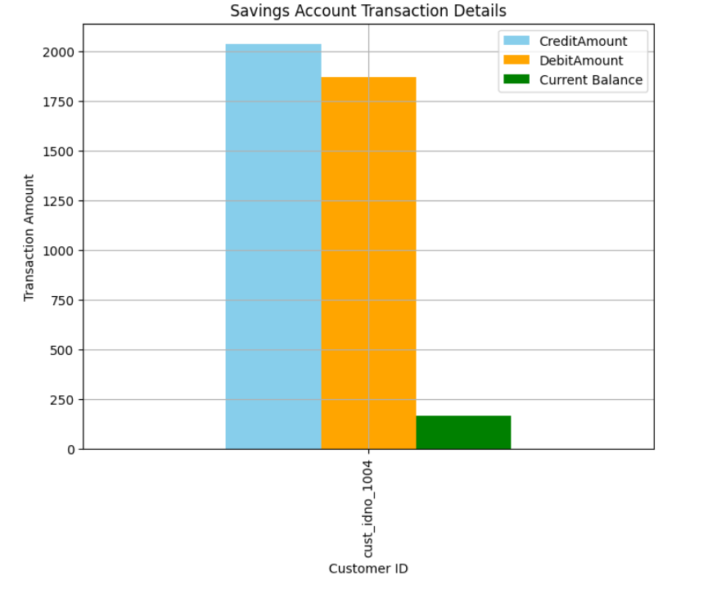
11. Data Visualization
Below are the data Insights
Customer 1004 has more Credit Transactions than Debit Transactions in Savings Account.

Slide 12
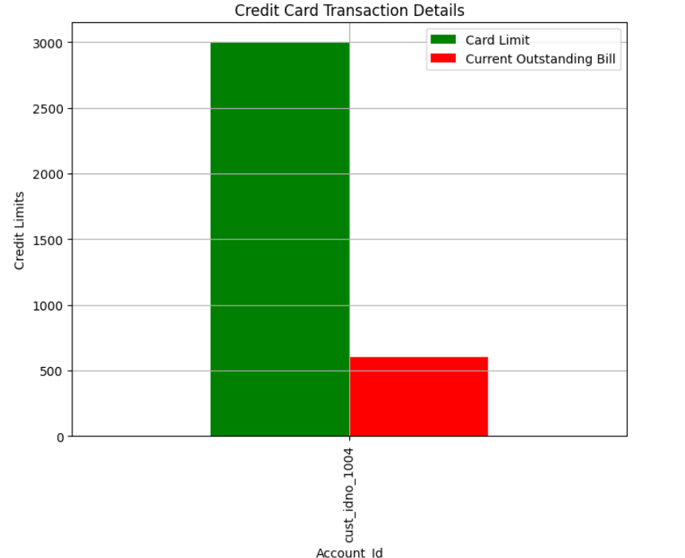
Customer 1004 has Less Outstanding Bill for given Card Limit

Slide 13
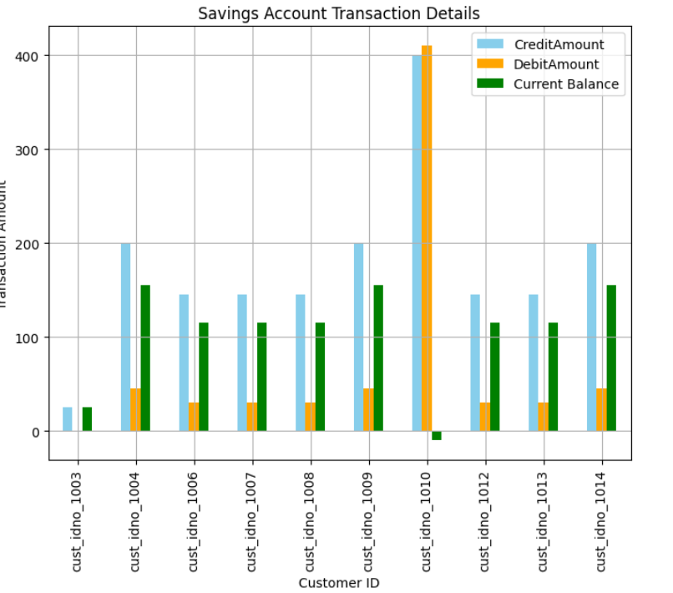
Financial Summary for all customers for Savings Account in the 2nd month.
Looking at the bar graph, 1010 customer has highest Debit and Credit Amounts but negative account balance which means Debit Amount is more than Credit Amount.

Slide 14
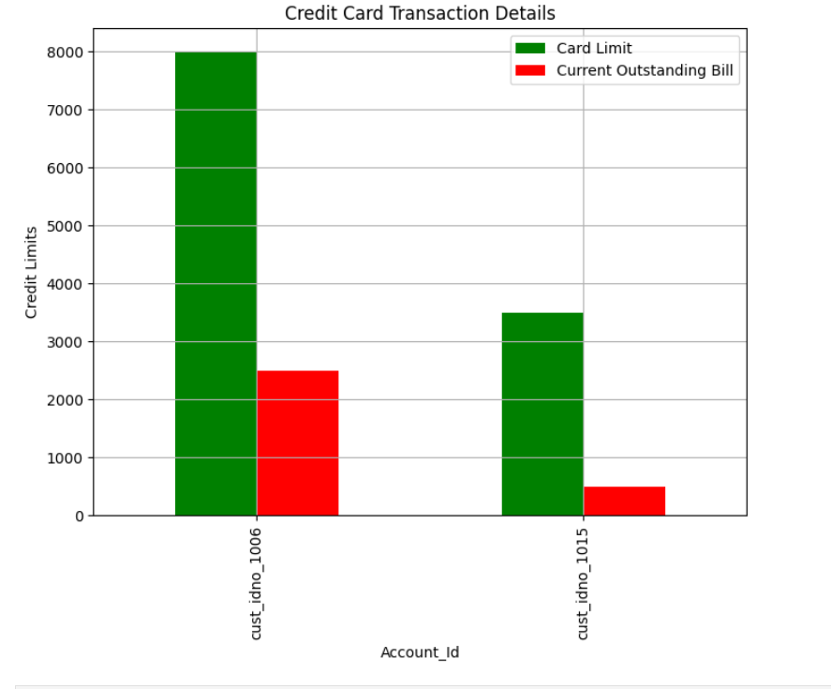
Financial Summary for all customers for Credit Card Account in the 2nd month.
Looking at the bar graph, 1006 customer has highest Debit and Credit Amounts.

Slide 15
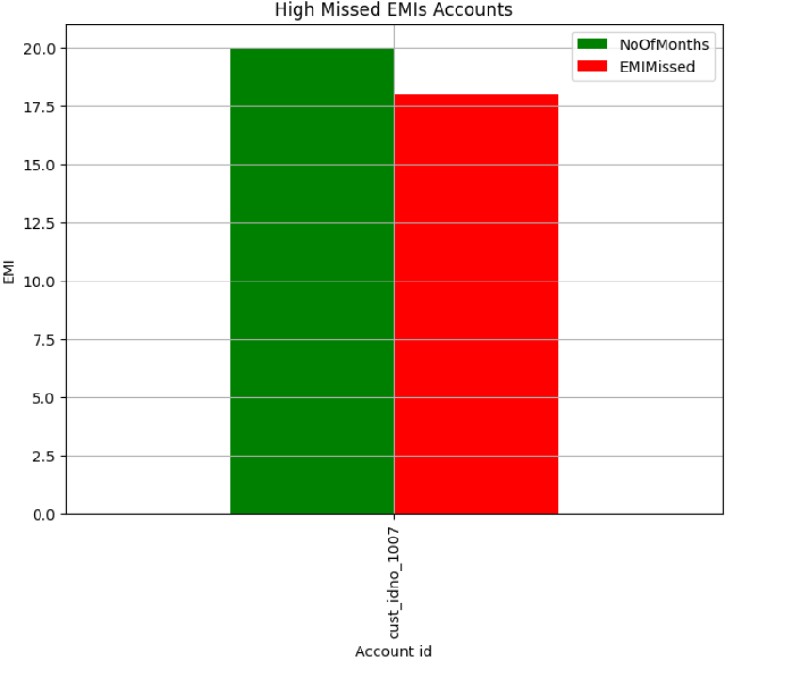
Out of all the Loan Accounts, customer 1007 has the highest missed EMI payments
based on the loan disbursed month.

Slide 16
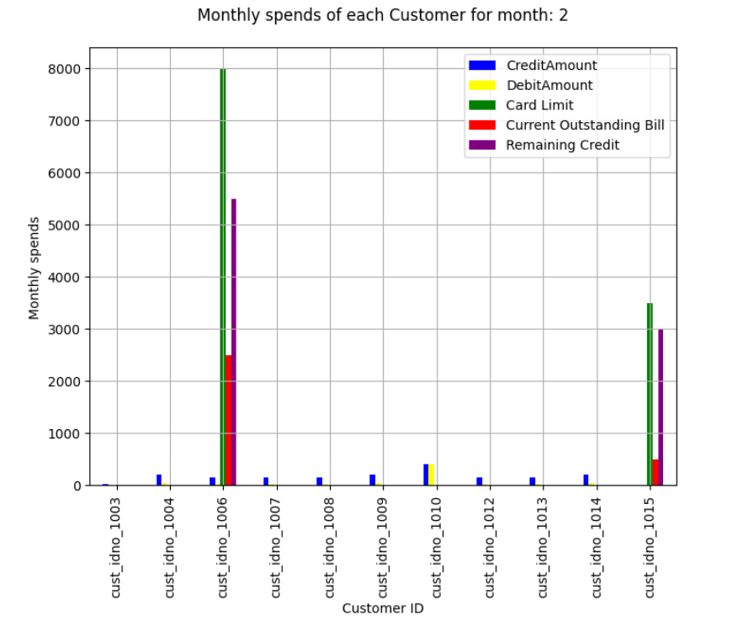
Monthly spends for all customers for Savings and Credit Card Account in the 2nd month.
Looking at the bar graph, 1006 customer has highest Credit Limit and has 1/3rd of credit amount outstanding and 2/3rd is remaining credit.

Slide 17
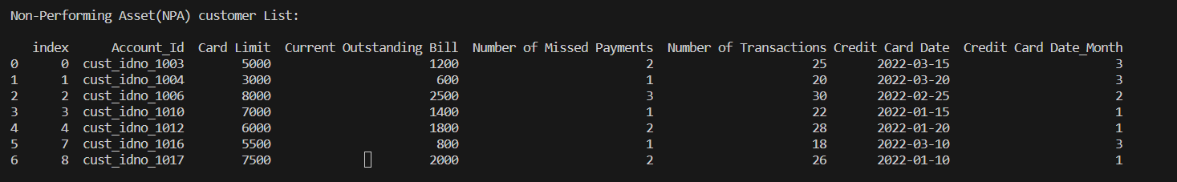
Non-Performing Asset(NPA) customer List:
Total of 7 customers have NPAs, Bank to take necessary actions on these customers to recover the pending payments.

Slide 18
Credit Card Offering - Eligible for increased credit card balances:
Above two customers with id’s 1-13 and 1015 have a good credit limit, less outstanding bills, and good transaction history.
Credit Limit is not high, it is less than 10000.
Less Outstanding Bill
No Missed Payments
Finally, more than or equal 10 transactions.
So these customers are eligible for increased credit card balances.

