Slide 1


DOWNLOAD & INSTALL
VISUAL STUDIO 2019 COMMUNITY EDITION
SSDT
&
SSRS Service

Slide 2
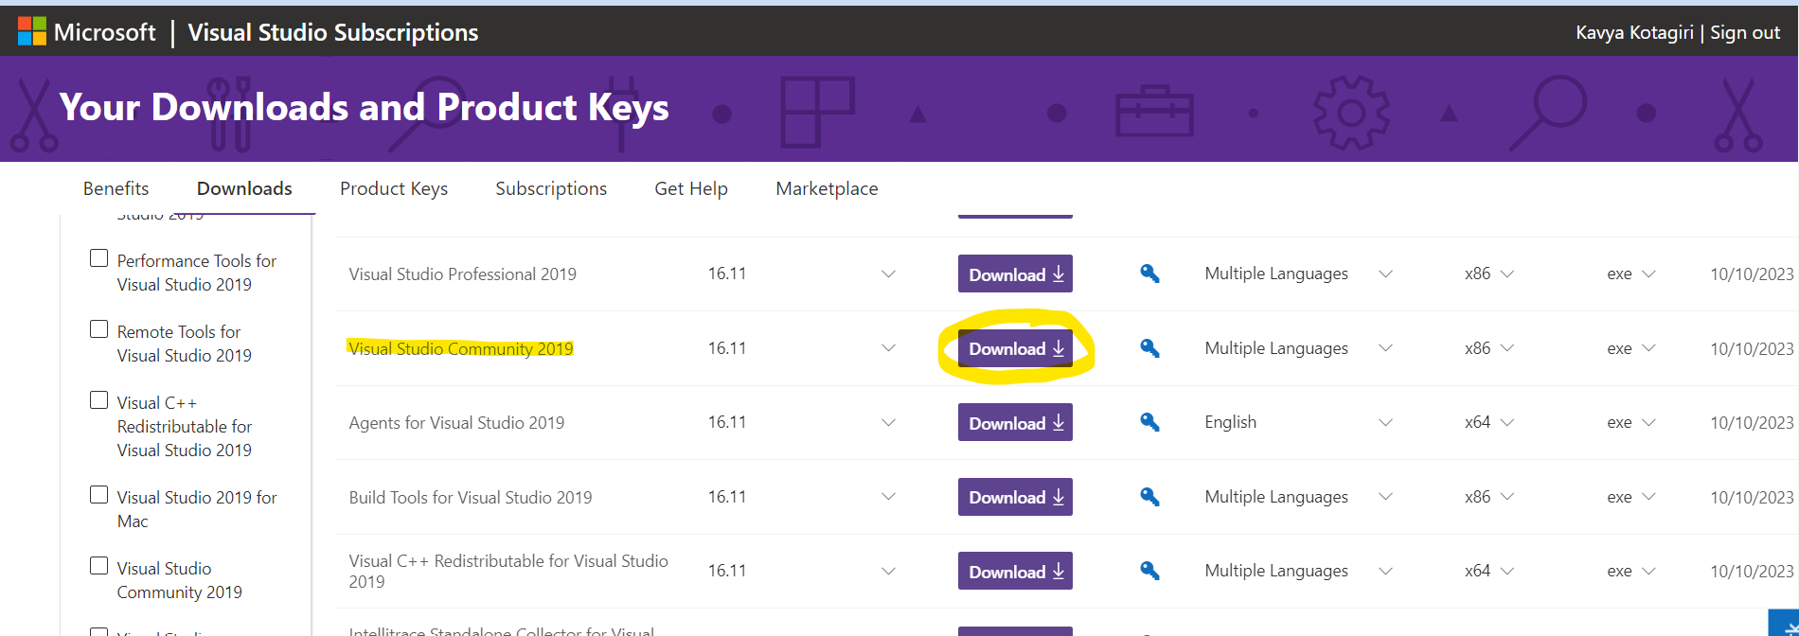
Open the browser and search for “Visual Studio 2019 community download” or go to the below link:
https://my.visualstudio.com/Downloads?q=Visual%20Studio%202019
Click download button next to “Visual Studio Community 2019”.

Slide 3
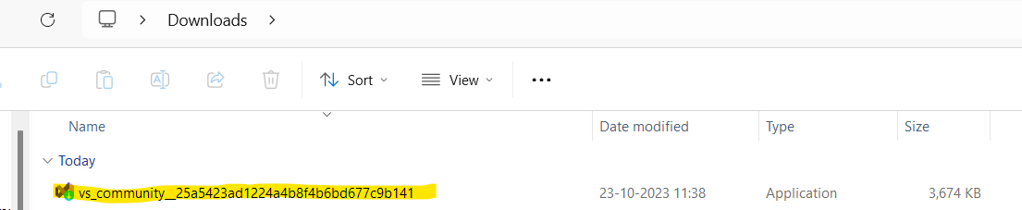
Once the download is completed. You will find an .exe file downloaded.
Now run the .exe file.

Slide 4
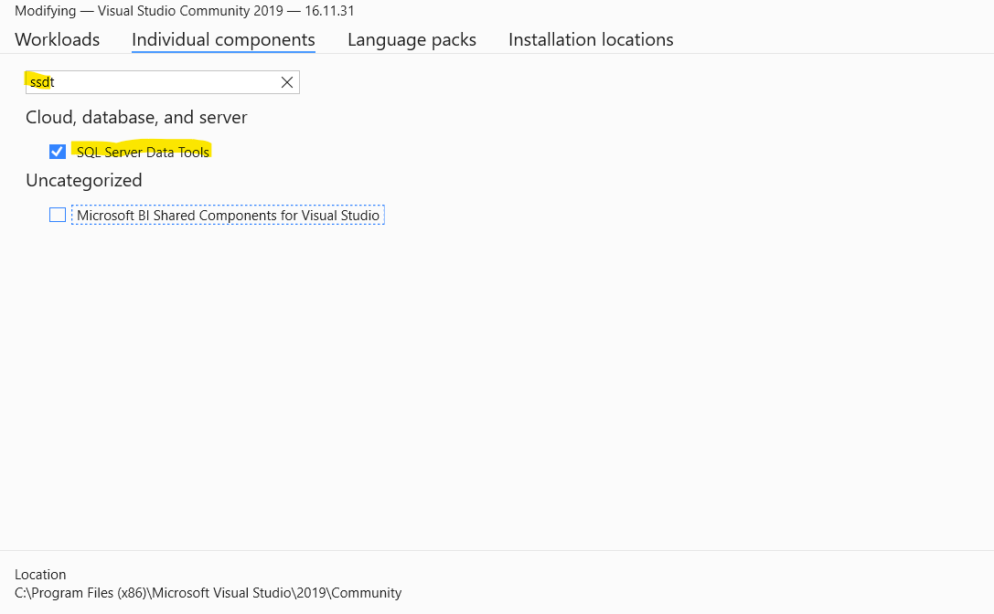
Visual Studio Installer gets downloaded and installed.
Once installation is completed, below window gets opened.
Go to Individual components and search for ssdt.
Check SQL Server Data Tools and click Install.
Once the installation is completed, launch Visual Studio 2019.

Slide 5
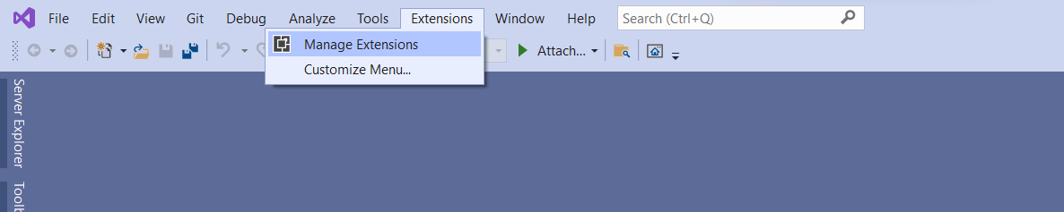
Once the Visual Studio is opened.
On the Menu bar click Extensions -> Manage Extensions

Slide 6
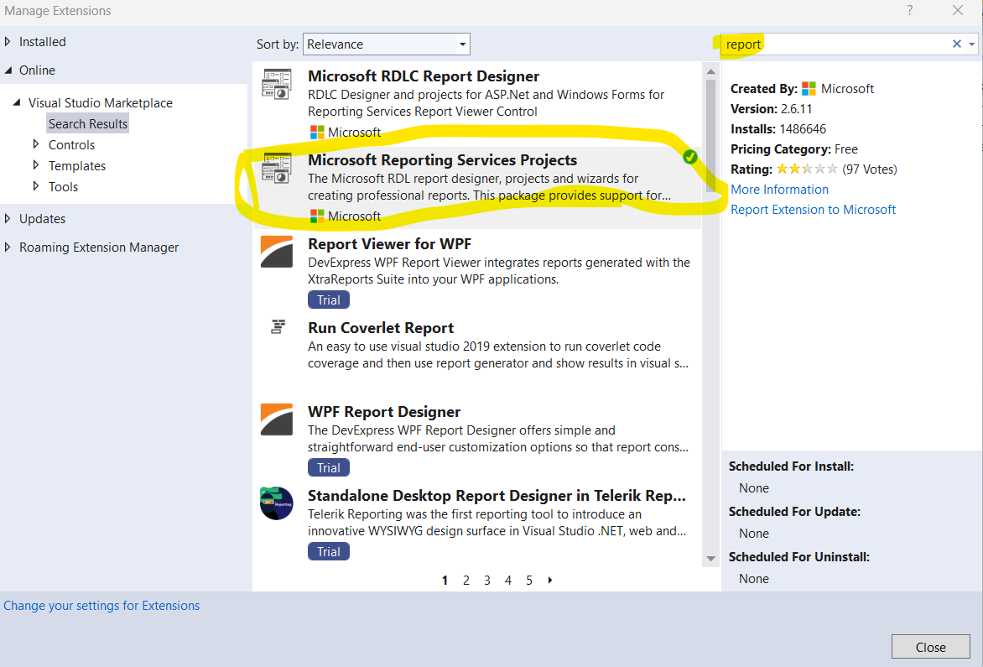
Search for “report”
Now Install the extension.
Once installation is completed, close the visual studio and re-launch.
That’s all, Visual Studio with SSRS tool is installed successfully.
Now, lets create first SSRS project.

Slide 7
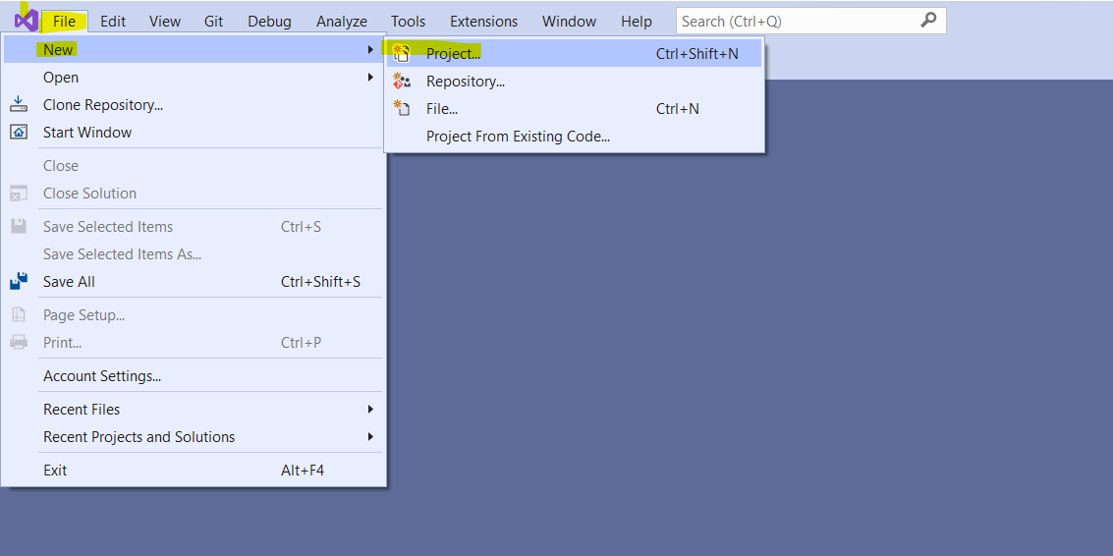
Click on File -> New -> Project

Slide 8
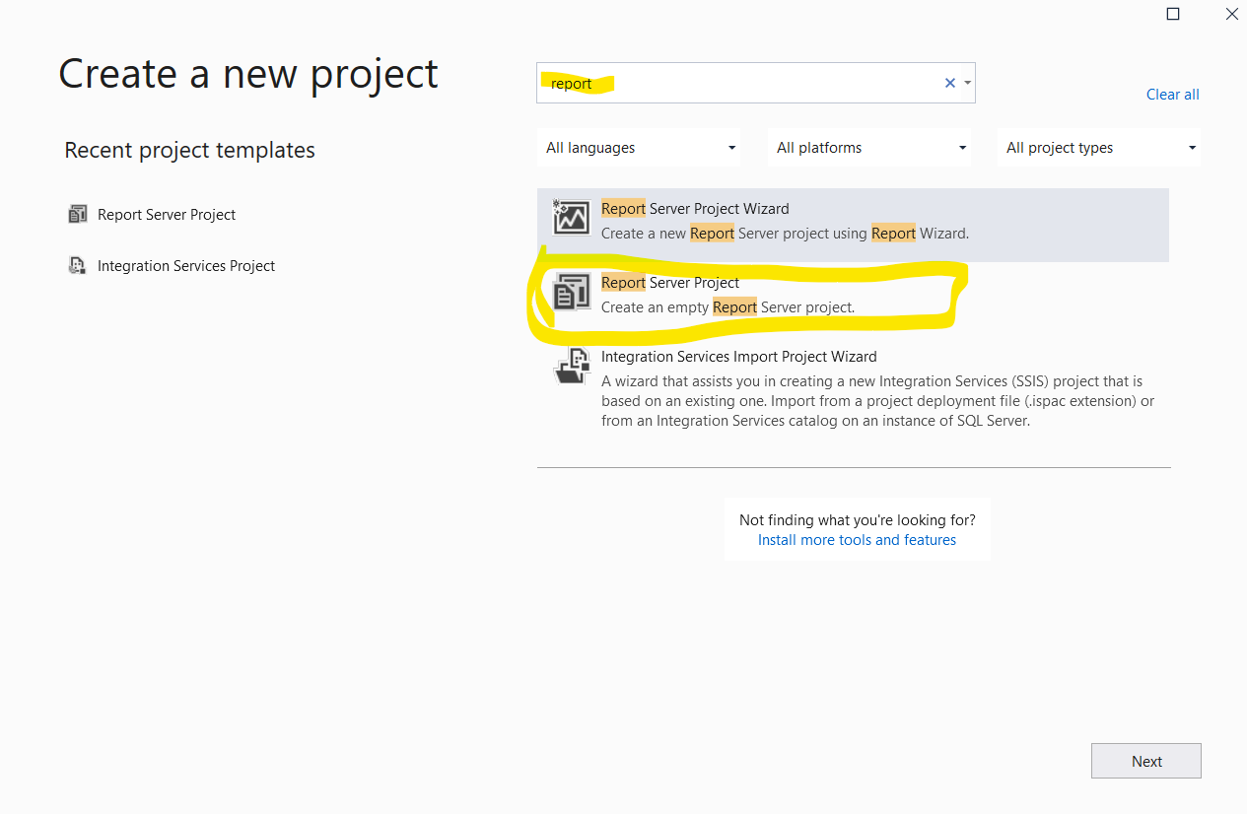
Search for “report” and select “Report Server Project”
Click “Next”

Slide 9
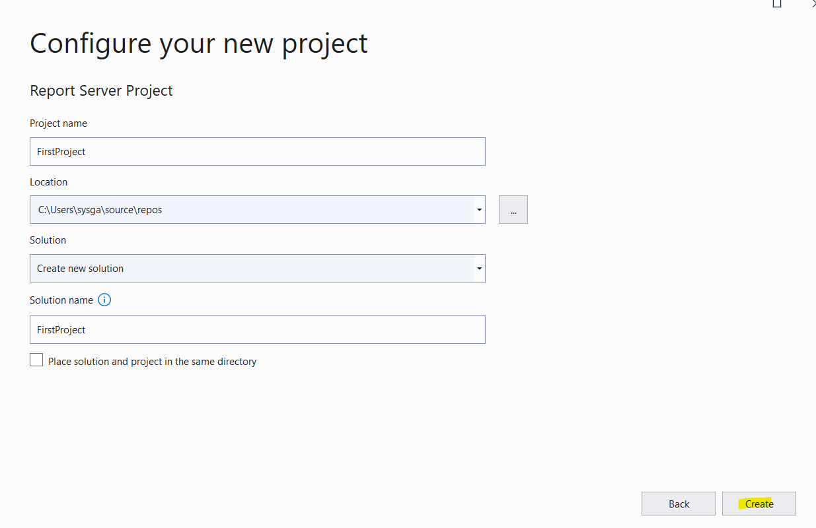
Give Project Name and select location to sae the solution
Click “Create”

Slide 10
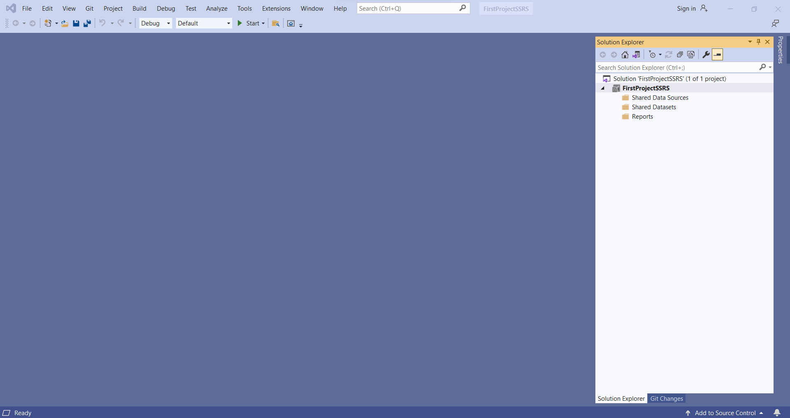
New SSRS project is now created.
Shared Data Sources, Datasets and Reports folders are created under the project.

Slide 11
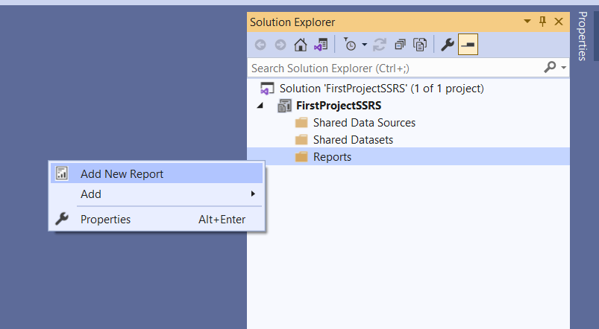
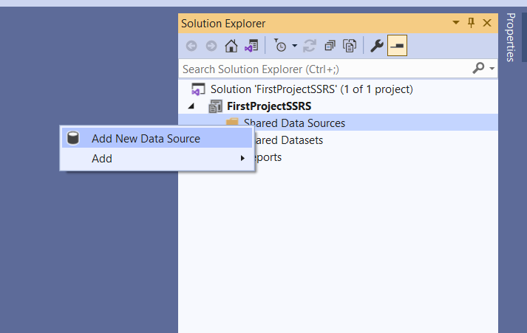
To create a new report right click and select Add New Report.
To create a new Data Source right click and select Add New Data Source.
Now, we are all set to create new SSRS report.

Slide 12
THANK YOU

