Slide 1


DOWNLOAD & INSTALL
SQL Server 2019
&
SSMS

Slide 2
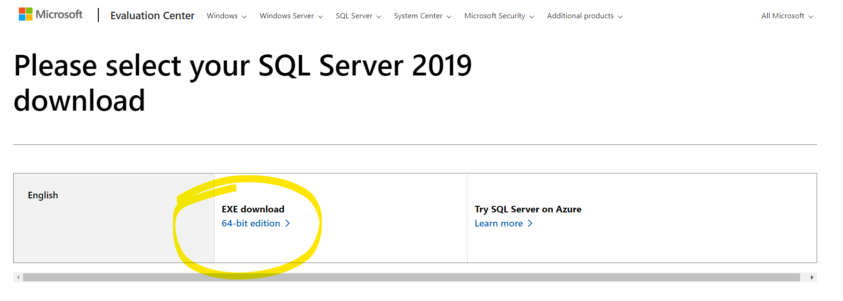
Open the browser and search for “SQL Server 2019 download” or go to the below link:
https://www.microsoft.com/en-us/evalcenter/download-sql-server-2019
Click on 64-bit edition.
Download gets started and an .exe file will be downloaded.

Slide 3
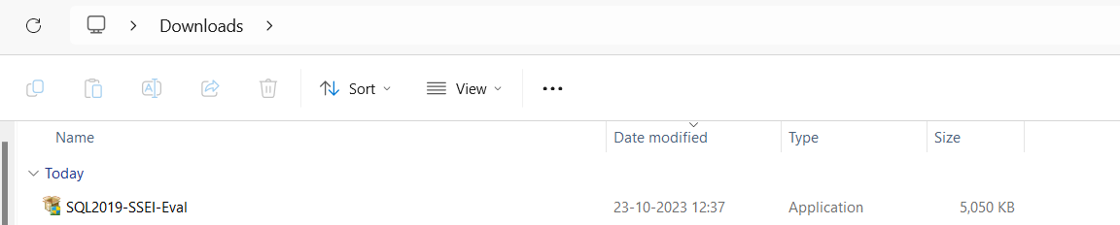
Once the download is completed. You will find an .exe file downloaded.
Now run the .exe file.

Slide 4
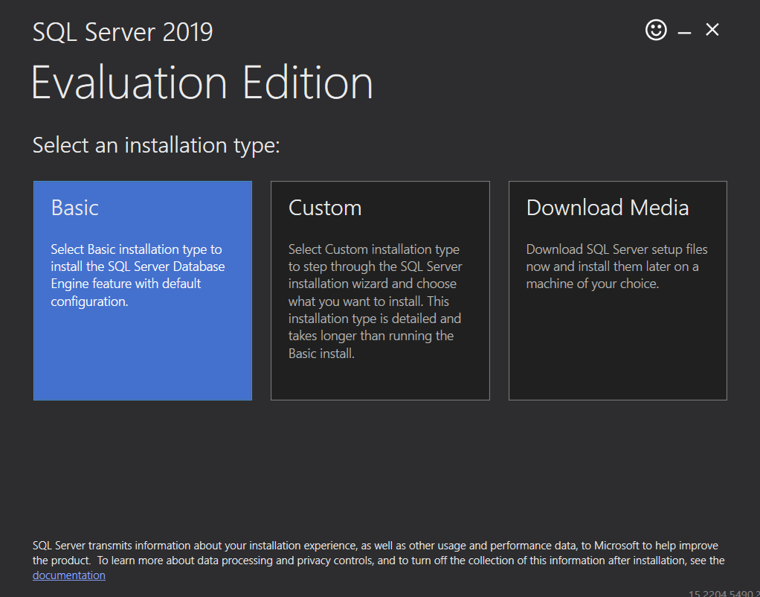
Select Basic.
Select Installation path.

Slide 5
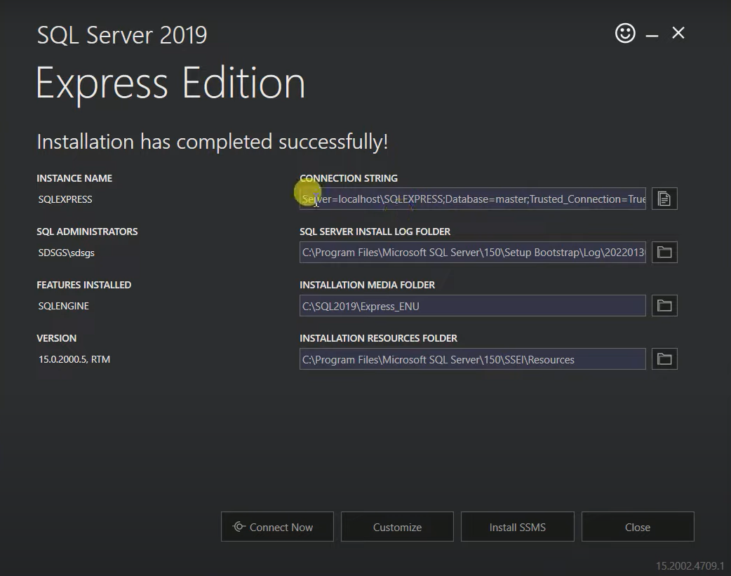
Once installation is completed.
Below window will pop up with Connection String and other details.
Server “localhost” will be created.

Slide 6
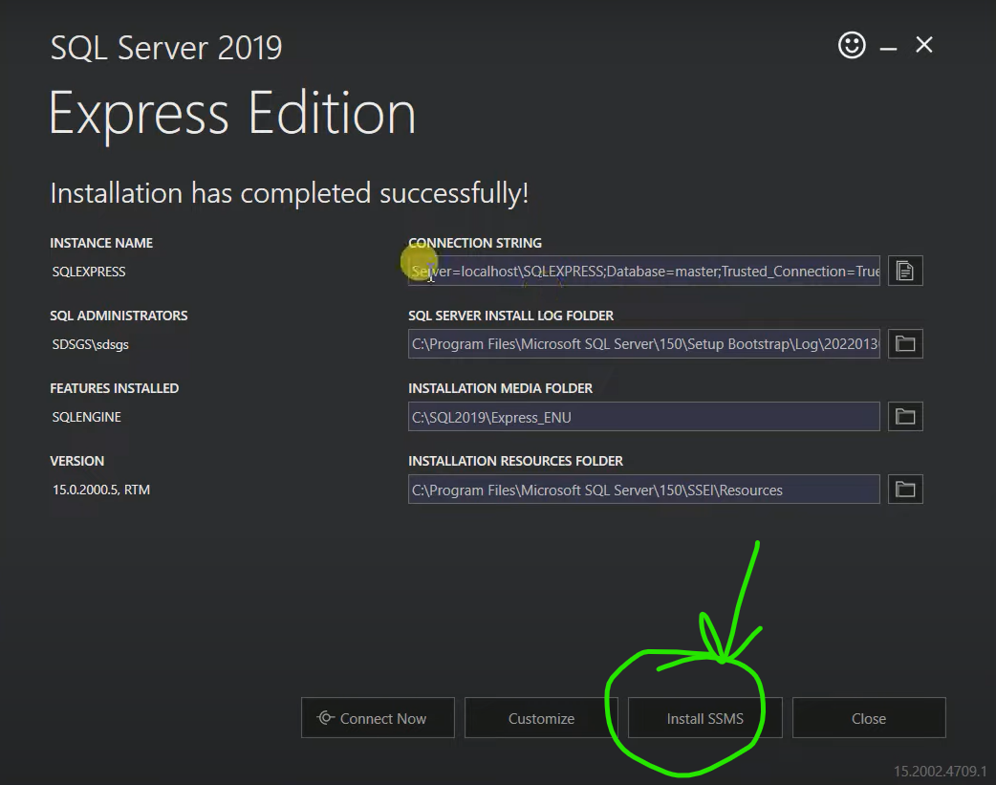
Now click on Install SSMS.
Now you will be redirected to Microsoft official website to download SSMS.
Click download

Slide 7
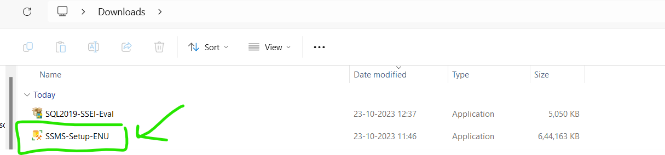
Once download is completed, an .exe file will be available.
Run the .exe file and click Install.

Slide 8
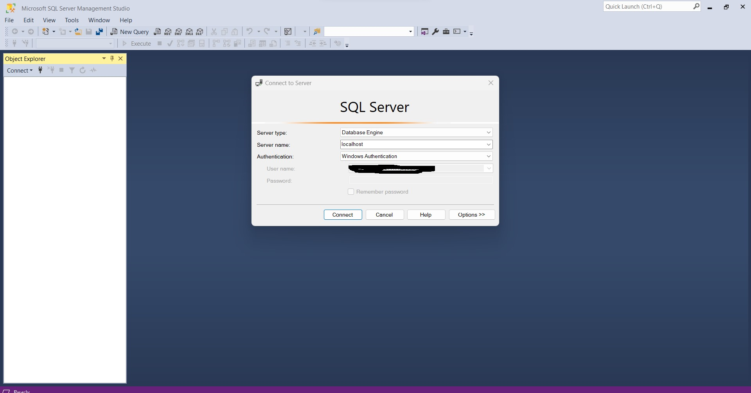
Once the installation is completed, SSMS window will be opened.
Enter “localhost” in Server name.
Click Connect.
That’s all, now you are all set and connected to SQL server.
You can now create databases, tables, stored procs, views etc..

Slide 9
THANK YOU

