Slide 1
Anomaly Detection of Audio Based on Real Audio Using GANs model
Branch & Year: AI&ML (4th YR 2nd SEM)
G. Kavya Kruthika - 22RH1A6671
Neeraja Hannala - 22RH1A6672
J. Kalpana - 22RH1A6673
Guide :Dr. VAMSI KRISHNA

Slide 2
INTRODUCTION
Anomaly audio can be used for malicious purposes such as impersonating individuals, bypassing voice authentication systems, spreading misinformation, or committing fraud. As synthetic speech becomes more realistic, it becomes increasingly difficult for humans and traditional detection tools to identify whether an audio clip is real or fake. This raises significant concerns for digital security, privacy, and trust in audio communication.
To address this issue, our project proposes an AI-based detection system that uses spectrogram analysis and deep learning to identify deepfake audio. The system converts audio inputs into Mel-spectrograms, which are visual representations of sound frequency over time. These spectrograms highlight subtle differences in pitch, tone, and noise artifacts that are often present in synthetic speech. A Convolutional Neural Network (CNN) is then trained to classify the spectrograms as either “Real” or “Fake.”

Slide 3
EXISTING SYSTEM
Current methods of detecting audio forgeries rely on manual analysis or simple feature extraction techniques such as MFCCs or audio fingerprints. These approaches often fail when adversarial attacks are introduced or when deepfake audio is generated with high-quality neural network models like WaveNet.
Disadvantages
Poor generalization across datasets
Inability to handle modern neural deepfakes

Slide 4
PROBLEM STATEMENT
With the rapid advancement of AI-driven voice synthesis, detecting deepfake audio has become a critical challenge, as such falsified audio can be misused for fraud, misinformation, and security breaches. This project addresses the problem by developing an automated system that analyzes audio signals using spectrogram-based features and machine learning models to accurately distinguish between genuine and deepfake audio.

Slide 5
OBJECTIVES
To develop an automated system capable of distinguishing between genuine and deepfake audio.
To extract and analyze audio features using Mel-spectrograms for reliable classification.
To apply machine learning/deep learning techniques for accurate detection of synthetic audio.
To create a user-friendly web interface for uploading and analyzing audio files in real time.
To enhance security and trust by mitigating risks associated with deepfake audio misuse.

Slide 6
PROPOSED SYSTEM
The system consists of audio preprocessing, spectrogram generation, and a CNN-based classifier. Mel-spectrograms are generated using Librosa, resized and normalized before being passed through the model. The CNN includes convolutional layers for feature extraction, pooling for dimensionality reduction, and dense layers for final classification. A simple GUI built with Tkinter allows users to upload audio files and receive predictions instantly. This architecture is designed for high accuracy, scalability, and ease of integration into real-world applications such as media platforms, security systems, and forensic tools.
ADVANTAGES :
High detection accuracy
End-to-end automation
Spectrogram-based feature analysis
Easy-to-use GUI

Slide 7
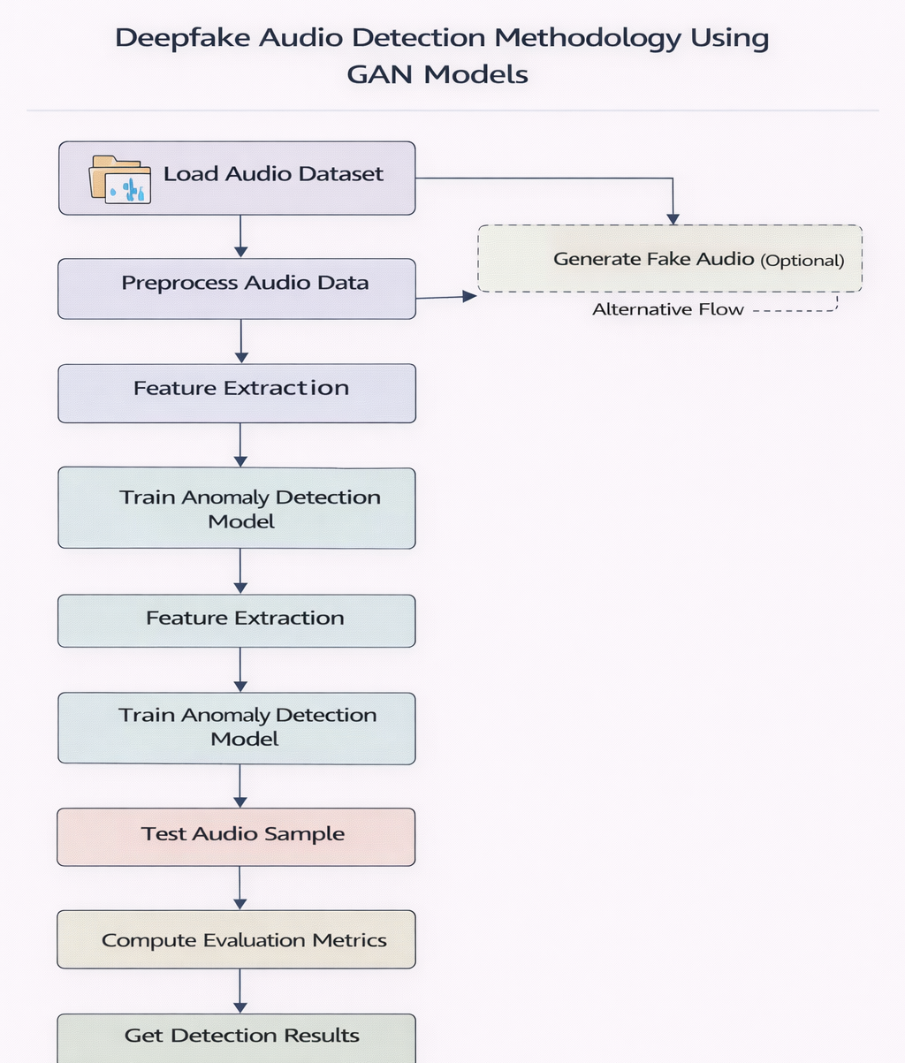
METHODOLOGY

Slide 8
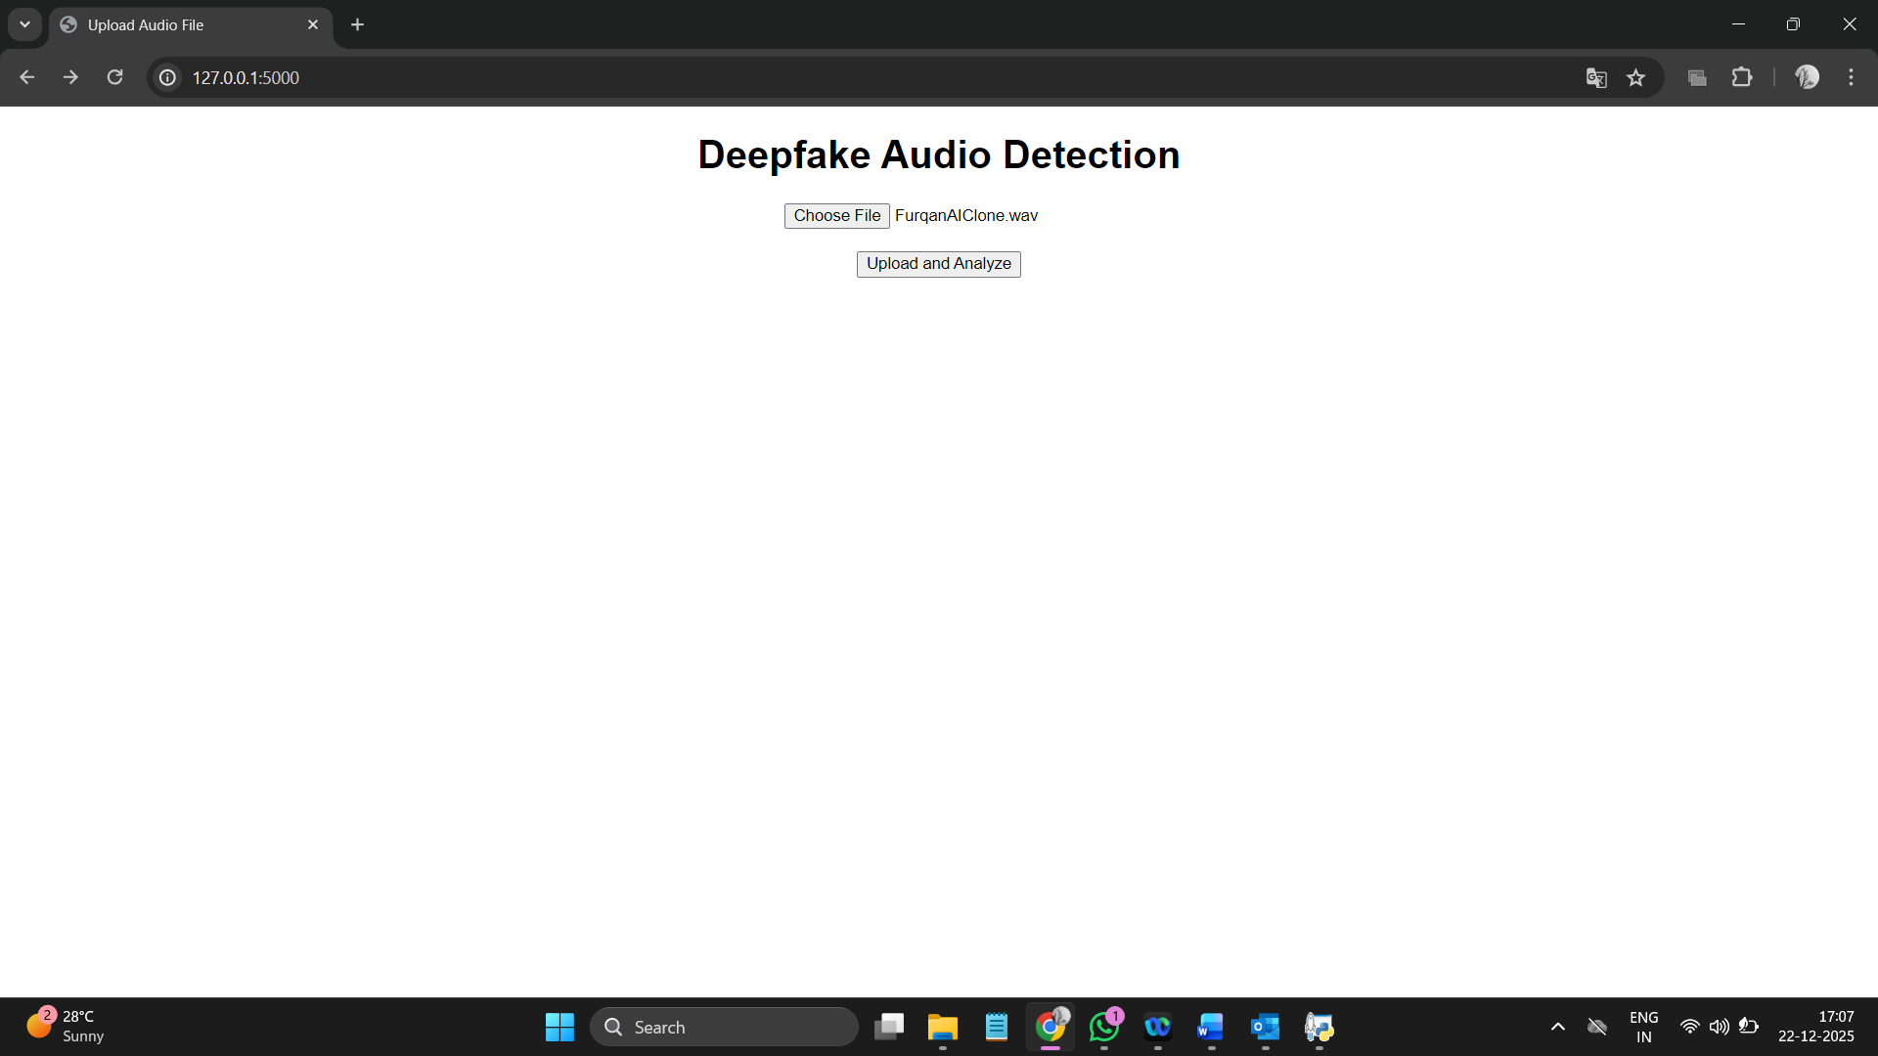
RESULTS

Slide 9
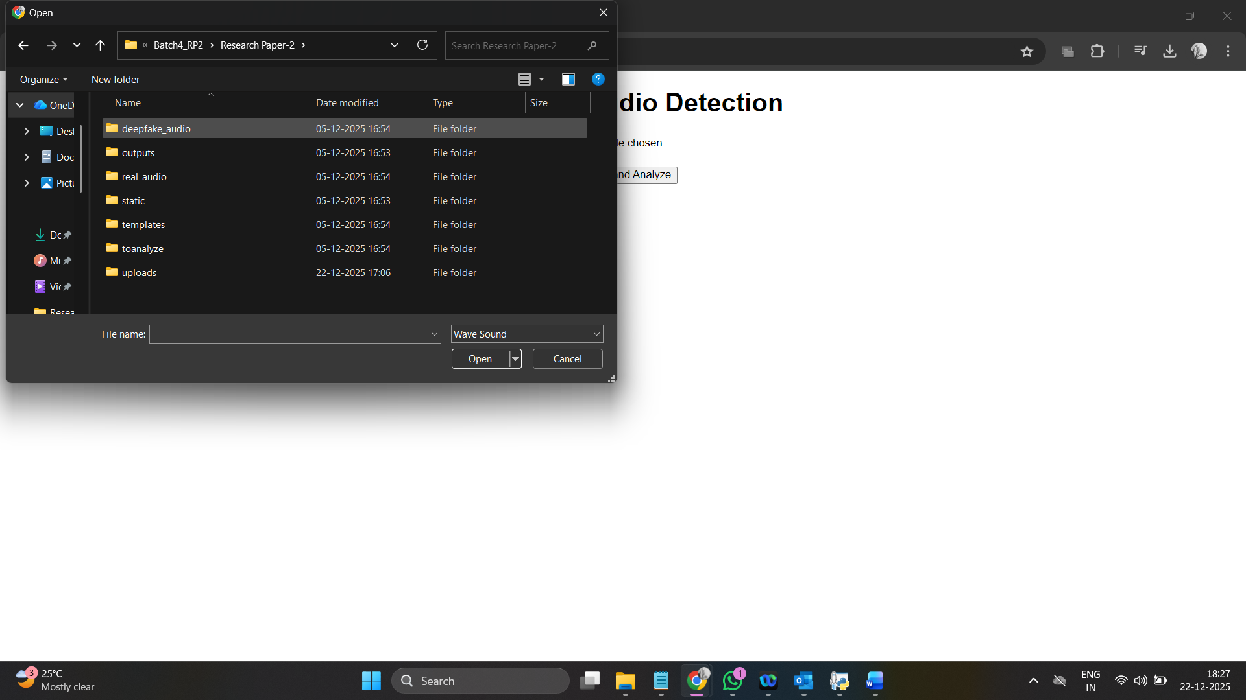
resultS

Slide 10
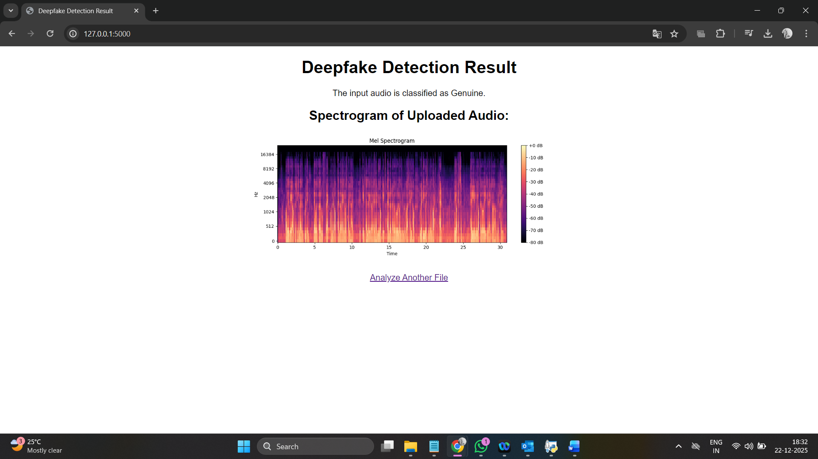
RESULTS

Slide 11
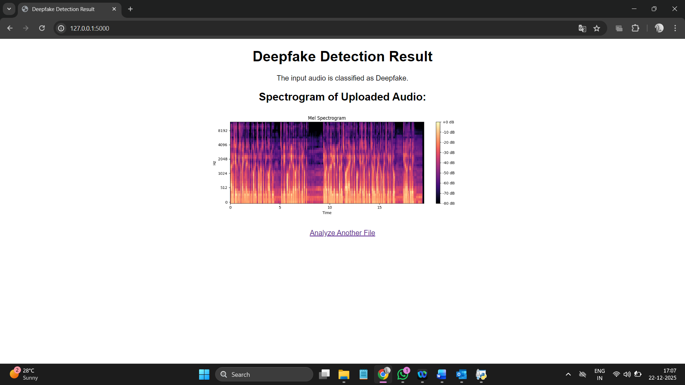
RESULTS

Slide 12
conclusion
"Anomaly Detection of Audio Based on Real Audio Using GANs Model" successfully demonstrates an efficient approach to detecting fake audio using deep learning techniques. By converting audio into Mel-spectrograms and MFCCs, and analyzing them through CNN and CNN+GRU models, the system accurately distinguishes between real and deepfake audio. The integration with Streamlit provides a simple and interactive user interface for real-time predictions. The model achieved high accuracy and fast processing, making it suitable for real-world applications in media verification, security, and digital forensics.

Slide 13
FUTURE SCOPE
Real-time deepfake detection in live audio streams is another promising direction. Integrating the system with streaming platforms could help prevent the spread of misinformation in real time. Additionally, combining deepfake detection with speaker verification could further strengthen voice authentication and improve reliability.

Slide 14
REFERENCES
G. Lin, W. Luo, D. Luo, and J. Huang, ‘‘One class neural network with directed statistics pooling for spoofing speech detection,’’ IEEE Trans. Inf. Forensics Security, vol. 19, pp. 2581–2593, 2024, doi: 10.1109/TIFS.2024.3352429.
G. Lin, W. Luo, D. Luo, and J. Huang, ‘‘One-class neural network with directed statistics pooling for spoofing speech detection,’’ IEEE Trans. Inf. Forensics Security, vol. 19, pp. 2581–2593, 2024, doi: 10.1109/TIFS.2024.3352429.

Slide 15
Thank you.

