Slide 1
API: a demo of Quandl

Slide 2
Objective:
What is an API
Codification of the steps
A look at the final table and plot
Steps followed in getting and visualizing the data
Demo of Quandl API

Slide 3


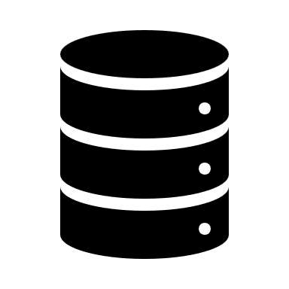
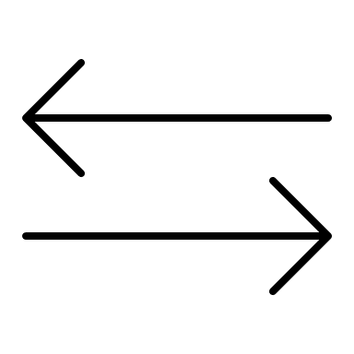

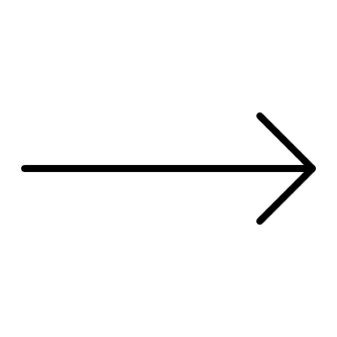





API: Application Programming Interface
API is a technology that allows different applications to communicate and transfer data with each other. A user knows the input and output, but not the underlying software or how the API works.
Client
Server
Request
API
Response
Order
Delivery
Customers
Waiter
Chef

Slide 4






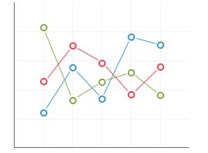

Steps in Data Analysis:
Step 1: Pull company data using Quandl API
Step 2: Select the columns required for analysis from entire dataset
Step 3: Merge them into a final dataframe for further analysis
Step 4: Visualize the data using a graph

Slide 5
Codify Steps in Data Analysis:
Step 1: dfAAPL = quandl.get("WIKI/AAPL", start_date="2015-7-1", end_date="2017-12-31")
Step 2: dfAAPL = dfAAPL.rename(columns={'Adj. Close':'AAPL’})
Step 3: df = pd.concat([dfAAPL, dfAMZN, dfEXC, dfNDAQ, dfRGLD], axis=1)
df = df[['AAPL', 'AMZN', 'EXC', 'NDAQ', 'RGLD']]
Step 4: plot_data(df)

Slide 6
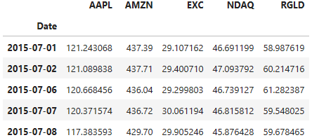
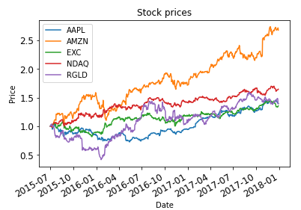
dfAAPL = quandl.get("WIKI/AAPL", start_date="2015-7-1", end_date="2017-12-31")
dfAAPL = dfAAPL.rename(columns={'Adj. Close':'AAPL’})
df = pd.concat([dfAAPL, dfAMZN, dfEXC, dfNDAQ, dfRGLD], axis=1)
df = df[['AAPL', 'AMZN', 'EXC', 'NDAQ', 'RGLD']]
plot_data(df)

