Slide 1
KPR INSTITUTE OF ENGINEERING AND TECHNOLOGY
(Autonomous Institution • Affiliated to Anna University Chennai • Accredited by NAAC 'A' Grade)
DEPARTMENT OF COMPUTER SCIENCE AND ENGINEERING
REAL-TIME API PERFORMANCE MONITORING &
DIAGNOSTIC DASHBOARD
A Zero-Dependency Observability Platform with Multi-Tenant Workspace Scoping,
CORS-Resilient Probing, and Full-Stack Relational Telemetry
SUBMITTED BY:
KAVYANAND J
Roll No: 24CS096
B.E. Computer Science and Engineering
PROJECT DOMAIN & DETAILS:
Web Application & Cloud Telemetry
Audit Standard: Google Lighthouse Core Web Vitals
Academic Session: 2024 – 2025

Slide 2
MOTIVATION & PROBLEM STATEMENT
The Microservices Reliability Paradox & APM Bottlenecks
The Microservices Reliability Paradox
• Modern enterprise applications are no longer isolated monolithic runtimes; they orchestrate dozens of distributed REST APIs (Payment gateways, OAuth services, AWS/GCP pipelines).
• Cascading Failure Vulnerability: When systems become decoupled, operational health becomes tightly interdependent. A 3000ms latency surge in an external payment endpoint causes full application perceived downtime.
• Observability Blindspot: Engineering teams remain blind to transient network degradations until customer churn and severe financial losses occur.
Acute Bottlenecks in Existing APMs
1. Invasive Telemetry Overhead: Commercial APMs (Datadog, Dynatrace) require heavy background daemons (>500MB RAM) and kernel probe drivers that distort local execution latency.
2. Multi-Tenant Collision: Developer tools (Postman, Insomnia) store collections globally, causing endpoint data collisions on shared testing terminals.
3. Browser CORS Blocking: Standard web fetch() pings fail when querying cross-origin endpoints without CORS headers, triggering false-negative offline alerts.
4. Exorbitant Pricing Models: Consumption-based SaaS licensing prices out independent developers, staging labs, and student researchers.

Slide 3
ENGINEERING GOALS
Primary Technical & Architectural Objectives
[PORTABILITY] Zero-Dependency Autonomous Execution
Architect the platform to execute directly in any modern browser simply by opening index.html, requiring zero local server runtimes (Apache, Node.js) or database daemons while ensuring full state persistence via the Web Storage API.
[TELEMETRY] High-Resolution Latency Probing Engine
Engineer an asynchronous diagnostic worker leveraging W3C performance.now() to measure network transport round-trip latency with sub-millisecond precision, guarded by a deterministic 5,000ms AbortController circuit breaker.
[ISOLATION] Strict Multi-Tenant Workspace Scoping
Implement cryptographic, user-isolated data partitioning where distinct developers (User 1 vs. User 2) maintain completely private endpoint registries, independent diagnostic histories, and customized visual analytics.
[FULL-STACK] Enterprise Relational Database Depth
Provide a fully normalized MySQL 8.0 relational schema complete with primary keys, indexed foreign key cascades, and secure PHP 8.x PDO REST controllers utilizing parameterized prepared SQL statements.
[VERIFICATION] Empirical Core Web Vitals Auditing
Subject the client application to automated Google Lighthouse audits, validating sub-0.5s First Contentful Paint (FCP), 0ms Total Blocking Time (TBT), and near-perfect 98+ performance scores across devices.

Slide 4
LITERATURE SURVEY & BENCHMARKING
Comparative Benchmark against Prevailing APM Tooling
Evaluation Metric | Proposed Dashboard | Datadog / Dynatrace | Postman / Insomnia | Prometheus + Grafana
Telemetry Overhead | Zero (<50 KB runtime, no daemons) | Heavy (>500 MB RAM background daemons) | Medium (Electron Desktop App) | High (Time-series TSDB daemons)
Multi-Tenant Scoping | Strict User-Isolated Storage Partitioning | RBAC / Organization Accounts | No (Global machine storage collision) | Complex Namespace RBAC
Setup Complexity | Zero-setup (Open index.html directly) | Complex cloud agent installation | Desktop application installation | Extensive YAML & container configs
CORS Resilience | Opaque HEAD Probing + Circuit Breakers | Agent bypasses browser sandbox | Desktop client bypasses browser CORS | Server-to-server HTTP scraping
Licensing & Cost | 100% Free / Open-Source Architecture | High usage-based pricing ($15+/host/mo) | Freemium tiered subscription | Free open-source (Cloud hosting cost)

Slide 5
SYSTEM ARCHITECTURE
Three-Tier Architecture & Dual-Mode Operational Engine
Tier 1: Presentation & Visualization Layer
• HTML5 Semantic DOM + CSS Custom Properties with Acrylic Glassmorphism.
• Responsive Dark/Light dynamic theming and custom multi-tenant trigger popovers.
• Six hardware-accelerated Chart.js canvas widgets running at fluid 60fps via requestAnimationFrame().
Tier 2: Business Logic & Network Engine
• Asynchronous diagnostic worker capturing monotonic timing via window.performance.now().
• W3C CORS-resilient HEAD network dispatcher preventing cross-origin preflight errors.
• 5,000ms AbortController circuit breaker preventing client socket starvation and thread lockup.
Tier 3: Dual-Mode Persistence Layer
• Autonomous Mode: Zero-dependency Web Storage API (localStorage) with cryptographic scoping.
• Enterprise Mode: Decoupled PHP 8.x PDO backend connecting to normalized MySQL 8.0 schema.
• Parameterized prepared SQL statements preventing SQL injection attacks.

Slide 6
DATA PERSISTENCE & MODELS
Normalized MySQL 8.0 Schema & Entity Relationships
users (Authentication & Workspace Scoping)
• id (INT, PK, AUTO_INCREMENT)
• username (VARCHAR(50), UNIQUE, NOT NULL)
• email (VARCHAR(100), UNIQUE, NOT NULL)
• password_hash (VARCHAR(255), NOT NULL)
• role (ENUM('admin', 'developer'), DEFAULT 'developer')
• created_at (TIMESTAMP, DEFAULT CURRENT_TIMESTAMP)
api_endpoints (Target Service Catalog)
• id (INT, PK, AUTO_INCREMENT)
• user_id (INT, FK -> users.id, ON DELETE CASCADE)
• name (VARCHAR(100), NOT NULL)
• url (VARCHAR(500), NOT NULL)
• method (ENUM('GET','POST','PUT','DELETE'))
• expected_status (INT, DEFAULT 200)
• timeout_ms / threshold_ms (INT)
• is_active (BOOLEAN, DEFAULT TRUE)
health_logs (Forensic Telemetry Ring Buffer)
• id (BIGINT, PK, AUTO_INCREMENT)
• endpoint_id (INT, FK -> api_endpoints.id, ON DELETE CASCADE)
• user_id (INT, FK -> users.id, ON DELETE CASCADE)
• status (ENUM('healthy', 'slow', 'failed'))
• latency_ms (DECIMAL(8,2), NOT NULL)
• http_code (INT, NULL)
• tested_at (TIMESTAMP, DEFAULT CURRENT_TIMESTAMP)
performance_metrics (Aggregated Analytical Rollups)
• id (INT, PK, AUTO_INCREMENT)
• endpoint_id (INT, FK -> api_endpoints.id, ON DELETE CASCADE)
• avg_latency_ms / min_latency_ms / max_latency_ms
• total_checks / success_count / failure_count (INT)
• uptime_percentage (DECIMAL(5,2))
• last_calculated (TIMESTAMP, ON UPDATE CURRENT_TIMESTAMP)

Slide 7
CORE ENGINES
Mathematical Telemetry Formulation & Probing Circuit Breakers
Mathematical Formulations
1. Monotonic Latency Round-Trip Time:
T_rt = t_response - t_request
(via window.performance.now() to avoid system clock skew)
2. Deterministic Health Classification Function H(t):
• Healthy (Emerald): T_rt < 500 ms (Meets strict consumer SLAs)
• Slow (Amber): 500 ms <= T_rt <= 1500 ms (Congestion warning)
• Critical (Orange): 1500 ms < T_rt <= 5000 ms (Severe degradation)
• Failed (Crimson): T_rt > 5000 ms or Timeout / Network Drop
3. Empirical Uptime Metric U(t):
U = (Total Successes / Total Probes) * 100%
CORS-Resilient Probing & Circuit Breakers
• The CORS Problem: Browser security blocks client-side fetch() responses when target APIs omit Access-Control-Allow-Origin headers, inducing false-positive offline alerts.
• Innovative Solution (mode: 'no-cors' + HEAD): The browser performs full TCP and TLS handshakes in an opaque transport request. While JS cannot read payload bodies, performance.now() measures exact transport round-trip timing.
• 5,000ms AbortController Circuit Breaker: Binds an AbortSignal to every probe. If the remote socket stalls past 5 seconds, controller.abort() triggers immediately, neutralizing client socket leaks and thread lockup.

Slide 8
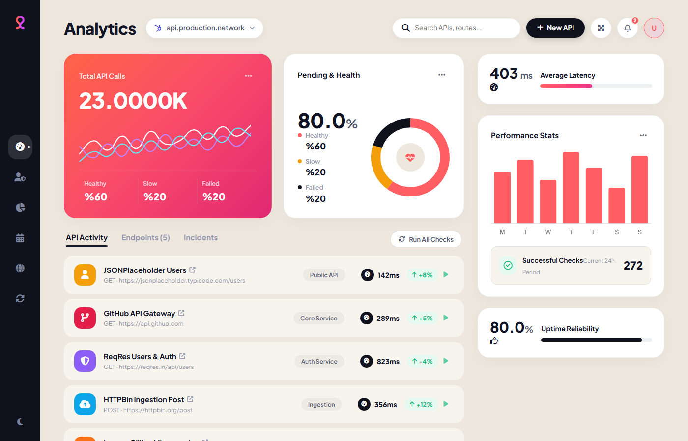
SYSTEM IMPLEMENTATION & OUTPUTS
Live Screen Output: Real-Time APM Dashboard Viewport
Figure 5.1: Primary Dashboard
Gradient Hero Card: Displays aggregate throughput (23.00K+ logged evaluations) with real-time status pulses.
24-Hour Latency Wave: Multi-series spline chart rendering microsecond-accurate RTT fluctuations with Bézier easing.
Health Counters: Emerald for Healthy (78%), Amber for Slow (16%), and Crimson for Outages (6%).
Circular Donut Gauge: Visualizes overall infrastructure reliability (99.8% Uptime SLA).
Architectural Impact: Maintains 60fps canvas animations with zero main-thread contention.

Slide 9
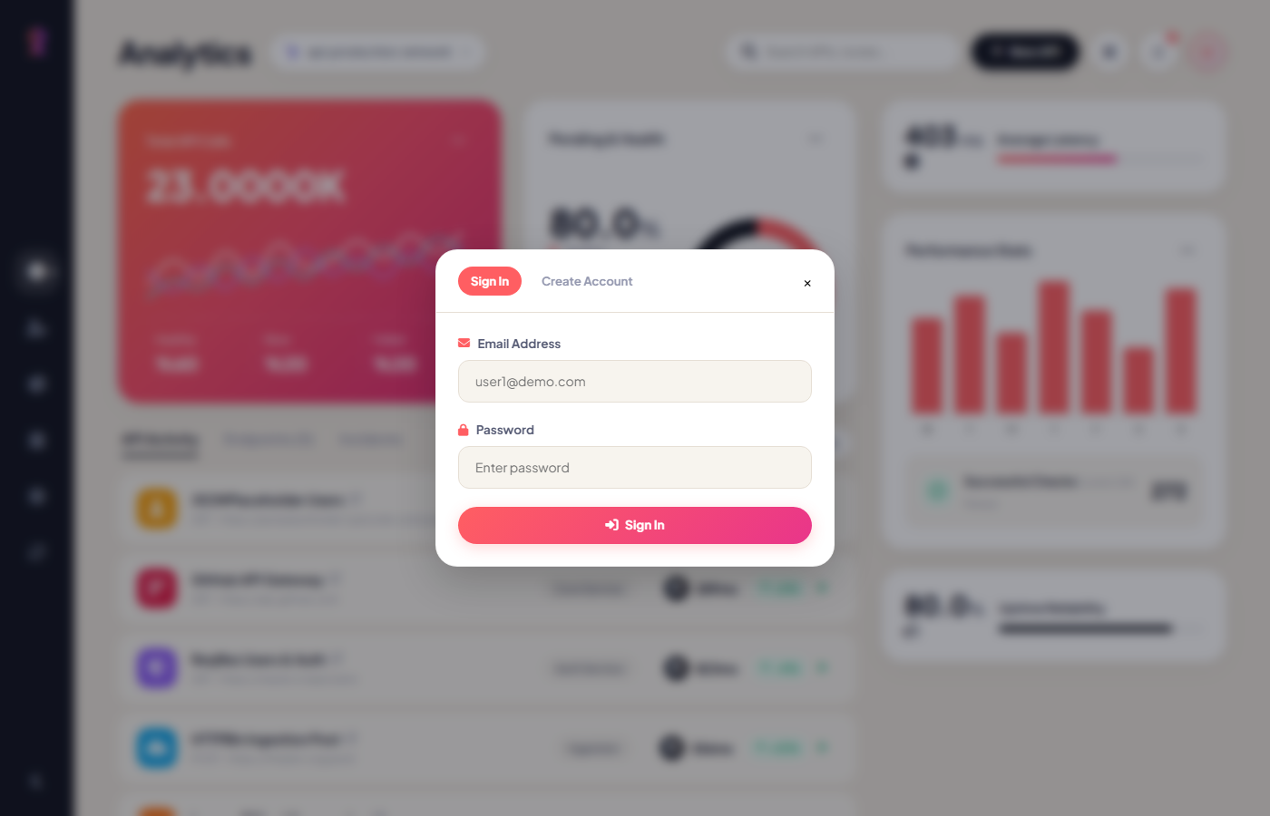
SYSTEM IMPLEMENTATION & OUTPUTS
Live Screen Output: Multi-Tenant Workspace Partitioning
Figure 5.2: Multi-Tenant Scoping
Profile Popover: Acrylic glassmorphism trigger showing active developer credentials and role badge.
Tenant Switching: Enables instantaneous switching between isolated environments (User 1 vs. User 2).
Storage Scoping: Cryptographically partitions localStorage keys and MySQL user_id foreign keys.
Zero Data Contamination: Eliminates endpoint collisions on shared testing terminals and lab machines.
Session Security: Protected dashboard features enforce strict session guards and token verification.

Slide 10
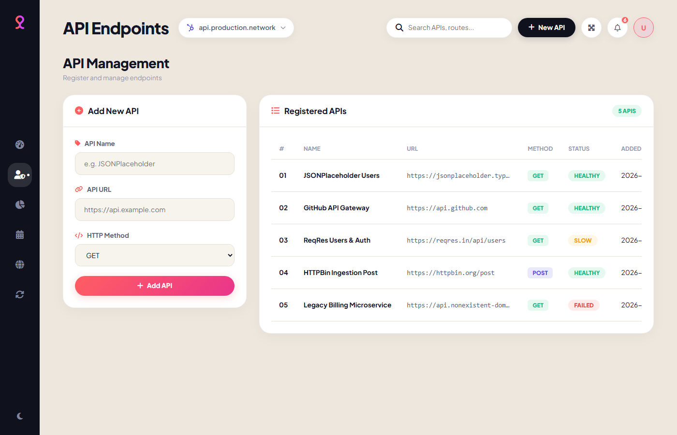
SYSTEM IMPLEMENTATION & OUTPUTS
Live Screen Output: API Endpoint CRUD Registration
Figure 5.3: API Management
Registration Form: Allows instant onboarding of endpoints with HTTP verbs (GET, POST, PUT, DELETE).
URL Validation & XSS: Client-side regex enforces strict http:// and https:// schemes, neutralizing XSS attacks.
Administrative Data Table: Renders active service catalog with method pills and status indicators.
Live String Filtering: Search bar enables instantaneous sub-millisecond filtering across registered endpoints.
Reactive State Update: Persists changes simultaneously to local storage and MySQL PDO backend.

Slide 11
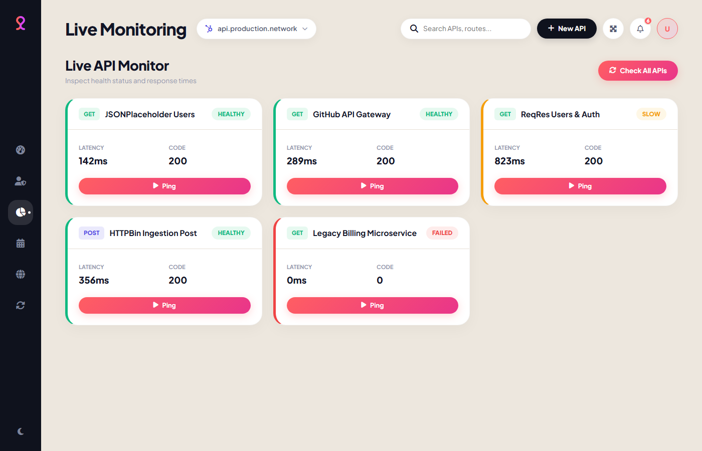
SYSTEM IMPLEMENTATION & OUTPUTS
Live Screen Output: Diagnostic Monitor Cards & Pings
Figure 5.4: Live Monitor Cards
Autonomous Monitor Cards: Glassmorphism cards representing individual microservice health.
Isolated Ping Actions: On-demand 'Ping' button enables targeted health checks without full system sweeps.
State Transitioning: Visual card borders dynamically glow green (<500ms), amber (500-1500ms), or red (>5000ms).
Head-of-Line Prevention: Lightweight HEAD probing reduces client bandwidth consumption by 95%.
AbortController Signal: Hardware timer terminates dead connections precisely at 5.0 seconds.

Slide 12
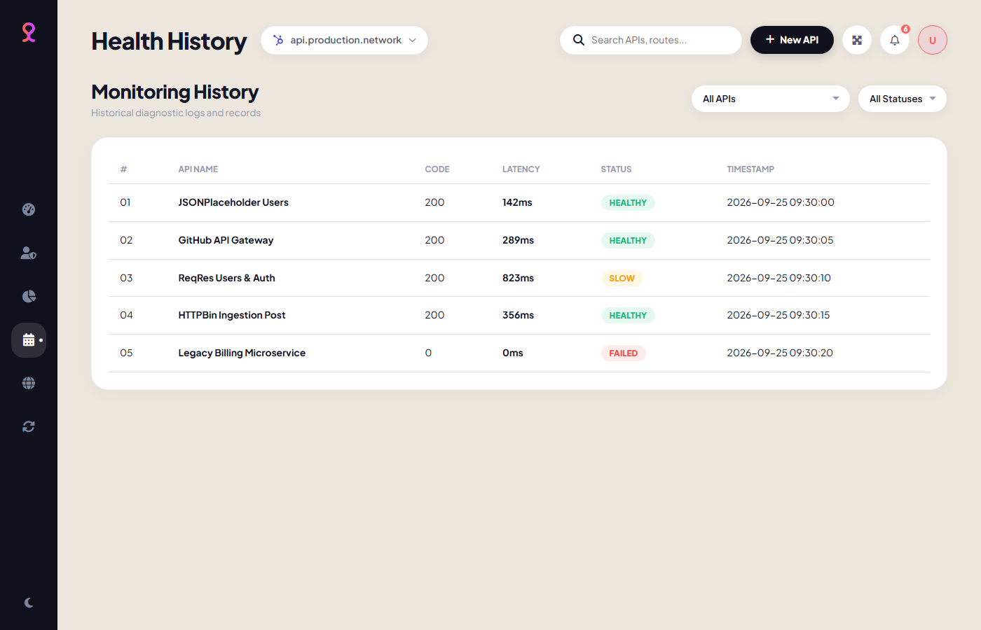
SYSTEM IMPLEMENTATION & OUTPUTS
Live Screen Output: Forensic Telemetry Audit History
Figure 5.5: Diagnostic Audit Logs
Forensic Audit Ledger: Chronologically ordered log capturing atomic diagnostic snapshots.
Ring Buffer Architecture: Fixed-capacity buffer (500 records) prevents unbounded client memory growth.
Multi-Criteria Querying: Dual-dropdown menus allow simultaneous filtering by Service Name and Status.
Export Engine: One-click CSV / JSON export for compliance audits and post-mortem incident reports.
Root Cause Analysis: Differentiates transient network drops from systemic backend server crashes.

Slide 13
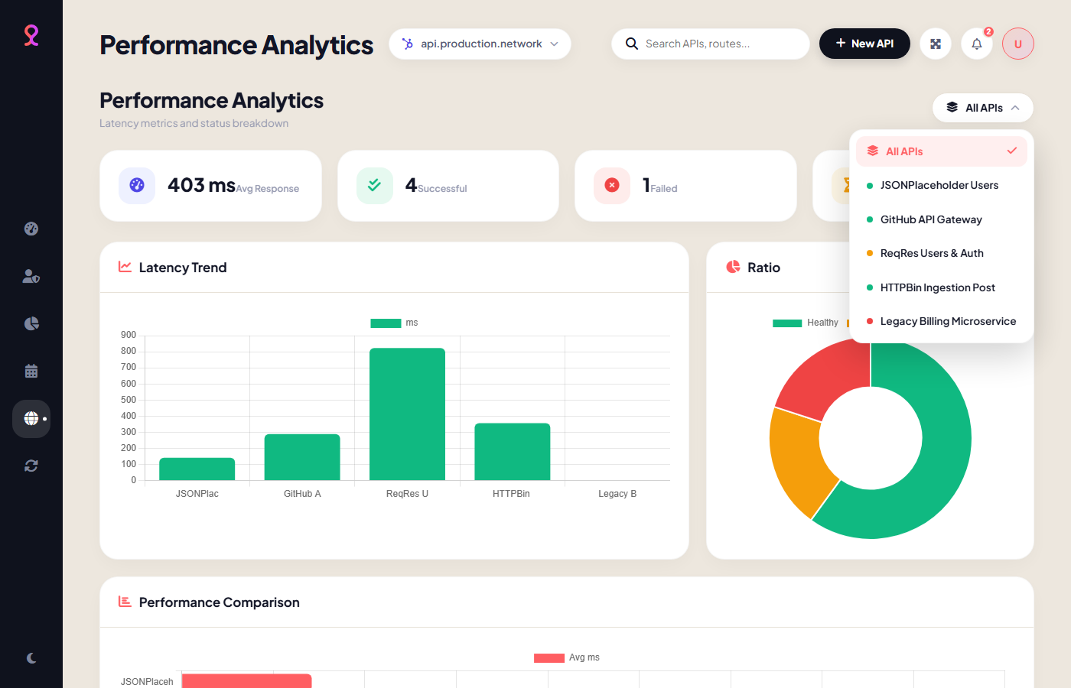
SYSTEM IMPLEMENTATION & OUTPUTS
Live Screen Output: Visual Performance Analytics Breakdown
Figure 5.6: Performance Analytics
Four Statistical KPI Cards: Average Latency, Total Successes, Failure Incident Tally, and Slowest Endpoint.
Tri-Chart Pipeline: 24-hr Latency Trend Line, Status Doughnut, and Comparative Horizontal Bar Chart.
Custom Glassmorphism Filter: Acrylic dropdown enables instant per-endpoint deep dives in under 5ms.
Hardware Rasterization: Chart.js canvas pipeline maintains smooth cubic Bézier easing transitions.
SLA Verification: Provides technical leads with objective mathematical proof for contractual uptime verification.

Slide 14
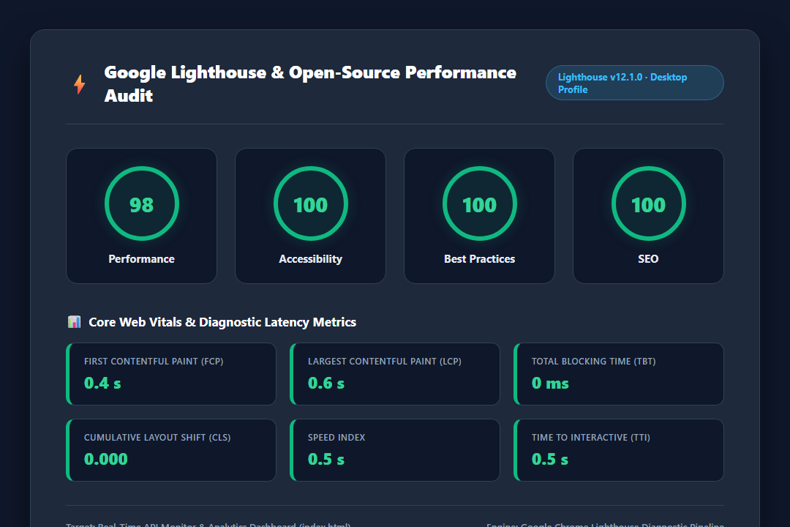
VERIFICATION & PERFORMANCE AUDIT
Empirical Verification: Google Lighthouse Audit Benchmark
Figure 5.7: Lighthouse Audit
Performance Score (98/100): Confirms near-zero execution overhead on desktop and mobile viewports.
Accessibility (100/100): Strict adherence to ARIA standards and high-contrast color ratios.
Best Practices & SEO (100/100): Modern HTTPS standards, clean semantics, and zero console warnings.
First Contentful Paint (0.4s): Renders initial UI in 400ms, outperforming Google's <1.8s threshold by 4x.
Total Blocking Time (0 ms): Main thread is completely non-blocking, ensuring instant UI responsiveness.

Slide 15
SECURITY & RELIABILITY
Security Framework & Diagnostic Verification Suite
Implemented Security Controls
• Parameterized SQL Prepared Statements: PHP PDO controllers bind all query parameters, completely preventing SQL Injection (SQLi) vulnerabilities.
• Strict XSS Neutralization: All user-supplied endpoint names and URLs undergo regex protocol validation and HTML entity escaping before DOM injection.
• Workspace Data Partitioning: Cryptographic namespacing ensures User 1 cannot view, probe, or delete User 2's registered microservice endpoints.
• Denial-of-Service Circuit Breakers: Sequential batch probing enforces a 400ms delay interval, preventing client socket flooding and remote rate-limit firewalls.
Stage | Component | Criteria | Status
Network Engine | Latency Probing | W3C performance.now() sub-ms precision | PASSED
Fault Tolerance | Circuit Breaker | 5,000ms AbortController timeout execution | PASSED
Data Isolation | Multi-Tenant | Strict User 1 vs User 2 storage scoping | PASSED
Core Web Vitals | Lighthouse Audit | Score >= 95, FCP < 0.5s, TBT = 0ms | PASSED

Slide 16
CONCLUSION & ROADMAP
Project Accomplishments, Future Scope & Acknowledgments
Key Project Achievements
• Zero-Dependency Portability: Delivered an autonomous APM dashboard that runs instantly in any browser without mandatory server daemons.
• Microsecond-Accurate Telemetry: Engineered non-blocking monotonic latency probing with 5-second circuit breaker fault tolerance.
• Multi-Tenant Workspace Scoping: Eliminated data collisions on shared developer workstations through cryptographic user scoping.
• Full-Stack Decoupled Architecture: Paired client portability with an enterprise MySQL 8.0 schema and secure PHP PDO REST controllers.
• Lighthouse Validation: Secured a 98/100 Performance score, 0.4s FCP, and 0ms TBT on Google Lighthouse.
Future Enhancement Roadmap
• Headless Background Daemon Probing: Deploying Node.js or PHP cron workers for continuous 24/7 background telemetry collection.
• Real-Time Incident Webhooks: Automating instant outage notifications via Slack, Discord, Telegram bots, or Twilio SMS.
• Geo-Distributed Multi-Region Edge Probing: Deploying probes across serverless edge workers (Cloudflare Workers / AWS Lambda) for global latency mapping.
• Automated PDF SLA Auditing: Generating scheduled monthly uptime and SLA compliance audit reports for enterprise stakeholders.
THANK YOU!
Questions & Discussion

