Slide 1
FeedMe!
A Content Management System for food recipes and videos.
Group 2 - Qiwen Zhu, Kavya Guruprasad, Baljit Singh, Mildred Noronha

Slide 2

Why this project?
I’m a foreign student!
Image Source: https://www.internationalstudent.com/school-search/530/usa/mississippi/mississippi-state-university/

Slide 3
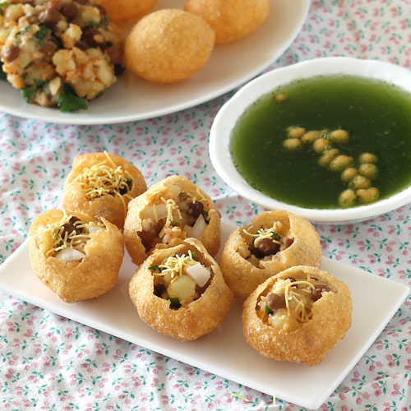
Why this project?
I miss eating Pani Puri!
Image Source: http://foodviva.com/snacks-recipes/pani-puri/

Slide 4

Why this project?
I want to cook but I mess up!
Image Source: https://gymtime.net/share/2012/05/cooking-in-the-gymtime-kitchen-less-mess-less-stress/

Slide 5

Why this project?
I wish Tarla Dalal could teach me!
Image Source: http://www.mid-day.com/articles/some-of-padma-shri-awardee-tarla-dalals-popular-recipes/15742163/

Slide 6
Why this project?
FeedMe! is a Content Management System to upload, share and view food recipes and videos.

Slide 7
Features
Make Innovative Budding Chefs Famous
Give an opportunity to make budding chefs famous
Publish Innovation (new interesting recipes)
Earn Revenue being a Professional Chef
Can sell top-quality video instructions for recipes
Earn revenue through selling videos
Professional chef videos will be paid.
Notes:
Feature 1 - Baljit
Feature 2 - Mildred

Slide 8
Features
3. Gathering Food Bloggers
Upload videos of your food adventures
4. Get Introduced to New Cultures
Search by Country
Search by Cuisine
Search by Ingredients
Notes:
Feature 3 - Qiwen
Feature 4 - Kavya

Slide 9





Technology to be used
Frontend Technologies: JQuery, HTML5, CSS3 , AngularJS
Developers - Baljit and Mildred
Backend Technologies: Django Framework v1.9 with unittest
Developer - Kavya
Database: MySql (v5.63 with MyISAM)
Developer - Qiwen
Notes:
Mention who is working on what.

Slide 10
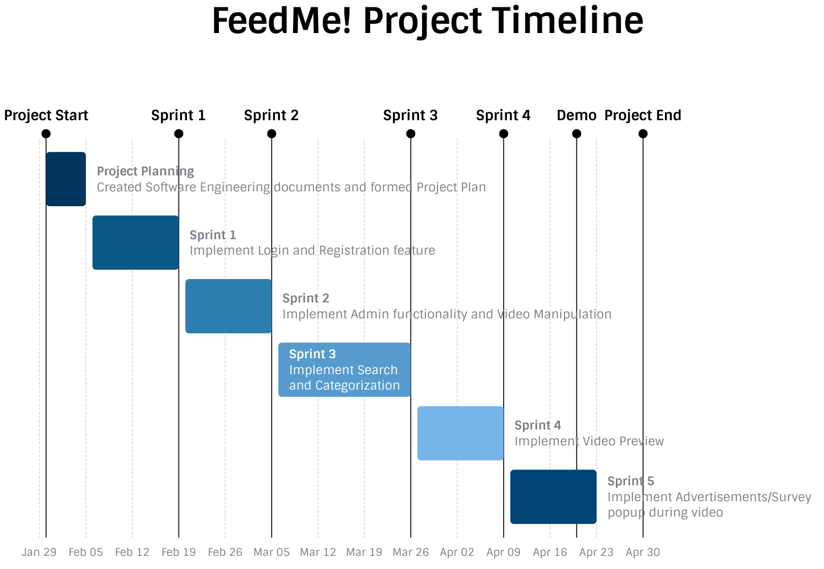
Project Timeline

