Slide 1
Pothole Analyser
Team : Quad Coders

Slide 2
Are Indian Roads Safe??
Are they maintained well ??

Slide 3
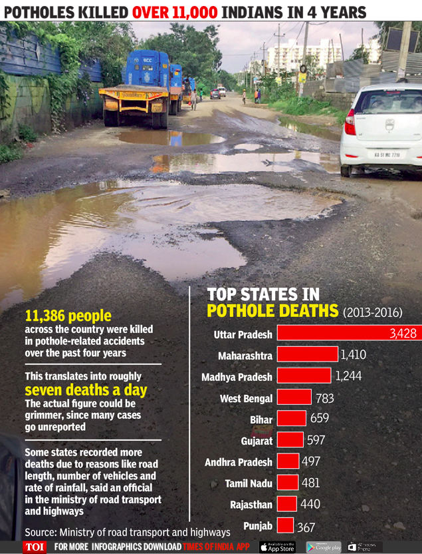

Slide 4
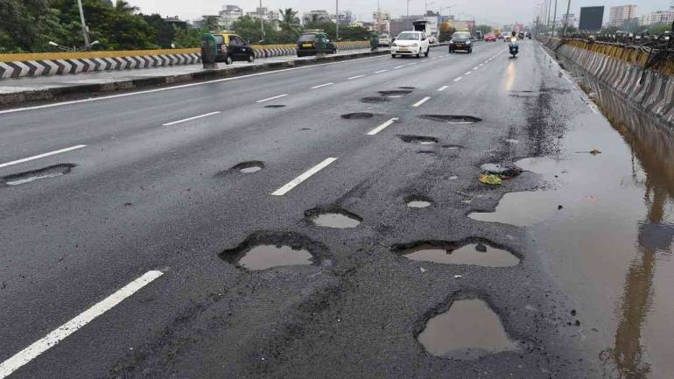

Slide 5
Why Pothole Analyser ??
There are many damaged roads throughout India.
Main roads are regularly repaired but not small roads, as they are not brought into the authority’s notice.
Pothole Analyser is a solution for this.

Slide 6
What it does
The pressure sensor placed on the shock absorber of the vehicle detects the holes when there is a pressure variation.
Get the location where there is a hole using GPS.
The locations and the pressure variations of the roads with holes are recorded.

Slide 7
Sent the data of holes having pressure variations that are greater than a threshold value considered normal, to the PWD Department.
They sent workmen to clear the potholes.
The problem thus gets solved.

Slide 8
FLOWCHART
Pressure Variations noted by the sensor
Detects the potholes
Is variations > desired variation
Sent the Details to the authority
Yes
No
Ignore

Slide 9
Thank you

