Slide 1
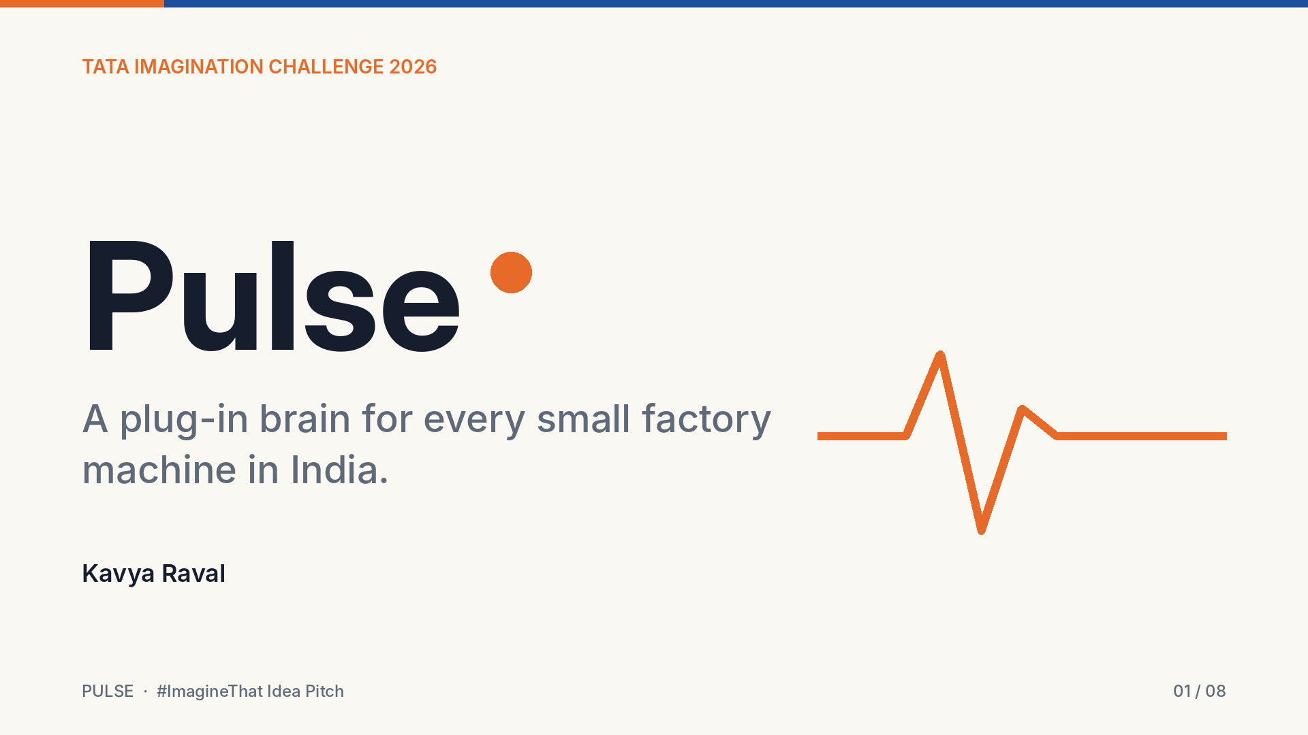
Notes:
Hi, I'm Kavya Raval. My idea is called Pulse: a plug-in brain for every small factory machine in India.

Slide 2
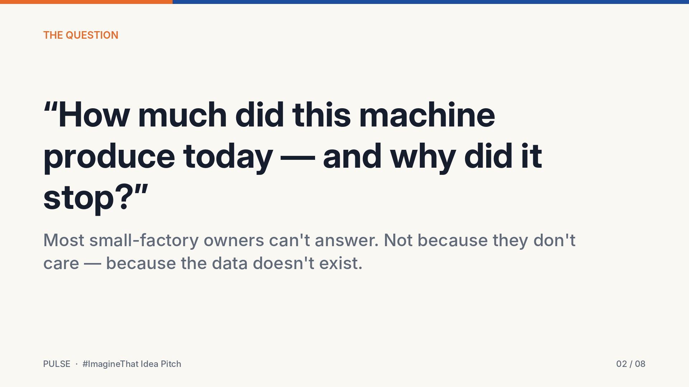
Notes:
Walk into almost any small factory and ask one simple question: *how much did this machine produce today, and why did it stop?*
Most owners can't answer. It's not that they don't care. The data simply doesn't exist.

Slide 3
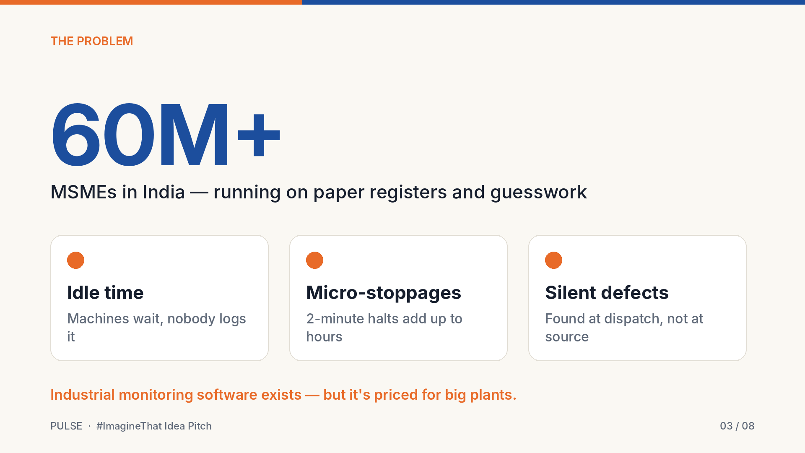
Notes:
India has more than sixty million MSMEs, and most of them still run on paper registers and guesswork.
Their machines quietly lose hours to idle time, to small two-minute stoppages that add up, and to defects that nobody notices until dispatch.
Industrial monitoring software does exist, but it's priced for big plants. Small factories are left out.

Slide 4
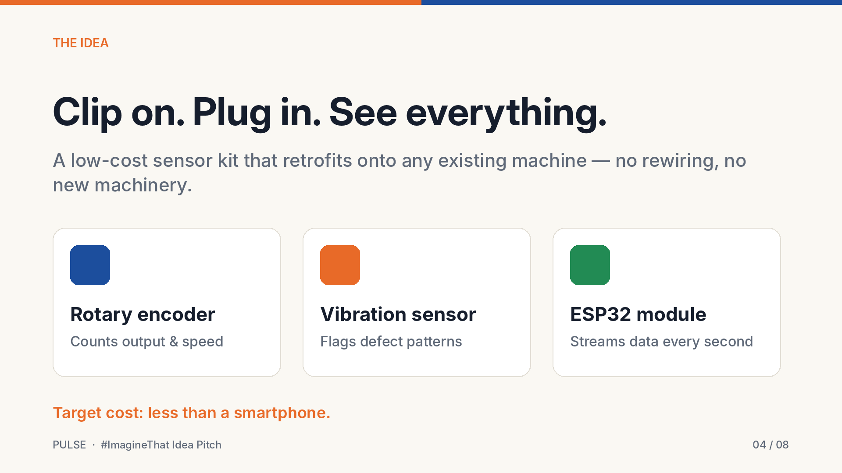
Notes:
Pulse is a low-cost sensor kit that clips onto a machine the factory already owns. There's no rewiring and no new machinery.
A rotary encoder counts output and speed, a vibration sensor flags defect patterns, and a small ESP32 module streams the data every second.
Our target is for the kit to cost less than a smartphone.

Slide 5
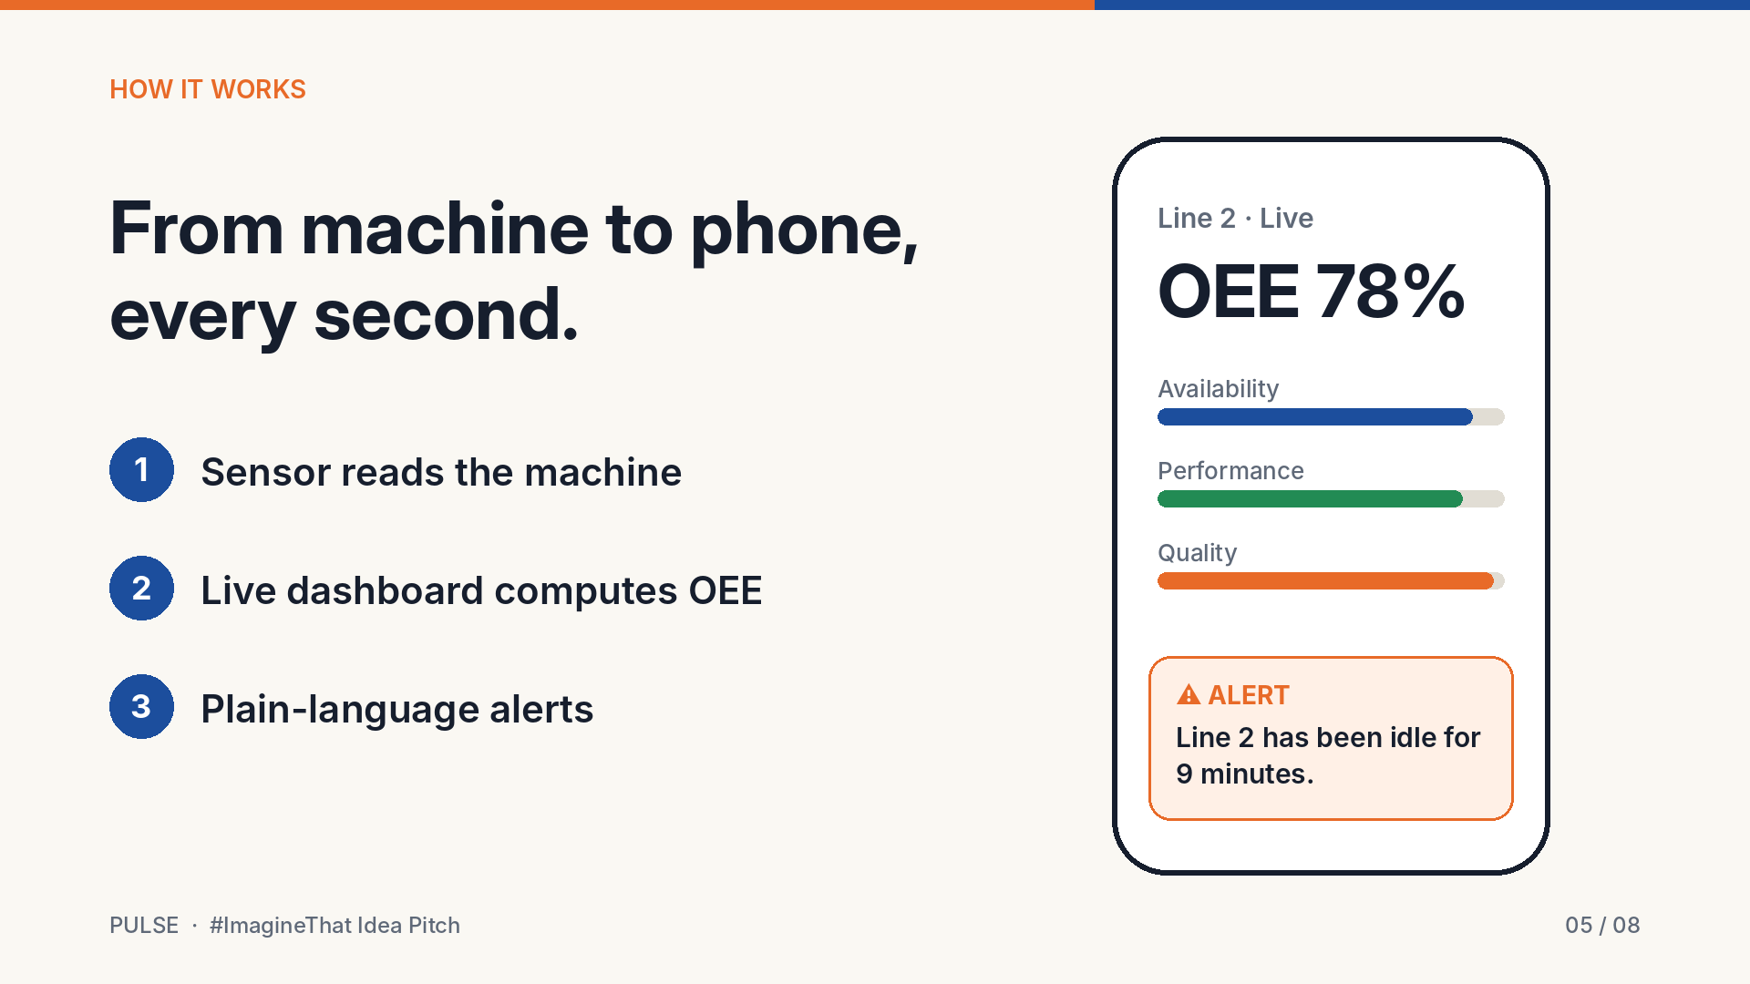
Notes:
The data goes straight to a simple dashboard on the owner's phone.
Pulse calculates OEE, the world-standard score for how well a machine is really being used.
It also sends alerts in plain language, like *"Line 2 has been idle for 9 minutes."* The owner can act right away instead of finding out at the end of the day.

Slide 6
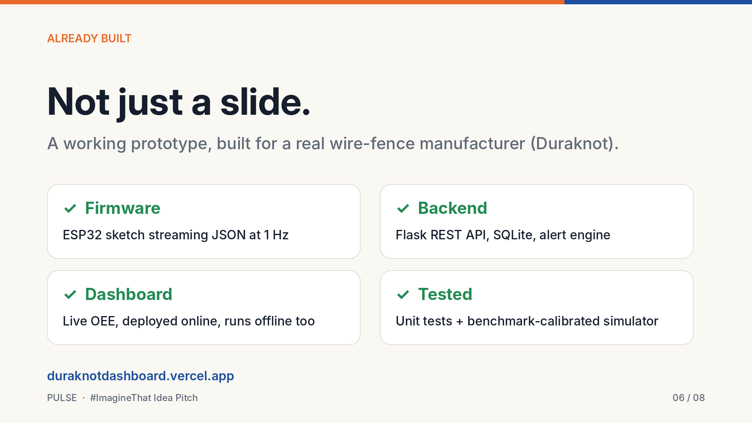
Notes:
This isn't just a slide. My teammate and I have already built a working prototype for a real wire-fence manufacturer, Duraknot.
It has ESP32 firmware, a live backend with an alert engine, and a dashboard deployed online. The whole thing is tested and calibrated against industry benchmarks.

Slide 7
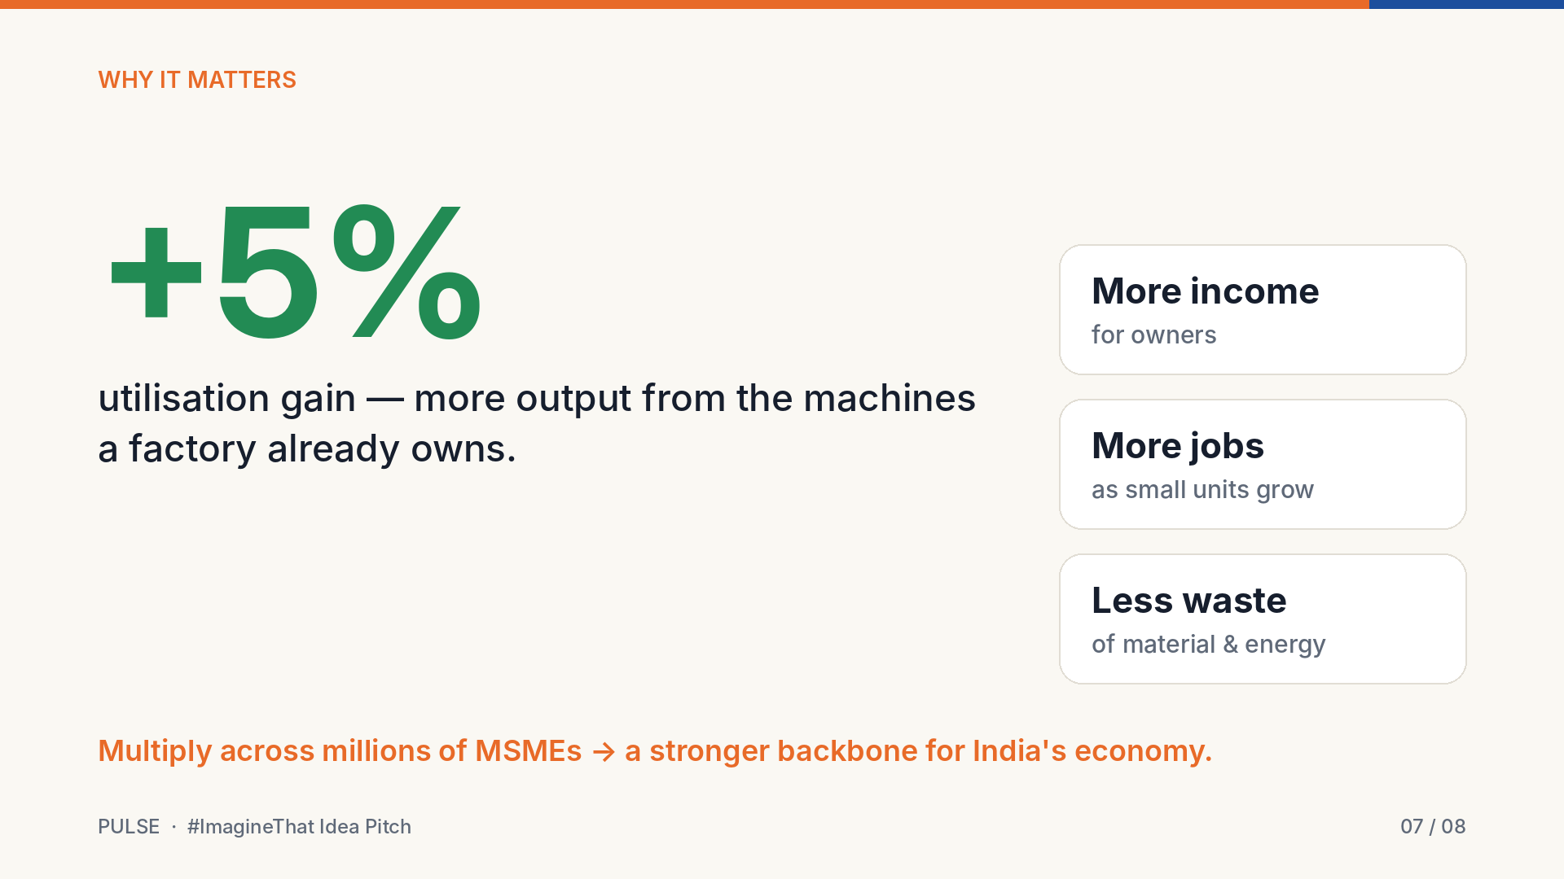
Notes:
Why does this matter? Even a five percent gain in utilisation means more output from machines a factory already owns.
That means more income for owners, more jobs as small units grow, and less wasted material and energy.
Multiply that across millions of MSMEs, and you strengthen the backbone of India's economy.

Slide 8
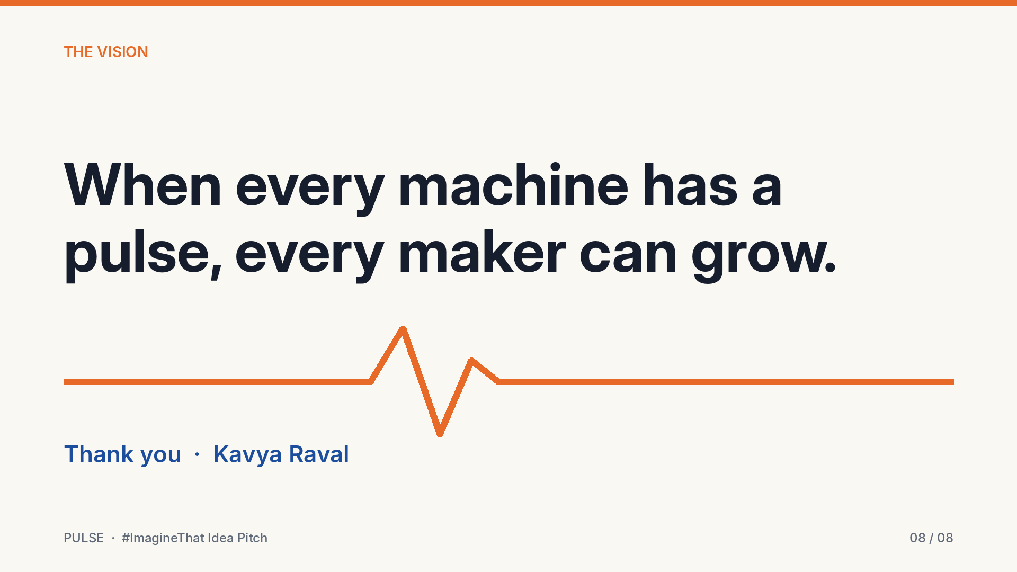
Notes:
Pulse gives the smallest factory the same intelligence as the biggest one.
Because when every machine has a pulse, every maker can grow. Thank you.

