Slide 1

Sales and Profitability Insights

Slide 2
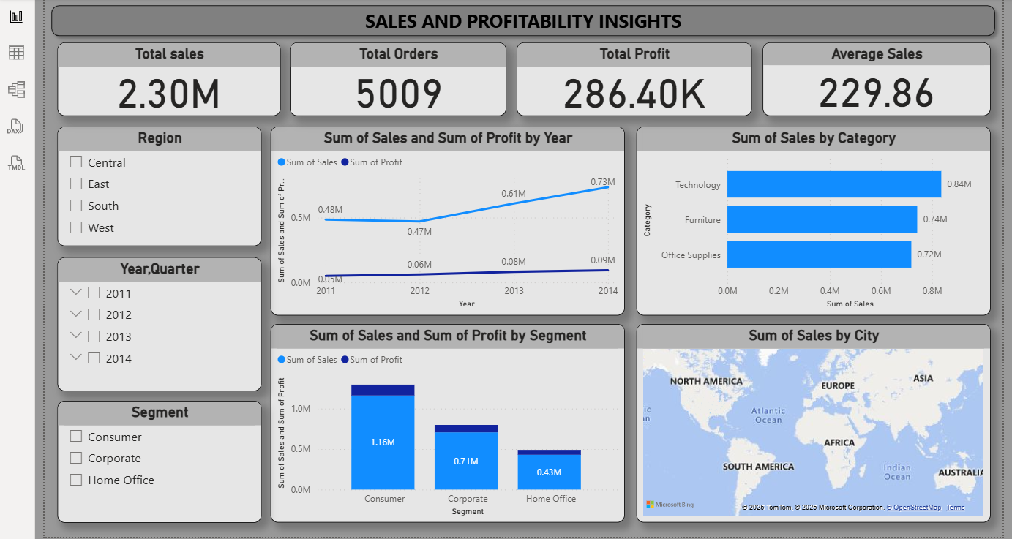

Slide 3
KPI Overview (Cards)
Total Sales (2.30M) → Overall revenue generated
Total Orders (5009) → Number of transactions
Total Profit (286.40K) → Net earnings after cost
Average Sales (229.86) → Average order value
These KPIs give a snapshot of overall business health.
Slicers :
Region (Central, East, South, West) → allows regional comparison
Year/Quarter (2011–2014) → enables trend analysis
Segment (Consumer, Corporate, Home Office) → customer segmentation
Slicers make the dashboard interactive, letting users drill down into specific areas.

Slide 4
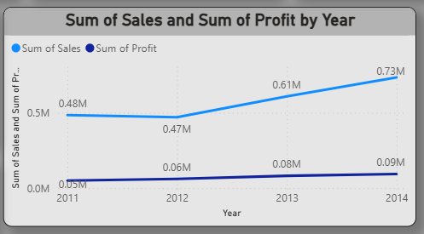
Sales & Profit by Year (Line Chart)
•Steady growth in sales from 2011 ($0.48M) to 2014 ($0.72M)
•Profits also rose from $0.05M to $0.09M
Insight: Business is expanding with consistent profitability growth.

Slide 5
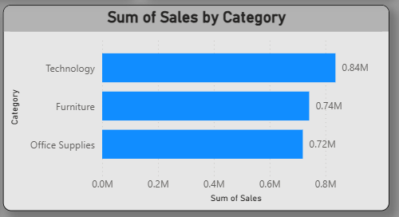
Sales by Category (Bar Chart)
•Technology leads with $0.83M sales
•Furniture and Office Supplies are tied at ~$0.72M
Insight: Technology is the main driver, while Furniture and Office Supplies need margin focus.

Slide 6
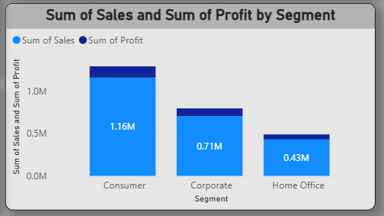
Sum of Sales and Profit by Segment
•Consumer: $1.16M sales, highest profit
•Corporate: $0.71M sales, moderate profit
•Home Office: $0.63M sales, lower sales and profit
Insight: Consumer drives both sales & profit, while Corporate and Home Office are smaller but stable contributors.

Slide 7
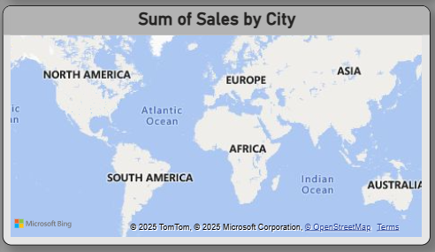
Sales by City
•Strong presence in North America and Europe
•Lower penetration in Asia, Africa
Insight: Global expansion opportunities exist in Asia & Africa.

Slide 8
CONCLUSION
•Business is growing steadily year on year
•Consumer + Technology are the biggest contributors
•Regional opportunities in Asia & Africa
•Profit margin improvement needed (~12% profit on 2.3M sales)
NOTE: Focus on high-margin products and expansion in untapped markets.

Slide 9

THANK YOU

