Slide 1
Titanic Dataset

Slide 2
Objective
Understand passenger characteristics and survival outcomes.
Explore factors affecting survival with visualization.
Generate insights for further modeling.

Slide 3
Data Cleaning
Age → median imputation.
Embarked → filled with mode.
Fare → median imputation.
Cabin → dropped/flagged due to high missingness.

Slide 4
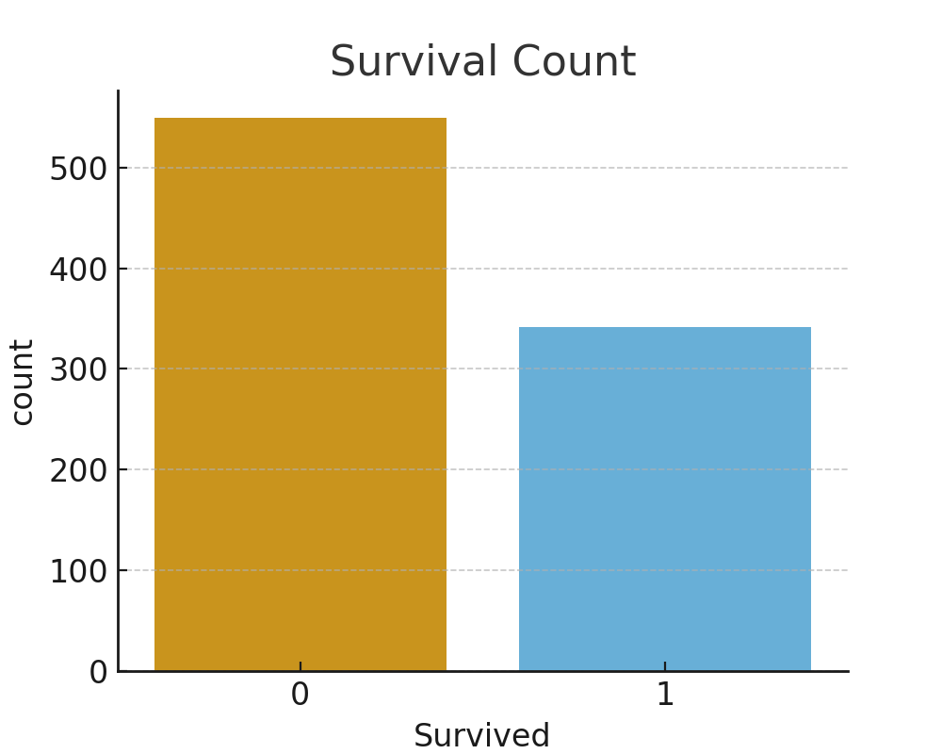
Survival Counts
38% survived, 62% died.
Target variable is imbalanced.

Slide 5
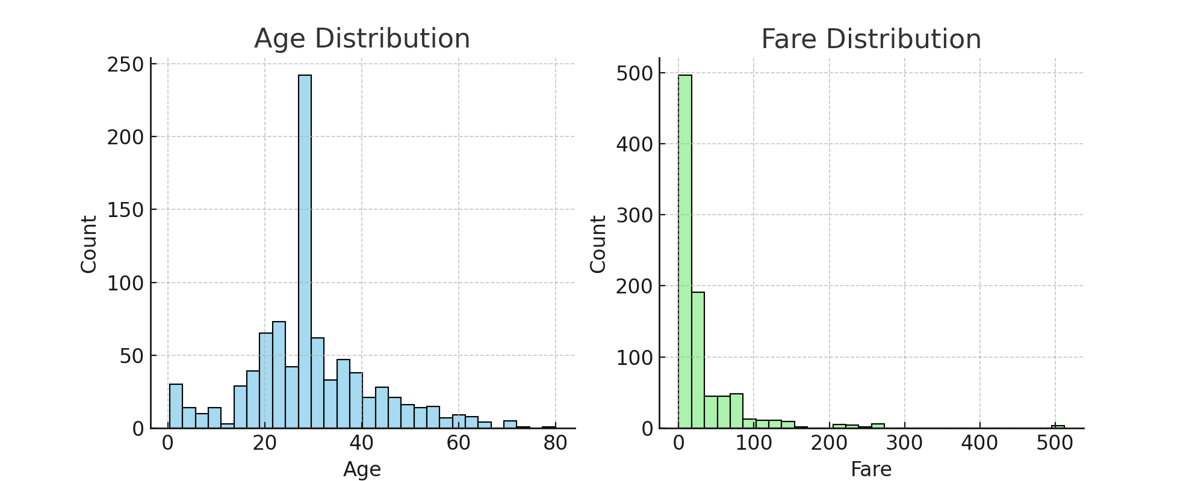
Age and Fare Distributions
Age concentrated between 20–40 years.
Fare is right-skewed with a few high outliers.

Slide 6
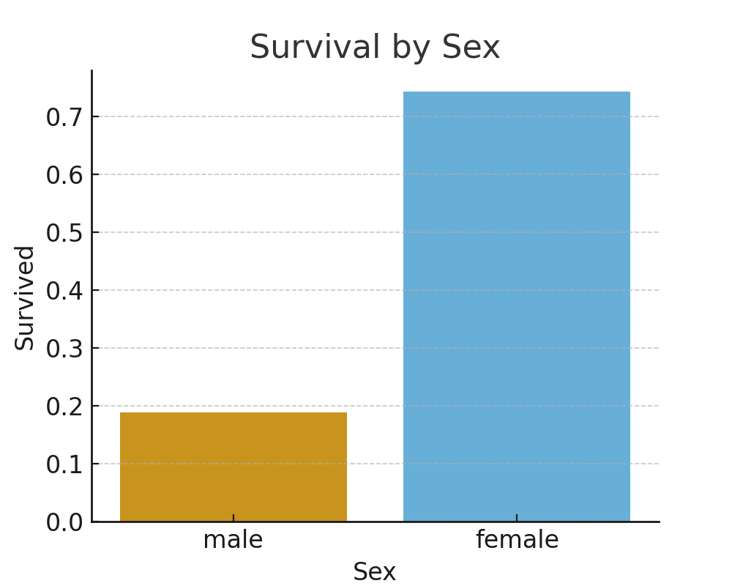
Survival by Sex
74% of females survived.
Only 19% of males survived.
Strongest predictor of survival.

Slide 7
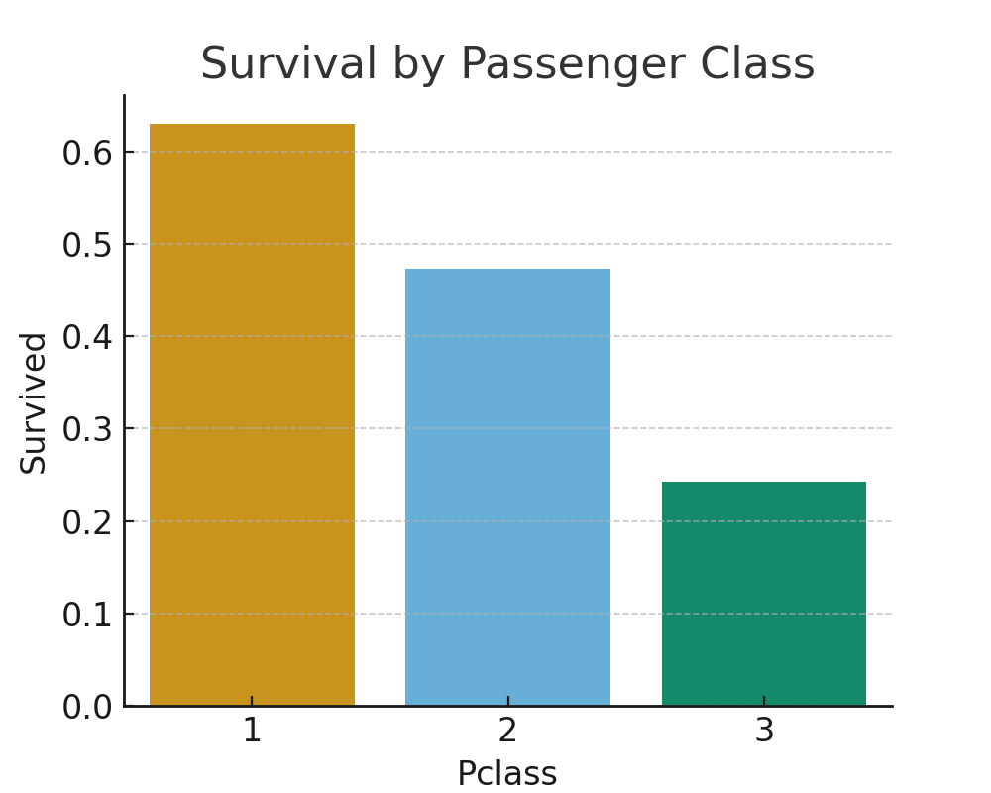
Survival by Passenger Class
1st class: 63% survived.
2nd class: 47% survived.
3rd class: 24% survived.

Slide 8
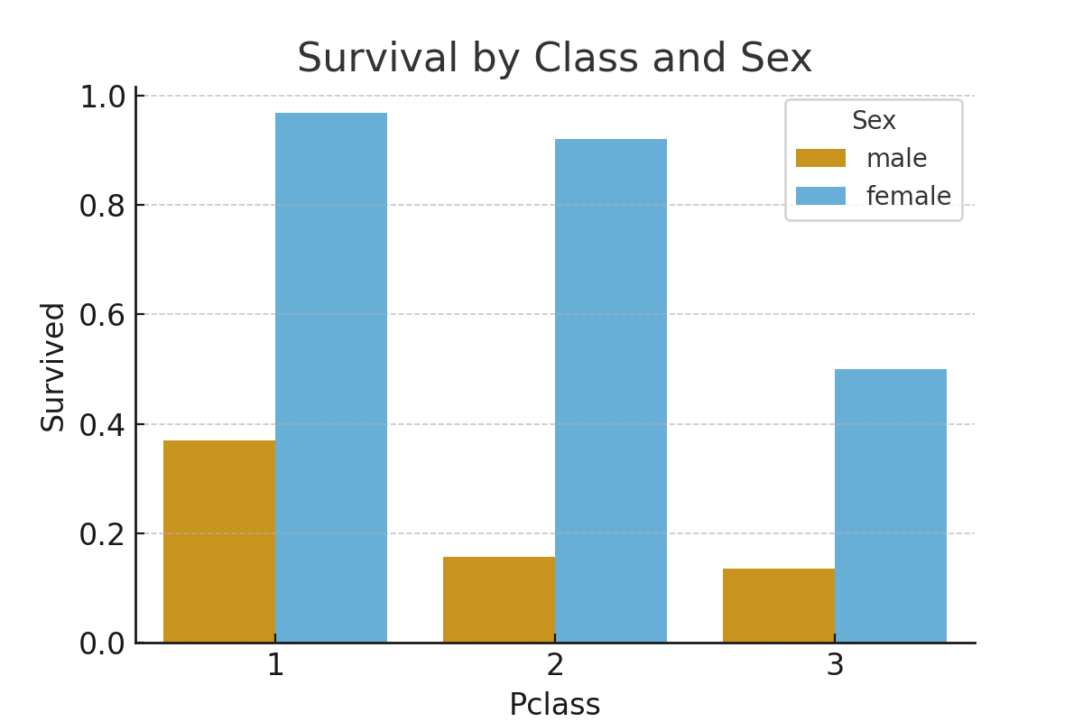
Survival by Pclass and Sex
Women in 1st class: 97% survival.
Men in 3rd class: 14% survival.
Gender and class both mattered.

Slide 9
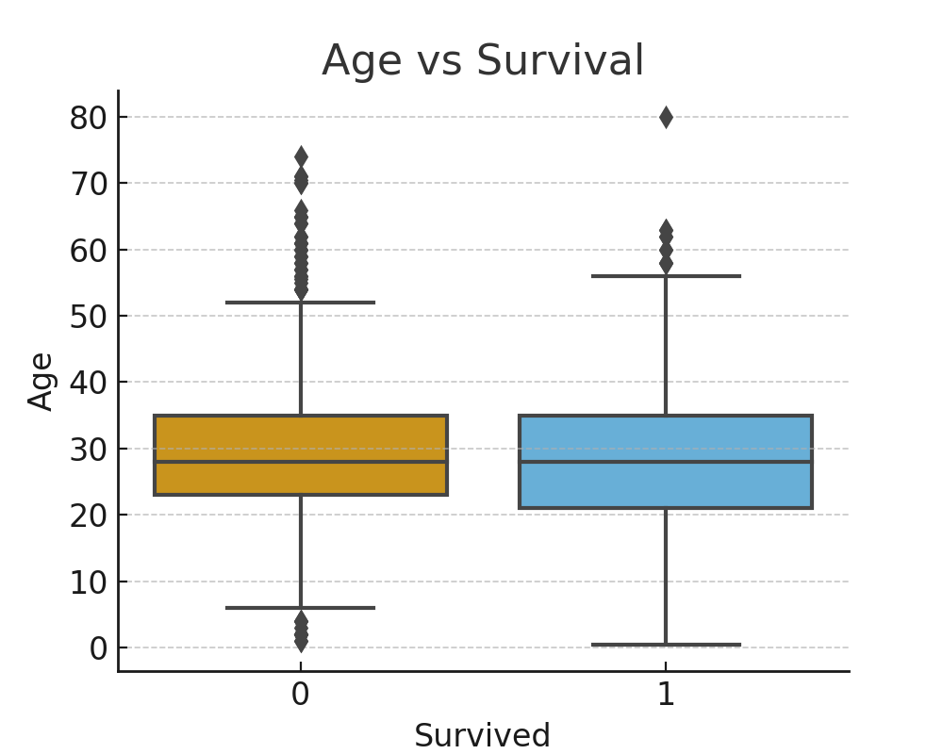
Age vs Survival
Children had higher survival rates.
Median survivor age ≈ 28 years.
Median non-survivor age ≈ 30 years.

Slide 10
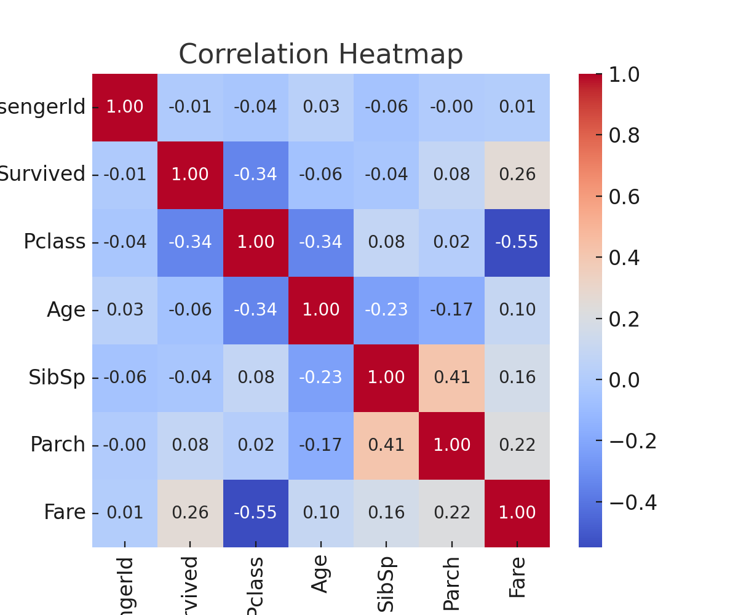
Correlation Heatmap
Survival positively correlated with Fare (0.26).
Negatively correlated with Pclass (-0.34).
Family size features correlated with each other.

Slide 11
Key Findings
Sex, Class, Age, and Fare strongly influenced survival.
Women and children prioritized.
Wealth and social status increased chances of survival.

Slide 12
Conclusion
Only 38% survived, showing high fatality.
Women (74%) and children had much higher survival than men (19%).
1st class (63%) > 2nd (47%) > 3rd (24%) — higher class meant better survival.
Wealth (Fare) improved chances, while poorer passengers suffered.
Strongest factor: Gender + Class interaction (1st-class women ≈ 97% survived, 3rd-class men ≈ 14%).

Slide 13
Thank you!

