Slide 1
IBM University Engagement Project Submission
“Exploring the Power of Agentic AI with IBM Granite and LangFlow”

Slide 2

Project Tile – [LearnMate_AI]
Domain of Project – [Education]
Student Name | Recent Passport Photo | Email ID | Mobile number [WhatsApp]
KAVYA |  | kavyarevoor9@gmail.com | 8317473545

Slide 3
Problem Statement -
Problem Statement No. 12 – Agentic AI for Personalized Course Pathways
Project Name: LearnMate – Agentic AI Personalized Learning Coach
The Challenge:
Students often struggle to identify the right learning path that aligns with their interests and long-term career goals due to the overwhelming number of online courses and lack of personalized guidance.
LearnMate aims to solve this problem by acting as an Agentic AI coach that interacts with students, understands their interests (such as Frontend Development, Cybersecurity, UI/UX Design, AI/ML, etc.), assesses their current skill levels, and dynamically builds personalized course roadmaps that adapt over time based on their learning progress and preferences.
Technology Requirement: Use of IBM Cloud Lite services / IBM Granite is mandatory.

Slide 4
Proposed Solution -
The proposed solution includes the following components:
1. Student Profile Creation: Students enter their educational background, interests, career goals and existing technical skills.
2. AI-Based Skill Assessment: The AI agent interacts with students through personalized questions to assess their current knowledge and categorize their skill levels as beginner, intermediate or advanced.
3. Personalized Course Recommendations: Based on the student's interests and skill assessment, LearnMate recommends suitable online courses, tutorials and learning resources.
4. Dynamic Learning Roadmap: The system generates a step-by-step learning pathway with topics, courses, practical exercises, projects and milestones.
5. Agentic AI Coach: Using IBM Granite, the AI agent analyzes student inputs, makes recommendations, identifies skill gaps and updates learning plans based on changing goals and preferences.
6. Progress Tracking: Students can mark courses and activities as completed, track their achievements and monitor their learning progress through a dashboard.
7. Adaptive Learning: The AI agent continuously evaluates progress and feedback to modify the roadmap and recommend the next appropriate learning activity.

Slide 5
Technology Used
Category | Technology | Purpose
AI Model | IBM Granite | Understand student queries and generate personalized learning roadmaps.
AI Platform | IBM watsonx.ai Studio | Develop and manage AI-powered workflows.
Cloud Platform | IBM Cloud Lite | Host and access IBM cloud services.
Frontend | HTML5 | Structure the user interface.
Styling | CSS3 | Design a responsive and user-friendly interface.
Frontend Logic | JavaScript | Handle user interactions and dashboard functionality.
Backend | Node.js | Run server-side application logic.
Backend Framework | Express.js | Build APIs and connect frontend with AI services.
Database | IBM Cloudant / SQLite | Store student profiles, skills, roadmaps and progress.
API Integration | REST APIs | Connect IBM Granite with the application.
Version Control | Git and GitHub | Manage and maintain project code.
progress.

Slide 6
Langflow component Used -
Langflow component | Purpose in LearnMate
Chat Input | Accept student queries and interests.
Chat Output | Display AI responses and learning roadmaps.
Prompt Template | Structure prompts for personalized learning recommendations.
IBM Granite / LLM | Generate intelligent responses and personalized pathways.
Agent | Coordinate tasks such as skill assessment and roadmap generation.
Memory | Maintain conversation context and student preferences.
Text Input | Collect career goals and existing skills.
Structured Output | Generate organized roadmaps in a defined format.
Conditional Router | Direct students to different learning pathways based on interests and skill levels.
Python Code | Calculate skill gaps and customize recommendations.
Data Store / Vector Store | Retrieve relevant course information from a course resource collection.
Parser | Process and format AI-generated responses.

Slide 7
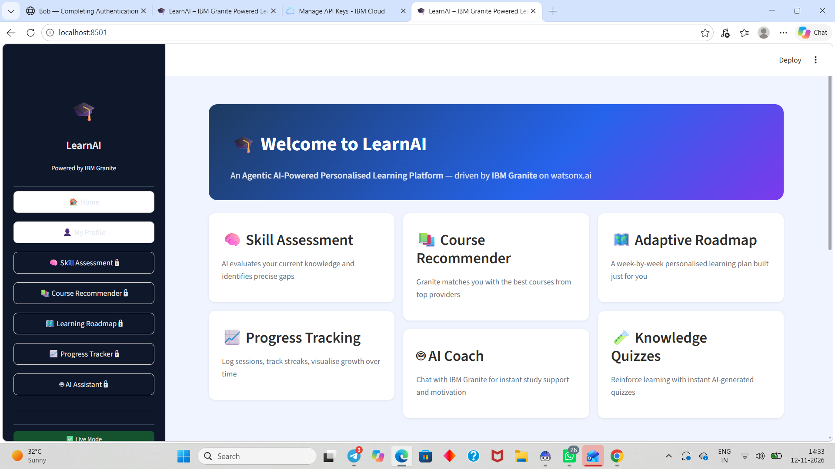

Slide 8
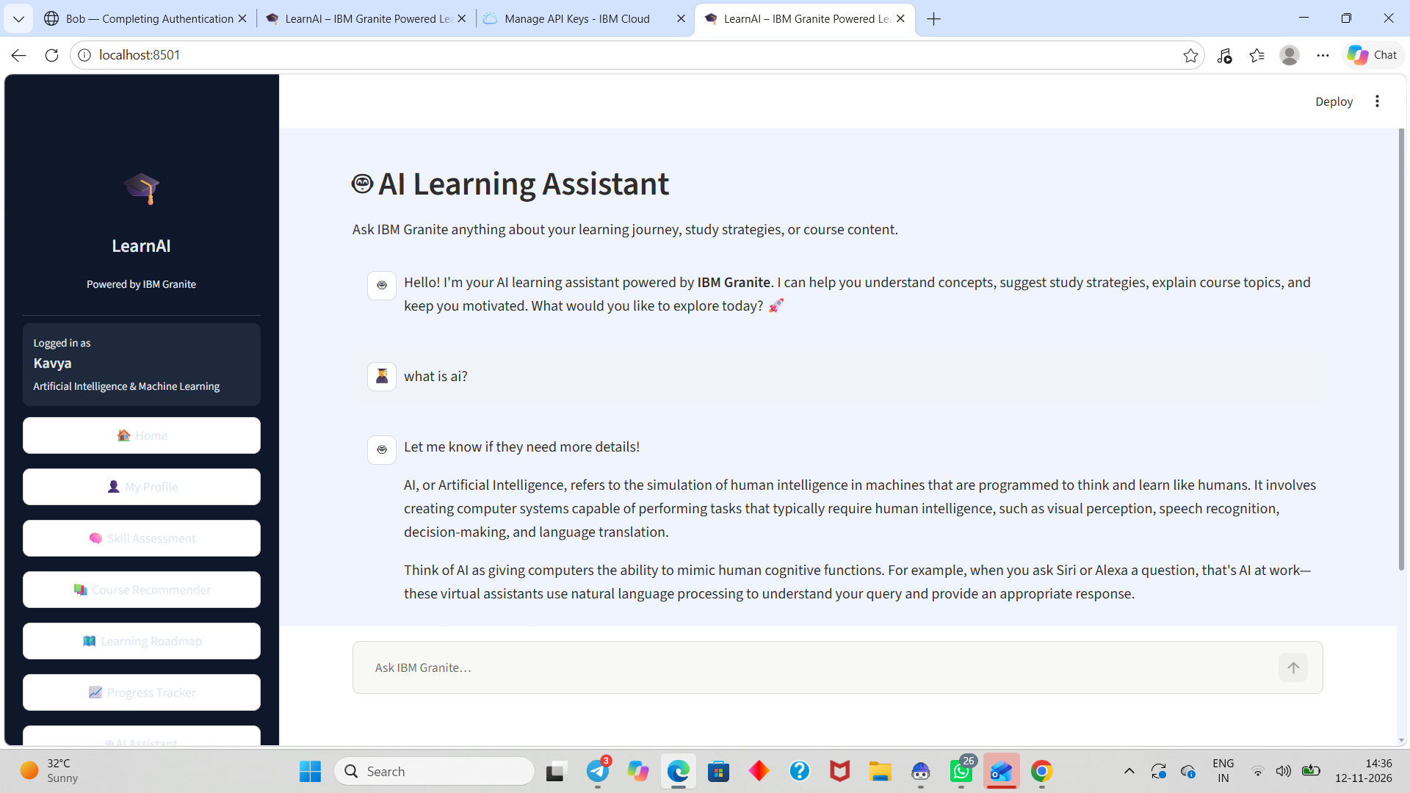

Slide 9
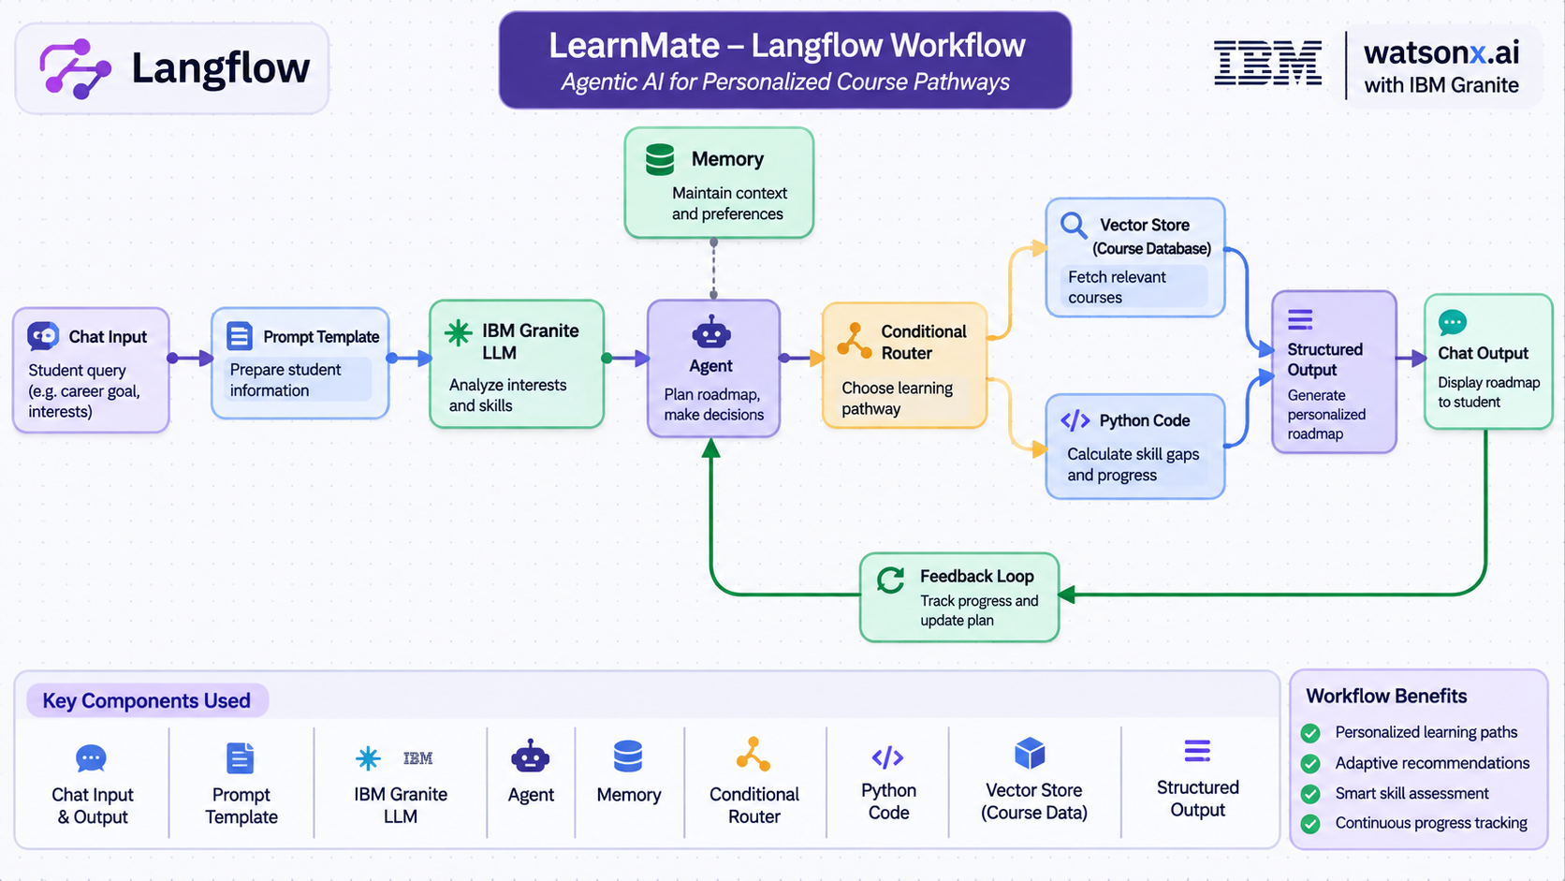
Langflow workflow -

Slide 10
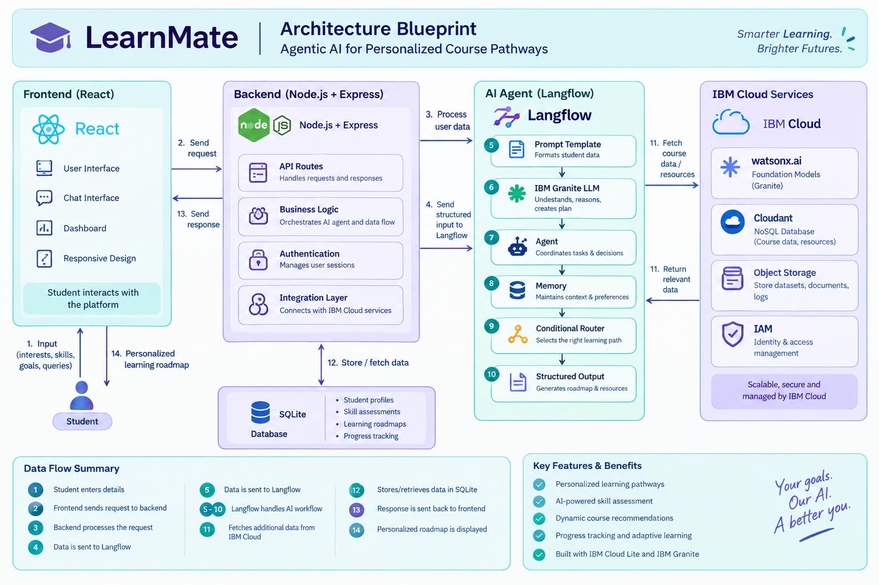
Architecture blueprint

Slide 11

Role of Agentic AI in the solution
Role of Agentic AI in LearnMate – Personalized Course Pathways
Agentic AI plays a central role in LearnMate by acting as an intelligent, autonomous learning coach that understands students' interests, evaluates their skills, makes decisions and continuously improves their learning pathways.
Unlike traditional AI systems that only provide answers, Agentic AI can perform multiple tasks, make decisions and take actions toward achieving a student's learning goals.
Key roles of Agentic AI
1. Understanding Student Goals: Interacts with students to identify their interests, preferred domains and long-term career objectives.
2. Skill Assessment: Evaluates students' existing knowledge and determines their skill levels through interactive questions.
3. Identifying Skill Gaps: Compares current skills with the skills required for the student's selected career and identifies areas that need improvement.
4. Personalized Roadmap Generation: Automatically creates a structured learning pathway containing courses, topics, practical exercises and projects.
5. Intelligent Course Recommendation: Analyzes student preferences and recommends relevant courses and learning resources.
6. Autonomous Decision-Making: Selects suitable next learning activities based on the student's skill level, goals and completed tasks.
7. Continuous Progress Monitoring: Tracks learning progress and identifies completed and pending activities.
8. Adaptive Learning: Modifies the learning roadmap whenever students complete courses, struggle with topics or change their career preferences.

Slide 12
Novelty and Uniqueness
Novelty and Uniqueness of LearnMate
LearnMate – Agentic AI for Personalized Course Pathways introduces an intelligent and adaptive learning approach that goes beyond traditional course recommendation systems.
The major novel aspects and unique features are:
1. Personalized AI Learning Coach: Uses IBM Granite to interact with students, understand their interests, career aspirations and existing knowledge, and provide individualized guidance.
2. Dynamic Skill-Gap Analysis: Identifies the difference between a student's current skills and the skills required for their desired career.
3. Agentic Decision-Making: Uses an AI agent to plan learning activities, select suitable courses and recommend the next steps based on individual student needs.
4. Adaptive Learning Roadmaps: Automatically modifies learning pathways based on completed courses, assessment results, student feedback and changing career interests.
5. Interest-Based Career Exploration: Helps students explore multiple career domains such as AI/ML, cybersecurity, frontend development, data science and UI/UX design

Slide 13
Git Hub Link
https://github.com/kavyarevoor9-design/LearnMate_AI.git
·
·
·

Slide 14
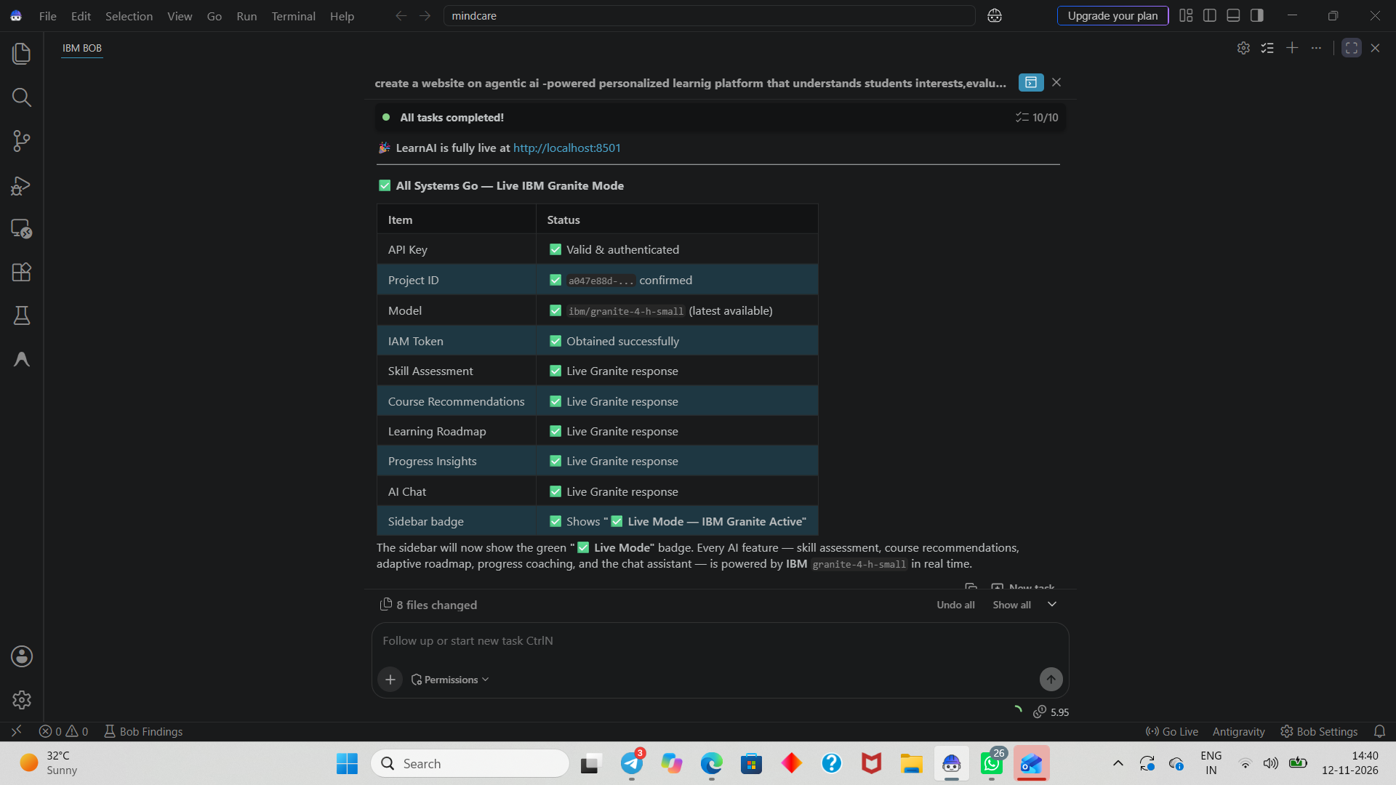

Slide 15
Future Scope
. Future Scope of LearnMate – Agentic AI for Personalized Course Pathways
LearnMate has significant potential for future development and can be expanded into a comprehensive AI-powered career guidance and personalized learning platform.
1. Advanced AI Career Guidance: Integrate advanced AI models to provide more accurate career recommendations based on students' interests, skills and industry trends.
2. Real-Time Industry Skill Analysis: Connect with job portals and industry data sources to identify emerging skills and recommend relevant learning pathways.
3. Multilingual AI Assistant: Support multiple languages to make personalized learning guidance accessible to students from different backgrounds.
4. Integration with Online Learning Platforms: Connect with platforms such as Coursera, Udemy, edX and NPTEL to recommend courses and provide direct learning links.
·
·
·

Slide 16
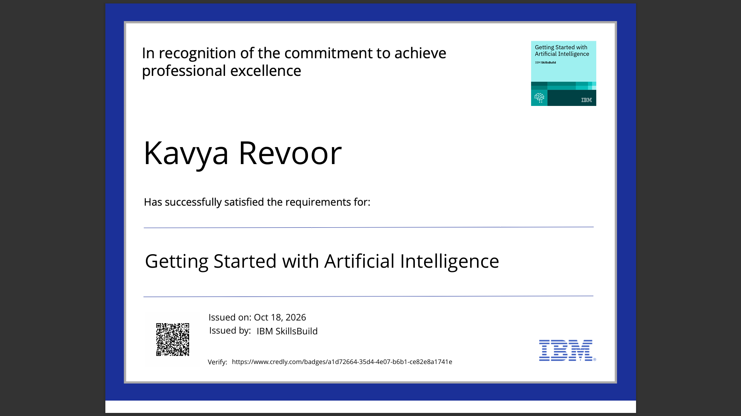
Certificates Earned:
Please add your credly certificate

Slide 17
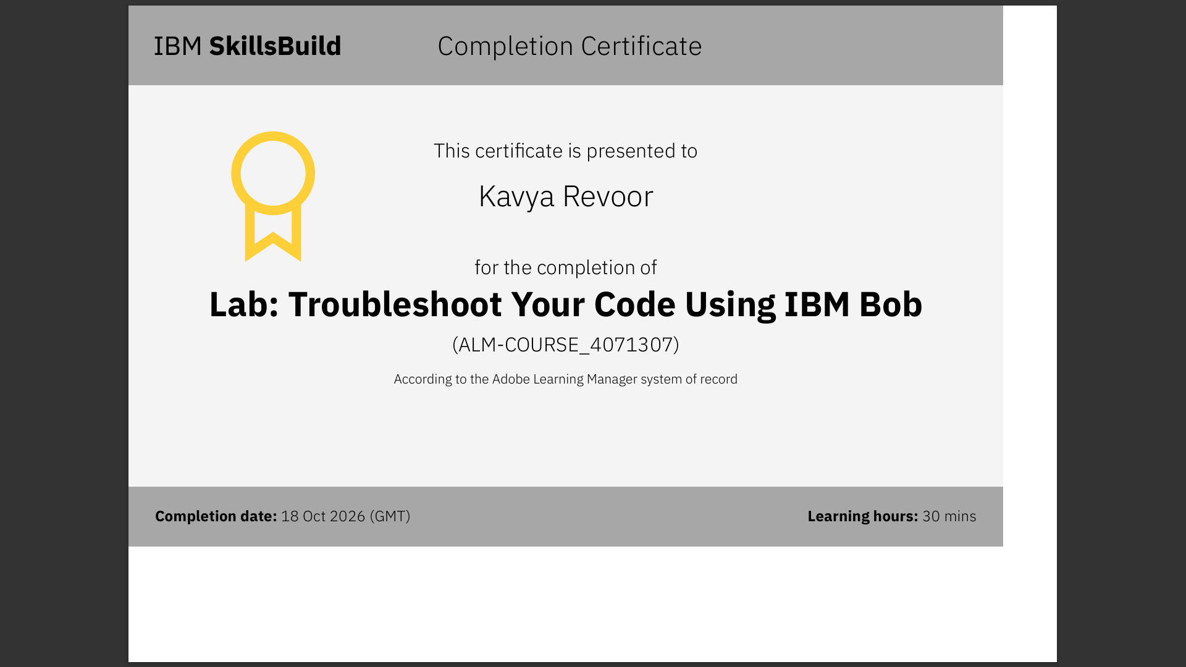
Certificates Earned:​
Add your IBM BOB Certificate

Slide 18


