Slide 1
Book Library Management System
Team Jaguar
1.Bijin
2.Kavya
3.Athul
4.Kavin Kumar
5.Pallavi

Slide 2
Book Library Management System
This is an application to manage a book library which has features as follows:
User registration
User authentication
Managing books
Transaction of books

Slide 3
Technology Stack
Front-end: html, css, js, react
Back-end: node js, Express js, bcrypt js, Json webtoken
Database: mongo db
Source code management: Github
IDE: VS code
Tools: mongoose, npm, react dev tool, postman
Testing: manual testing and automated testing(jest)

Slide 4
Database Structure

Slide 5
lms_user
parameter | type | size | Auto increment | key
user_id | integer | 50 | yes | Primary key
user_login_id | varchar | 50
user_name | varchar | 50
user_email | varchar | 150
user_address | varchar | 500
user_password | varchar | 250
user_type | varchar | 50
user_status | integer | 50

Slide 6
lms_book
parameter | type | size | Auto increment | key
book_id | integer | 20 | yes | Primary key
book_title | varchar | 300
book_category | varchar | 50
book_author | varchar | 500
book_publisher | varchar | 500
stock | integer | 50

Slide 7
lms_book_category
parameter | type | size | Auto increment | key
category_id | integer | 20 | yes | Primary key
category_name | varchar | 300
book_id | varchar | 500 |  | Foreign key

Slide 8
lms_transaction
parameter | type | size | Auto increment | key
Transaction_id | integer | 20 | yes | Primary key
user_id | integer | 20 |  | Foreign key
book_id | integer | 20
book_category_id | integer | 20
status | varchar | 300
borrow_date | integer | 200
return_date | integer | 200

Slide 9
Forms/Pages

Slide 10
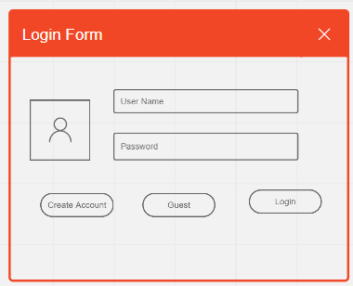

Slide 11
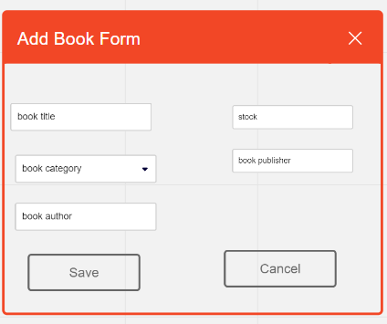

Slide 12
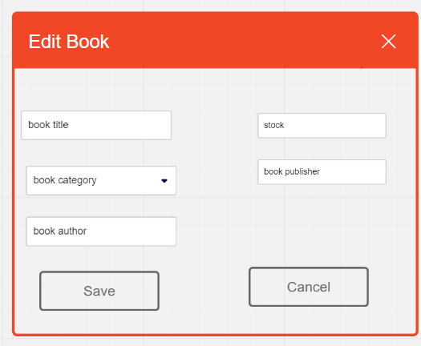

Slide 13
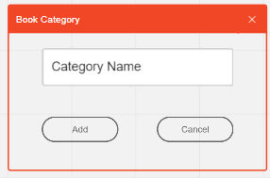

Slide 14
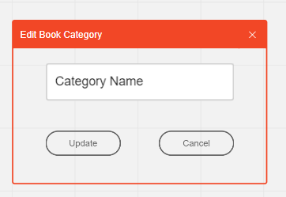

Slide 15
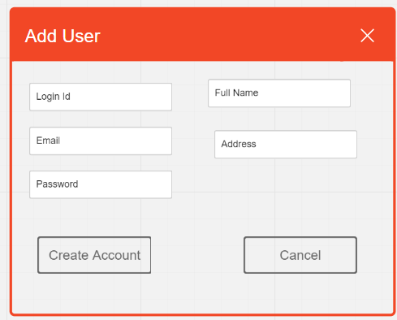

Slide 16
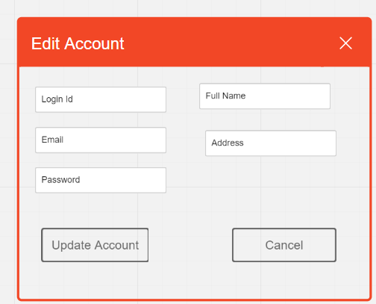

Slide 17
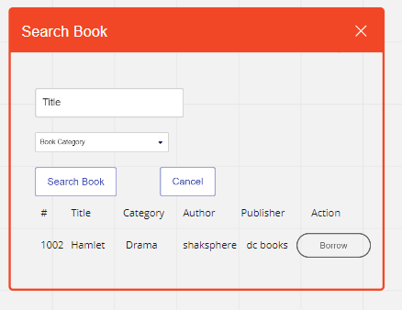

Slide 18
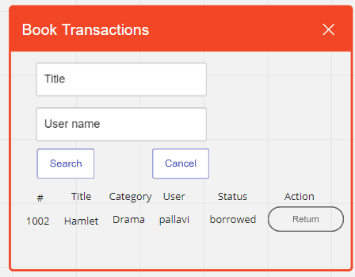

Slide 19
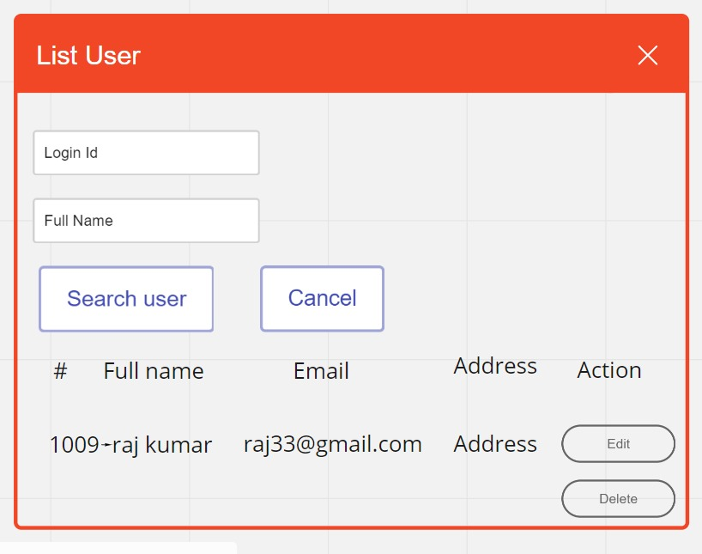

Slide 20
Thank You

