Slide 1
API-LED-CONNECTIVITY
By : Kavyashree K R
Date:16-12-2021

Slide 2
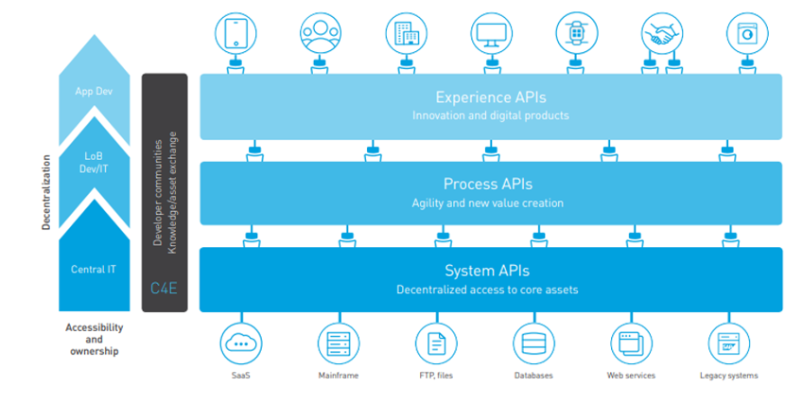
API-LED-CONNECTIVITY

Slide 3
System APIs
System API’s are built to connect through underlying systems (Any system which contains the raw data) .
Basically System API contains Sensitive information as it contains raw data.
Should never be exposed for public use.

Slide 4
Process APIs
Process API’s are built to compose or combine two or more System API’s
Usually to do any kind of transformation or to implement any kind of business logics or shape the data out of system apis.
It may perform aggregation / splitting / routing the data.
Process APIs must be private and should not be exposed to public for use.

Slide 5
experience APIs
These are API’s which are a kind of a wrapper either to Process API’s (if present ) or to System API’s , so that Client/Consumers can use it.
Client/Consumers will not have exposure or contact with direct Raw Data.
We can have minimal Data Transformation like the final result to be in JSON or XML or whatever the consumer wants to have.
Remember , if there is any change in System API , we do not need to modify or change anything in Process or Exp API.

Slide 6
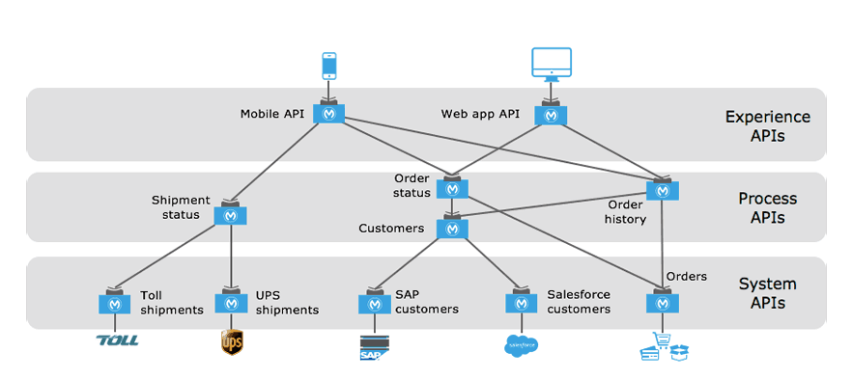
Example:

