Slide 1
B V RAJU INSTITUTE OF TECHNOLOGY (UGC Autonomous) Vishnupur, Narsapur, Medak District
Department of CSE(Artificial Intelligence and Machine Learning)
Minor Project – Review
Voice Activated - Emotion Based Study Assistant
Empathetic AI For Students
Guide :
Supervisor : Ms. Srilakshmi V
Co-Supervisor : Ms. B . Priyanka
Presented by :
Ch. Kavya Spoorthi 23211A6633
D. Ramcharan 23211A6643
D. Harsha Vardhan 23211A6640

Slide 2

Outline
Motivation
Introduction
Introduction to Domain
Abstract
Problem Statement
Literature Review
Methodology
Architecture
Flowchart
Implementation
Results
Conclusion
References

Slide 3

MOTIVATION
Emotion-aware voice assistants detect and respond to emotions, enabling personalized interactions that meet individual needs.
Students with ADHD often struggle with focus, organization, and completing tasks.
An emotion-aware study assistant offers structure and support, reducing anxiety and boosting focus.
Traditional classrooms can worsen these challenges, causing more off-task behavior and lower engagement.

Slide 4
INTRODUCTION
The Voice Activated Emotion-Based Study Assistant is an interactive tool built to support students both academically and emotionally
It allows users to input queries through voice or text, analyzes the emotional tone of the input, and responds accordingly.
If signs of stress or low motivation are detected, the assistant first provides moral support.
Once the student is emotionally ready, it delivers relevant study material, explanations, and learning tips.
This approach makes learning more personalized and effective, especially for students facing challenges like ADHD or difficulty focusing.

Slide 5
INTRODUCTION TO DOMAIN
Speech and Natural Language Processing
Speech and Natural Language Processing (NLP) is a field of Artificial Intelligence that enables machines to understand, interpret, and respond to human language in a natural way.
It combines computational linguistics with machine learning to process both spoken and written language.
From voice assistants to sentiment analysis, this domain plays a vital role in creating intelligent systems that can interact with users more intuitively.
In this project, speech recognition and emotion detection are key NLP components used to build a more personalized and empathetic learning experience.

Slide 6
ABSTRACT
The Voice-Activated Emotion-Based Study Assistant is a smart tool that helps students with both learning and emotions. It allows users to speak or type their questions, and the assistant understands not just the words but also how the student is feeling. If the student sounds stressed, sad, or unmotivated, the assistant gives motivational messages to help them feel better. When the student is ready, it provides study materials like notes, formulas, and explanations by checking the topic they mentioned. It can also turn voice into text, making it easier to take notes without typing. The goal of this project is to make studying more helpful, comfortable, and personal by supporting both the mind and the mood of the student.

Slide 7
PROBLEM STATEMENT
.
Students—especially those with ADHD or emotional challenges—often struggle to stay focused and motivated using traditional study tools. This highlights the urgent need for an adaptive assistant that combines emotional support with academic guidance in a personalized and engaging way.

Slide 8
LITERATURE REVIEW
S.no. | Year of publication | Title of paper with author name | Objectives | Methods /Approach | Inference
1. | 2023 | “Adaptive Virtual Assistant Interaction through Real-Time Speech Emotion Analysis Using Hybrid Deep Learning Models and Contextual Awareness” -Elham Karim Zadeh , Maryam Alaeifard | To explore how emotions affect students' motivation, self-regulation, and academic performance, and develop a framework linking them. | Hybrid deep learning models use acoustic and linguistic features with contextual awareness for real-time emotion detection and adaptive virtual assistant interactions. | The study concludes that combining speech emotion analysis, deep learning, and context boosts adaptive and empathetic virtual assistant responses.

Slide 9
LITERATURE REVIEW
S.no. | Year of publication | Title of paper with author name | Objectives | Methods /Approach | Inference
2. | 2022 | “Emotion-Aware Voice Interfaces Based on Speech Signal Processing”. -Yong Ma. | To improve voice interfaces by combining speech processing and emotion recognition for more natural, emotion-based interactions. | Speech processing and emotion recognition detect emotional cues, enabling voice interfaces to adapt responses to the user's mood. | Integrating emotion recognition with speech processing makes voice interfaces more personalized and emotionally responsive.

Slide 10
LITERATURE REVIEW
S.no. | Year of publication | Title of paper with author name | Objectives | Methods /Approach | Inference
3. | 2024 | “Auditive Emotion Recognition for Empathic AI‑Assistants” - Roswitha Duwenbeck, Elsa Andrea Kirchner | To enhance AI assistants by integrating speech and signal-based emotion recognition for more empathetic, real-time interactions. | To combine speech and physiological signals with machine learning for real-time emotion detection on low-resource devices. | To improve AI assistants’ empathy by enabling real-time emotion detection through speech and physiological signals.

Slide 11
LITERATURE REVIEW
S.no. | Year of publication | Title of paper with author name | Objectives | Methods /Approach | Inference
4. | 2022 | “A voice-based real-time emotion detection technique using recurrent neural network empowered feature modelling”- Sadil Chamishka, Ishara Madhavil, Rashmika Nawaratne, Damminda Alahakoon, Daswin De Silva, Naveen Chilamkurti & Vishaka Nanayakkara | To develop a real-time emotion detection system using BoAW for feature extraction and an RNN for classification. | BoAW converts audio to fixed-size embeddings, processed by a Bi-directional GRU-based RNN with attention for emotion classification. | The method improves emotion detection accuracy by capturing both acoustic features and contextual dynamics.

Slide 12
METHODOLOGY
User Input Collection
The system allows users to either speak or type their input. For voice input, the speech is captured using a microphone and converted into text using the Web Speech API.
2. Emotion Detection
The converted or typed text is analyzed using a rule-based emotion detection model. Specific keywords related to emotions (like "stressed", "happy", or "bored") are matched to classify the user’s emotional state.
3. Motivational Response Generation
If the user is found to be stressed, sad, or unmotivated, the system first provides motivational or calming responses to emotionally support the user before continuing with the study material.
4. Topic Identification
The system scans the input for keywords that indicate the user's desired study topic (e.g., “learn about,” “study,” “revise”) and extracts the topic.

Slide 13
METHODOLOGY
:
5. Content Generation
Based on the identified topic, the system checks for any known formulas and fetches relevant study notes using the Wikipedia API.
6. Response Delivery
The assistant responds by displaying the motivational message (if needed), the study topic, any related formula, and notes—all through a simple text-based interface.
7. Real-Time Adaptability
The assistant runs in a loop, allowing continuous interaction. It dynamically adapts based on the user's ongoing emotional and academic input, making the experience more personalized.

Slide 14
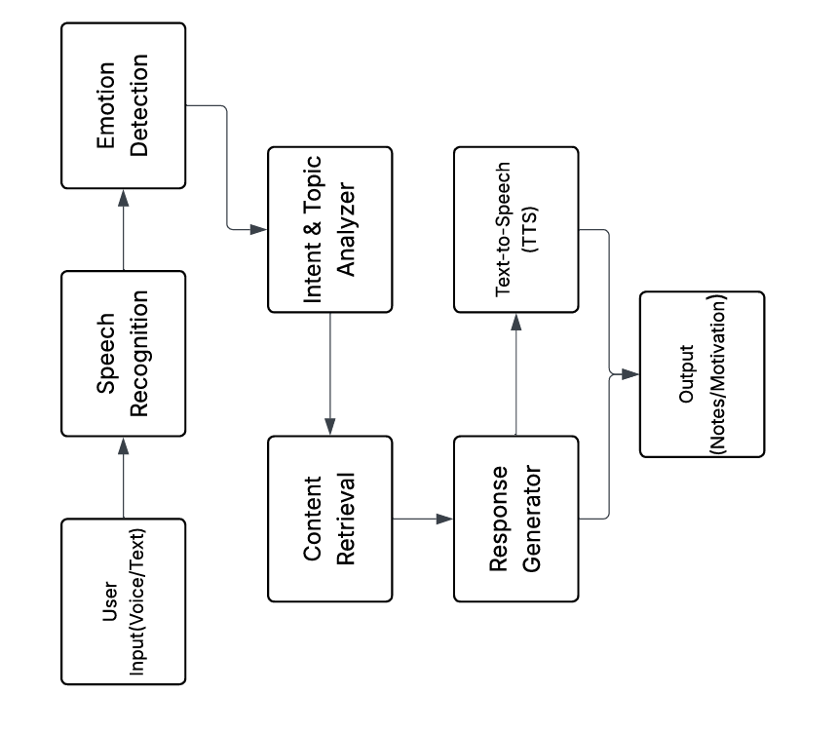
ARCHITECTURE
Fig. Architecture of the model

Slide 15
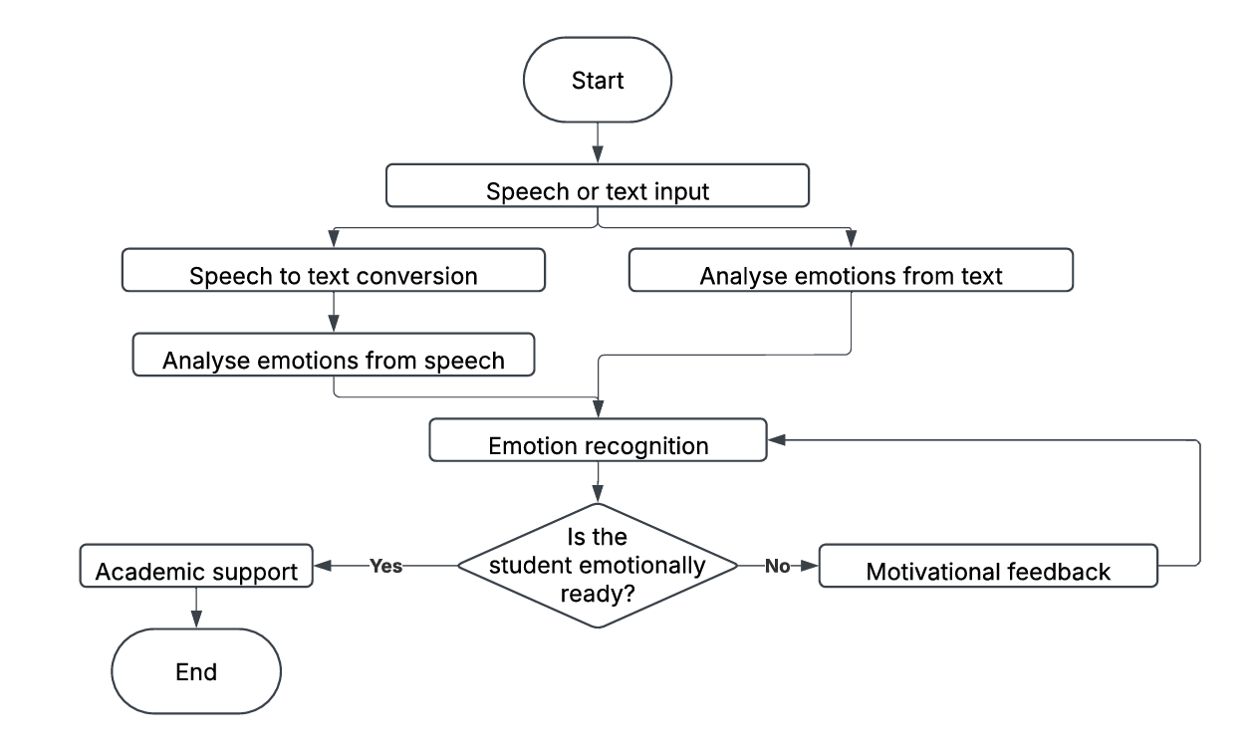
FLOWCHART
Fig. Flowchart of the working process

Slide 16
IMPLEMENTATION
The study assistant was built in Python for its readability and rich library support. It accepts input via text or voice, using the speech_recognition library.
The assistant uses a rule-based method to detect emotions from input by matching keywords to predefined emotional cues. If detected, it displays a relevant motivational message.
The assistant identifies study topics using pattern matching (e.g., phrases like “learn about”) and checks them against a dictionary of predefined formulas. If matched, it displays the relevant formula.
If no formula matches, the assistant fetches a summary from Wikipedia and displays it. The output includes motivation (if needed), a formula (if available), and concise study notes in a clean terminal view.

Slide 17
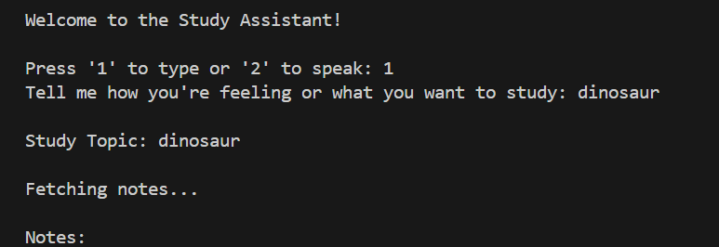
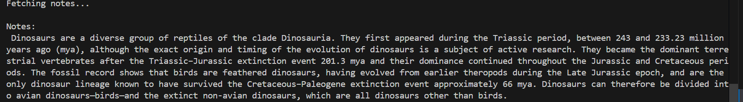

RESULTS
TEXT INPUT
SPEECH INPUT

Slide 18
CONCLUSION
The study assistant effectively combines emotion detection, topic recognition, formula retrieval, and Wikipedia-based summarization to support learners in a personalized way. By integrating speech recognition, it offers a natural and accessible interface. Though simple, it highlights how AI can enhance learning by being both informative and emotionally responsive. Future improvements could expand its capabilities and refine user experience.

Slide 19
REFERENCES
“Adaptive Virtual Assistant Interaction through Real-Time Speech Emotion Analysis Using Hybrid Deep Learning Models and Contextual Awareness” - Elham Karim Zadeh & Maryam Alaeifard.
“Emotion-Aware Voice Interfaces Based on Speech Signal Processing” - Yong Ma.
“Auditive Emotion Recognition for Empathic AI‑Assistants” - Roswitha Duwenbeck & Elsa Andrea Kirchner.
“A voice-based real-time emotion detection technique using recurrent neural network empowered feature modelling” - Sadil Chamishka, Ishara Madhavi, Rashmika Nawaratne, Damminda Alahakoon, Daswin De Silva, Naveen Chilamkurti & Vishaka Nanayakkara1
Python Documentation: https://docs.python.org/3/
6. SpeechRecognition Library: https://pypi.org/project/SpeechRecognition/
7. Wikipedia REST API: https://en.wikipedia.org/api/rest_v1/
8. Python Requests Library: https://requests.readthedocs.io/en/latest/

Slide 20
Thank You

