Slide 1


BANK CUSTOMER CHURN PREDICTION
Kavyasree Kanakaveedu Peta

Slide 2









Introduction
Literature
Data Description
Conclusions
Agenda
Data Exploration
Recommendations
Data Models
Findings

Slide 3

Introduction:
Problem Statement:
A major European commercial bank is losing customers to competitors. Because customer churn is a huge issue in the banking industry, the bank wants to figure out what is causing the dissatisfaction. To be competitive, the bank wants to focus on customer retention rather than new customer acquisition because the latter is more expensive.
Solution:
A statistical prediction model would be constructed using the customer data and attributes to estimate the likelihood of the customer leaving the bank. Following pattern detection, recommendations would be made to the bank on how to act on and target these clients in order to reduce churn.

Slide 4
Data Description:
Data-set is a collection of customer demographic and interaction with the bank.
Data-set sourced from kaggle
It has a total of 14 columns
Total of 10,000 independent customer records
Target variable is “Exited”
Target variable has only two values 0 and 1
0 means the customer stays with the bank
1 means the customer leaves the bank.
Resource: https://www.kaggle.com/datasets/shantanudhakadd/bank-customer-churn-prediction

Slide 5
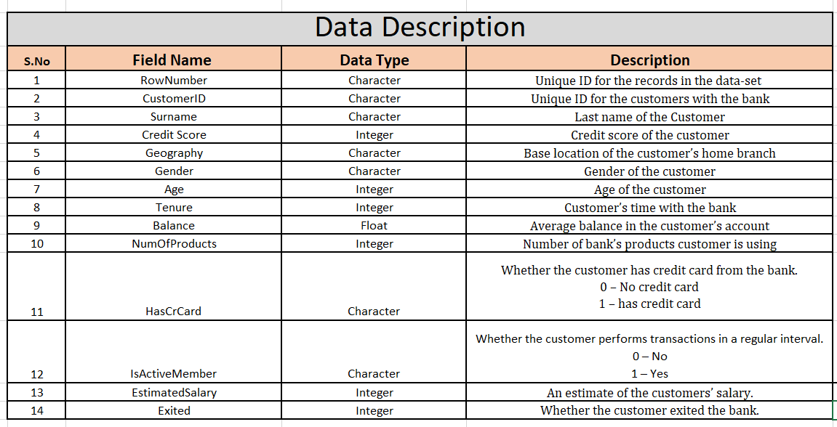
Data Description:

Slide 6
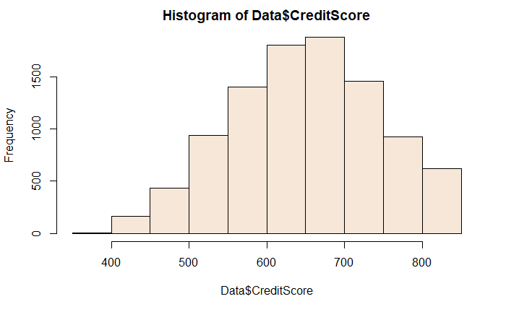
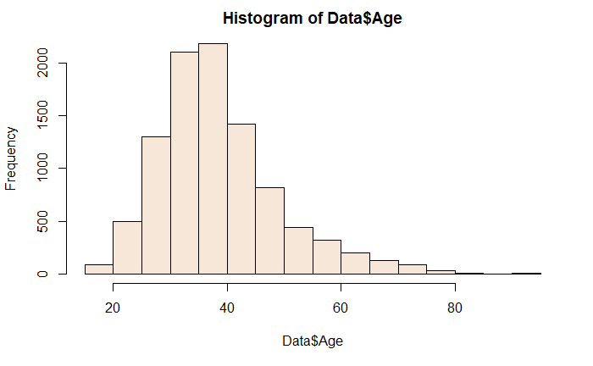
Data Statistics:
CreditScore
Age
Mean – 651
Median – 652
Max – 850
Min – 383
Range – 467
Mean – 38.93
Median – 37
Max – 92
Min – 18
Range – 72

Slide 7
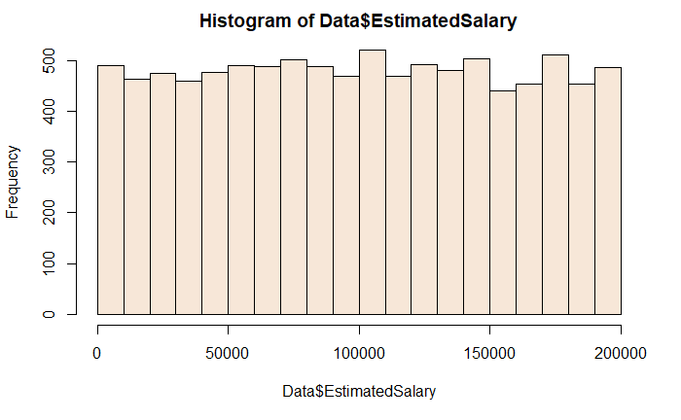
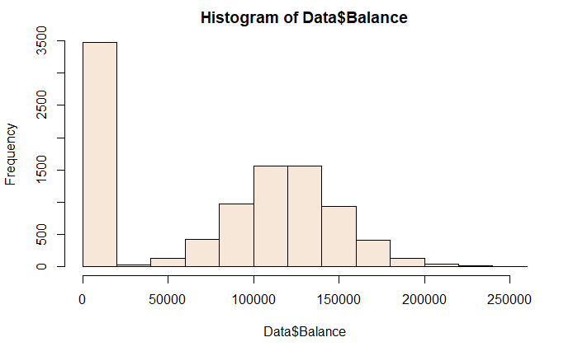
Data Statistics (Continued) :
Estimated Salary
Balance
Mean – 76515
Median – 97090
Max – 250898
Min – 0
Range – 250898
Mean – 99945.03
Median – 100134.32
Max – 199992.48
Min – 11.58
Range – 199980.98

Slide 8
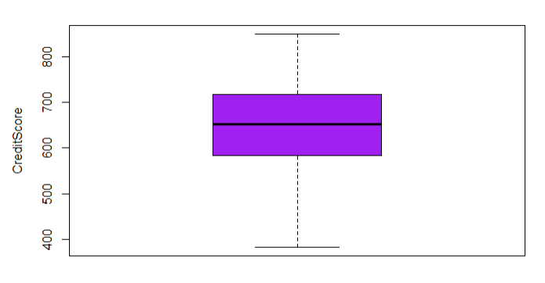
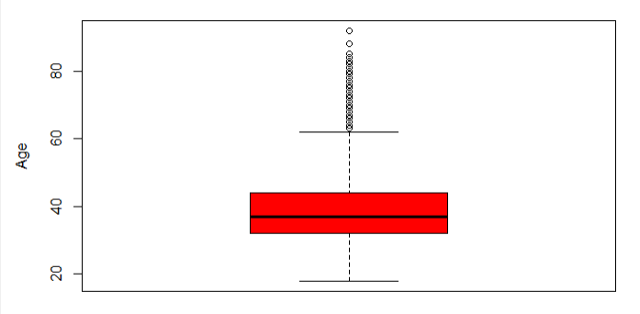
Data Exploration:
Missing values
There are no missing values in the dataset.
Outliers:
CreditScore: 15 outliers have been found and deleted.
Age: 359 outliers were found and deleted

Slide 9
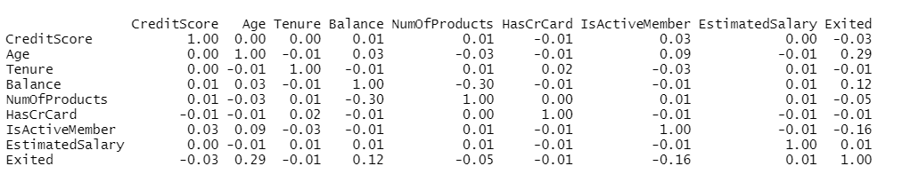
Data Exploration:
Correlations:
There are no significant correlations between continuous variables.
One-hot encoding:
Made dummy variables for Gender and Geography.

Slide 10
Data Exploration:
Standardization:
Scaled the predictor variables in the dataset.
Final set of predictor variables:
CreditScore
Age
Tenure
Balance
NumOfProducts
HasCrCard
EstimatedSalary
IsActiveMember
Gender_M
Geo_France
Geo_spain

Slide 11
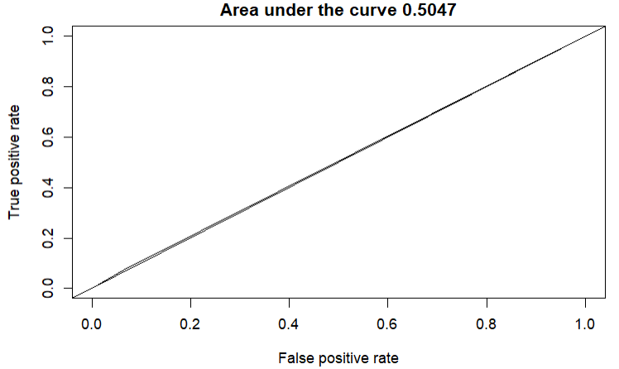
Modeling:
Logistic regression:
Trainset:
Accuracy : 0.8187
Confusion matrix:
0 1
0 5217 174
1 1037 310
Testset:
Accuracy: 0.8130
Confusion matrix:
0 1
0 2209 73
1 479 127
The optimal F1 score for the model is 0.49
Sensitivity: 0.8266
Specificity: 0.6318

Slide 12
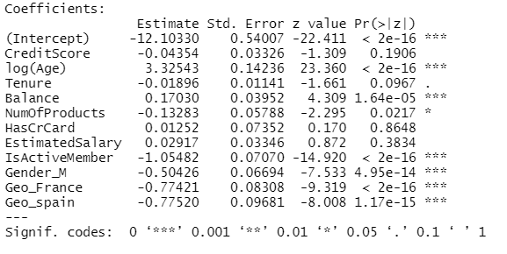
Logistic regression: (Continued)
Since p-values of these variables greater than significant alpha value, these may be excluded.
Credit Score
Tenure
Hascrcard
Estimated salary
Trainset:
Accuracy score: 0.81405
Confusion Matrix:
0 1
0 2209 73
1 480 126

Slide 13
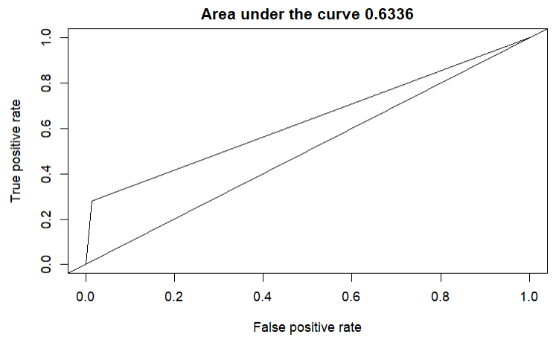
Modeling:
Decision tree:
Trainset:
Accuracy = 0.8428
Confusion Matrix:
0 1
0 5230 163
1 793 552
Testset:
Accuracy = 0.8421
Confusion Matrix:
0 1
0 2221 59
1 361 247

Slide 14
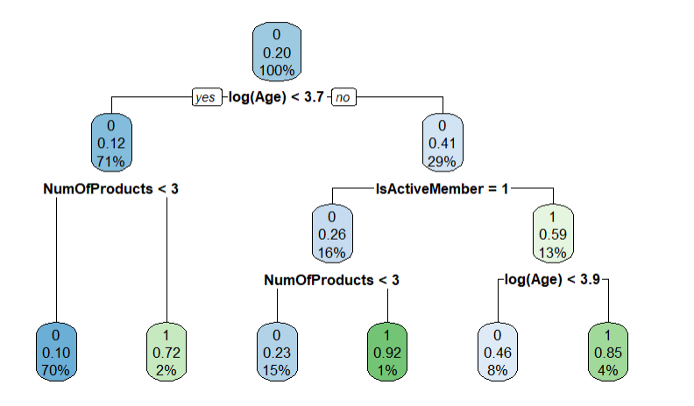
Decision tree: (Continued)
The optimal F1 score for the model is 0.5296.
Sensitivity: 0.8414
Specificity: 0.8513

Slide 15
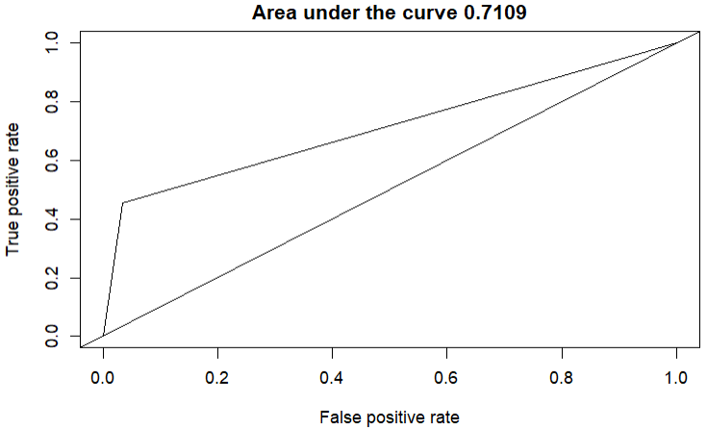
Modeling:
Random Forest:
Trainset:
Accuracy = 0.993
Confusion matrix:
0 1
0 5393 0
1 46 1299
Testset:
Accuracy = 0.8614
Confusion Matrix:
0 1
0 2204 76
1 345 263
The optimal F1 score for the model is 0.35
Sensitivity: 0.8729
Specificity: 0.7781

Slide 16

Best Model:
Decision tree is the best model chosen.
It has accuracy of 84.28% for the train dataset and 84.21% for the test dataset.
Accuracy of customers exiting is around 84.14%
Accuracies of train and test datasets have huge difference for Random Forest model( 13%) indicating that model is overfit for train dataset.

Slide 17
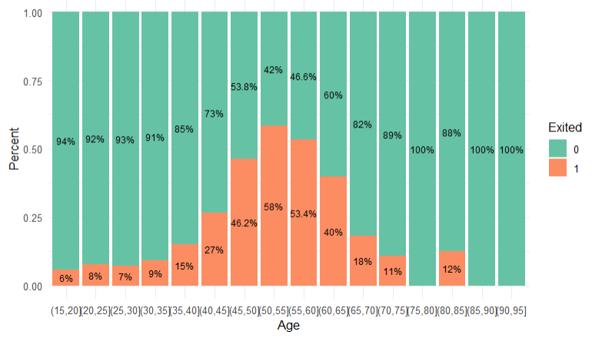
Findings:
Age VS Exited
The proportion of customers exiting the bank are relatively more in age group with 36 years or more.
Until the age of 35, the churn follows a steady trend
From 36 years of age, the churn rate follows an increasing trend

Slide 18
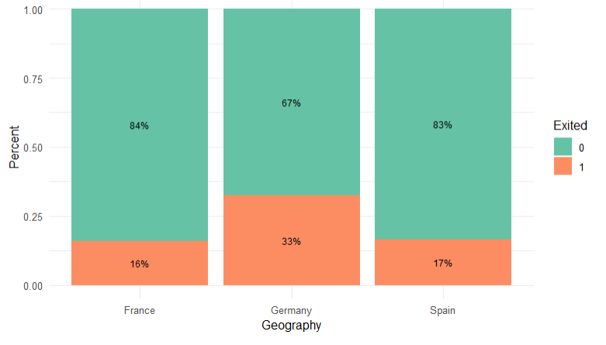
Findings:
Geography VS Exited
In comparison to other geographies, Germany has the largest proportion of consumers leaving the bank.
In Germany, 33 percent of consumers left the bank, although in France and Spain, just 16 percent and 17 percent of clients left the bank, respectively.

Slide 19
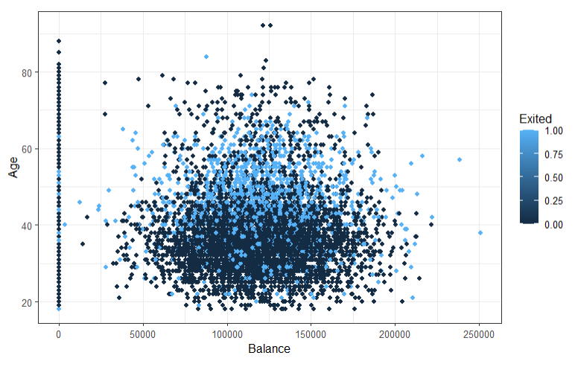
Findings:
Age VS Balance VS Exited
Banks have high churn rate with customers aged between 40 and 60, with balance between 50000 and 200000 .
Customers with balance zero have low probability of exiting the bank.

Slide 20
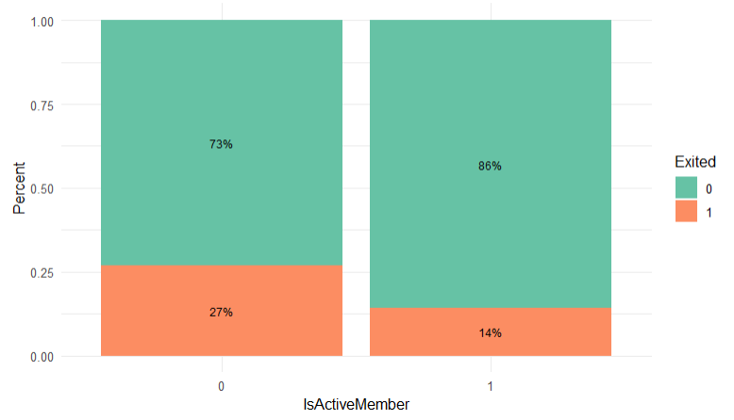
Findings:
Active_member VS Exited
We can see from the above graph that inactive customers are more likely to leave than active consumers.
The rate of customer churn for inactive customers is 27% whereas active customers are less likely to leave. They have only 14% churn rate

Slide 21

Recommendations :
Since Germany has higher churn rate, Bank should concentrate on keeping customers by increasing interest rate and discount on services offered
Bank should provide incentives to the customers whose age is between 40 to 60 and has a balance between 50000 to 200000 for making these group more loyal..
The bank should customize its services for account holders whose age is greater than 36 for improved customer retention.
Since active customers are less likely to leave the bank, The bank should discount its services for customers who have their salary credited to their account in the bank.

Slide 22

Conclusions :
Using the data, The model with highest predictive power for the future data is selected.
Bank can identify customers likely to churn by using the results of the model built.
Categories of customers who are more likely to churn are provided. These customers can be made to stay by following the recommendations provided.

Slide 23
Literature:
https://www.kaggle.com/datasets/shantanudhakadd/bank-customer-churn-prediction
https://www.researchgate.net/publication/306388481_Developing_a_prediction_model_for_customer_churn_from_electronic_banking_services_using_data_mining
https://journals.gen.tr/index.php/jame/article/view/1677/1072
https://run.unl.pt/bitstream/10362/71584/1/TGI0223.pdf

