Slide 1
Operating system and system programming (25CS2104E)
Linux Dynamic Memory Allocation and Memory Monitoring System
Review-I
Under the Esteemed Guidance of
Raghupathi M
CSE Department
Team Members:
Kavya Sree 2520090143
P. Srivalli 2520090040
V. Pavani 2520090041

Slide 2
Introduction
Memory management is an important function of a Linux operating system because efficient use of memory directly affects system performance, stability, and resource utilization. Linux dynamically allocates and releases memory based on the requirements of running processes. However, understanding how memory is allocated, monitored, and released is essential for identifying inefficient memory usage and preventing problems such as memory leaks and excessive resource consumption. The Linux Dynamic Memory Allocation and Memory Monitoring System is designed to demonstrate and monitor the dynamic allocation of memory in a Linux environment. The system allows memory to be allocated and released during program execution while providing information about memory usage and system resources. The project focuses on concepts such as dynamic memory allocation, process memory usage, memory monitoring, allocation and deallocation, and memory utilization analysis. By combining memory allocation techniques with monitoring mechanisms, the system provides a practical understanding of how Linux manages memory and how applications interact with system memory. Overall, this project helps in understanding the practical aspects of Linux memory management and provides a simple way to observe memory usage, detect inefficient allocation, and improve resource utilization.

Slide 3
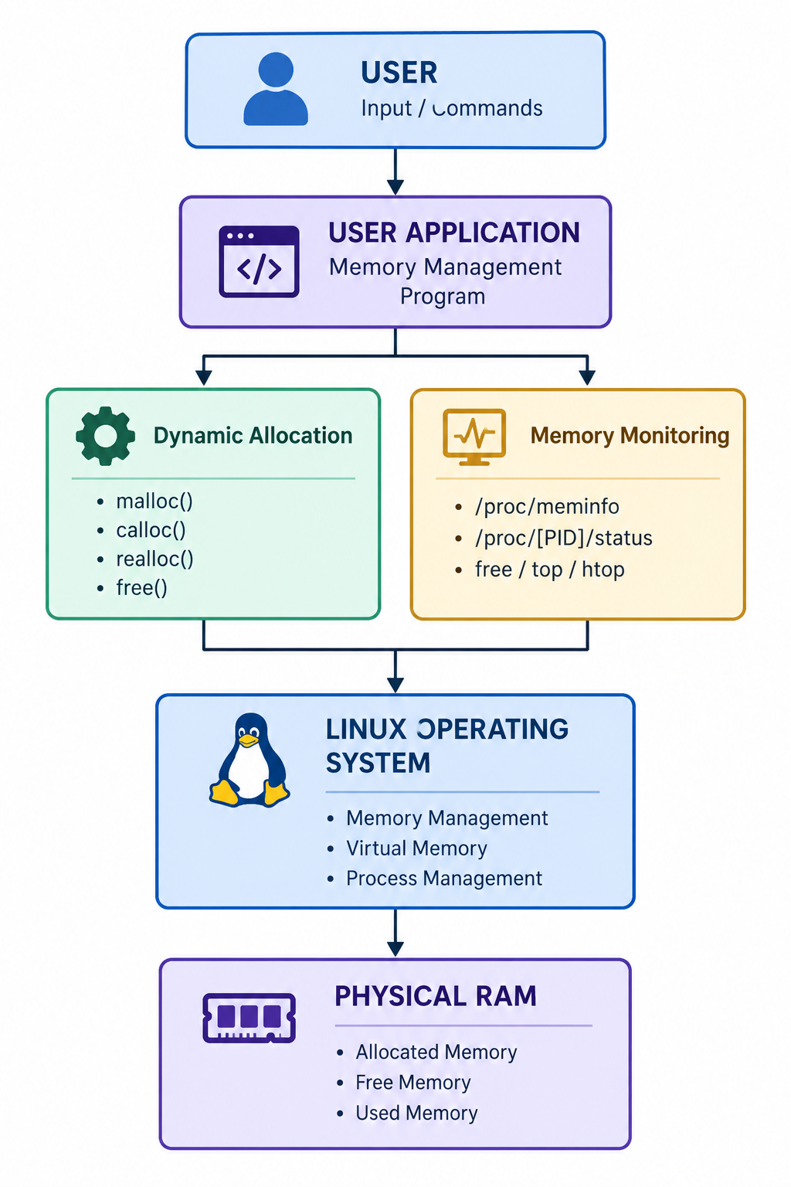
System Architecture

Slide 4
Hardware and Software requirements
Hardware Requirements
Component | Requirement
Processor | Intel Core i3 or equivalent and above
RAM | Minimum 4 GB
Storage | Minimum 10 GB free space
Display | Standard monitor
Keyboard & Mouse | Standard keyboard and mouse
Software Requirements
Operating System | Linux (Ubuntu 20.04/22.04 or later recommended)
Programming Language | C
Compiler | GCC (GNU Compiler Collection)
Development Environment | VS Code / Vim / Nano / any C IDE
Build Tool | GNU Make (optional)
System Monitoring Tools | free, top, htop, /proc/meminfo
Terminal | Linux Terminal / Bash

Slide 5
Thank you

