Slide 1
Agentic RAG Chatbot with MCP
A multi-format document QA chatbot using Agentic Architecture & Model Context Protocol
Author:Kavyasri Kammari
kammarikavyasri11@gmail.com

Slide 2

TABLE OF CONTENTS
01
02
03
04
05
06
07
ARCHTECTURE OVERVIEW
SYSTEM WORKFLOW
TECH STACK USED
IMPLEMENTATION
SCREENSHOTS
CHALLENGES FACED
FUTURE SCOPE

Slide 3
Architecture Overview
Agent-Based Design:
UI ➝ CoordinatorAgent
IngestionAgent: Parses documents and generates text chunks
RetrievalAgent: Embeds text & performs FAISS similarity search
LLMResponseAgent: Forms final prompt and calls Groq LLM

Slide 4
MCP Message Format:
{
sender": "RetrievalAgent",
"receiver": "LLMResponseAgent",
"type": "CONTEXT_RESPONSE",
"trace_id": "abc-123",
"payload": { "top_chunks": ["...", "..."],
"query": "What are the KPIs?"
}
}

Slide 5
System Workflow
User Uplaod Files(PDF, PPTX, DOCX, TXT, CSV)
IngestionAgent: Parses & splits documents into text chunks
RetrievalAgent: Embeds chunks & retrieves relevant ones
LLMResponseAgent: Forms LLM prompt & queries Groq
UI: Displays answer + context
➡️ All messages passed using MCP format ➡️ Stateless, traceable communication using trace_id

Slide 6
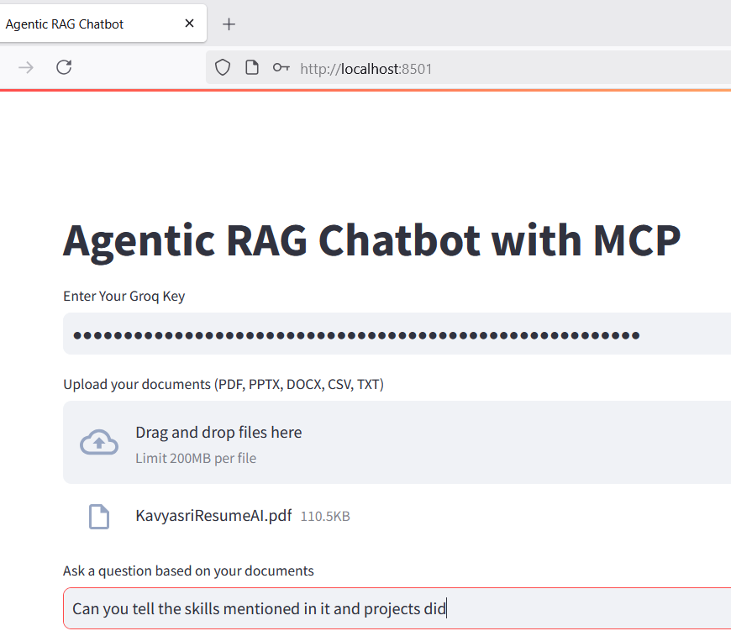
Screenshots

Slide 7
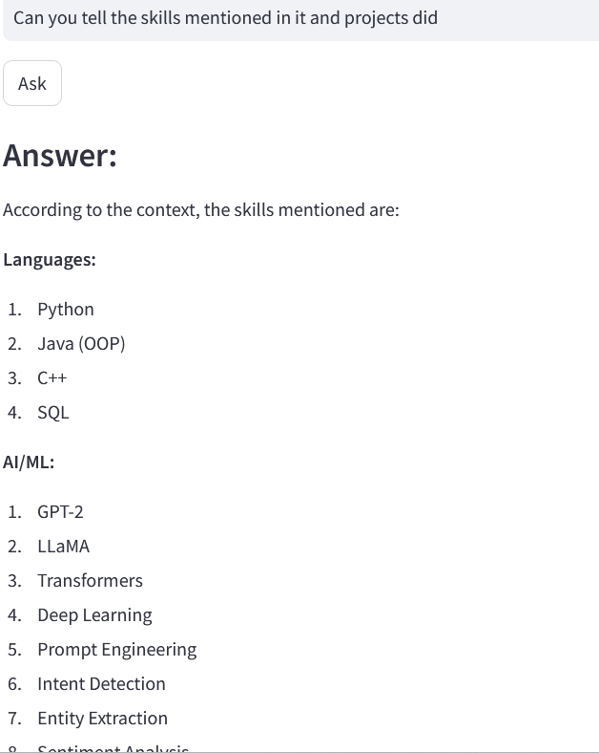
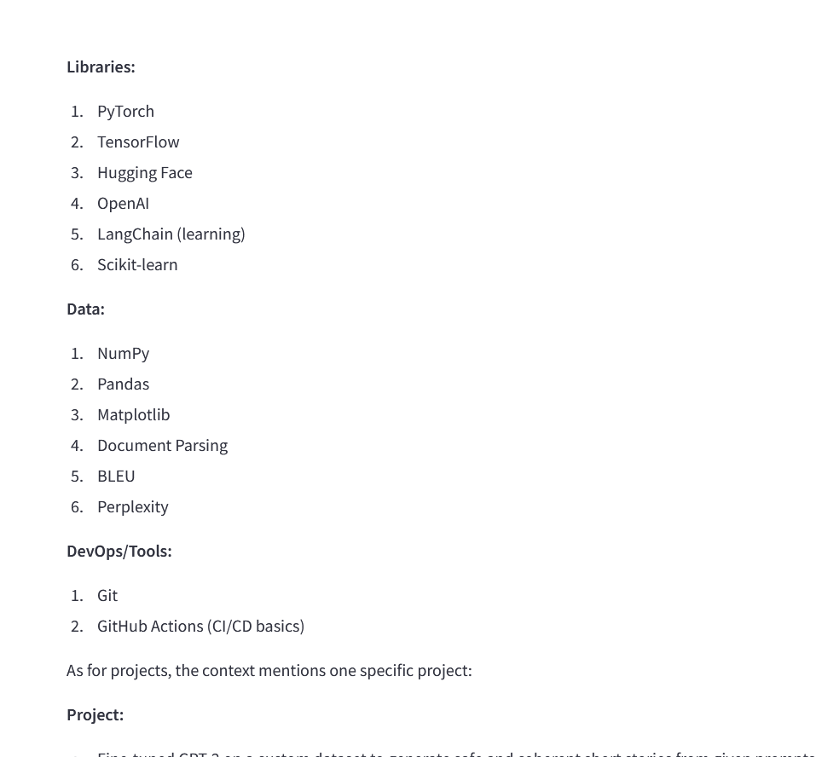
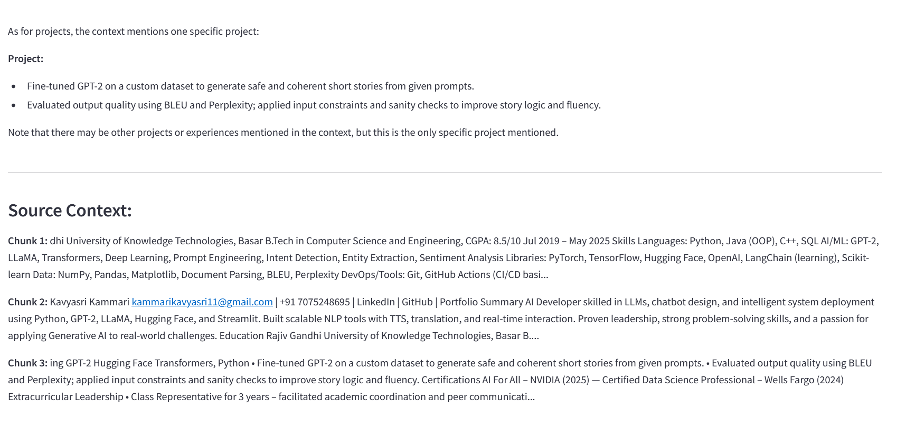

Slide 8
Challenges & Improvements
Challenges Faced:
Groq model deprecation & version mismatch
Duplicate text chunks from low-informational content
Parsing edge cases in PPTX and CSV
Future Scope:
Add XLSX & OCR document support
Introduce memory for multi-turn context
Export QA history as PDF/Markdown
Streamlit Cloud or HF Spaces deployment

Slide 9

Notes:
9

