Slide 1

Exploratory Data Analysis for Sentiment Analysis of Product Reviews Predicting Product Review Scores Using Machine Learning

Slide 2


About Us:
Batch no 265/266
e
01
Kavya Sri R
MBA
e
01
N Sri Kumar
B Com(Gen)

Slide 3
Agenda:
Introduction
Project Heading and Title.
Objective of the Project.
Data Overview
Description of the dataset.
Data Extraction Process.
Exploratory Data Analysis (EDA)
Visualizations and insights from the data.
Data Preparation and Modeling
Data Cleaning, preprocessing steps.
Training and evaluating models.
Model Comparison
Evaluation metrics and comparison of models.
Conclusion and Next Steps
Summary of findings and recommendations.

Slide 4
The objective of Project:
To preprocess and analyze product review text data.
To build and evaluate multiple machine learning models to predict review scores based on textual reviews.
To identify the best performing model for predicting the sentiment score of product reviews.

Slide 5
Summary:
Dataset:
Includes 500,000 entries with fine reviews from Amazon.
Features: ProductId, UserId, ProfileName, HelpfulnessNumerator, HelpfulnessDenominator, Score, Time, ReviewSummary, ReviewText.
Next Steps:
Conduct EDA for deeper insights.
Preprocess data: clean text, handle categorical variables, and split data.
Train and evaluate predictive models: Logistic Regression, Naive Bayes, SVM, Gradient Boosting, Random Forest.
Select the best model based on evaluation metrics.

Slide 6




Libraries and Modules Used Used
Pandas : For data manipulation and analysis.
Numpy : For numerical computing and array operations.
Seaborn : For statistical data visualization based on matplotlib.
Matplotlib.pyplot : For data visualization using plots and charts.
Scikit-learn (sklearn) : For various machine learning algorithms and tools.

Slide 7
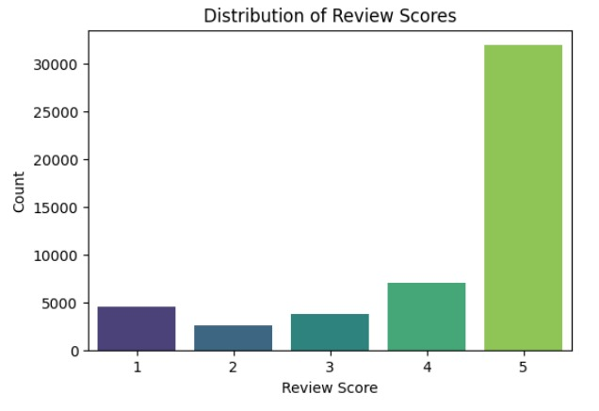
Distribution of Review Scores
Review Count: The y-axis indicates the count of reviews, with score 5 having the highest count, significantly more than the other scores.
Score Comparison: Scores 1 and 3 have similar counts, score 2 has slightly more, and score 4 has fewer than score 5 but more than scores 1, 2, and 3.

Slide 8
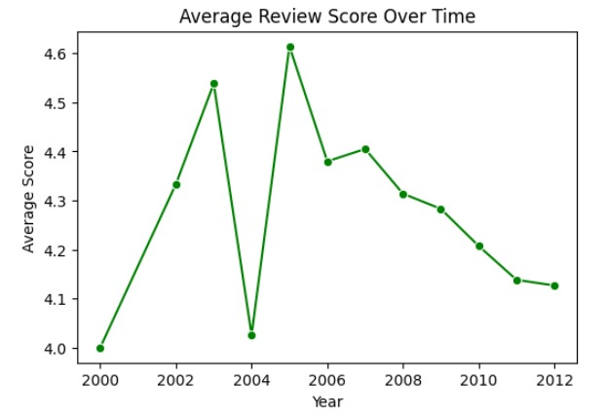
Average Review Scores
Score Fluctuations: The graph shows significant fluctuations in average review scores, suggesting changes in customer satisfaction or product quality over time.
Data Points: Green dots represent individual data points, providing a visual representation of the scores each year.

Slide 9
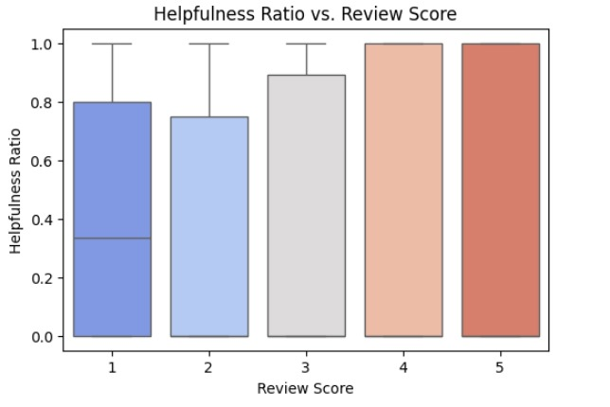
Helpfulness Ratio vs. Review Score
Helpfulness Ratio: The graph indicates a correlation between the Review Score and the Helpfulness Ratio, suggesting that higher-rated reviews are often found more helpful.
Score Distribution: There is a clear trend showing that reviews with scores of 4 and 5 have notably higher helpfulness ratios.

Slide 10
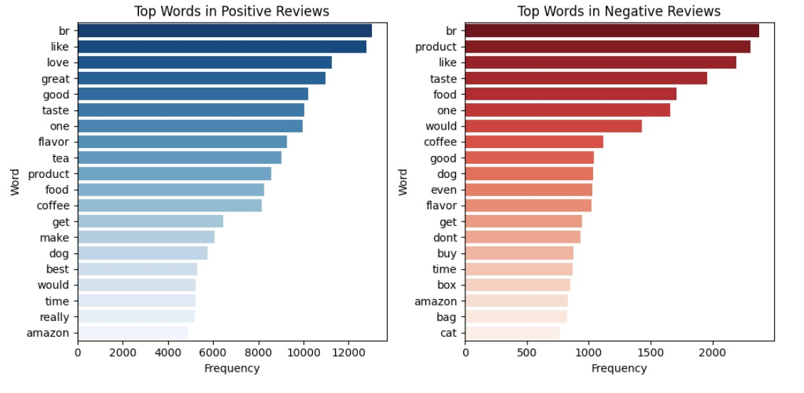
Positive Reviews & Negative Reviews
Vocabulary Usage: The bar graphs show the top words used in positive and negative reviews. Words like “great,” “love,” and “best” are common in positive reviews, while “product,” “taste,” and “like” appear often in negative reviews.
Frequency of Words: The frequency of these words is represented on the x-axis, with positive words reaching up to 12000 occurrences and negative words up to 2000.
Sentiment Indicators: The choice of words can be strong indicators of sentiment, with positive reviews using more emphatic and enthusiastic language.

Slide 11
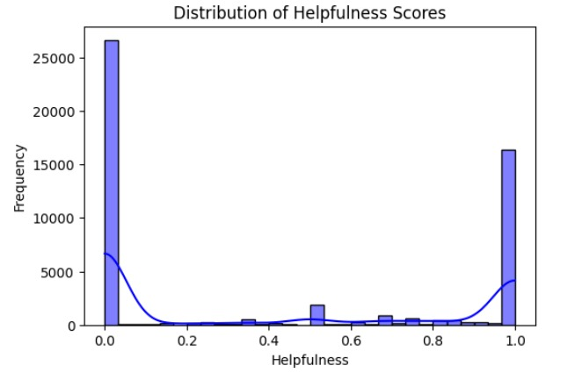
Helpfulness Scores
Helpfulness Calculation: The calculation of the helpfulness ratio by dividing the HelpfulnessNumerator by the HelpfulnessDenominator, which is a common approach in sentiment analysis to gauge the perceived value of a review.

Slide 12
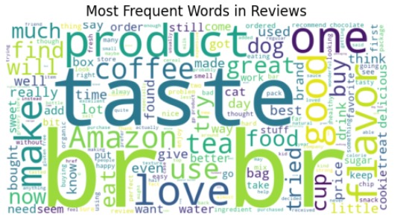
These are most frequently used words in reviews which are taste, product , one etc.

Slide 13
Data Preparation and Modeling
Data Cleaning and Preprocessing:
Remove non-alphabetic characters from the text data.
Tokenize the text into individual words.
Remove stop words such as 'and', 'the', etc., from the tokenized text.
Lemmatize the words to normalize the text (convert words to their base form).
Training and Evaluating Models:
Split the dataset into training and testing sets, typically using an 80-20 or 70-30 ratio.
Implement TF-IDF (Term Frequency-Inverse Document Frequency) vectorization to convert text data into numerical vectors.
Train multiple machine learning models on the training data, including Logistic Regression, Naive Bayes, Gradient Boosting, SVM, and Random Forest.
Evaluate each model's performance using accuracy as the metric.

Slide 14
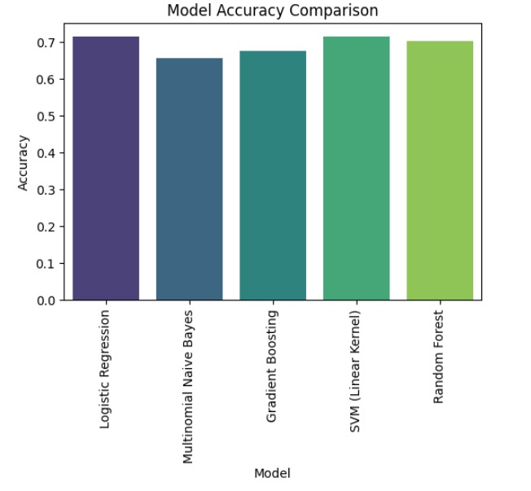
Model Performance
Accuracy Range: The y-axis shows accuracy ranging from 0 to 0.7, indicating a moderate level of accuracy across models.
Model Performance: SVM (Linear Kernel) and Random Forest show similar performance,

Slide 15
Conclusion :
Text preprocessing steps such as tokenization, stopword removal, and lemmatization significantly improved model performance.
TF-IDF vectorization effectively converted text data into numerical features for model training.
Logistic Regression outperformed other models in predicting review scores based on textual data

Slide 16

THANK YOU

