Slide 1

Maximizing Academic Collaboration and Productivity through Project Management Solutions
Department of Computer Science and Engineering
VI Semester, Mini Project MidSem Evaluation
Code: CS65
By:
1MS21CS040- Charishma Mallem
1MS21CS056- Jyothi Yadav
1MS21CS063- Kavyasri R
Under the Guidance of
Brunda G
Department of Computer Science and Engineering

Slide 2
Agenda
Introduction
Problem Definition
Current Methodology
Proposed Methodology
System Requirements
Literature Survey/Related Work
Design
System Architecture
Algorithmic Description
Reason for the choice of specific Architecture
Implementation details
Results Snapshot and Description
Conclusion
References

Slide 3
1. Introduction
Our project aims to revolutionize project management within the Department of Computer Science and Engineering at MSRIT.
Through developing a sophisticated project management tool, we seek to streamline project workflows, enhance collaboration, and ensure efficient project delivery, and easy project tracking and
Leveraging modern technologies such as React.js, Django, Djoser, Redux, Docker, and AWS our tool will empower users to plan, track, and manage projects effectively.
With its user-friendly interface and comprehensive feature set, our project promises to be a cornerstone in fostering innovation and excellence within the academic community at MSRIT.

Slide 4
2. Problem Definition
Current Methodology : At the Department of Computer Science and Engineering in MSRIT, project management currently involves a combination of paper-based processes and limited utilization of Jira, which is not fully functional. This absence of meticulous project oversight and the lack of implementation of Scrum or Agile methodologies mean that we lack insight into the individual working statuses of each student within the team.Manual updates and communication, along with dependency on physical documentation, hinder collaboration and coordination. With limited automation and integration, there's a pressing need for a comprehensive solution to streamline workflows and enhance project delivery.
Proposed Solution : This tool will integrate seamlessly with existing systems while addressing the limitations of the current methodology. Leveraging modern technologies such as React.js, Django, Docker, and AWS, our solution will offer a user-friendly interface and a robust feature set for project planning, task tracking, issue resolution, and collaboration. By centralizing project management processes, automating routine tasks, and providing real-time visibility into project progress, our solution aims to streamline workflows, enhance communication, and improve overall project efficiency within the academic environment and also helps in micromanagement of the project.

Slide 5
3. System Requirements FUNCTIONAL REQUIREMENTS
User authentication and authorization.
Project creation, editing
Task creation, assignment, and tracking.
Issue logging, prioritization, and resolution.
Document management
Reporting and analytics for project performance of members.
Access control for project visibility and permissions management.
Calendar integration for scheduling and milestone tracking

Slide 6
3. System Requirements NON-FUNCTIONAL REQUIREMENTS
Data Integrity
Resource Management
Security
Scalability
Maintainability

Slide 7
5. Literature Survey
Sl.No. | Reference | Outcomes | Disadvantages
1 | "Arnautović, Aleksandar. (2022). Managing project using JIRA software. Serbian Journal of Engineering Management. 7. 40-46. 10.5937/SJEM2202040A. | Efficiency Improvement, Lifecycle Management of the Project, Collaboration, Agile Methodology, Transparency In project Progress | Lack of Comparative Analysis.
2 | Danijela Ciric, Bojan Lalic, Danijela Gracanin, Nemanja Tasic, Milan Delic, Nenad Medic, (2019) Agile vs. Traditional Approach in Project Management: Strategies, Challenges and Reasons to Introduce Agile, Procedia Manufacturing, Volume 39. | The paper provides a theoretical background on APM, emphasizing its origins in the changing Business environment and its evolution beyond software development. It contrasts APM with traditional project management approaches, highlighting its focus on flexibility, adaptability to change, and iterative development. | Subjective Perception of Reasons and Challenges

Slide 8
5. Literature Survey
Sl.No. | Reference | Outcomes | Disadvantages
3 | Faculty of Electrical Engineering and Computer Science, University of Maribor, Koroška cesta 46, 2000 Maribor, Slovenia 2 S8 d.d, Cesta v Gorice 34, 1000 Ljubljana, Slovenia | compared the tools with each other according to the quality of the features of a good projectmanagement tool,Like clickup,Trello,Asana etc. the tools ClickUp and Wrike ranked best. | Lack of Systematic Data Collection : There wasn't a systematic approach to gathering information about how different companies use project management tools.
4 | Jira Software | Project Management tool, issue tracking, agile project management, scrum boards, Customised workflows | The subscription amount for Jira Software is higher compared to other software. Standard: $8 Premium:$12.48

Slide 9
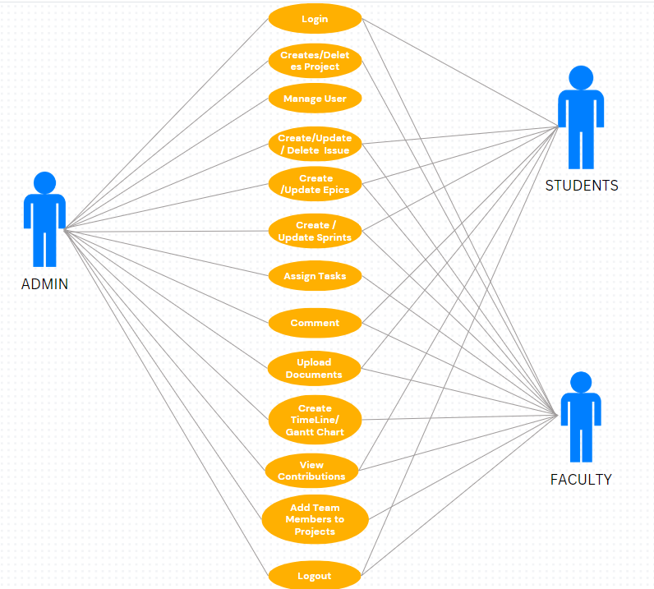
6. Design USE CASE DIAGRAM

Slide 10
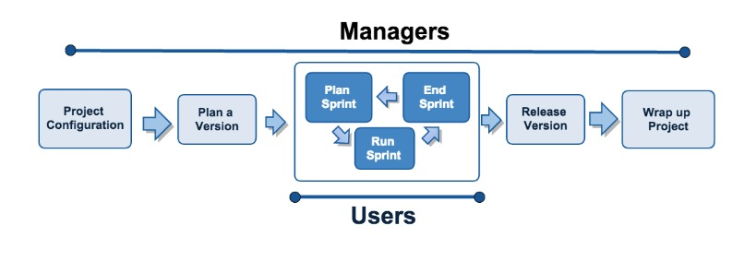
Salty software workflow

Slide 11
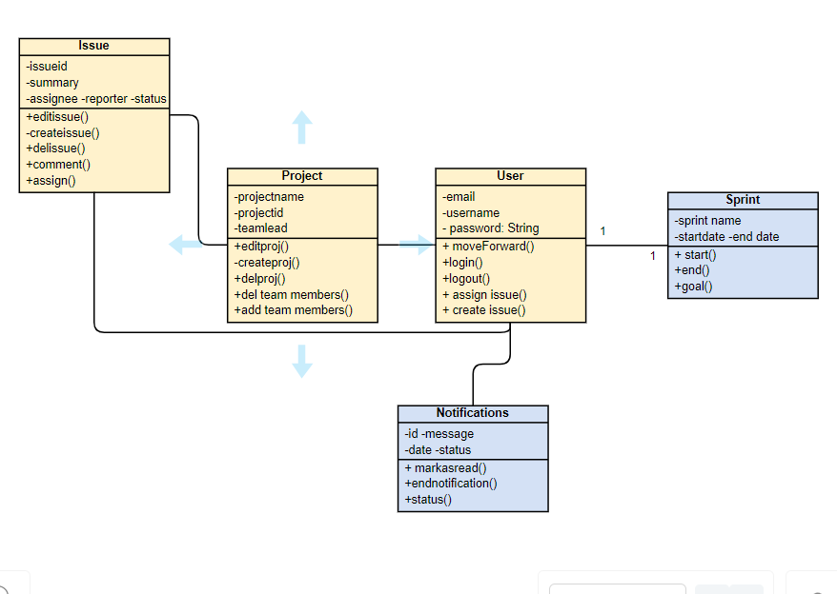

Slide 12
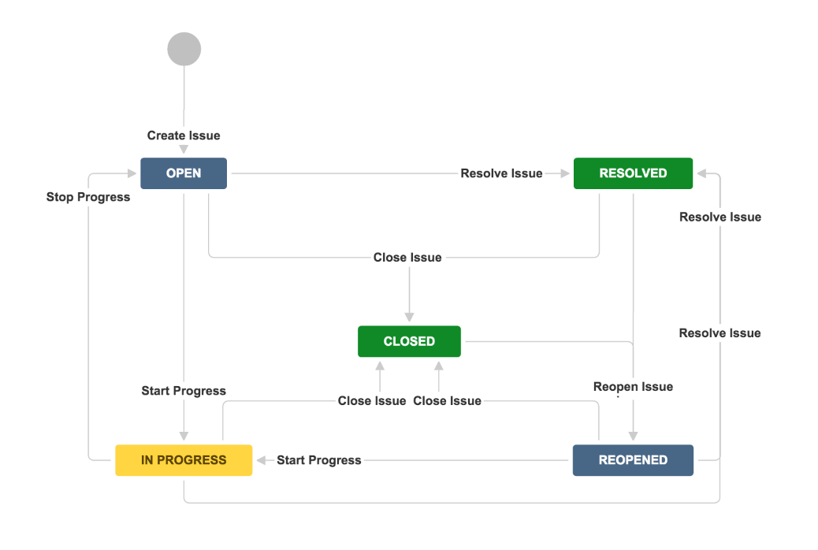
Workflow diagram of issue creation

Slide 13
7. Implementation
Sprint 1: Planning and Requirements Gathering
Define project objectives, scope, and deliverables.
Identify technology stack, tools, and frameworks to be used.
Develop wireframes and mockups to visualize the user interface and workflow.

Slide 14
7. Implementation
Sprint 2: Setting up git and other tools and evnironments for collaborative coding
Set up the project environment, including version control, development tools, and project management system.
Define user stories and acceptance criteria.
Develop the basic user interface (UI) layout and navigation structure.
Sprint 3: Login page, Project Creation, Backlog creation, and sprint creation
Implementation of an inbuilt Django authentication system. Database(Sqlite3).
Implementation of the project creation page.
Implementation of Backlog (issues) creation and sprint cycle.

Slide 15
7. Implementation
Sprint 4: Email integration, Backlog features, Add team members, salty invitation
Email Integration: Implement email integration for notifications.
Backlog Features : Prioritize backlog features for future sprints.
Add Team Members and Salty Invitation: Onboard new team members and Implement user invitation functionality.
Sprint 5: Creation of Filters, My Issues, Implementing structure of Timeline, Backlog advanced features and css
Define and implement the structure of the timeline feature, allowing users to view a chronological feed of recipe updates and activities.
Prioritize and incorporate advanced features from the backlog into the development pipeline.
Implement a feature for users to track their interactions with recipes, such as liked recipes, saved recipes, and previously

Slide 16
7. Implementation
Sprint 6: Timeline, Sidebar, navbar, reports routing through the website
Develop the timeline feature to display chronological updates and activities related to recipes.
Design and implement the sidebar and navbar components for easy navigation throughout the website.
Test navigation functionality to verify smooth transitions and responsiveness.
Define and configure routes for each page or feature, ensuring proper URL handling and bookmarking.
Sprint 7: Advanced CSS, Clean up code , Fix Bugs
Identify and prioritize bugs reported during testing.

Slide 17
8. Conclusion
Development of a tailored project management tool offers significant benefits for MSRIT's Department of Computer Science and Engineering.
The solution addresses current limitations and enhances project efficiency, collaboration, and transparency.
Leveraging modern technologies ensures streamlined workflows and improved communication.
A phased approach comprising planning, implementation, and iterative development ensures effective project delivery.
Ongoing collaboration, feedback incorporation, and continuous improvement are key to project success.
The project management tool will serve as a cornerstone for fostering innovation and excellence within the department.

Slide 18
9.Reference
"Arnautović, Aleksandar. (2022). Managing project using JIRA software. Serbian Journal of Engineering Management. 7. 40-46. 10.5937/SJEM2202040A.
Danijela Ciric, Bojan Lalic, Danijela Gracanin, Nemanja Tasic, Milan Delic, Nenad Medic, (2019)Agile vs. Traditional Approach in Project Management: Strategies, Challenges and Reasons to Introduce Agile,Procedia Manufacturing,Volume 39.
Faculty of Electrical Engineering and Computer Science, University of Maribor, Koroška cesta 46, 2000 Maribor, Slovenia 2S8 d.d, Cesta v Gorice 34, 1000 Ljubljana, Slovenia

Slide 19
Thank You

