Slide 1
Analyzing Speech Prosody
Julia Hirschberg
CS 6706
Notes:
Welcome to week 5!

Slide 2
Reminders
Please check your reading assignments at Courseworks → Syllabus and Courseworks → Assignments
No weekly post for Week 6 – just HW1 due
But still do the readings!
Any other questions?
Notes:
As usual we’ll start with a couple of housekeeping notes. At this point, this should be familiar to most, if not all, of you, but as a reminder, you can keep track of weekly reading post assignments on Courseworks under the Syllabus and Assignments tabs. Also, since HW1 is due next week, there are readings for you to read but NO associated weekly post for next week. If there are no questions about any of that, I’ll go on to today’s content…

Slide 3
Today
How can we represent differences in how people produce speech that influence how we interpret their speech?
Expanded vs. compressed pitch range?
Louder vs. softer speech?
Faster vs. slower speech?
Differences in intonational prominence?
Differences in intonational phrasing?
Differences in pitch contours?
Notes:
Today, we’re going to talk about speech prosody and how we can represent differences in speech production that influence our understanding and interpretation of that speech. We’ll cover the impact of prosodic features like pitch, intensity, and duration, which are the three broad categories of prosodic features, as well as more specific prosodic features like intonational prominence, intonational phrasing, and intonational (or pitch) contours.

Slide 4
Joshua Steele’s Prosodia Rationalis (1779)
Notes:
Let’s start with an example to help us build some intuition about prosody, and look at a poem. For many people, reading or reciting poetry gives them a keener sense of their own changes in prosody and intonation than in more typical spontaneous conversational speech, so I hope this will be helpful.
Here we have a prosodic transcription of Alexander Pope’s Happiness poem. Steele, who did the transcription, says that since speech is composed of “slides”, and not stable, discrete pitches, he developed Note Heads which are lines, curves, and cirumflex notes that could cover several pitches. To these curved heads, which he named “accents”, he then added a tail or “phrase boundaries” which marked the duration of the syllable in a number of beats within a musical bar. By looking at this notation, you might notice that these look a little bit like a pitch or intonational contour as we saw on Praat last week. Recall that a pitch contour is a visual representation of how the fundamental frequency of a voice changes over time. An intonational contour, on the other hand, refers to the specific patterns of pitch changes that carry meaning in a language, such as indicating questions or statements. Think of the pitch contour as the raw data, while the intonational contour is the meaningful interpretation of that data within a linguistic context.
[Figure 1. Transcription of Alexander Pope’s Happiness poem (Steele, 1775, p. 13)
Since speech is composed of slides, and not stable, discrete pitches, he developed note heads which were lines, curves, and circumflex notes that could cover several pitches. To these curved heads (“accents”), he then added a tail (“phrase boundaries”) which marked the duration of the syllable in a number of beats within a musical bar.
Looks sort of like an intonational contour..]

Slide 5

Limitations of Music Representations
Difficult to represent similarities between contours
E.g. these contours are the same
but in a different pitch range
A good start for intonation analysis but too tied to particular instances – hard to generalize
Notes:
While this is an example of promising early work relating to prosody, there are some limitations to the specifically musical notation form of prosodic representation. For instance, it is difficult to represent similarities between contours that are the same but happen to be in different pitch ranges, like these. [play sounds] So this makes it hard to generalize prosodic analysis.

Slide 6
Language Training Approaches
A simpler approach with arrows and capital letters
/ IS it INteresting /
/ d’you feel ANGry? /
/ WHAT’S the PROBlem? /
(McCarthy, 1991:106)
Too general
Doesn’t capture full contours or type of pitch accents or phrase boundaries
Notes:
One possible alternative is the approach outlined here, where we represent prosodic stress with arrows and capitalization [produce examples], but this is too general and can’t capture a complete picture of what is happening with the prosody of speech.

Slide 7
What Do We Really Need?
Capture sufficient variation to
Explain both similarities and differences in prosodic meaning in a language
Compare prosody across languages
How much detail do we need to capture?
How do we do this?
Notes:
So this brings us to a clearer motivation for what we need to know and do to perform prosodic analysis well. When we study prosody, we want to be able to capture enough variation to compare prosodic patterns and meanings within and across languages, and in enough detail to build a complete prosodic picture, using methods that are general enough to allow for those comparisons. So throughout the rest of today’s class, we’re going to talk about how we can achieve this goal.

Slide 8
Prosodic Prominence
Terms: Prominence, emphasis, [pitch] accent, stress
Prominence is an acoustic excursion used to make a word or syllable “stand out” from the rest
Used to draw a listener’s attention to some quality of an utterance: Topic, Contrast, Focus, Information Status
Notes:
We’ll begin with the basics and go over some definitions of terms that we are introducing today, starting with prosodic prominence, which might also be referred to as prominence, emphasis, accent or pitch accent, or stress. You may already have an intuitive understanding of this term, but its official definition is an acoustic excursion, or in other words a change over time in some acoustic feature of a sound, that is used to make a word or a syllable in a given utterance stand out from the rest. It is often used to draw a listener’s attention to a change in some semantic aspect of the utterance, for example the topic or focus of the conversation. We’ll see an illustrative example on the next slide and then we’ll circle back to the concept of prosodic prominence in more detail in later parts of today’s class.
[Show next slide w/picture]

Slide 9

Prosodic Prominence
there’s ALSO some SHOPPING
BDC h1s9
Notes:
Here is an example of varied prosodic prominence that we can both look at and listen to. [play sound] What semantic purpose does the increased prominence on specific words here convey?

Slide 10
Prosodic Phrasing
An acoustic “perceived disjuncture” between words
Physiologically necessary – a speaker cannot produce sound indefinitely
Used to structure information in an utterance, grouping words into regions
Phrasing structure may be related to syntactic structure – or it may not…
Notes:
Another important term for us to define is prosodic phrasing, which relates to a perceived disjuncture or boundary separation between words. This is important for the production and perception of speech, because a speaker cannot produce sound indefinitely, and a listener also knows that. So prosodic phrasing is used cognitively to create structure in an utterance – this structure may be syntactic, or something other kind. We will circle back to the acoustic correlates of phrasing later. For now, let’s just get an overview of how this works., and take a look at another example.

Slide 11
Prosodic Phrasing
finally we will get off - - at Park Street - and get on the Red Line - -
BDC h1s9
Notes:
Here [play sound] you should be able to clearly hear the distinct prosodic phrases in the utterance

Slide 12
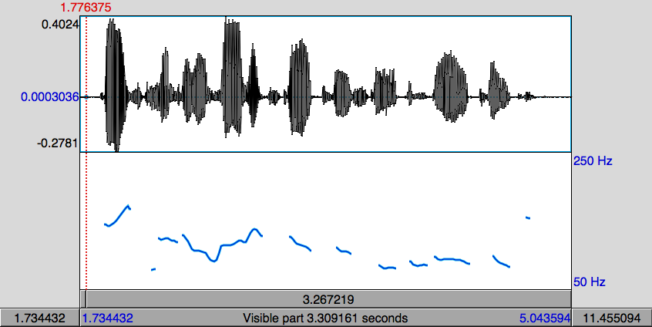
Pitch Contour Example
Pitch (fundamental frequency) is estimated by finding the length of the period of the speech signal.
If a cycle is missed, the period appears to be twice as long (pitch halving)
If an extra cycle is found, the period appears to be half as long (pitch doubling)
Notes:
And now, for completeness, here is a review slide on fundamental frequency and associated pitch contours, which, as we know from previous classes, have to deal with potential issues of pitch halving and pitch doubling. [play sound] Are there any questions so far about the new terms we just covered?

Slide 13
Tone Sequence Models
Intonation that’s generated from sequences of categorically different, phonologically distinctive tones
Basic unit of description: intonation phrase (tone unit, breath group)
Delimited by pauses, phrase-final lengthening, pitch
Syllables may be stressed or accented
Accent aligned with primary stress -- telephone
Indicated by F0, duration, intensity, voice quality
Notes:
Now that we have our basic prosodic term definitions in hand, we can start talking about different ways to represent prosody. Tone sequence models are one example of a prosodic representation framework. Under this framework, we think of and represent prosody or intonation as a sequence of phonologically distinctive tones, and a basic unit of the framework is an intonation phrase, as we just saw a couple of slides ago. Note that we can tell where a prosodic phrase begins and ends by paying attention to pauses, speech duration, and pitch changes; in other words, these are the acoustic correlates of a prosodic phrase. Tone Sequence models also represent prosodic emphasis by accounting for syllables that are stressed or accented. These also have acoustic correlates: pitch, duration, intensity, and voice quality are all indicators of where prosodic prominence falls in a word or utterance.
O’Connor and Arnold 1972:
Earliest textbook for English instruction that tells user which contour appropriate in which context

Slide 14
Types of Tone Sequence Models
Type 1: based on pitch movements
a
t
r
g
Type 2: based on pitch levels
e
t
H
The British School The Dutch School
a
t
r
g
L
e
t
The American School
Notes:
There are a couple of different types of tone sequence models out there. The British and Dutch Schools focus on capturing intonation via pitch movements, whereas the American School, which we’re mostly going to talk about today, focuses on capturing intonation via different pitch levels. So the former is interested in how pitch changes over a word, while the latter is interested in the different levels or heights of the pitch at different points in a word. We’ll illustrate the differences between the two types on the next slide…
[How is the pitch changing over a word vs. what level is the pitch of a word]

Slide 15

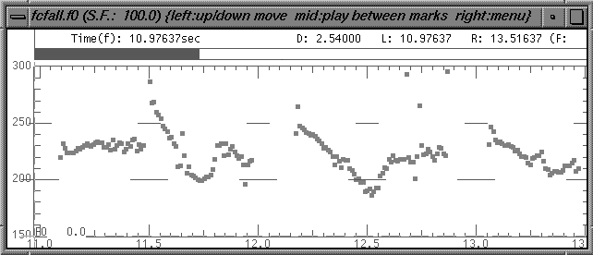
Types of Tone Sequence Models
and I think it’s HOrriblerrible
...a POINT where
you have to CLEAN it
There’s a point where you have to clean it and I think it’s horrible...
Notes:
So this example should help illustrate the key difference between the two different types of tone sequence models. [play sound] For the British or Dutch schools, the main points of relevance here would be these arrows indicating the movement or change in pitch throughout the utterance. Whereas for the American School, the absolute pitch levels indicated on the y-axis would be more relevant in representing and analyzing the prosody of this utterance.

Slide 16
The British School
Each accent defines the beginning of a prosodic constituent
Prenuclear accent unit
Nuclear accent unit
Prehead
‘Head’
‘Nucleus’
Stressed syllable
But
JOHN’s never BEEN to Jamaica
Received Pronunciation (RP)
Notes:
Let’s go into more detail on the two schools now. Under the British School, there are two types of prosodic accent unit: the prenuclear accent unit, which is also called the head, and the nuclear accent unit, which is also simply called the nucleus. The nuclear accent unit is the last accent unit in the intonational phrase, and the head comprises everything before that. In this example utterance, [read example], the word BEEN corresponds to the nucleus, because it is the final accent unit in the intonational phrase, and the other words before it correspond to the head or even the prehead. If you’re interested in further detail about how the British School represents intonation, you can check out the link on Received Pronunciation after class, which will take you to a really great 9 minute YouTube video on this.

Slide 17
Six nuclear choices in British English
m
a
a
a
i
c
J
c
i
a
a
a
J
m
falling
rising
m
a
a
a
i
i
J
c
a
a
c
J
m
a
rising-falling
falling-rising
i
a
i
m
a
c
a
c
a
a
a
J
J
m
a
Rising-falling-rising
level
Notes:
Since the British School is primarily interested in pitch movement, there are six typical kinds of movement in the nucleus that are studied under this framework. I’m going to try to produce a couple of these to illustrate.

Slide 18
The American School
American School Models make a distinction between accents and boundary tones
Auto-segmental metrical or two-tone model
Only two tones, which may be combined
H = high target
L = low target
Notes:
Let’s move on now to talking about the American School. This framework has now been applied to many languages including but not limited to English, mainly because this model is simpler than the British one, and we’ll see why that is. So under the American School, we make a distinction between accents, or what makes a particular word or syllable prominent, and boundary tones, or how a phrase ends. The American School Model is known as an auto-segmental metrical model or a two-tone model, because there are only two tones to keep track of, a high tone and a low tone, which can be combined in different ways.

Slide 19
Price, Ostendorf et al, late 1980s
Defined different types of prosodic phrases by the degree of juncture between words
Break indices from 0 to 8
0: no word boundary
1: word boundary
2: strong juncture with no tonal markings
3: intermediate phrase boundary
4: intonational phrase boundary
5,6,7: increasing length of phrase boundary
Notes:
When the American School Model started out, early work by Price and Ostendorf and colleagues began by defining different types of prosodic phrases based on the degree of juncture between words within the phrase. They came up with the concept of break indices, which ranged from 0, indicating words with no boundary in between them, all the way up to 8, indicating phrases with increasingly longer boundaries. I’m going to highlight break index 3, which corresponds to a boundary within a phrase, and break index 4, which corresponds to the boundary between phrases. We’ll mainly focus on 0 to 4 in the rest of class, and will circle back to some of these in a few slides time.

Slide 20
Pierrehumbert 1980
Contours = pitch accents, phrase accents, boundary tones
Pitch Accents*
Phrase Accents*
Boundary Tone
H* L*
L*+H L+H*
H*+L H+L*
L- H-
L% H%
Notes:
Around the same time as Price, Ostendorf, and colleagues, Janet Pierrehumbert had also come up with a way to bring together the concepts of phrases and accents, where she defined prosodic contours as being made up of pitch accents, phrase accents, and boundary tones. Pitch accents go on words within a phrase, phrase accents go at the end of a phrase, and there is a boundary tone at the end of the utterance. As you can see from the diagram here, there are only two types of accent in each category, but for pitch accents, these can be combined in multiple different ways.
[There can be multiple utterances produced by a speaker in a conversation.]

Slide 21
To(nes and )B(reak )I(ndices)
ToBI: Developed by prosody researchers in four meetings over 1991-94, plus several more to refine the system and address issues
Combining Pierrehumbert ‘80 and Price, Ostendorf, et al
Goals:
Devise a common labeling scheme for Standard American English that is robust and reliable
Promote the collection of large, prosodically labeled, shareable corpora
Notes:
These two early, foundational pieces of work came together and led to the system of Tones and Break Indices, or ToBI, which you all read about in this week’s readings. The primary goals of this framework of the American School were to devise a robust and reliable prosodic labelling scheme for Standard American English, that could then allow for the curation of large data sets that are labeled for prosody in a consistent way, making it easier to share data and compare work.

Slide 22
ToBI
Prosody is described by high (H) and low (L) tones that are associated with prosodic events (pitch accents, phrase accents, and boundary tones) and break indices which describe the degree of disjuncture between words.
ToBI is inherently categorical in its description of prosody
Notes:
Under the ToBI system, prosody is described using the now familiar concepts of high and low tones and break indices. Since these are made up of discrete kinds of tones and disjunctures, ToBI is inherently categorical in its description of prosody – putting prosodic items into distinct groups or categories

Slide 23
ToBI Pitch Accent Types in SAE
Words are accented or deaccented
5 pitch accent types (in Standard American English) are defined by target level
H* simple high (declarative)
L* simple low (ynq)
L*+H scooped, late rise (uncertainty/ incredulity)
L+H* early rise to stress (contrastive focus)
H+!H* fall onto stress (implied familiarity)
H*
L*
L*+H
L+H*
H+!H*
Notes:
Let’s now get a better sense of the different combinations of high and low tones that form pitch accents under ToBI. Note that words can be either accented or deaccented, and there are five pitch accent types in standard American English, which are defined by their pitch level. [play examples] We’ll start with high star, which is the kind of accent you’d expect to hear in a declarative sentence…
[L*+H and L_H* have joint audio clip
H+!H* is described on next slide]

Slide 24
Special Case: Downstepping
High tones can be produced in an increasingly compressed pitch range – catathesis, or “downstepping”
Downstepped accents:
!H*,
L+!H*,
L*+!H
Notes:
There is one special kind of prosodic contour that I want to highlight now, that’s known as downstepping. This is what happens when a high tone is produced in an increasingly compressed pitch range – I’ll play this example to illustrate one kind of prosodic downstepping. [play top sound] There are a few combinations of tones that encompass downstepping – I’ll play all of these examples, and hopefully you can hear the typical falling tone in at least one of them…[play remaining sounds] Any questions so far?

Slide 25
Minimal ToBI Transcription
Recording of speech
F0 contour
ToBI tiers:
Orthographic Tier: words
Break-index Tier: degrees of juncture (Price et al ‘89)
Tonal Tier: pitch accents, phrase accents, boundary tones (Pierrehumbert ‘80)
Miscellaneous Tier: disfluencies, laughter and other non-speech sounds, etc.
Notes:
Knowing what the different categories of tones are, if we now want to produce a prosodic transcription using ToBI and the different accents we just saw, we first need a speech recording. From that, we need to extract the fundamental frequency or pitch contour, and then we can label the different aspects that are relevant to ToBI -- from the orthographic tier where we label words and the break index tier where we label degrees of disjuncture between those words, to the tonal tier where we label high and low tones for pitch accents, phrase accents, and boundary tones. We can also label a miscellaneous tier for completeness, and mark disfluencies and non-speech sounds in it.

Slide 26
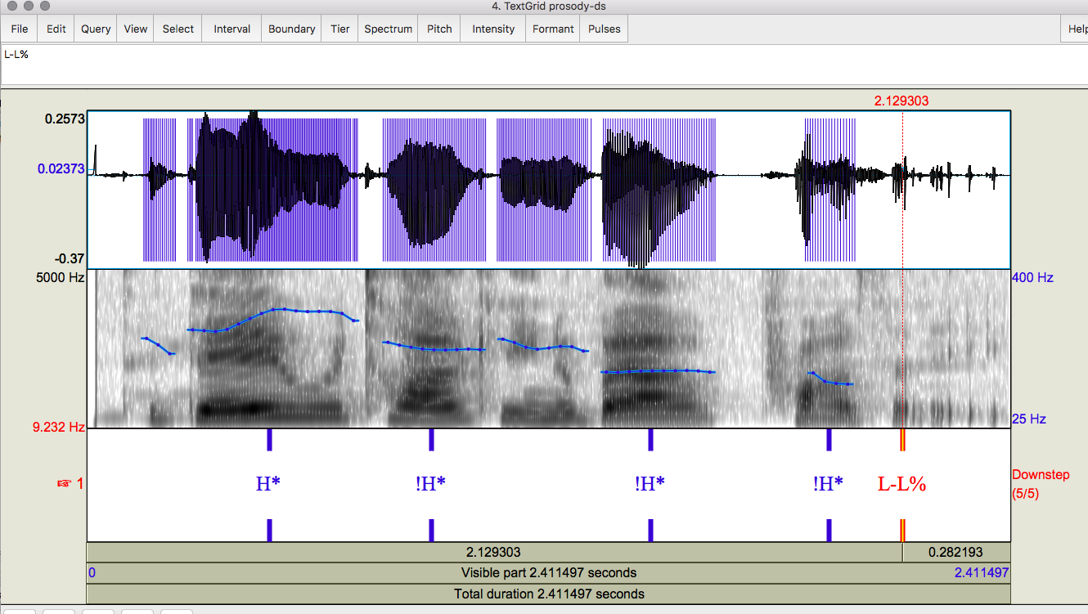
Minimal ToBI Transcription
Notes:
Here is an example transcription done in the minimal style that I just described using Praat [play sound] – you can see the different pitch accent labels and a phrase and boundary tone label at the end of the utterance. We’ll start seeing what a complete or maximal ToBI annotation of an utterance looks like over the next few slides.

Slide 27
Prosodic Phrasing in ToBI
‘Levels’of phrasing:
Intermediate phrase: 1+ pitch accent & a phrase accent, H- or L-
“marmalade H-”
“I” L-
Intonational phrase: 1+ intermediate phrase & boundary tone, H% or L%
Amelia H-H%
Amelia L-L%
Notes:
Now let discuss more details of how complete prosodic annotation works with ToBI, starting with the levels of prosodic phrasing, which we didn’t see on the minimally transcribed example. Combining the pitch accents and phrase accents we’ve already seen, you can have slightly more complex intermediate phrases involving one or more pitch accents plus a phrase accent, and these can either be high, as you’ll notice on the word marmalade in this example [play example]… or you can have a low tone intermediate phrase as in this example with respect to the word I [play example]. Another more complex combination of concepts we’ve already seen is an intonational phrase, which involves one or more intermediate phrases plus a boundary tone, which can also either be high or low as in these examples [play examples]

Slide 28
Phrase Endings from Natural Speech in ToBI
Intermediate Phrase boundaries have associated Phrase Accents describing the pitch movement from the last accent to the phrase boundary
Phrase Accents: H-, !H- or L-
Intonational phrase boundaries have Boundary Tones describing the pitch movement immediately before the boundary
Boundary Tones: H% or L%
L-L%
L-H%
H-H%
H-L%
!H-L%
Notes:
I’m going to play some more examples of intermediate phrases and intonational phrases, and hopefully you’ll be able to hear the different phrase accents associated with intermediate phrases and the boundary tones associated with intonational phrases. [play sounds]

Slide 29
Break Indices in ToBI
Word boundaries are marked with a degree of disjuncture, or break index
Break indices range from 0-4
0: no boundary
1: a word boundary
2: between a word and a phrase boundary
3: intermediate phrase boundary
4: intonational phrase boundary
Notes:
Another aspect of ToBI that we’ve talked about but didn’t see on the minimally transcribed example is break indices, or the boundaries between words or phrases. This is pretty much the same as the original version we saw from Price and Ostendorf and colleagues, but now only focuses on the break indices from 0 to 4. 0 represents the lack of a boundary, for example in a contraction like ”it’s” or “didja”, 1 represents a typical boundary between words, 2 is somewhere in between a word and a phrase boundary, which is pretty hard to distinguish from 1 and 3, 3 corresponds to an intermediate phrase, and 4 to a intonational phrase, both of which we now know about.

Slide 30
L-L%
L-H%
H-L%
H-H%
H*
L*
L*+H
Notes:
Here are some summaries of pitch accent, phrase and boundaries tones together:
Left column = pitch accent
Top row = phrase accent and boundary tone

Slide 31
L-L%
L-H%
H-L%
H-H%
L+H*
H+!H*
H* !H*
Notes:
And more.
You can try producing the rest of these yourselves after class.

Slide 32
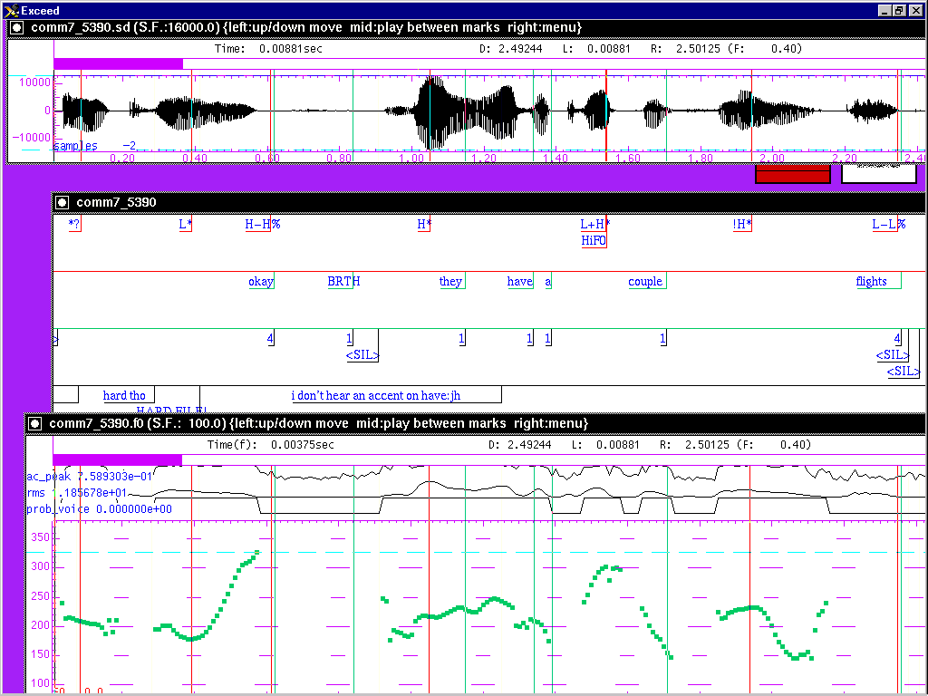
Sample ToBI Labeling

Slide 33
Sample ToBI Labeling
Notes:
So now, we can look at this fully transcribed example with all tiers: word boundaries in the orthographic tier, break indices in the break index tier below it, and intermediate phrase breaks and boundary tones in the tonal tier at the top. Let’s listen to what this sounds like and match it up with what we see in the transcription [play sound]

Slide 34
ToBI Example (in Praat)
Notes:
And here is another example, this time transcribed using Praat, but showing all the same labeling tiers. [play sound]

Slide 35
ToBI Evaluation
Good inter-labeler reliability for expert and naive labelers
88% agreement on presence/absence of tonal category, 81% agreement on category label, 91% agreement on break indices to within 1 level (Silverman et al. ‘92,Pitrelli et al ‘94)
ToBI Lite and other simpler schemes created for English (e.g. Yoon et al 2004)
E.g. Binary classification of 2 pitch accents (L*, H*) phrase accents (H-, L-) and boundary tones (H%, L%)
Agreement on presence or absence and choice of
pitch accents, 86.57%, phrase accents 85.63%, boundary tones 89.33%
Notes:
Once we produce transcriptions like the ones we just saw, we need to be able to evaluate whether they are valid and reliable. To do this, you need multiple people to produce labels for the same data, and then you can compare all the sets of labels, and compute inter-labeler or inter-annotator agreement. If you have high agreement between all the different annotators, you can infer that you have reliable labels. In the past, people have studied how reliable ToBI annotations are when they are produced by expert and non-expert labelers, basically to get a sense of how good people are at applying the ToBI system and how easy it is for them to do so consistently, and they’ve found that generally it is easier to produce valid break index labels compared to the other ToBI aspects, but overall, these agreements are still very high. This points to the ease with which the ToBI system can be applied in manual transcription. To make this easier, some authors have since developed ToBI Lite, which is an even simpler version of the original ToBI scheme, and shows comparable to higher inter-annotator agreement on a given dataset.

Slide 36
ToBI Conventions for English
Hirschberg and Beckman
Carnegie Mellon
Beckman and Elam
Notes:
There are many resources available online if anyone is interested in further details about ToBI conventions in English, including some work by me and colleagues. So definitely check these links out after class for more information. And, if you’re curious about whether ToBI can be applied to other languages…

Slide 37
ToBI Conventions in Many Languages
Mandarin, Taiwanese, Cantonese
Korean
Japanese
Spanish (many)
Catalan
Basque
Portuguese
Greek
Australian, British, Glasgow English
Serbian
Slovak
Italian (many)
Chicasaw
Bengali
Dutch
German (many)
Notes:
Conventions have been developed for many other languages and even dialects of some languages of the world, so feel free to explore these if you find prosody is especially interesting.

Slide 38
AuToBI (Rosenberg 2010)
Automatic ToBI labels for multiple languages:
https://github.com/AndrewRosenberg/AuToBI
Rosenberg TED Talk video on “talking”
Identifies pitch accents and boundaries with high accuracy using many acoustic-prosodic features
Input:
Time-aligned word boundaries (human or automatic)
TextGrid, CPROM, BURNC forced alignment (.ala) for text
Wav file
Previously trained AuToBI models (available from AuToBI website)
Notes:
Having seen how fine grained ToBI labels are and how detailed a short transcription can be, you might be wondering about how time- and labour- intensive producing ToBI labels is, and whether that is practical for working with large speech corpora. You would be on the right track, because Andrew Rosenberg, who is a PhD graduate of the Columbia Speech Lab, worked to address that exact issue by developing AuToBI, which is a system for generating accurate, automatic ToBI labels for multiple languages based on the expression of many acoustic-prosodic features, given inputs of time-aligned word boundaries as in a Praat TextGrid and an audio wav file. AuToBI is built using Java and open sourced and you can check that out at the GitHub link here. I also highly recommend checking out Rosenberg’s 15 minute TED Talk on how speech is about more than just the words we say. And he’ll be giving another talk in one of our classes.

Slide 39
AuToBI (Rosenberg 2010)
Output:
Hypothesized ToBI tones (with confidence scores) and break indices
Praat TextGrid format
Languages employed to date by us and many others
Developed for English and adapted for Mandarin, German, Italian, Portuguese and French, with small amounts of labeled data
“Extending AuToBI to Prominence Detection in European Portuguese” H. Moniz, A. I. Mata, J. Hirschberg, F. Batista, A. Rosenberg and I. Trancoso. Speech Prosody 2014, Dublin, Ireland.
A. Rosenberg, E. Cooper, R. Levitan, and J. Hirschberg, “Cross-language prominence detection,” in Proc. Of Speech Prosody, Shanghai, China, 2012.
V. Soto, E. Cooper, A. Rosenberg, and J. Hirschberg, “Cross-language phrase boundary detection,” in Proc. Of ICASSP, Vancouver, Canada, 2013.
Notes:
AuToBI has been very influential and important in the study of prosody, and has been used and further developed to work on other languages apart from English by members of the Columbia Speech Lab and many others all over the world.

Slide 40
AuToBI Command Line Example
java –jar AuToBI.jar \
-text_grid_file=in.TextGrid \
-wav_file=in.wav \
-out_file=out.TextGrid \
-pitch_accent_detector=accent.model \
-pitch_accent_classifier=pa_type.model \
-intonational_phrase_detector=ip.model \
-intermediate_phrase_detector=interp.model \
-phrase_accent_classifier=phraseac.model \
-boundary_tone_classifier=bt.model
Notes:
TODO fix command line example

Slide 41
AuToBI Schematic
Audio (wav)
Normalization Parameters
Segmentation (TextGrid)
ToBI Annotation Specific Feature Extraction
ToBI Annotation Specific Classifier
Hypothesized Prosodic Events
Evaluation
Notes:
At a very high level, here is an overview of how AuToBI works: you provide inputs of wav files and time-aligned word boundaries, for instance in the form of a Praat TextGrid, and feed those into a pre-trained AuToBI model, and which then produces outputs of ToBI tone labels in a Praat TextGrid format.
[Normalization parameters are for speaker normalization based on set of wav files from given speaker
Feeds these with wav file and segmentation textgrid to feature extraction module which feed these to the pre-trained model to
Identify ToBI features for the new data
Textgrids from previously trained models provide textgrid information for identification and evaluation]

Slide 42
AuToBI Performance
Cross-Corpus Performance: BURNC → CGC
Task | Accuracy
Pitch Accent Detection | 73.5%
Pitch Accent Classification | 69.78%
Intonational Phrase Boundary Detection | 90.8% (0.812 F1)
Phrase Accent/Boundary Tones Classif. | 35.34%
Intermediate Phrase Boundary Detection | 86.33% (0.181 F1)
Phrase Accent Classification | 62.21%
Notes:
In terms of the performance of AuToBI when trained on the Boston University Radio News Corpus and then tested on the Columbia Games Corpus, on the task of detection, or in other words “is this tone X or not?” the model is comparable to human performance, and on the task of classification, i.e. “what kind of tone is this?”, AuToBI models far exceed what humans can do. So overall, its performance is very good and shows that the system is a desirable alternative to human manual annotation.
[Trained on BURNC and then tested on Columbia Games Corpus
Detection: is this an X or not?
Classification: what type of X is it]

Slide 43
Available ToBI Labeled Corpora
Boston University Radio News Corpus
Available from LDC
6 speakers (3M, 3F)
Professional news readers (broadcast news)
Reading the same news stories
Boston Directions Corpus
Available from ELRA (European Language Resources Association)
Read and spontaneous speech
4 non-professional speakers (3M, 1F)
Speakers perform a direction-giving task (spontaneous)
~2 weeks later, speakers read a transcript of their speech with disfluencies removed.
Notes:
Speaking of annotated data, there are several corpora that have been labeled with ToBI annotations that are commonly used in prosody research, including the Boston Radio corpus I just mentioned, the Boston Directions Corpus, the Columbia Games corpus, which I also just mentioned, and the Switchboard Corpus, among others. The links on this slide and the next will take you to where these corpora are available and show more detailed information about how they were collected.
https://groups.inf.ed.ac.uk/switchboard/prosody_annotation.pdf
https://groups.inf.ed.ac.uk/switchboard/ostendorfetal01.pdf
BDC link is to the 2007 “Intonational overload: Uses of the Downstepped (H* !H* L- L%) contour in read and spontaneous speech
Julia Hirschberg, Agustín Gravano, Ani Nenkova, Elisa Sneed and Gregory Ward

Slide 44
Available ToBI Labeled Corpora
Columbia Games Corpus
13 subjects (6 female, 7 male), each having 2 conversations with different partners
10h of speech, averaging 45m per dialogue
Manually transcribed and aligned
Annotated also for affirmative cue words, turn-taking
Switchboard Corpus (SWBD-1 Release 2 of many)
Available from LDC: Spontaneous phone conversations on different topics
543 U.S. speakers from different regions (302 male, 241 female) recorded in early 1990s
2400 conversations on 70 topics
Subset annotated with ToBI labels and other NXT features (Next Generation Technologies)
Notes:
So if you are interested in seeing what real world data that has been annotated with ToBI labels looks like, you can check out any or all of these options. And, you’ll be seeing more of the Switchboard corpus later in the course for homework 2, so that’s something to look forward to.
Link to information on the CGC
Link to LDC info on SWBD corpus

Slide 45
Current Work on SWDA Corpus
Switchboard Dialog Act Corpus is a portion (1155 conversations) of the original Switchboard Corpus
Transcribed
Aligned using old ASR methods which did not work well
43 DAs annotated
Much other work on annotation but no human alignment correction which is what we have now
Our new version is RASwDA (Re-Aligned Switchboard Dialog Act Corpus) which we plan to make publicly available

Slide 46
ASCCD-Annotated Speech Corpus of Chinese Discourse
Created by the Institute of Linguistics Chinese Academy of Social Sciences
ASCCD includes
A text corpus
wav data
Labeling information
Useful for research in speech and language, the development of speech software and the foundational teaching of Mandarin
Notes:
All the datasets I just mentioned consist of English speech and corresponding ToBI labels, but there are also similarly labeled corpora in other languages, such as this one in Mandarin. [read slide]

Slide 47
C-ToBI Labels for Mandarin
Pinyin tier with tones
Syllable initial labels tier
Tone and intonation tier
Break index tier (0-4)
Stress index tier (1-4): @ indicates contrastive stress
Sentence function tier: interrogative, imperative, declarative, exclamation
Regional accent tier for dialect/accent
Turn-taking tier: start and end of each tier
Miscellaneous tier: paralinguistics (e.g. laughter)
Notes:
This corpus was prosodically labeled using ToBI conventions that were specifically adapted for Mandarin and involve some additions and changes to what we have seen so far for English.

Slide 48
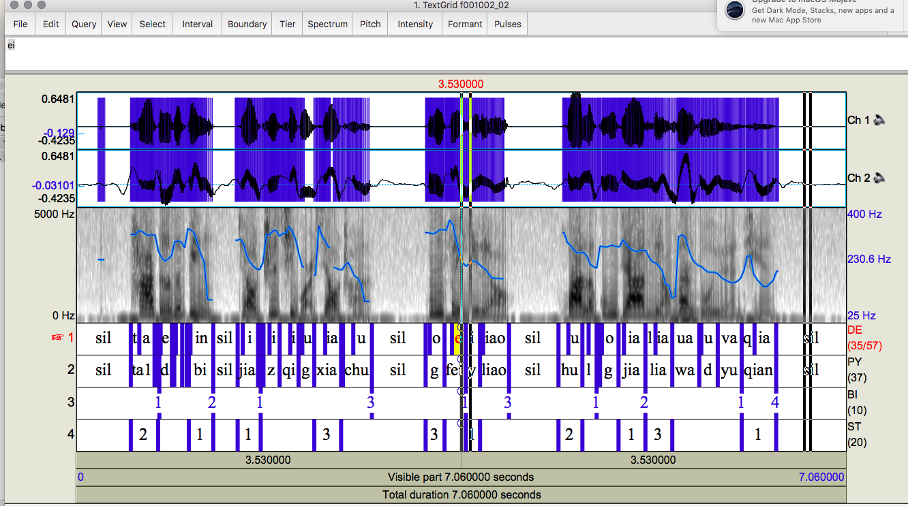
C-ToBI Corpora
Notes:
Here is an example of a prosodically labeled utterance from that corpus. [play sound] What are some of the differences you notice between this transcription and the English ones we saw previously?
[From the ASCCD (Annotated Speech Corpus of Chinese Discourse): label tiers seem to include phones on tier DE
We also acquired another corpus, the COSPRO corpus of Taiwanese Chinese]

Slide 49
Other Prosodic Models
Developed for database retrieval, phonological analysis and text-to-speech synthesis
How can we extract information from large speech corpora that go beyond pitch, intensity, speaking rate?
How can we analyze the way subjects convey different kinds of information?
How can we generate synthetic speech that sounds like a human being?
Notes:
That brings us to the end of our discussion on ToBI and its derivatives… I’m now going to briefly touch on some other approaches and models of the study of prosody that have posed slightly different motivating questions from the ones we saw at the beginning of today’s class, and are different from the ones that the ToBI system specifically addressed. For instance, how do we approach representing and studying prosody if we want to consider features other than the broad categories of pitch, intensity, and speaking rate? And how do we analyze prosodic variation or generate prosodically authentic machine speech?

Slide 50
Other Prosodic Models
Generation or Event Detection
ToBI: event detection and TTS
Fujisaki model: Japanese TTS
TILT: developed for Festvox TTS
Tonal Center of Gravity: developed for linguistic analysis
Quantized Contour Modeling: Pitch Accent Detection (Rosenberg)
And many more…
Notes:
Here is a quick overview of some other prosodic models that have been developed for research and for applications in text-to-speech synthesis. I’ll briefly mention a couple of things about each one now, and if you are interested in learning more about any of these, you can follow the links in the slides after class. I’ll start with a high-level picture of the Fujisaki model, then go into the TILT and Tonal Center of Gravity models, and finish up with an overview of Quantized Contour Modeling.

Slide 51
Fujisaki’s Superpositional Models
Pitch pattern of intonation modeled with two components: phrase component and accent component.
Phrase has basic shape, and pitch movements for individual accents are superimposed over basic shape:
plus
=
Apples, oranges and tomatoes
Notes:
Fujisaki’s model of prosody focused on the idea of superposition, which was operationalized as a phrase having a basic pitch shape, with individual accents getting superimposed over that basic shape to produce an overall more complex contour, similar to the way we saw that sound waves are made up of multiple smaller periodic waves added to each other. If you’re interested in how this is different from other sequential models, you can check out the slides after class – there’s a slide that I won’t be presenting in the deck that goes into much more detail on this.
Coming back to this model, it was developed specifically for speech generation purposes for Japanese, which has little variation in accent type, and has been found to work especially well at modeling utterance level prosodic trends.
[Hiroshi Fujisaki and TTS]

Slide 52
Fujisaki Model
Superpositional view of intonation Fujisaki & Hirose 1982
Prosody is described by a phrase command which is modified by accent commands.
In the Fujisaki model, this is an additive process in log Hz space.

Slide 53
Fujisaki model

Slide 54
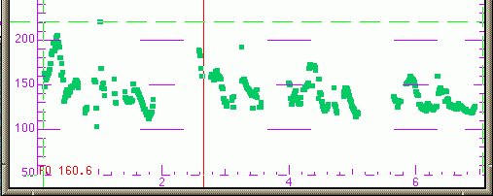
Useful for Modeling Utterance-level Trends
Declination: downtrend in f0 over the course of an utterance
Successful in speech synthesis for languages like Japanese (little variation in accent type, e.g.)
Lily and Rosa thought this was divine.
Prince William was gorgeous
and he was looking for a bride.
They dreamed of wedding bells.

Slide 55
Superpositional vs. Sequential
Superpositional models require identification of an overall phrase signal
Sequential models describe one prosodic event – phrasing or prominence – at a time
Similarities
Both describe phrasing and accenting
If the phrasal context can be accommodated by a sequential model, there are no analytical reasons to do otherwise
Differences
Categorical vs. continuous accent types
Superpositional model is tightly coupled with pitch

Slide 56
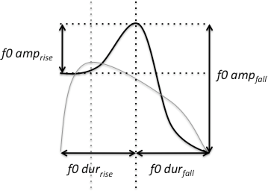
FestTILT Model
Describes an F0 excursion based as a single parameter (Taylor 1998)
Compact representation: TILT parameters allow generation/db retrieval
Notes:
Moving on now to the TILT model, this approach makes use of and describes prosody through changes in only a single parameter, which is different from what we’ve seen so far. This has been found to work well for modeling and synthesizing statements, questions, and even conveying sentiment or affect in synthesized speech.
Tilt=+1 all rise
Tilt= -1 all fall
In betw, some of each

Slide 57
Festvox TILT Model
Basic unit: the intonational event which changes TTS over time
Types are pitch accents and boundary tones which provide continuously varying shapes in terms of pitch, amplitude and duration
Useful for modeling:
Questions
Statements
Even moods
Notes:
Tilt=+1 all rise
Tilt= -1 all fall
In btw, some of each
The basic unit in the tilt model is the intonational event. Events occur as instants with nothing between them, as opposed to segmental based phenomena where units occur in a contiguous sequence. The basic types of intonational event are pitch accents and (following the popular terminology) boundary tones. Pitch accents (denoted by the letter a) are F0 excursions associated with syllables which are used by the speaker to give some degree of emphasis to a particular word or syllable. In the tilt model, boundary tones (b) are rising F0 excursions which occur at the edges of intonational phrases and as well as giving the hearer a cue as to the end of the phrase, can also signal effects such as continuation and questioning. A combination event ab occurs when a pitch accent and boundary tone occur so close to one another that only a single pitch movement is observed. There are different kinds of pitch accents and boundary tones: the choice of pitch accent and boundary tone allows the speaker to produce different global intonational tunes which can indicate questions, statements, moods etc to the hearer.

Slide 58
Tonal Center of Gravity (ToG)
Measures the distribution of the area under the F0 curve within a region
Perceptually robust
Better classification of pitch accent types than peak timing measures (Veilleux et al. 2009, Barnes et al. 2010)
Notes:
The Tonal Center of Gravity Model zooms in on a particular aspect of prosody modeling and offers a better way of classifying pitch accent types compared to the approaches we’ve seen so far. It does so by studying the distribution of the area under a fundamental frequency curve within a particular utterance or speech segment. It computes a weighted avg of different tones over a time period to identify different types of pitch accents.
X is F0, t is time

Slide 59
Quantized Contour Modeling
A Bayesian approach to simultaneously modeling contour shape and classifying prosodic events (Rosenberg 2010)
Specify a number of time (M) and value (N) bins
Represent a contour as an M dimensional vector where each entry can take one of N values.
For extension to higher dimensions, allow values to be even more multidimensional vectors
Notes:
And quantized contour modeling is another example of work done by Rosenberg, which applied Bayesian modeling to prosodic contours and classification. Again, I won’t be going over any of these alternative prosodic modeling frameworks in detail, but if you’d like to learn more or get a handle on the math behind some of them, you can follow up on the slides after class.

Slide 60
Weizmann Institute Prosody Quantification Project (Tirza Biron et al)
An integrative theory for prosody analysis combining:
Para-syntactic Prototype: dialogue act
Discourse functions: e.g. rhetorical question, parenthetical phrase
Information structure: e.g. marking focus
Attitude/sentiment
Here’s an example…
Notes:
Finally, I’m going to highlight the Weizmann Institute Prosody Quantification Project. The goal of this project was to find a way to integrate the study of prosody with other aspects of dialogue that all come together to inform the production and comprehension of the meaning of speech. These other aspects include factors like discourse functions and dialogue acts and convey information about the speaker’s intention in a particular utterance, and the sentiment or affect of utterances. Let’s look at an example of this…

Slide 61

[If you’re poorly educated,] Why shouldn’t you steal/shoot/go to prison
Three segments
Para-syntactic Prototype: Wh-question
Discourse function I: Rhetorical question
Discourse function II: Item in a list
Discourse function III: Apodosis (the clause “Why shouldn’t you…”) expressing the consequence of a conditional sentence – “If you’re poorly educated”
Information structure: marked focus on shouldn’t
Attitude/sentiment: Insistent reprimand
Notes:
This example represents 3 different possibilities of a conditional utterance with different verbs (steal, shoot, go to prison). Let’s listen to what these sound like: [play sound] .Across all the possibilities, the relevant dialogue act is a wh-question. In the first case, this serves the discourse function of posing a rhetorical question to which you don’t actually expect an answer, and whose prosody is slightly different from the second option, which serves the purpose of stating a list, which is again different in prosody from the third option whose discourse function is apodosis (Apodosis (linguistics), the main clause in a conditional sentence, expressing the logical consequent). [play sound again to emphasize] Across all three possibilities, there is a common prosodic focus on shouldn’t, which aligns with the information structure of the utterance, and all three have the attitude of an insistent reprimand. So this example overall should give you a sense of how prosody interacts with many other aspects of speech production to produce meaning.

Slide 62
“[If you’re poorly educated,] Why shouldn’t you steal?”
Para-syntactic prototype
WH question
Discourse functions
Rhetorical; list; apodosis
Information structure
Contrastive shouldn’t
Sentiment/Attitude
Insistent reprimand
Notes:
These are the elements identified with this utterance

Slide 63
More Recent Prosodic Contour Modeling
Prosodic cue use for identifying interrogative and declarative structures with wide and narrow focus in individuals with and without aphasia. Schneider K, Tuomainen O, Wartenburger I and Hanne S (2025)
Prosody enhances learning of statistical dependencies from continuous speech streams in adults. Soila Kuuluvainen et al (2025)
Do newborns detect prosodic violations in an unfamiliar language at birth? Caterian Marino et al (2025)
Prosodic variation in negative and positive polarity questions in English. Johannes Heim, Judith Schlenter, Sophie Repp (2025)
Disentanglement of prosodic meaning: Toward a framework for the analysis of nonverbal information in speech. Biron et al (2025)
The time course of speech act recognition conveyed by speech prosody: a gating study. Caterina Villani et al (2025)
Sung Speech Training Improves Prosodic Focus Marking in a Nondominant Language in Children With Autism Spectrum Disorder. Yixin Zhang et al (2025)
Notes:
That brings us almost to the end of our discussion which began with ToBI and its derivatives. I just gave you some alternatives to ToBI that exist, but there is much more information available online and in the hidden slides of this deck that you can look into if you are interested… In general, there continues to be a lot of research in this area of speech processing, as you can tell from just this sample of papers published recently. Definitely check these out if you want to know more about how some of the methods we covered today are applied and extended in real world research scenarios.

Slide 64
Is Pitch Contour Sufficient to Encode Prosody in Neural Text-to-Speech? (Peiró-Lilja and Farrüs 2024)
Which prosodic features matter most for pragmatics? (Ward et al 2024)
An automatic prosodic transcriber for the P-ToBI system (Elvira-Garcia et al, 2024)
PE-Wav2vec: A Prosody-Enhanced Speech Model for Self-Supervised Prosody Learning in TTS (Liu et al 2024)
Establishing the domain of intonation patterns: syllabic nuclei vs syllabic rimes (Svatosova and Volin 2024)
Explicit Prosody Control to Realize Discourse Focus in End-to-End Text-to-Speech (Wada et al 2024)
RMT: Rhythm and Melody Tools for Prosody Computation (Gibbon 2024)
The Role of Different Intonation Contours in Social Perception (Gocsal et al 2024)
The role of prosody in therapists’ speech: A scoping review (Klapprott et al 2024)

Slide 65
Variety of Methods for Modeling Intonation
All these models can be used to identify or produce some forms of intonational variation in speech in different languages
However, the ToBI model has been used most widely for many languages and is often modified to represent that language more correctly
Also: a useful way to learn about native intonation for language learning!
Notes:
So, what have we covered today? We’ve seen that there are a variety of methods for modeling prosody and intonation in speech, which can be used to represent differences in how people produce speech, which in turn influence how we interpret that speech. We primarily focused on the ToBI system and discussed English, but both ToBI and many of the other approaches that I briefly touched on at the end can be applied to multiple other languages.

Slide 66
Why are Prosodic Models Important?
Improve Text-to-Speech Synthesis: build TTS systems that sound more like humans
Improve Automatic Speech Recognition (ASR) and understanding: what people convey is more than just the words they say
Dialogue modeling on both sides, understanding and producing
Machine translation: translate what the speaker means to convey, not just the words they produce
Notes:
And in terms of why we spent today’s class discussing prosody and how to measure it, I want to finish up by highlighting that an understanding of prosody and the methods needed to represent and model it are essential for a number of spoken language applications, ranging from TTS systems that are able to generate human-like prosody, to improving ASR and machine translation methods that are attuned to differences in prosody that impact meaning, and more general dialogue modeling and understanding applications too. We’ll learn more about some of these application areas over the rest of the semester.

Slide 67
Next Class
Topic: Text-to-Speech Synthesis (Andrew Rosenberg)
HW1 due by 4:10pm on February 24
Please remember to confirm your attendance today with our TAs
Any questions?
Notes:
Next week, we’ll have a guest lecture by Andrew Rosenberg, so if you have any remaining questions about the details of AuToBI, you can ask him in person then! Remember that HW 1 is due before the start of class next week, and don’t forget to sign in for attendance. Since we have had some issues with Courseworks retaining attendance records, please let us know if you were here last week too.

