Slide 1
Superstore Sales Analytics
Prepared By:KAVYA DIXIT
Tools:Python,Pandas,SQL Server,Matplotlib,Seaborn

Slide 2
Dataset Overview
✓ Data Cleaning Performed
✓ Duplicate Records Removed
✓ Data Types Validated
✓ Missing Values Checked
Source : Superstore Sales Dataset
Period : 2019 – 2022
Records : 9,993 Transactions
Regions : 4
States : 49
Categories : 3
Sub-Categories : 17
Coloumns used-:
Order Date
Sales
Profit
Discount
Region
State
City
Category
Sub-Category
Segment
Ship Mode

Slide 3
KPI Summary
Total Sales
$2.30 Million
The company generated $2.30M in sales during the analysis period.
Overall profit reached $286.8K, indicating positive business performance.
Nearly 10,000 customer orders were processed across multiple regions and product categories.
Total Profit
$286.8 Thousand
Total Orders
9,977

Slide 4
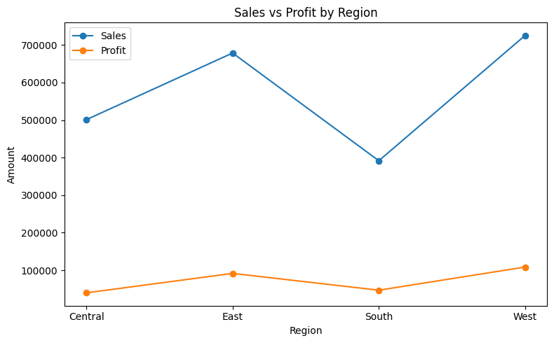
Regional Sales & Profit Performance
Key Insights
West region generates the highest sales and profit.
Central region shows lower profitability relative to sales.
South contributes the least to overall revenue.

Slide 5
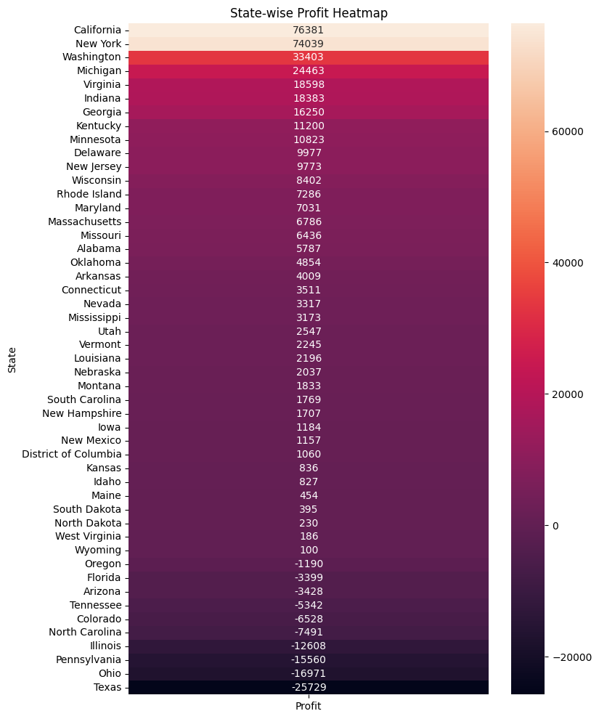
Geographic Performance Analysis
Top Profit State
California → $76.4K
2nd Highest Profit
New York → $74.0K
Highest Loss State
Texas → -$25.7K
Key Insights:
• California and New York are the primary profit engines.
• Profitability is concentrated in a few states.
• Texas, Ohio and Pennsylvania require immediate attention.
• Large regional performance gaps exist across the business.

Slide 6
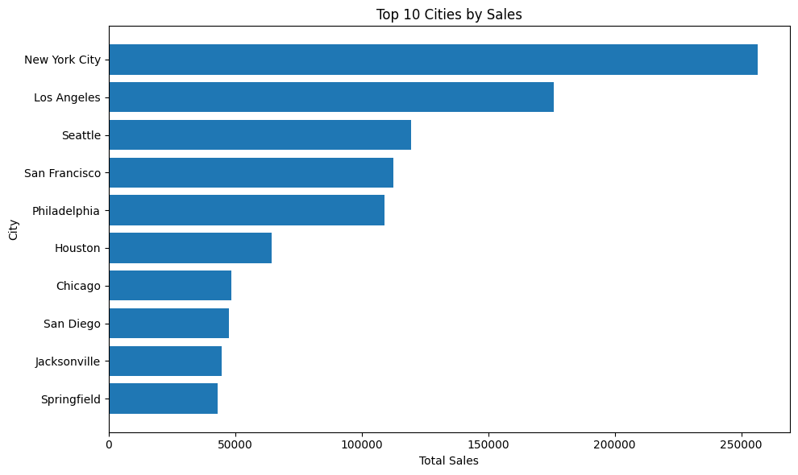
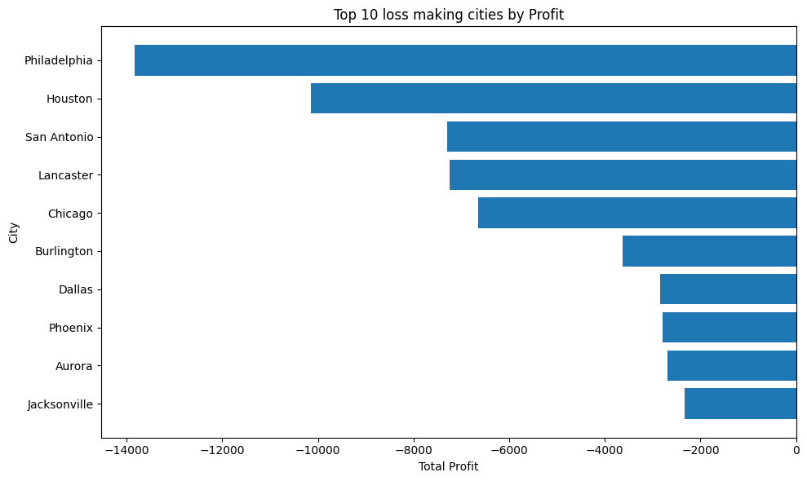
City Performance Analysis
New York City and Los Angeles are the largest revenue-driving markets.
Sales are concentrated in a small number of major urban centers.
Several cities generate negative profit despite contributing sales volume.
Loss-making cities require review of pricing, discounting, and operational efficiency.

Slide 7
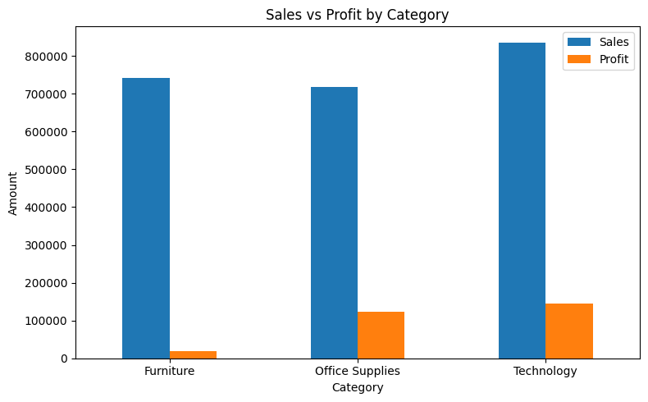
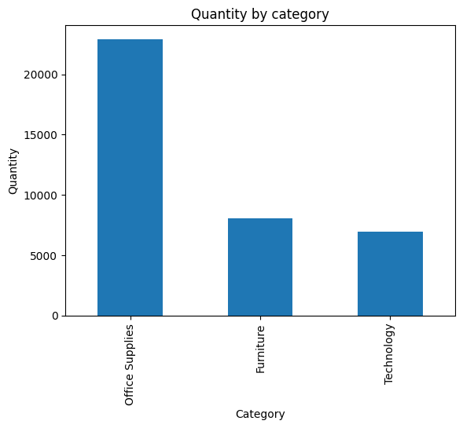
Category Analysis
Highest Sales Category
Technology
Highest Profit Category
Technology
Highest Quantity Sold
Office Supplies
Technology drives profitability, Office Supplies drive volume, while Furniture requires margin improvement.

Slide 8
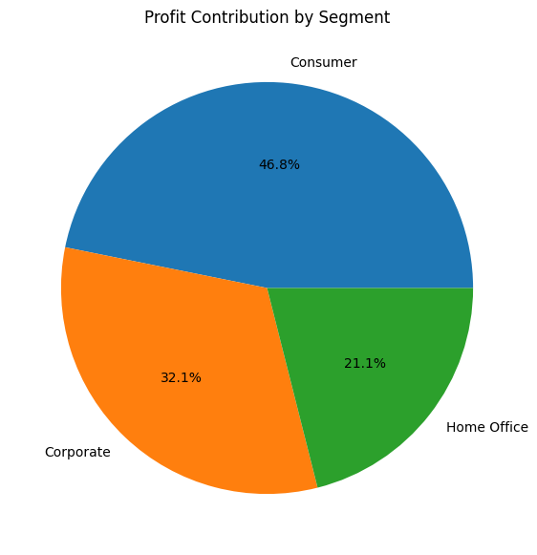
Customer Segment Analysis
👥 Consumer segment contributes the largest share of total profit, making it the company's most valuable customer segment.
💰 Corporate customers represent a significant profit source and provide a stable secondary revenue stream.
📉 Home Office contributes the smallest share of profit, indicating relatively lower market penetration.
🎯 Business growth initiatives should prioritize Consumer and Corporate customers, as they generate the majority of profits.

Slide 9
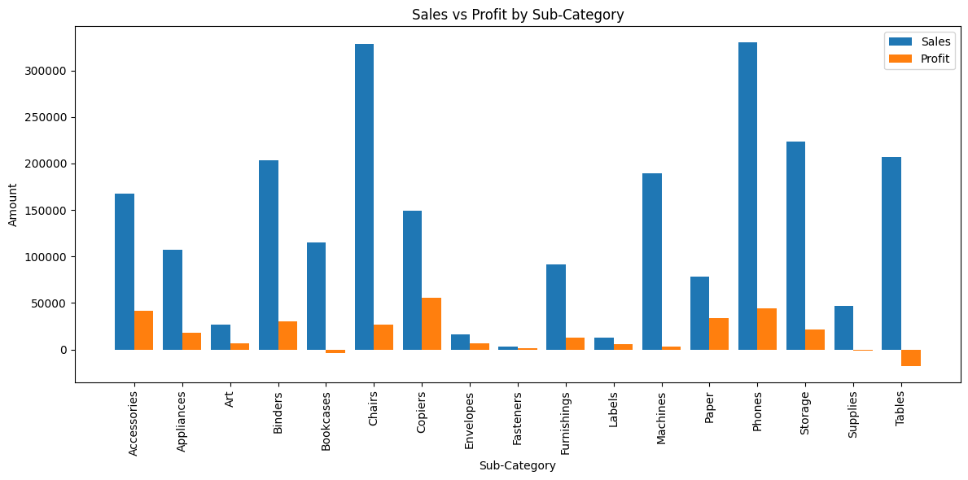
Sub-Category Performance Analysis
Phones generated the highest sales ($330K), making them the primary revenue driver.
Copiers delivered the highest profit ($55.6K), demonstrating strong profitability.
Tables recorded a loss of $17.3K despite generating over $206K in sales.
The performance gap across sub-categories highlights the need to focus on both sales and profitability.

Slide 10
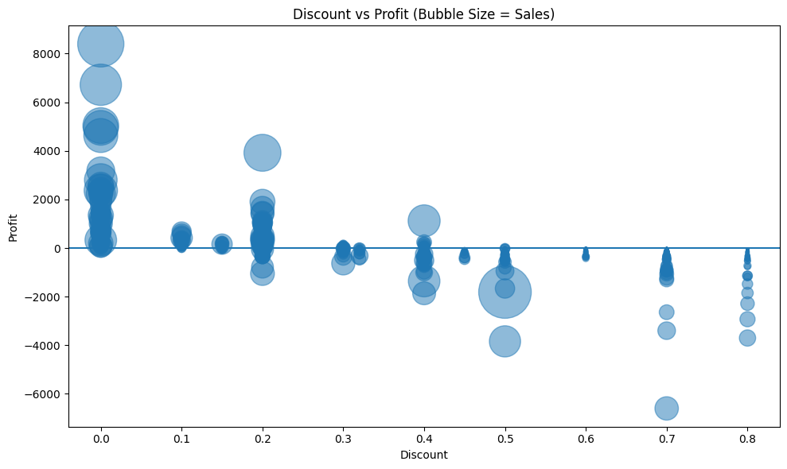
Discount & Profitability Analysis
Higher discount levels are generally associated with lower profitability.
Several products become unprofitable when excessive discounts are applied.
Revenue growth through discounting does not always translate into profit growth.
Optimizing discount policies can improve overall business profitability.

Slide 11
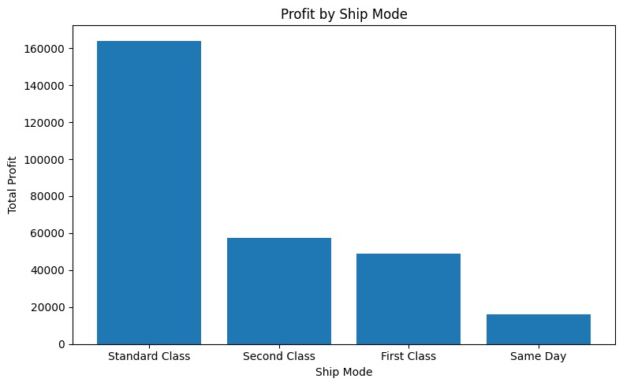
Shipping Analysis
Standard Class is the most preferred shipping mode among customers.
Standard Class also contributes the highest overall profit.
Faster shipping modes are used less frequently compared to standard delivery.
Customer preference indicates a stronger focus on cost-effective shipping rather than speed.
Standard Class remains the dominant shipping option, balancing customer preference and profitability.

Slide 12
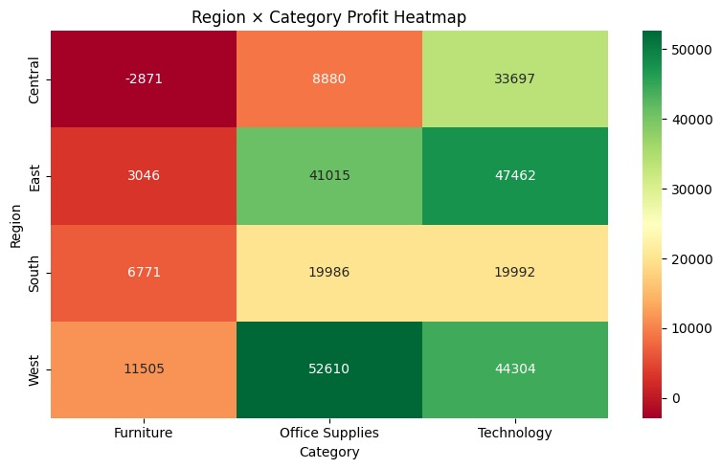
Region × Category Profit Heatmap
Technology generates strong profits across most regions.
Furniture profitability varies significantly by region.
Certain region-category combinations underperform despite generating sales.
Profitability opportunities exist by optimizing category focus within specific regions.

Slide 13
Business Recommendations
Reduce discounts on loss-making products such as Tables.
Increase focus on high-profit products like Copiers and Phones.
Improve performance in loss-making states such as Texas and Ohio.
Continue investing in Technology category.
Optimize regional product strategies using category-level performance insights.
Maintain Standard Class as the primary shipping strategy.

Slide 14
THANK YOU

