Slide 1

Healthy Diet Application
Wan aqmal hariz

Slide 2
Introduction
Healthy Diet (APP) is an application for patients and for someone wants to be healthy that doesn’t know how to diet with healthy by using nutrient.
Healthy Diet (APP) its develop to help the user calculate nutrient per day they take.
This application also provide that have suggestion food to eat at certain hours, where the user can view the recipe food to eat at certain hours.

Slide 3
Problem statement
Some Patients or someone wants to be healthy that doesn’t have a full tips for diet with healthy by using nutrient .
Patients or user need to calculate manually what a gram does the Patients or user pick nutrition in daily.
Sometimes Patients or user doesn't know what to eat at certain hours.

Slide 4
Project Objectives
To provide an application that have full tips for diet with healthy by using nutrient .
To provide an application that can calculate what a gram does the Patients pick nutrition in daily .
To provide an application that have suggestion food to eat at certain hours.

Slide 5
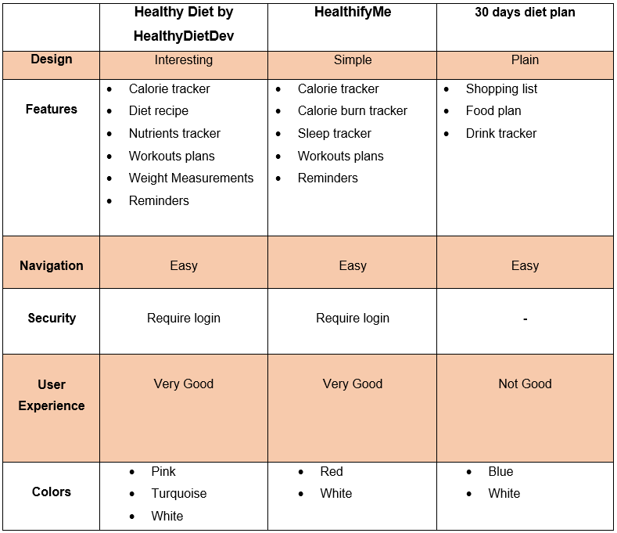
Literature Review

Slide 6
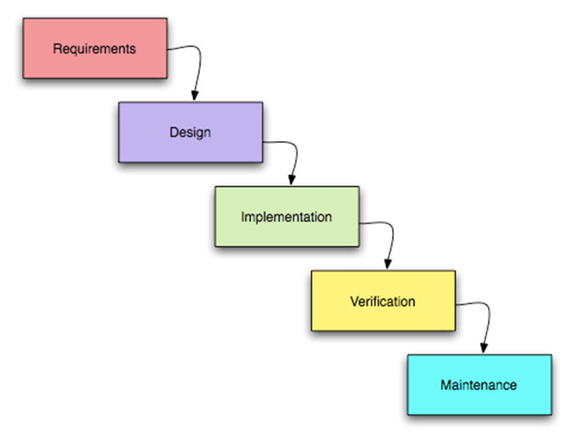
Methodology
Waterfall methodology

Slide 7
Why ? Waterfall methodology
Suitable for the projects that meet the specific documentation, sample resources, fixed requirements, established timeline, and understanding of technology.
Best for the long-term project where it needs the details of the plan that needs one phase to be done before starts another phase.
This methodology runs a progression where in one stage follows the next stages.

Slide 8
Testing and Result
A survey was released to the semester five students and family through WhatsApp, 15 feedbacks are collected from the students and family.

Slide 9
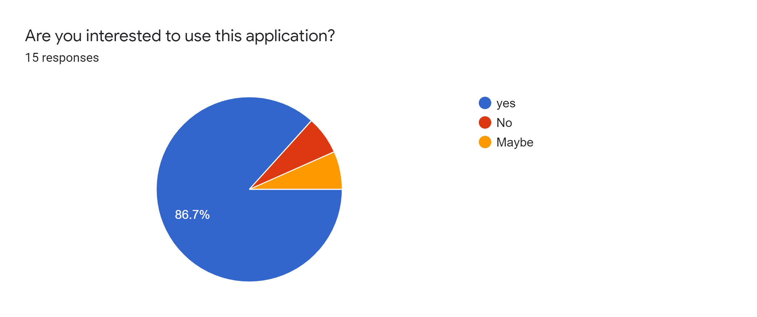
The pie chart shows the percentage of the respondents chosen answer based on the question:
86.7% chosen yes
6.7% chosen No
6.7% chosen maybe

Slide 10
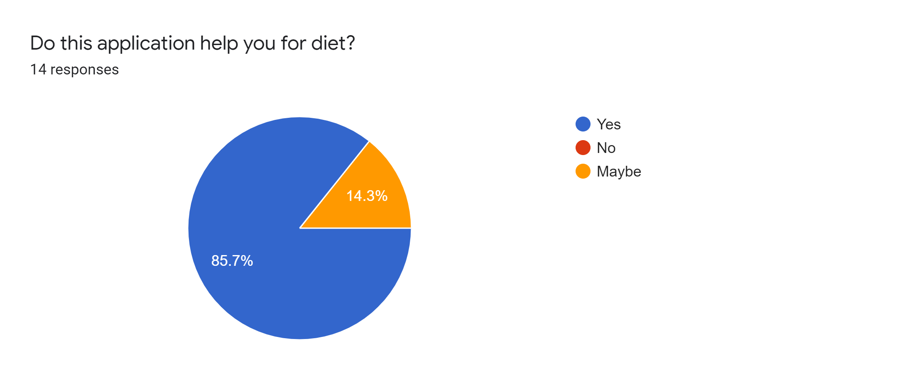
The pie chart shows the percentage of the respondents chosen answer based on the question:
85.7% chosen yes
14.3% chosen Maybe
0% chosen no

Slide 11
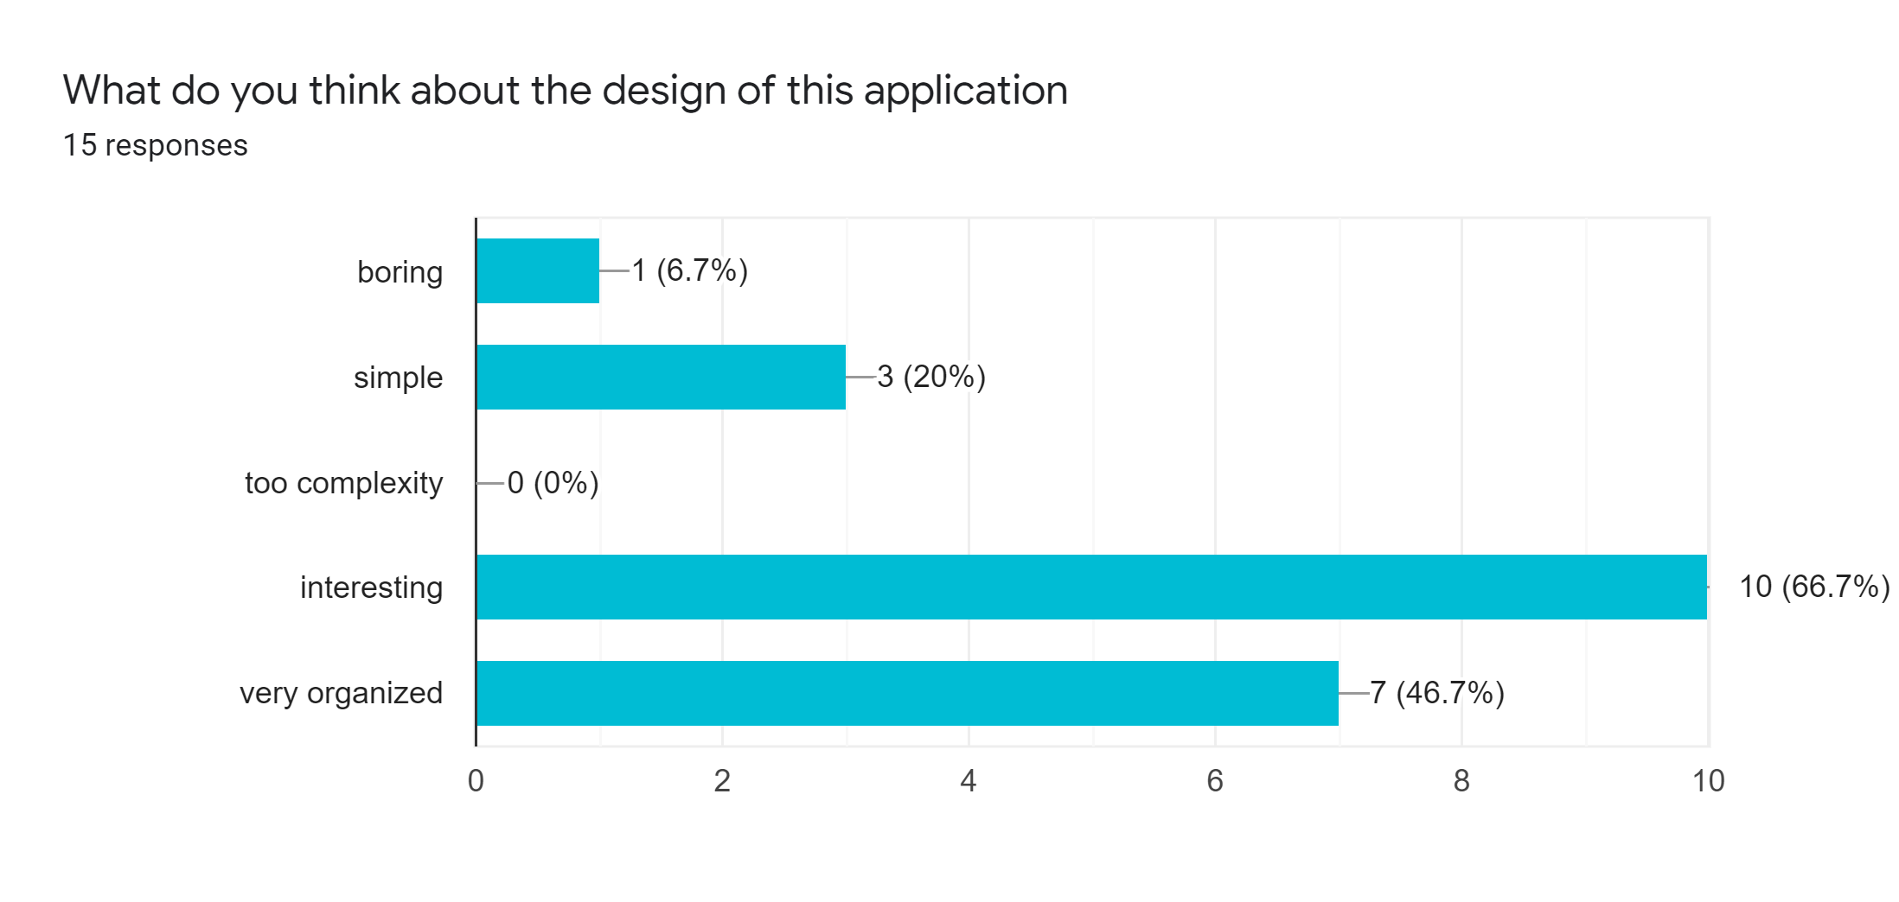
The graph shows the percentage of the respondents chosen answer based on the question:
66.7% chosen interesting of the design
46.7% chosen very organized of the design
0% chosen too complexity of the design
20% chosen simple of the design

Slide 12

The pie chart shows the percentage of the respondents chosen answer based on the question:
86.7% chosen yes
13.3% chosen maybe
0% chosen no

Slide 13
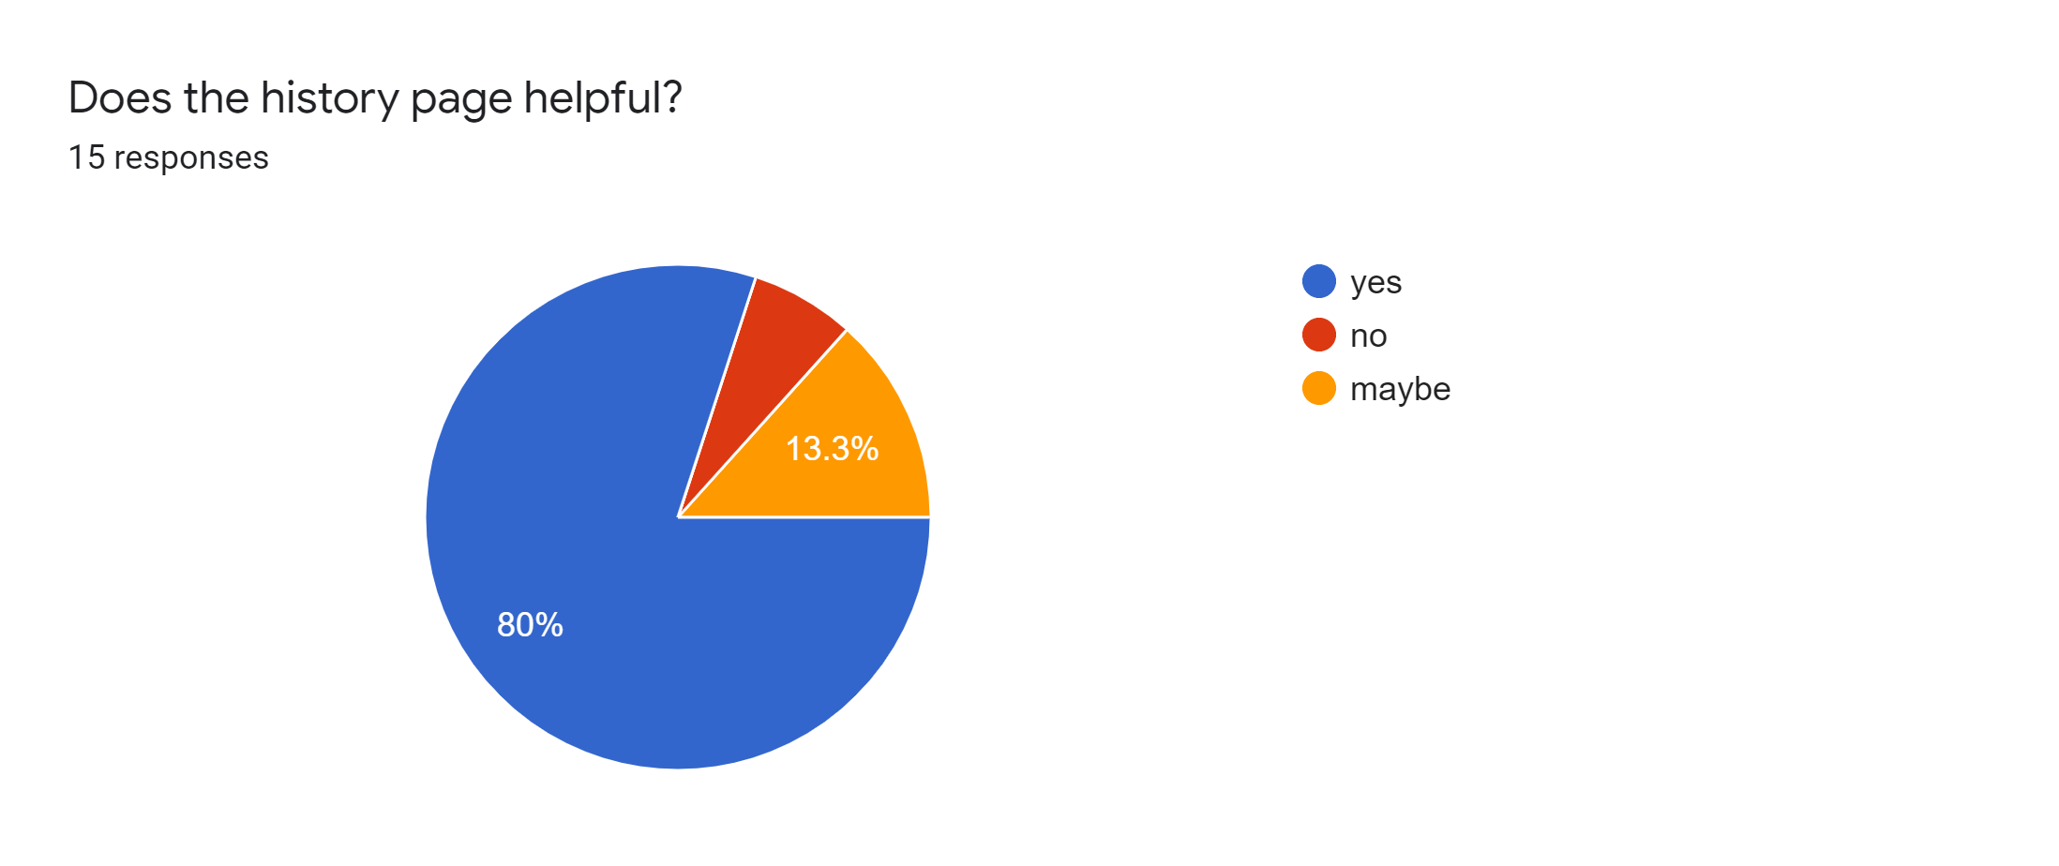
The pie chart shows the percentage of the respondents chosen answer based on the question:
80% chosen yes
13.3% chosen maybe
6.7% chosen no

Slide 14

The pie chart shows the percentage of the respondents chosen answer based on the question:
93.3% chosen yes
6.7% chosen maybe
0% chosen no

Slide 15
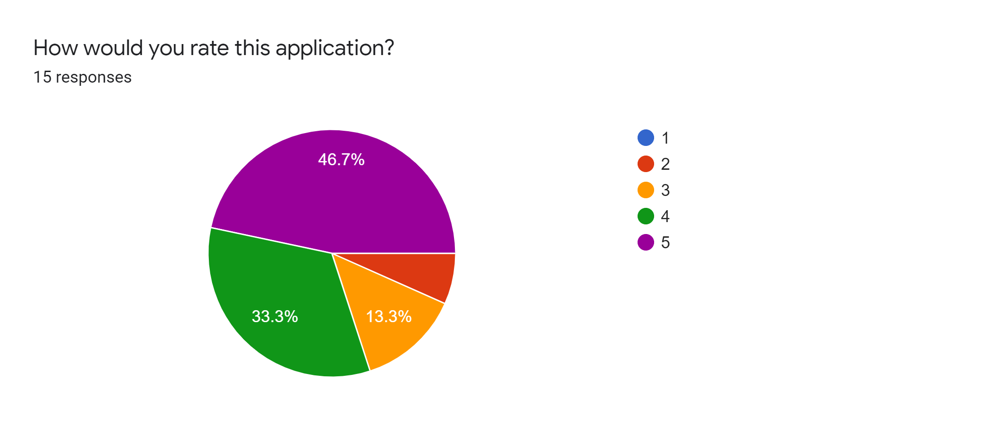
The pie chart shows the percentage of the respondents chosen answer based on the question:
46.7% chosen 5 star out of 5
33.3% chosen 4 star out of 5
13.3% chosen 3 star out of 5
6.7% chosen 2 star out of 5
0% chosen 1 star out of 5

Slide 16
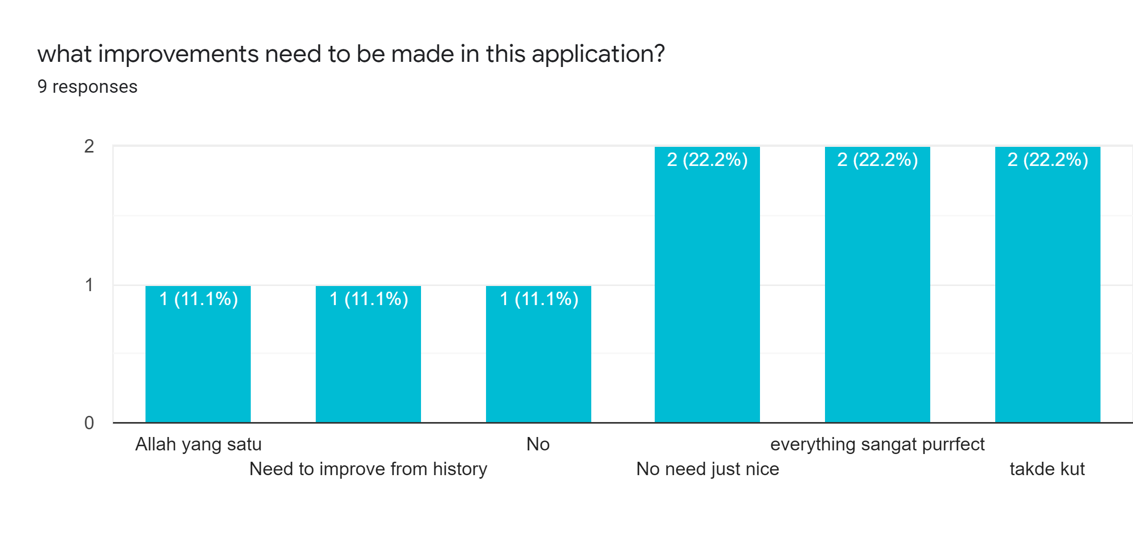
The graph shows the percentage of the respondents chosen answer based on the question:
Only 1 user say that need to improve the history page
Other else say no need do anything

Slide 17
Future Works
Additional Security on Login page
In future work developers can approve this additional security authentication to be improved only by users who have registered access to the system and additional security layers other than text passwords such as OTP passwords. Lastly if the user forget the password user can request to reset the password by click the link .
User interface
The user interface should be enhanced is to make the user interface easier and more pleasant to use and not confusing to use.
Additional function
The current system only allows users nutrient history. In the future enhancement, the system will have history that what the user eat at the certain time. Lastly I will add more food to the database.

Slide 18
Conclusion
This applications will give a full tips diet with healthy and this applications will automatically calculate the what a gram does the user pick nutrition in daily . we hope that the Healthy Diet mobile application can be developed with all the design that help to user easy to understand and not confusing the design. Next i also hope that we will fix the problem statement very fast and efficient ways. Lastly, I will improve this application in the future.

