Slide 1
M1 Shen Yizhu

Slide 2
Content
Ying Zhang and Roger Zimmermann (2013) 2013 IEEE 21st International Symposium.
Camera Shooting Location Recommendations for Landmarks in Geo-Space.
Tveit, M., Ode, A., and Fry, G. (2006) Landscape Research. 31, 229-255.
Key concepts in a framework for analyzing visual landscape character.

Slide 3
Content
Ying Zhang and Roger Zimmermann (2013) 2013 IEEE 21st International Symposium.
Camera Shooting Location Recommendations for Landmarks in Geo-Space.
Tveit, M., Ode, A., and Fry, G. (2006) Landscape Research. 31, 229-255.
Key concepts in a framework for analyzing visual landscape character.

Slide 4
Goals
Most of existing studies only focus on extracting representative photos and neglect the approach
This paper focus on recommending camera locations where appealing photos can be captured by visitors in spatio-temporal domain

Slide 5
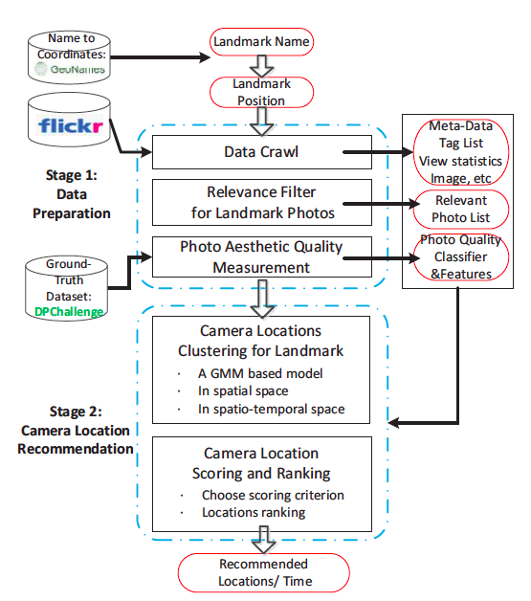
Architecture

Slide 6
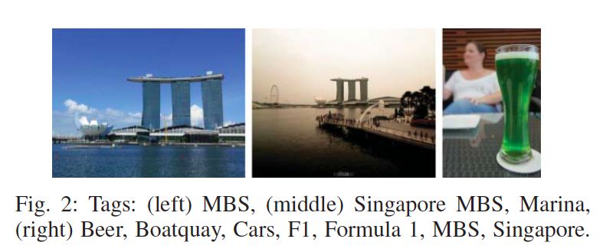
Relevance Filter For Landmark Photos
A context-based approach using frequent occurrence for tags

Slide 7
Photo Aesthetic Quality Measurement
Color Features :
1) color histogram & color moment
Texture Features :
1) histogram of oriented gradients (HOG)
2) Local Binary Patterns (LBP)
Spatial Distribution Features
1) Difference of Gaussian (DOG)
2) Salience Map

Slide 8
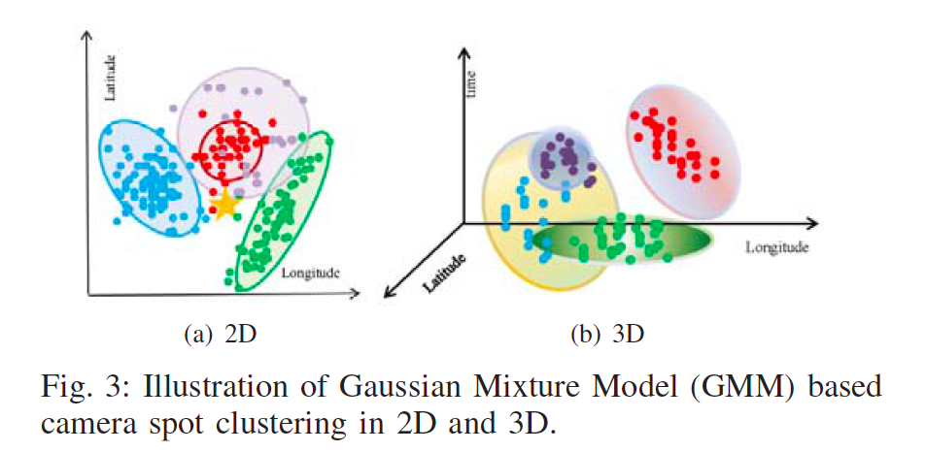
GMM-based Camera Location Clustering

Slide 9
Camera Location Recommendation
Six criteria
1) Photo quality (s1)
2) Total area popularity (s2)
3) Area popularity consistency (s3)
4) Photo spatial density (s4)
5) Photo temporal density (s5)
6) Social attractiveness (s6)

Slide 10

Photo Quality
The higher the aesthetics of a set of photos, the higher the probability that the location is a promising place

Slide 11
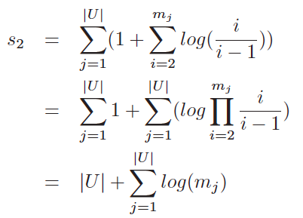
Total Area Popularity
A better camera location attracts more visitors and photos taken by each visitors

Slide 12
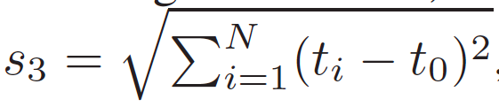
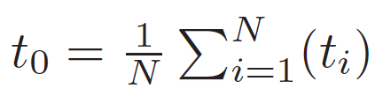
Area Popularity Consistency
A good view location should attain a steady popularity over time.

Slide 13
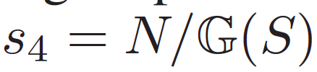
Photo Spatial Density
A higher photo density indicates a more promising place

Slide 14


Photo Temporal Density
If a location has the potential for an appealing landmark view, it would gain popularity much quicker in the temporal dimension.

Slide 15


Social Attractiveness
A subjective assessment that indicates how a photo is liked by others

Slide 16

Combination for Overall Score
A linearly combination to compute the overall score for a single camera location

Slide 17
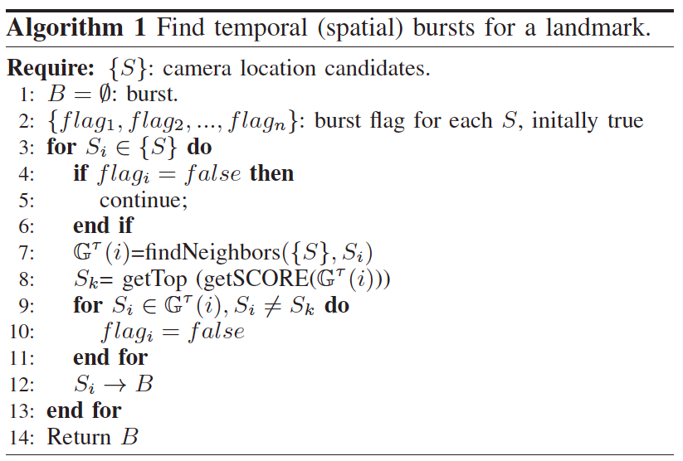
Spatio-temporal Camera Spot Recommendations
G(S) : Spatial Coverage
T(S) : Temporal Coverage

Slide 18
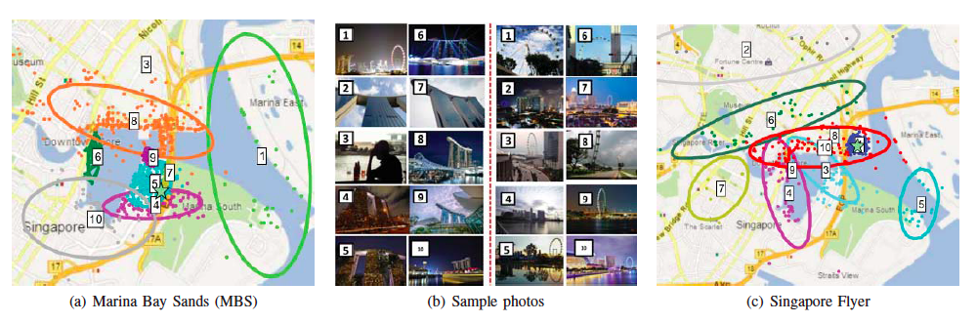
Results in Spatial Space

Slide 19
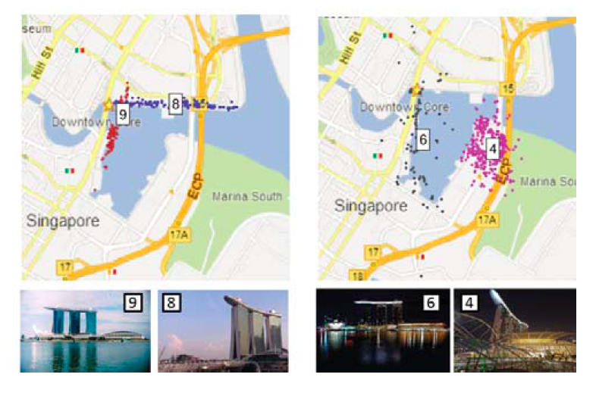
Results in Spatial-temporal Space

Slide 20
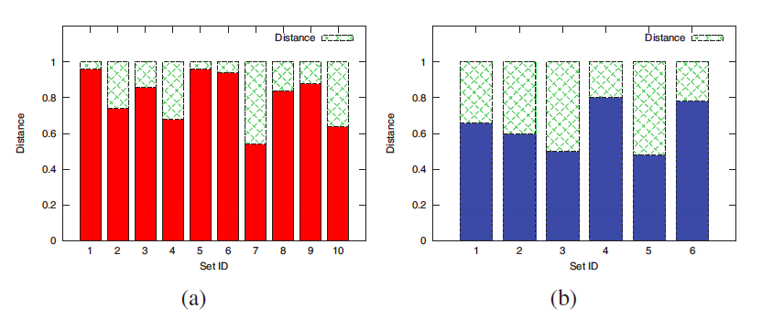
Evaluations
A user study for framework evaluations

Slide 21
Content
Ying Zhang and Roger Zimmermann (2013) 2013 IEEE 21st International Symposium.
Camera Shooting Location Recommendations for Landmarks in Geo-Space.
Tveit, M., Ode, A., and Fry, G. (2006) Landscape Research. 31, 229-255.
Key concepts in a framework for analyzing visual landscape character.

Slide 22
Major Challenge
The lack of operational landscape indicators of visual quality in :
1) Objective measurements that are meaningful to people is need
2) Between-group differences in aesthetic quality assessment should be considerable

Slide 23
Landscape Aesthetics Theories
Evolutionary Theories
1) Based on human biological needs to survive and thrive as a species
2) argue for a common landscape features perceived for all humans
Cultural Preference Theories
1) Based on cultural background and personal attributes
2) links landscape features with ethics

Slide 24
View From Author
A synthesis of the evolutionary and cultural perspectives is appropriate
Landscape Aesthetics is mainly decided by common features and shaped by cultural features

Slide 25
Method
Analyzing related literature to explore current terminology describing visual quality
Source used:
1) academic literature
2) guidelines and
3) policy documents

Slide 26
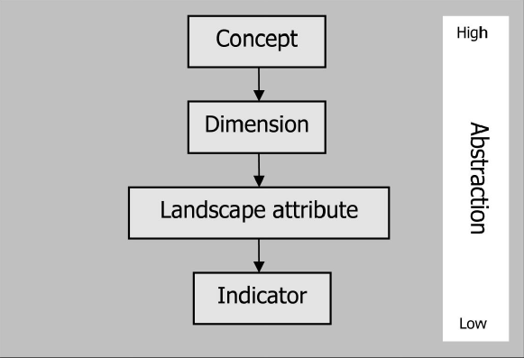
Hierarchical Structure to Levels Of Abstraction
An umbrella term
Describe concepts at abstract level
Determine dimension at physical level
Measure Landscape attribute at physical level

Slide 27
Nine Key Aspect of Visual Landscape
Stewardship | Sense of order and care, perceived human care through active and careful management
Coherence | Unity of a scene, repeating patterns of color and texture, correspondence between land use and natural conditions
Disturbance | Lack of contextual fit and coherence, constructions and interventions
Historicity | Historical continuity and historical richness, different time layers, amount and diversity of cultural elements
Visual scale | Landscape rooms or perceptual units: their size, shape and diversity, degree of openness

Slide 28
Nine Key Aspect (Cont.)
Imageability | Qualities of a landscape present in totality or through elements; landmarks and special features, both natural and cultural, making the landscape create a strong visual image in the observer, and making landscapes distinguishable and memorable
Complexity | Diversity, richness of landscape elements and features, interspersion of pattern
Naturalness | Closeness to a preconceived natural state
Ephemera | Change with season and weather

Slide 29
Stewardship
Concept | Human care for the landscape through active and careful management
Dimensions | sense of order; sense of care; upkeep
Landscape attributes | signs of use/non-use; vegetation succession; Buildings, linear features, management detail;
Potential indicators | percentage of abandoned land and stage of succession; status of maintenance of buildings; management type and frequency;

Slide 30
Coherence
Concept | A reflection of the unity of a scene, where coherence may be enhanced through repeating patterns of color and texture
Dimensions | harmony; unity/holistic; land-use suitability
Landscape attributes | land use; water; pattern
Potential indicators | percentage land use in correspondence with natural conditions; water presence and its spatial location; repeating colors and patterns

Slide 31
Disturbance
Concept | lack of contextual fit and coherence, where elements deviate from the context
Dimensions | lack of contextual fit; lack of coherence
Landscape attributes | extraction; natural disturbance; constructions
Potential indicators | number of disturbing elements; percentage area impacted by disturbance, visibility of disturbing elements

Slide 32
Historicity
Concept | The visual presence of different time layers and the age of the layers; The amount, condition and diversity of cultural elements
Dimensions | historical continuity; historical richness.
Landscape attributes | visible time layers; cultural elements; traditional agricultural structures.
Potential indicators | presence of cultural and historical elements; age of historical elements; number of time layers; presence of traditional land use and pattern.

Slide 33
Visual Scale
Concept | perceptual units that reflect the experience of landscape rooms, visibility and openness
Dimensions | visibility; openness; grain size
Landscape attributes | topography; vegetation; man made obstacle
Potential indicators | viewshed size; depth of view; degree of openness; number of obstructing objects.

Slide 34
Imageability
Concept | landmarks and special features, making the landscape create a strong visual image in the observer, and making landscapes distinguishable and memorable.
Dimensions | spirit of place; uniqueness/distinctiveness; vividness.
Landscape attributes | spectacular elements; landmarks; Iconic elements
Potential indicators | viewpoints; presence of spectacular, unique or iconic elements and landmarks; presence of historic elements and patterns

Slide 35
Complexity
Concept | the diversity and richness of landscape elements and features, their interspersion as well as the grain size of the landscape
Dimensions | diversity; variation; complexity of patterns and shapes.
Landscape attributes | linear features; point features; land cover
Potential indicators | number of objects and types; diversity indices; shape diversity; edge density; aggregation indices

Slide 36
Naturalness
Concept | closeness to a preconceived natural state
Dimensions | intactness; wilderness; natural
Landscape attributes | natural feature; structural integrity of vegetation; water; management
Potential indicators | vegetation intactness; presence of water; presence of natural feature; degree of wilderness

Slide 37
Ephemera
Concept | elements and land-cover types changing with season and weather
Dimensions | seasonal change; weather related changes；
Landscape attributes | land cover/vegetation; animals; weather.
Potential indicators | percentage of land cover with seasonal change; presence of animals; presence of weather characteristics

Slide 38
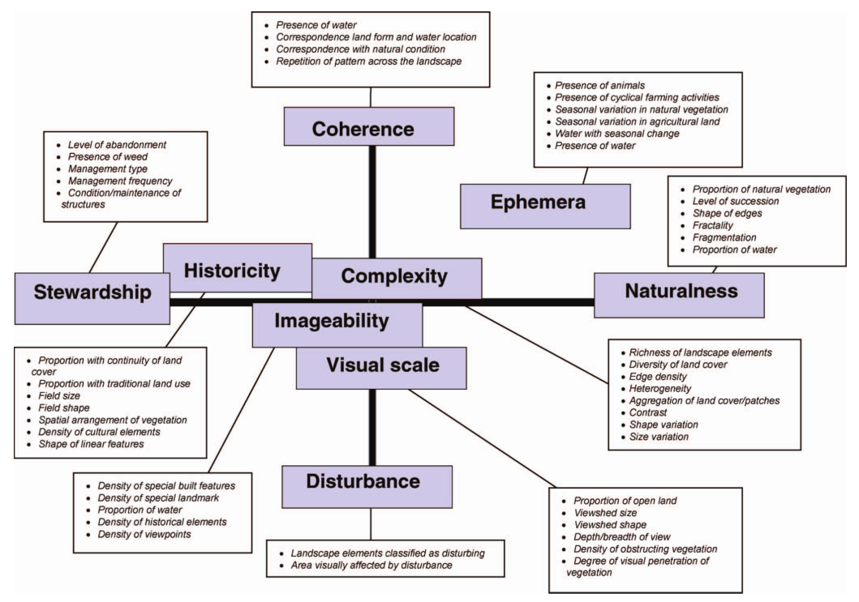
Interrelated Concepts

Slide 39
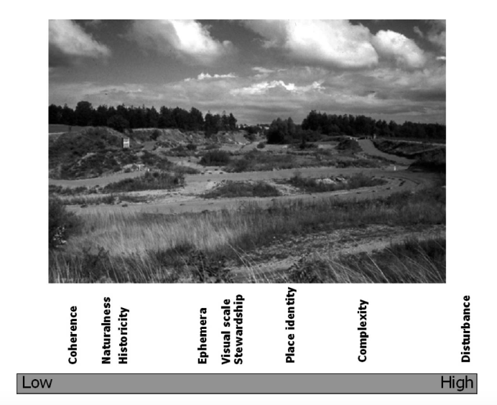
Example

Slide 40
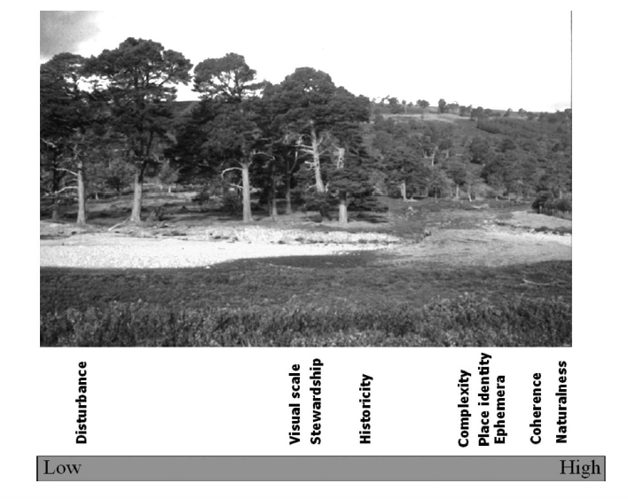
Example

Slide 41
Relationships between Concepts and Visual Quality
Context-Dependent Concepts
The context of introduced elements will determine the visual impact perceived by the viewer
Observer-Dependent Concepts
Visual concepts are given different relative weights by different people and according to the purpose of the observation

