Slide 1

The Projectile Motion Simulator
Notes:
Introduce the project and the four OOP pillars that the presentation focuses on.
1

Slide 2
Team Members
Nirmal Akarsha
Dineth Fernando
Sanju Ekanayaka
Nethmi Tharuka
Poorni Chathurika

Slide 3

Agenda
01
Project overview
02
Abstraction
03
Inheritance
04
Encapsulation
05
Polymorphism
06
Live demo (screenshots)
2
Notes:
2

Slide 4
Project overview
  Simulates projectile motion with optional air resistance (drag)
  Numerical integration with a small time step (dt = 0.001 s)
  Results: max height, range, flight time
  Two interfaces: pygame GUI and command line (CLI)
  Drag presets: Basketball, Golf Ball, Cannonball
  Matplotlib visualizer for static graphs and animation (GIF)
Project files
main.py
projectile_physics_engine.py
gui.py
ui.py
visualizer_animation.py
3
Notes:
3

Slide 5
Project architecture
main.py
Entry point
gui.py
pygame interface
ui.py
CLI input / output
visualizer_animation.py
matplotlib graphs
projectile_physics_engine.py (physics + drag models)
Every interface reads its numbers from the same physics engine.
4
Notes:
4

Slide 6
The 4 OOP pillars used in this project
Abstraction
Inheritance
Encapsulation
Polymorphism
Hide details, show only what is needed
Child classes reuse parent code
Protect data inside the class
Same method, different behaviour
In the code:
In the code:
In the code:
In the code:
DragModel, Widget, SimulationRunner, BaseVisualizer
NoDrag, QuadraticDrag, BasketballDrag ...
__trajectory, _simulate(), @property
acceleration() overridden per drag model
5
Notes:
5

Slide 7
1. Abstraction
An abstract class defines WHAT must be done. The child classes decide HOW.
Notes:
6

Slide 8
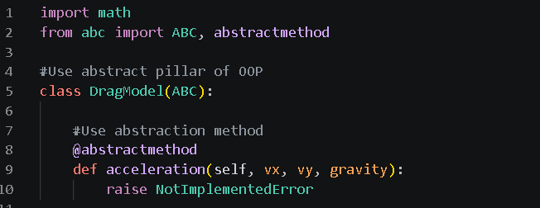
Abstraction: DragModel (physics engine)
  DragModel inherits from ABC (Abstract Base Class)
  @abstractmethod forces every child to write its own acceleration()
  You cannot create DragModel() directly
  ProjectilePhysics only needs to know: "give me the acceleration"
The simulation loop does not care which drag model is used. The abstraction hides the formula details.
7
Notes:
7

Slide 9
Abstraction used in 4 places
Abstract class
File
Abstract methods
DragModel
projectile_physics_engine.py
acceleration()
SimulationRunner
main.py
run()
Widget
gui.py
handle_event(), draw()
BaseVisualizer
visualizer_animation.py
render_static(), render_animation()
8
Notes:
8

Slide 10
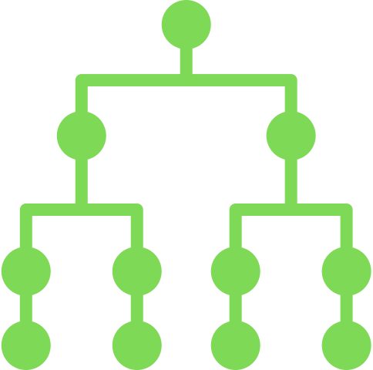
2. Inheritance
A child class gets the data and methods of its parent class, so code is reused.
Notes:
9

Slide 11
Inheritance: drag model hierarchy
DragModel (abstract)
NoDrag
QuadraticDrag
BasketballDrag
GolfBallDrag
CannonballDrag
Single inheritance: NoDrag, QuadraticDrag -> DragModel. Multilevel inheritance: BasketballDrag -> QuadraticDrag -> DragModel.
10
Notes:
10

Slide 12
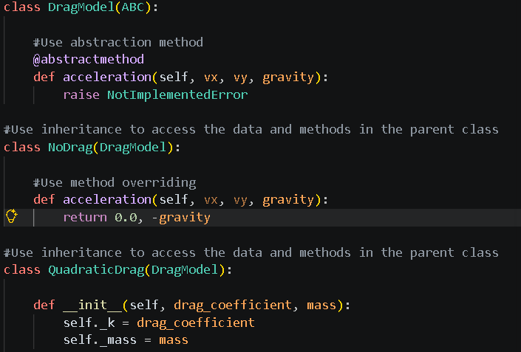
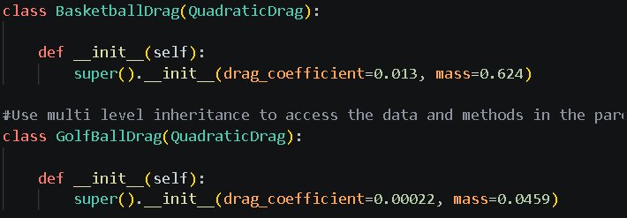
Inheritance: multilevel
  super().__init__() calls the parent constructor
  Children only supply their own numbers (k and mass)
  The acceleration formula is written once in QuadraticDrag
  Same idea in other files: CLIRunner / GUIRunner, Button / Slider / TextBox, TrajectoryVisualizer
11
Notes:
11

Slide 13

3. Encapsulation
Keep data private inside the class and allow access only through controlled methods.
Notes:
12

Slide 14
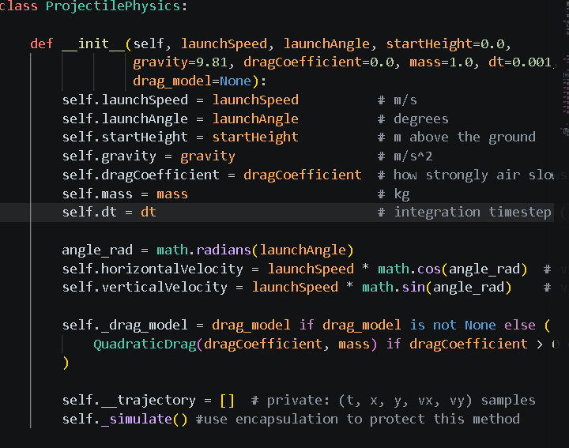
Encapsulation: ProjectilePhysics
  __trajectory (double underscore) is private: outside code cannot touch it
  _simulate() (single underscore) is for internal use only
  Public methods give safe access: max_height(), range(), flight_time(), results()
  Results cannot be broken by accident from the GUI or CLI
13
Notes:
13

Slide 15
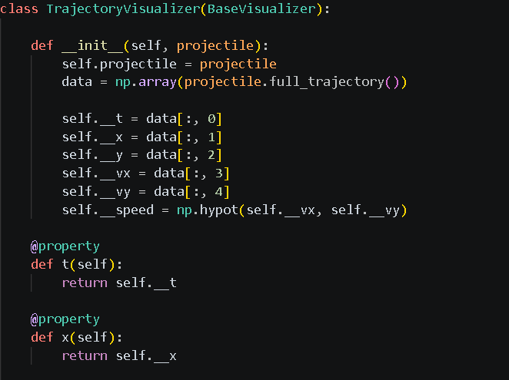
Encapsulation: private data + @property
Read-only access
  Data is private (__x, __y, _k, _mass)
  @property exposes it as read-only
  No setter, so the values cannot be changed from outside
  Protects the integrity of simulation data
14
Notes:
14

Slide 16
4. Polymorphism
One method name, many forms: each class overrides the method in its own way.
Notes:
15

Slide 17
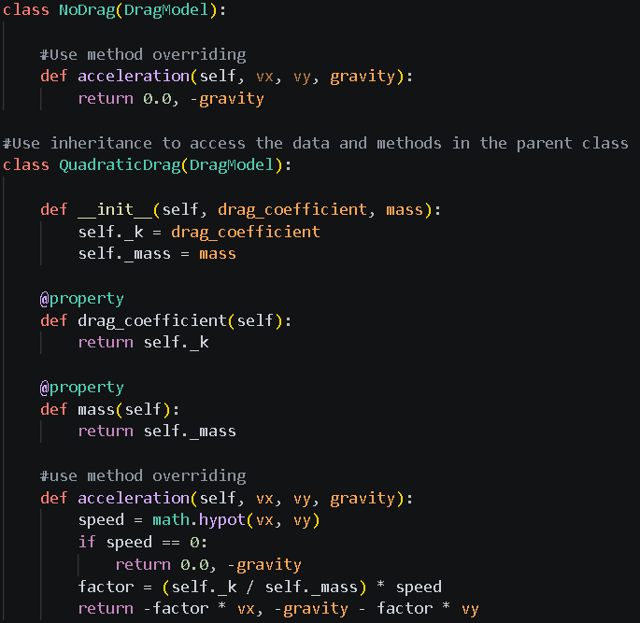
Polymorphism: method overriding
  Same method name acceleration(), different result
  NoDrag: only gravity acts
  QuadraticDrag: gravity plus air resistance
  Overriding the abstract method in DragModel
16
Notes:
16

Slide 18
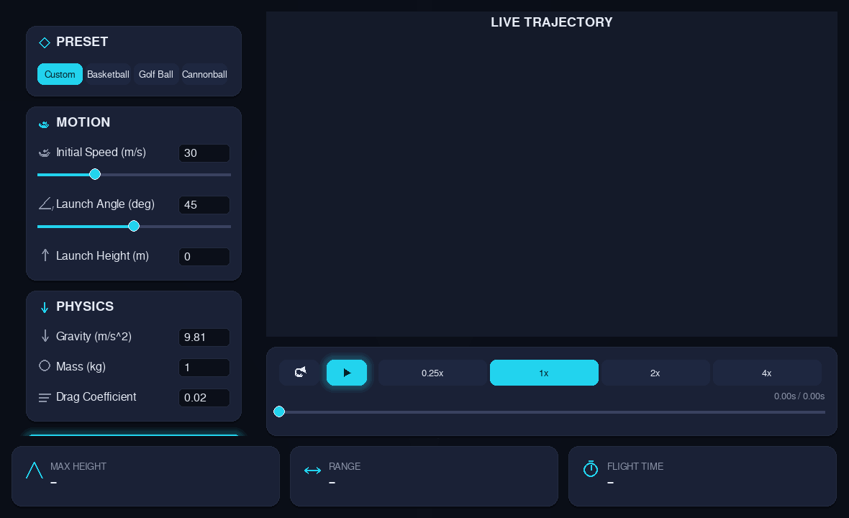
Demo: GUI application
  Widget subclasses: Button, Slider, TextBox, SegmentedControl
  Preset buttons pick a drag model object
  Inputs: speed, angle, height, gravity, mass, drag
17
Notes:
17

Slide 19
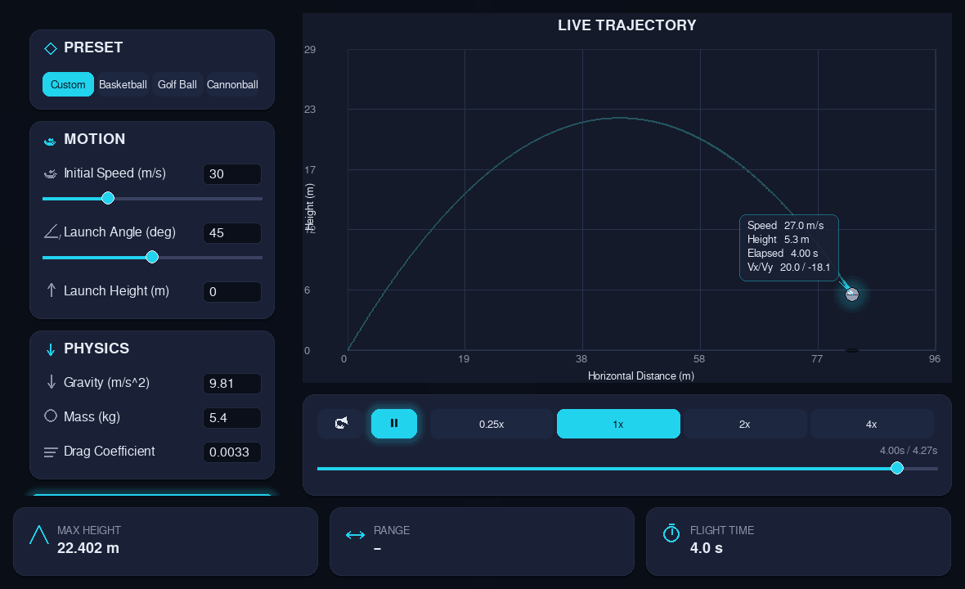
Demo: Cannonball preset (QuadraticDrag child)
  Preset fills mass = 5.4 and k = 0.0033 from CannonballDrag
  Live animated trajectory with speed, height, time
  Same GUI, different drag model object = different path
18
Notes:
18

Slide 20
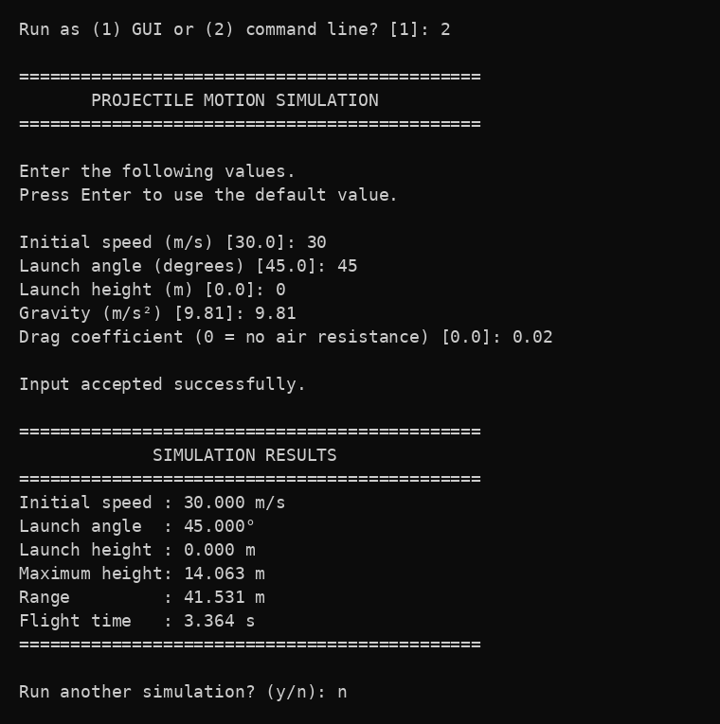
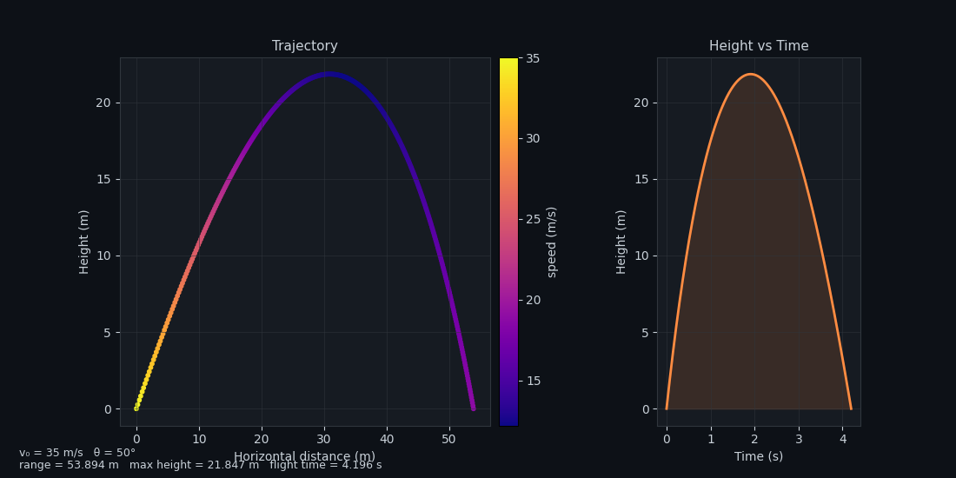
Demo: CLI and matplotlib visualizer
TrajectoryVisualizer.render_static()
CLI runner (ui.py + CLIRunner)
19
Notes:
19

Slide 21
How the 4 pillars work together
Abstraction
Inheritance
Encapsulation
Polymorphism
DragModel defines the contract
Drag presets reuse QuadraticDrag
Trajectory data kept private
acceleration() behaves per model
Result: clean, reusable and easy to extend code. A new drag model (e.g. a tennis ball) needs only one small new class.
20
Notes:
20

Slide 22

Thank you!
Notes:
21

