Slide 1
Memo
Kawin Chinpong

Slide 2
Pain point or motivation
I would like to make the overall process faster.
This is just proof of concept; income may not be considered in this stage.

Slide 3
Overall steps
Label facility usage by inspecting IcdCmCode
Try to estimate step time usage using labelled facilities and overall time (VN_IN to VN_OUT), simple linear regression may be used.
Try to run discrete event simulation of overall process for 365*24*60 minutes starts from 2022-01-01 and evaluate RMSE of per-VN time process and compare with ground truth.
Create some strategies to reduce overall average process time and compare it.

Slide 4
Definition
Process Time (VN_OUT – VN_IN in minutes)

Slide 5
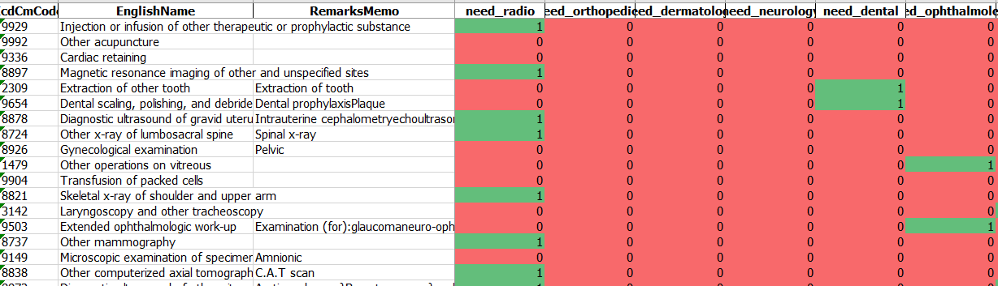
Process Time Estimation
Manually Labelled facility usage using interpretation from IcdCmCode
450 out of 4xxx codes were manually labelled on 18 facilities (departments).

Slide 6
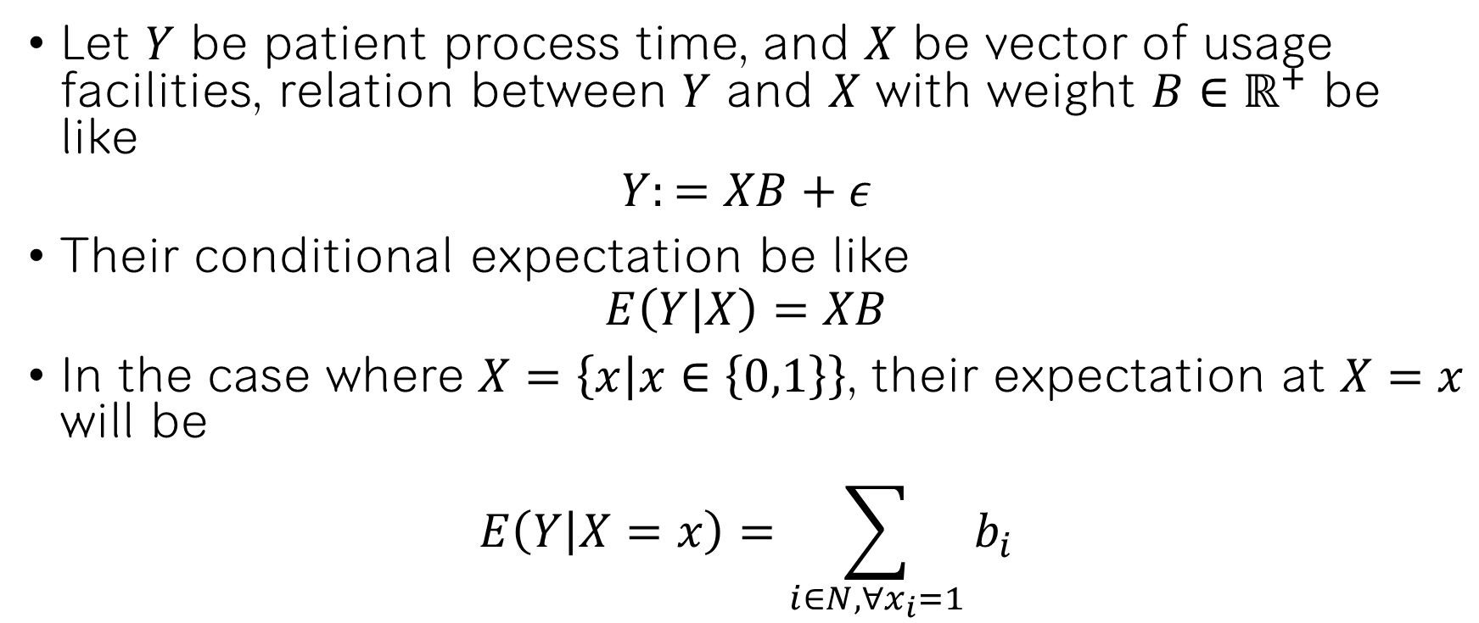
Process Time Estimation
Let $Y$ be patient process time, and $X$ be vector of usage facilities, relation between $Y$ and $X$ with weight $B∈ℝ^{+}$ be like
$$Y:=XB+ε$$
Their conditional expectation be like
$$E\left(Y | X\right)=XB$$
In the case where $X=\left\{x | x∈\left\{0,1\right\}\right\}$, their expectation at $X=x$ will be
$$E\left(Y | X=x\right)=\sum_{i∈N,∀x_{i}=1}{b_{i}}$$

Slide 7
Process Time Estimation
Result table

Slide 8
Simple Abstract Hospital Pathway
Show diagram and process time

Slide 9
Simple Abstract Hospital Pathway
OPD
Orthopedics
Dermatology
Neurology
Dental
Ophthalmology
Otolaryngology
Thoracic Department
Hematology
GI, Liver department
Nephrology
Laboratory
Radiology
OR
IPD
Physical Therapy
Pharmacy
VN_IN
VN_OUT

Slide 10
DES Assumptions
Every patients must be started on OPD and sequentially visited through the last department without any deaths.
Every departments were visited only one time per VN, non any revisiting on the same VN.
Some unnecessary departments may be skipped, as the case may be
Average minutely interarrival time may be difference on working day and weekend.

Slide 11
DES Assumptions
Patients were able to get VN queue between 5am to 3pm.
OPD were started at 7am each day without any lunch or dining.
Other departments were 24/7 standby.
Distance between departments were insignificantly affected overall process time.
Any workers in the same department were equal on performance.

Slide 12
DES parameter initialization
Parameter initialization

Slide 13
Strategy Designs

Slide 14
Strategy Results

Slide 15
Conclusion and Limitations

