Slide 1
Memo
Kawin Chinpong
24th August 2023

Slide 2
Pain point or motivation
I would like to make the overall process faster.
This is just proof of concept; income and financial processes may not be considered in this stage.

Slide 3
Overall steps
Estimate step time usage based on labelled facilities from IcdCmCode using simple linear regression.
Run discrete event simulation of overall process for 365*24*60 minutes starts from 2022-01-01 and evaluate RMSE of per-VN time process and compare with ground truth.
Create some strategies to reduce overall average process time and compare it.

Slide 4
Simple Abstract Hospital Pathway
OPD
Orthopedics
Dermatology
Neurology
Dental
Ophthalmology
Otolaryngology
Thoracic Department
Hematology
GI, Liver department
Nephrology
Laboratory
Radiology
OR
IPD
Physical Therapy
Pharmacy
VN_IN (start)
VN_OUT (end)
Gynaecology

Slide 5
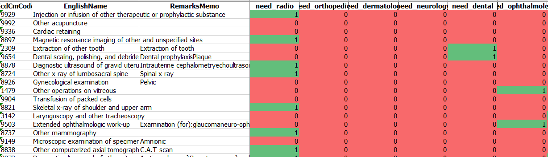
Process Time Estimation
Manually Labelled facility usage using interpretation from IcdCmCode
450 out of 4xxx codes from patients which contains top 100 IcdCmCode were manually labelled on 18 facilities (departments).

Slide 6
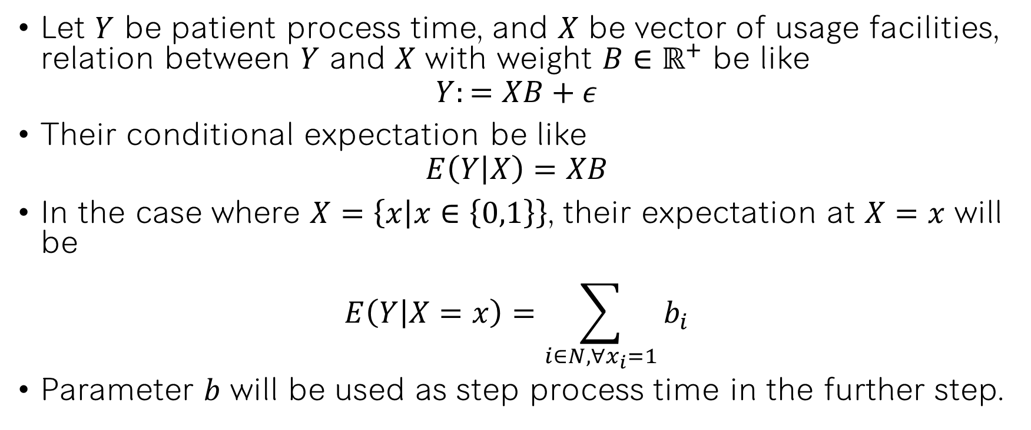
Process Time Estimation
Let $Y$ be patient process time, and $X$ be vector of usage facilities, relation between $Y$ and $X$ with weight $B∈ℝ^{+}$ be like
$$Y:=XB+ε$$
Their conditional expectation be like
$$E\left(Y | X\right)=XB$$
In the case where $X=\left\{x | x∈\left\{0,1\right\}\right\}$, their expectation at $X=x$ will be
$$E\left(Y | X=x\right)=\sum_{i∈N,∀x_{i}=1}{b_{i}}$$
Parameter $b$ will be used as step process time in the further step.

Slide 7
Simple Abstract Hospital Pathway
OPD
Orthopedics
Dermatology
Neurology
Dental
Ophthalmology
Otolaryngology
Thoracic Department
Hematology
GI, Liver department
Nephrology
Laboratory
Radiology
OR
IPD
Physical Therapy
Pharmacy
VN_IN (start)
VN_OUT (end)
15 minutes
120 minutes
50 minutes
11 minutes
13 minutes
30 minutes
31 minutes
33 minutes
18 minutes
23 minutes
60 minutes
12 minutes
22 minutes
Gynaecology
30 minutes
60*4 minutes
1440*5 minutes
60*3 minutes
10 minutes

Slide 8
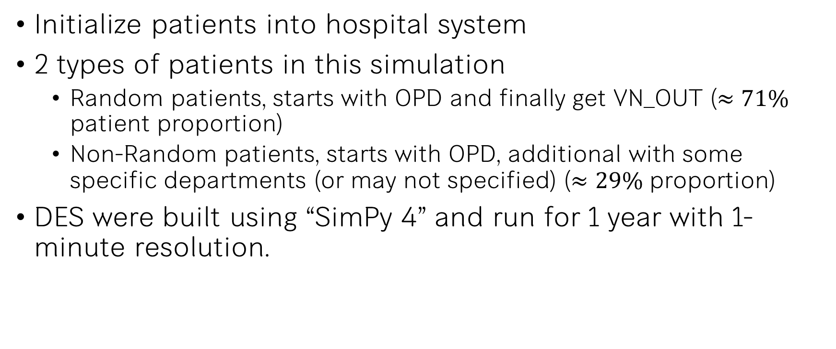
Discrete Event Simulation (DES)
Initialize patients into hospital system
2 types of patients in this simulation
Random patients, starts with OPD and finally get VN_OUT ($≈71\%$ patient proportion)
Non-Random patients, starts with OPD, additional with some specific departments (or may not specified) ($≈29\%$ proportion)
DES were built using “SimPy 4” and run for 1 year with 1-minute resolution.

Slide 9
Simulation Evaluation
qq-plot of actual vs simulated process time and their RMSE

Slide 10
Simulation Evaluation
Max queue length for each department

Slide 11
Expected Strategy Designs

Slide 12
Conclusion and Limitations

Slide 13
Memo
Kawin Chinpong
24th August 2023

Slide 14

Definition
Process Time $Y$ (VN_OUT – VN_IN in minutes)
Vector of required facilities $X⊂\left\{0,1\right\}$

Slide 15
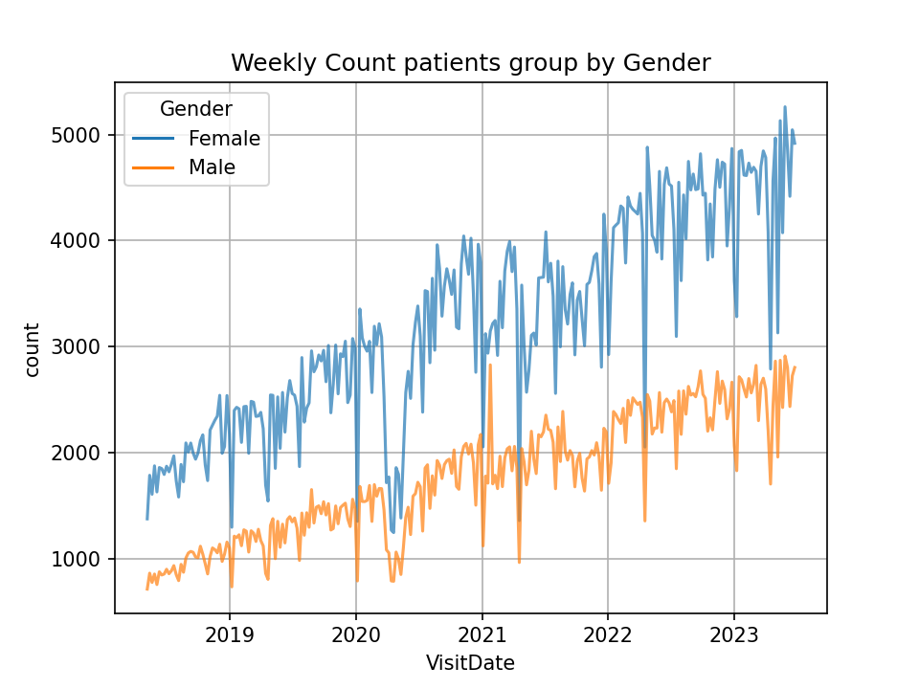
Weekly count patients, grouped by Gender

Slide 16
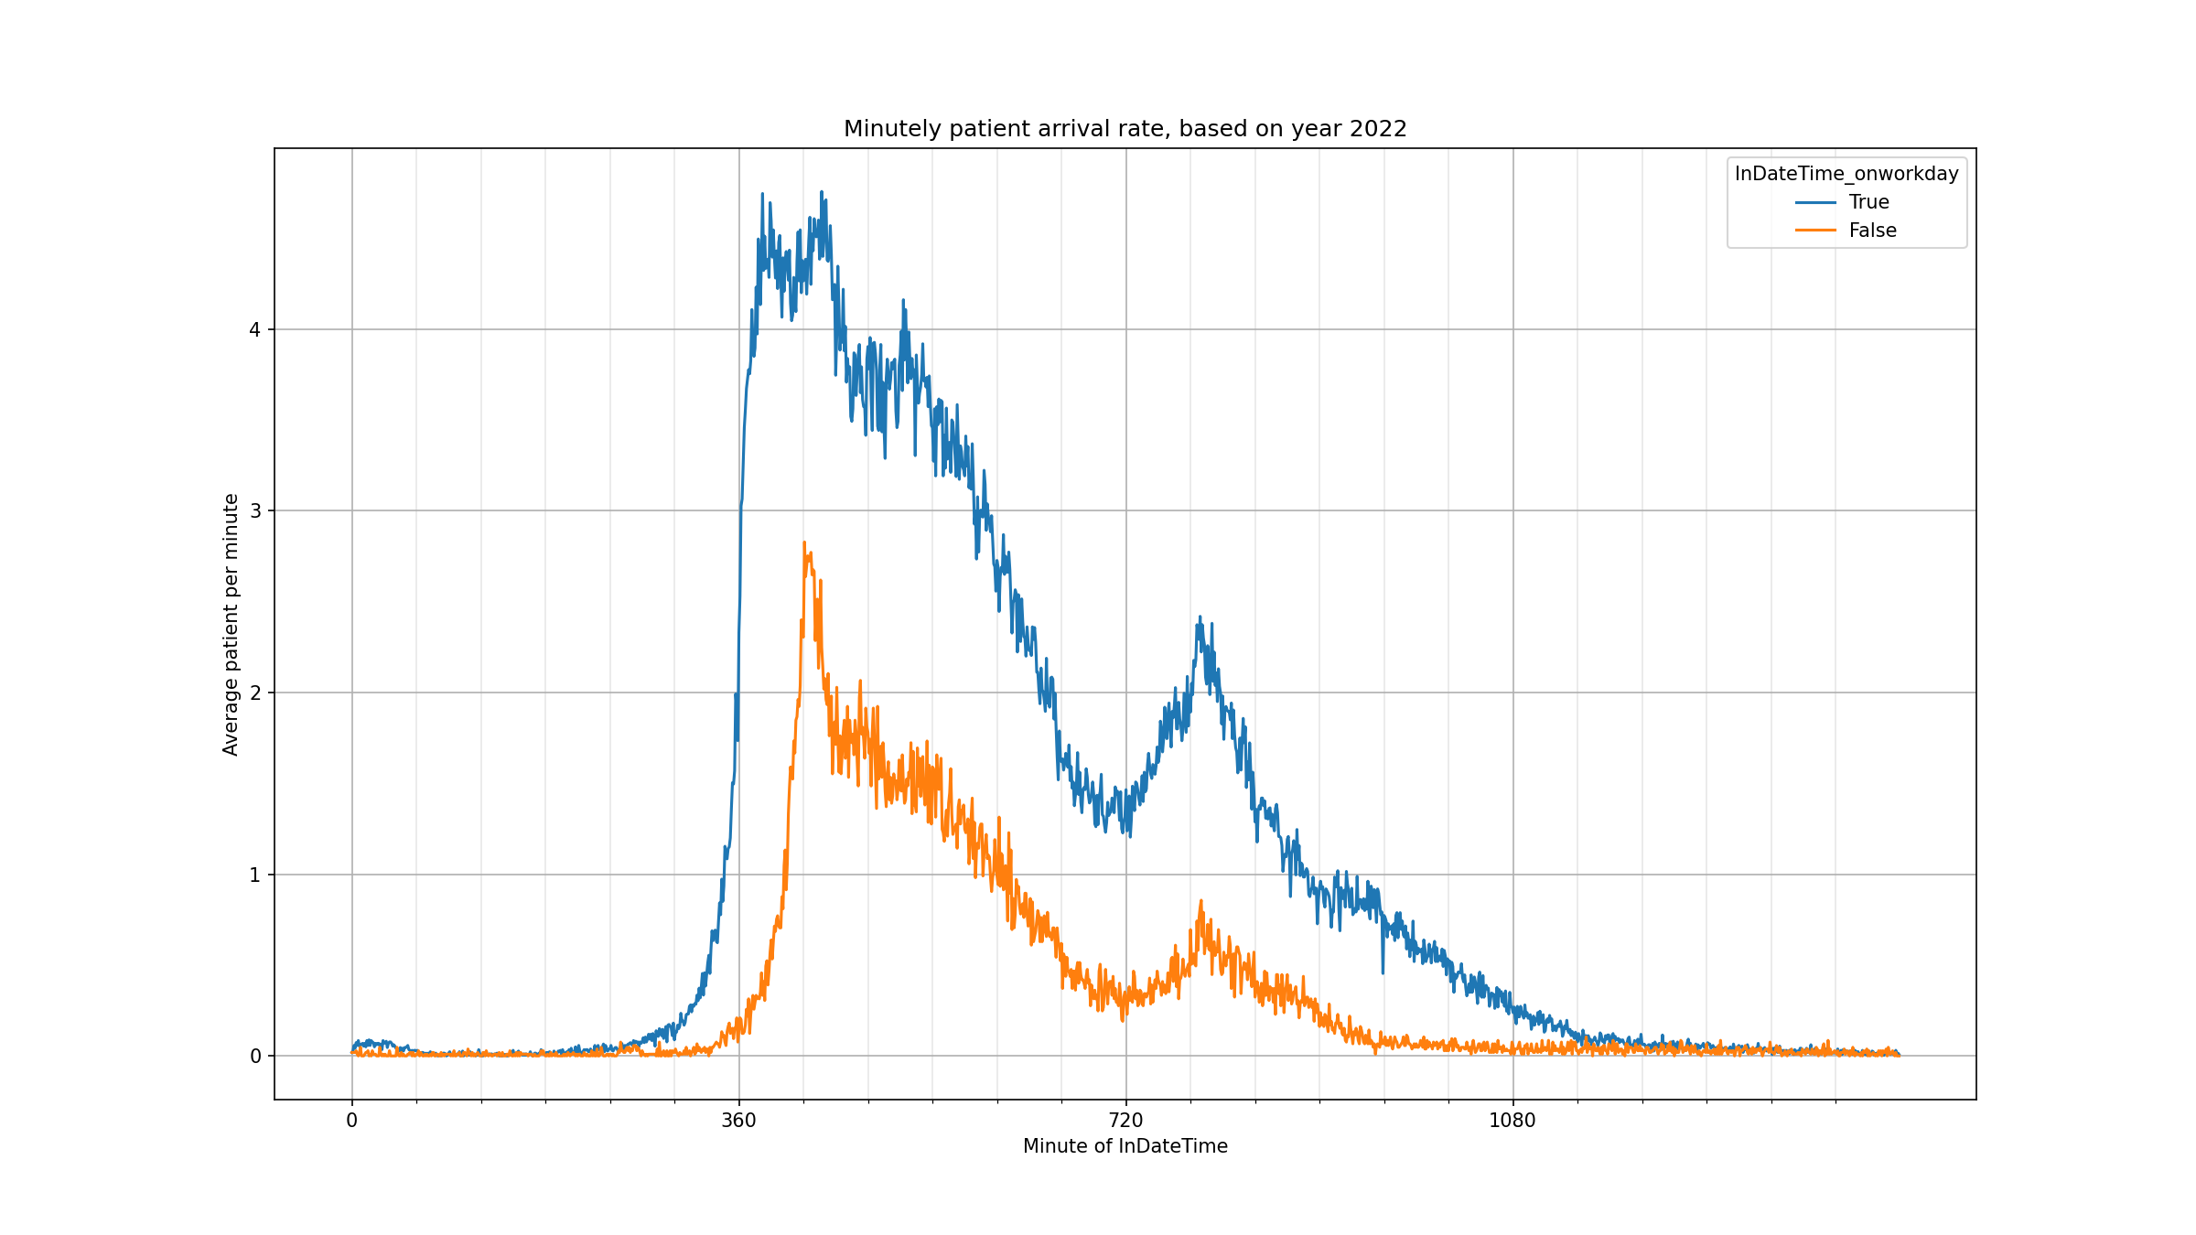
Minutely patient arrival rate in 2022, grouped by weekday name

Slide 17
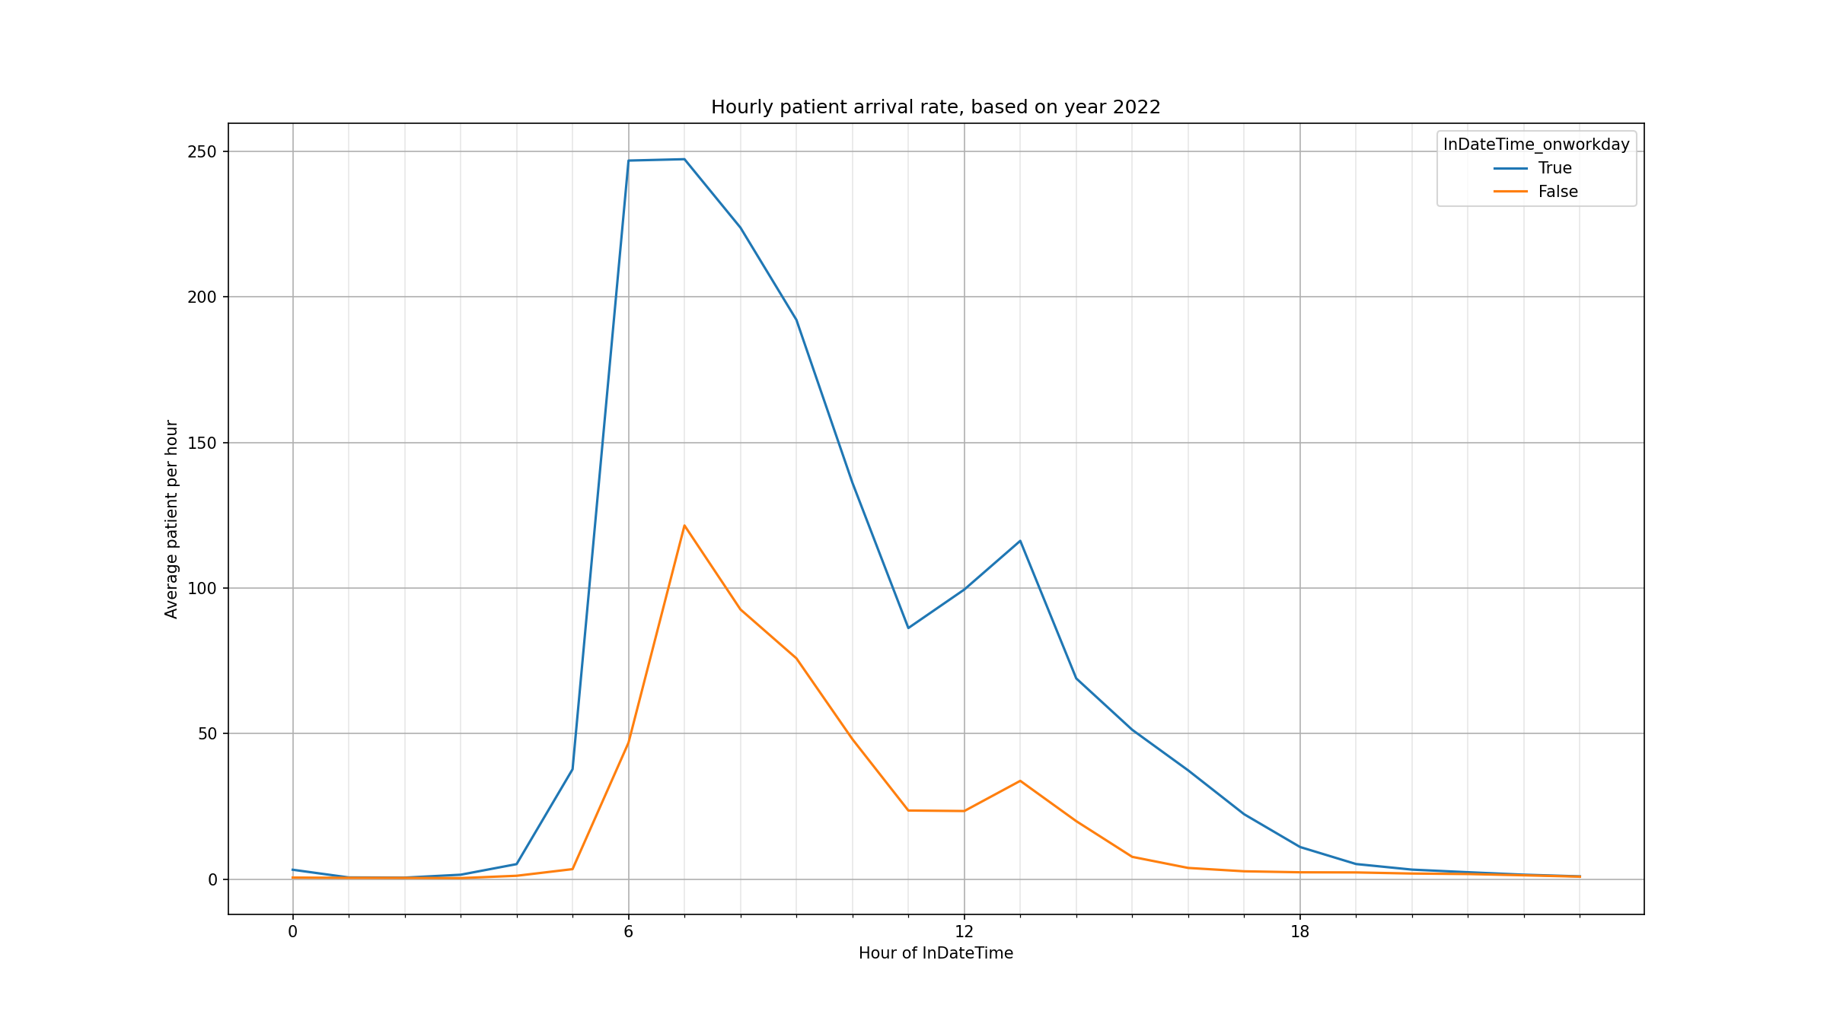
Hourly patient arrival rate in 2022, grouped by weekday name

Slide 18
DES Assumptions
Every patients must be started on OPD and sequentially visited through the last department without any deaths.
Every departments were visited only one time per VN, non any revisiting on the same VN.
Some unnecessary departments may be skipped, as the case may be
Average minutely interarrival time may be difference on working day and weekend.

Slide 19
DES Assumptions
Patients were able to get VN queue between 5am to 3pm.
OPD were started at 7am each day without any lunch or dining.
Other departments were 24/7 standby.
Distance between departments were insignificantly affected overall process time.
Any workers in the same department were equal on performance.

Slide 20
Process Time Estimation Result
Department | b
Intercept (OPD) | 47.8212
Laboratory | 39.788647
OR | 24.181263
Radiology | 50.242355
Orthopedics | 11.190809
Dematology | 13.065031
Neurology | 2.8287795
Dental | 31.856829
Ophthalmology | 33.430458
Otolaryngology | 18.843546
Thoracic | 23.66695
Hematology | 5.973023
Gi liver | 12.282339
Gynaecology | 30.360632
Nephrology | 22.84473
IPD | 48.2733
Physical Therapy | 48.408253
Pharmarcy | 36.675156
RMSE = 761.155987627
MAE = 255.2391
MAPE = 64.2965

Slide 21
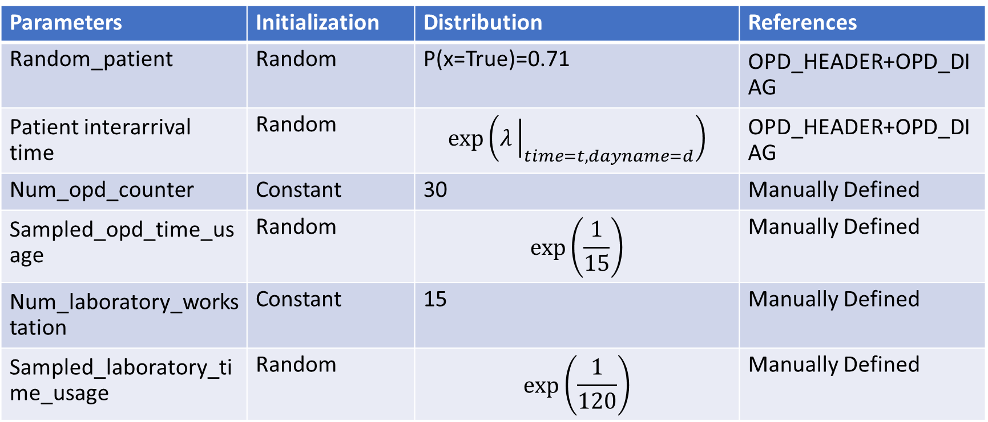
DES parameter initialization
Parameters | Initialization | Distribution | References
Random_patient | Random | P(x=True)=0.71 | OPD_HEADER+OPD_DIAG
Patient interarrival time | Random | $$\exp\left(λ{\left.​\right|}_{time=t,dayname=d}\right)$$ | OPD_HEADER+OPD_DIAG
Num_opd_counter | Constant | 30 | Manually Defined
Sampled_opd_time_usage | Random | $$\exp\left(\frac{1}{15}\right)$$ | Manually Defined
Num_laboratory_workstation | Constant | 15 | Manually Defined
Sampled_laboratory_time_usage | Random | $$\exp\left(\frac{1}{120}\right)$$ | Manually Defined

Slide 22
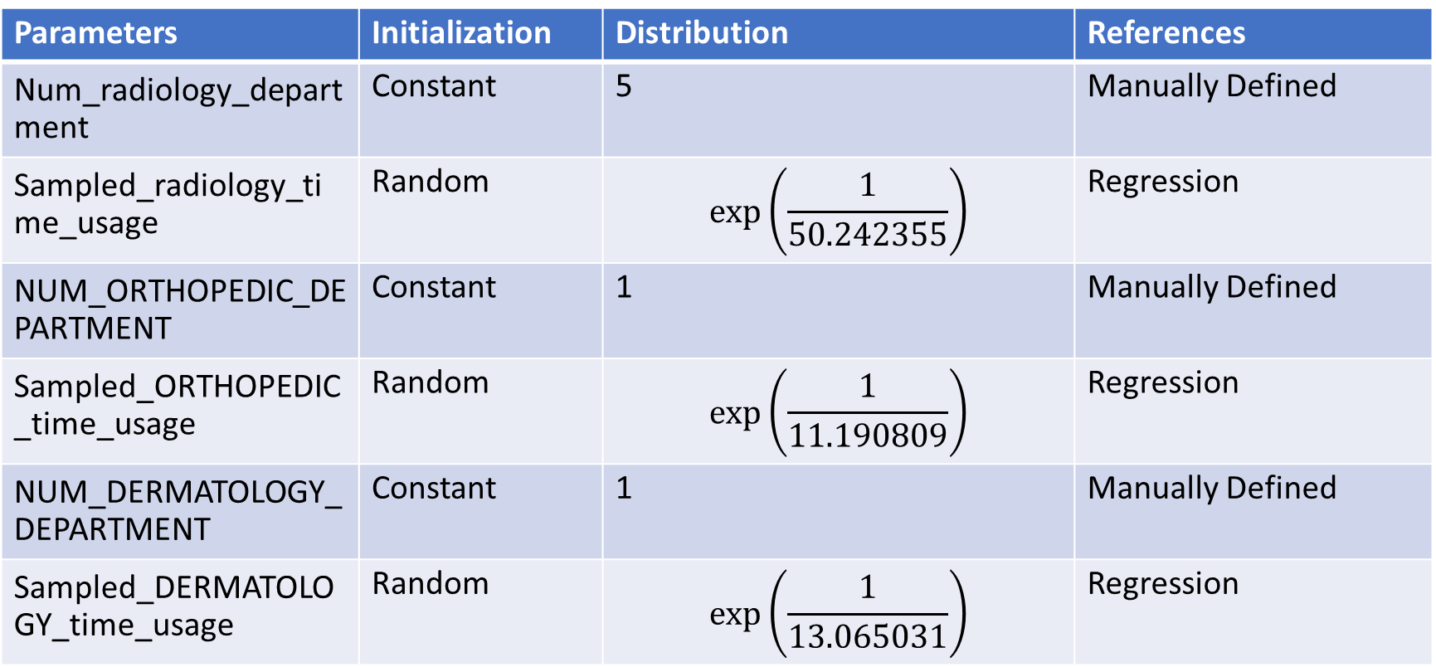
DES parameter initialization
Parameters | Initialization | Distribution | References
Num_radiology_department | Constant | 5 | Manually Defined
Sampled_radiology_time_usage | Random | $$\exp\left(\frac{1}{50.242355}\right)$$ | Regression
NUM_ORTHOPEDIC_DEPARTMENT | Constant | 1 | Manually Defined
Sampled_ORTHOPEDIC_time_usage | Random | $$\exp\left(\frac{1}{11.190809}\right)$$ | Regression
NUM_DERMATOLOGY_DEPARTMENT | Constant | 1 | Manually Defined
Sampled_DERMATOLOGY_time_usage | Random | $$\exp\left(\frac{1}{13.065031}\right)$$ | Regression

Slide 23
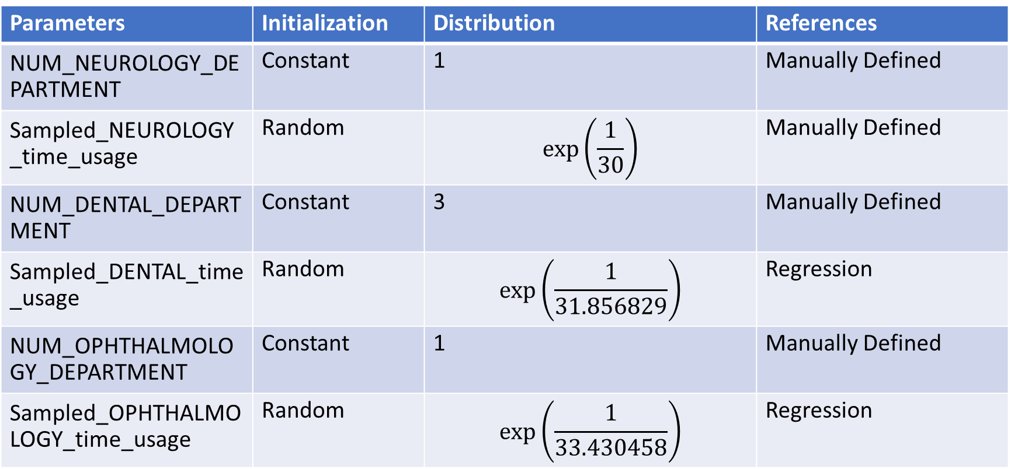
DES parameter initialization
Parameters | Initialization | Distribution | References
NUM_NEUROLOGY_DEPARTMENT | Constant | 1 | Manually Defined
Sampled_NEUROLOGY_time_usage | Random | $$\exp\left(\frac{1}{30}\right)$$ | Manually Defined
NUM_DENTAL_DEPARTMENT | Constant | 3 | Manually Defined
Sampled_DENTAL_time_usage | Random | $$\exp\left(\frac{1}{31.856829}\right)$$ | Regression
NUM_OPHTHALMOLOGY_DEPARTMENT | Constant | 1 | Manually Defined
Sampled_OPHTHALMOLOGY_time_usage | Random | $$\exp\left(\frac{1}{33.430458}\right)$$ | Regression

Slide 24
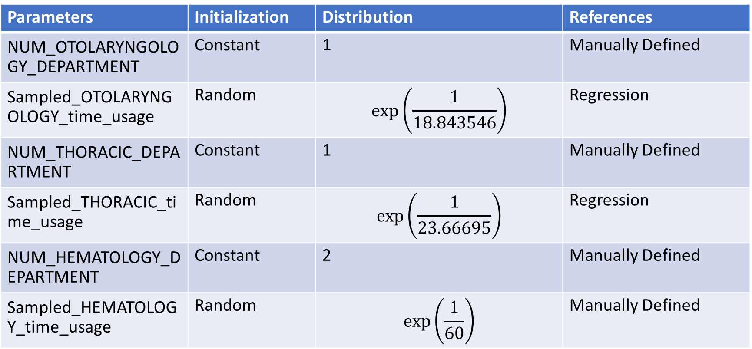
DES parameter initialization
Parameters | Initialization | Distribution | References
NUM_OTOLARYNGOLOGY_DEPARTMENT | Constant | 1 | Manually Defined
Sampled_OTOLARYNGOLOGY_time_usage | Random | $$\exp\left(\frac{1}{18.843546}\right)$$ | Regression
NUM_THORACIC_DEPARTMENT | Constant | 1 | Manually Defined
Sampled_THORACIC_time_usage | Random | $$\exp\left(\frac{1}{23.66695}\right)$$ | Regression
NUM_HEMATOLOGY_DEPARTMENT | Constant | 2 | Manually Defined
Sampled_HEMATOLOGY_time_usage | Random | $$\exp\left(\frac{1}{60}\right)$$ | Manually Defined

Slide 25
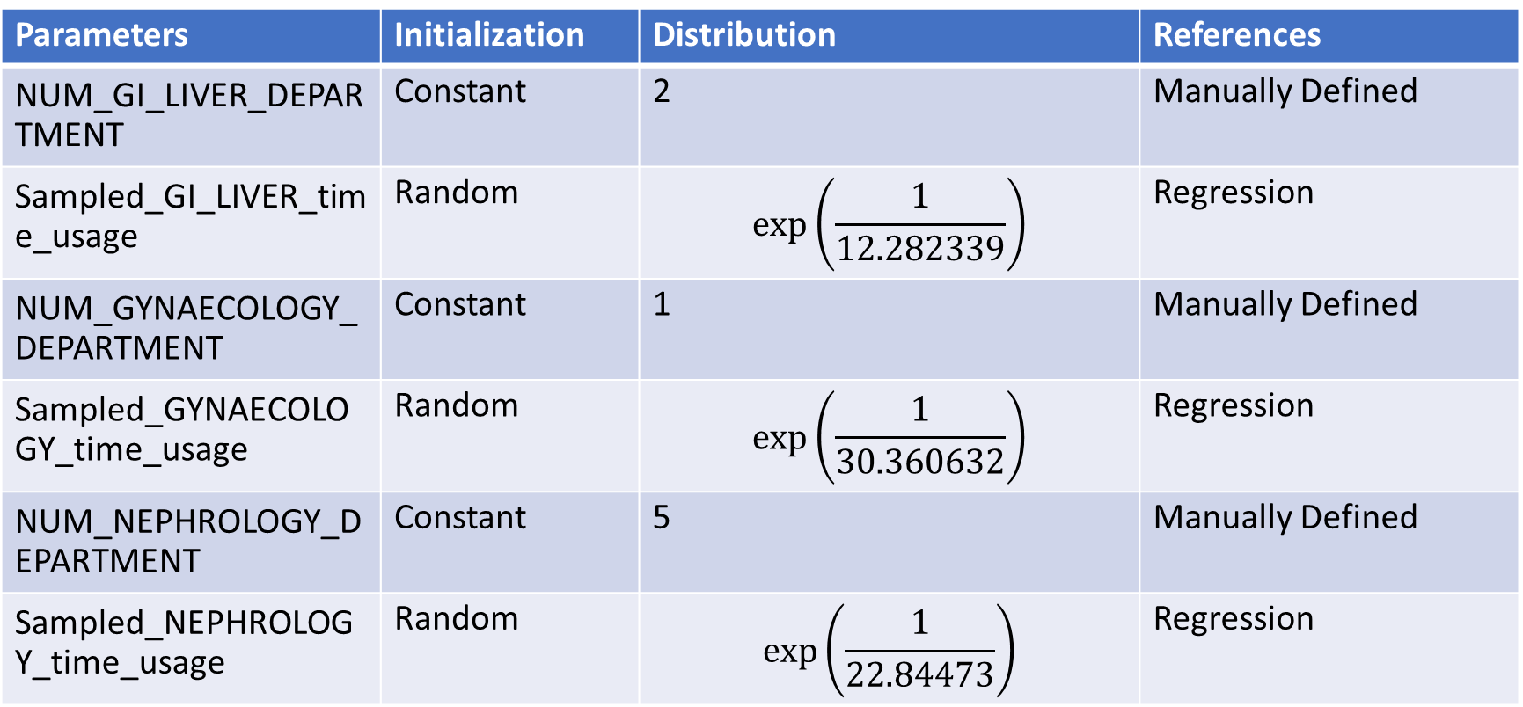
DES parameter initialization
Parameters | Initialization | Distribution | References
NUM_GI_LIVER_DEPARTMENT | Constant | 2 | Manually Defined
Sampled_GI_LIVER_time_usage | Random | $$\exp\left(\frac{1}{12.282339}\right)$$ | Regression
NUM_GYNAECOLOGY_DEPARTMENT | Constant | 1 | Manually Defined
Sampled_GYNAECOLOGY_time_usage | Random | $$\exp\left(\frac{1}{30.360632}\right)$$ | Regression
NUM_NEPHROLOGY_DEPARTMENT | Constant | 5 | Manually Defined
Sampled_NEPHROLOGY_time_usage | Random | $$\exp\left(\frac{1}{22.84473}\right)$$ | Regression

Slide 26
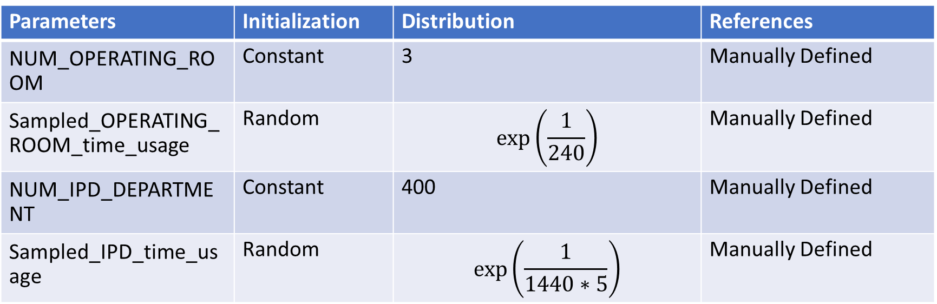
DES parameter initialization
Parameters | Initialization | Distribution | References
NUM_OPERATING_ROOM | Constant | 3 | Manually Defined
Sampled_OPERATING_ROOM_time_usage | Random | $$\exp\left(\frac{1}{240}\right)$$ | Manually Defined
NUM_IPD_DEPARTMENT | Constant | 400 | Manually Defined
Sampled_IPD_time_usage | Random | $$\exp\left(\frac{1}{1440∗5}\right)$$ | Manually Defined

Slide 27
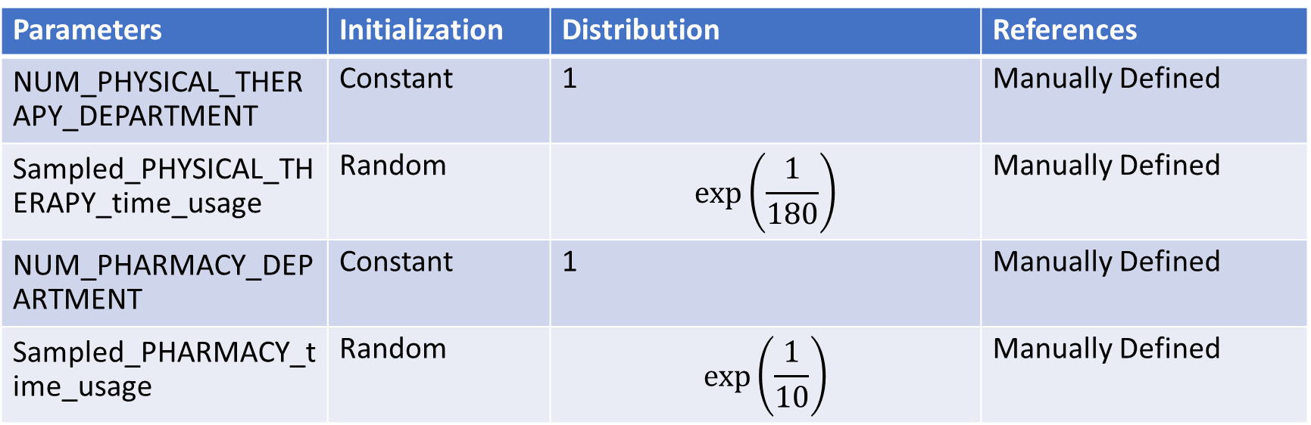
DES parameter initialization
Parameters | Initialization | Distribution | References
NUM_PHYSICAL_THERAPY_DEPARTMENT | Constant | 1 | Manually Defined
Sampled_PHYSICAL_THERAPY_time_usage | Random | $$\exp\left(\frac{1}{180}\right)$$ | Manually Defined
NUM_PHARMACY_DEPARTMENT | Constant | 1 | Manually Defined
Sampled_PHARMACY_time_usage | Random | $$\exp\left(\frac{1}{10}\right)$$ | Manually Defined

