Slide 1


Developed by
Personal hygiene
Notes:
Instructor notes:
Trainer to enter wearing torn lab coat, large jewellery (watch, rings, necklace, earrings), fingernail polish that is chipped, hairnet not covering all hair, open toed shoes, cut but not bandaged finger, torn/dirty gloves, chewing gum or eating/drinking
Good morning everyone. Before we start, can some one give me a tour of the plant?
(The group should say no, as you are not dressed properly)
Why not? (let them tell you each thing that is wrong.)
If they are hesitant, cue them with one simple thing. For example- “Perhaps I should discard my gum first”. Take off or fix each item as you discuss it.
After completing the list, you should be dressed properly…move onto the next slide

Slide 2
Agenda
Importance of good personal hygiene
Contamination
Proper dress
What you can and can’t do at work
If you are sick
Hand washing
Notes:
Today, we will discuss the following (read bullet points). It should take about one hour and we will be doing some exercises, to help you learn and so I can get feedback on what you understand

Slide 3
Importance of good personal hygiene
Food safety
  Prevent contamination of food products
Notes:
Ask “Why is personal hygiene important?”
Let the group give you some answers.
The basic answer is to “keep the food safe”, but they will word it many different ways.
(Keep people from getting hurt, getting sick, keep our jobs…..)
Remind them about the training session on hazards that they have already done.
Be sure to consider each answer carefully and indicate why it is right.
Then summarize with your answers.

Slide 4
Hazard review
Physical
Chemical
Biological
Notes:
Review types of hazards; Chemical. Physical and Biological and make it specific to your operation. Ask for examples from the group.
Remind them of the sorting exercise that was done in a previous session.

Slide 5
Food safety
Preventing or reducing contamination of foods
  by people or
  by their actions or inactions
Notes:
Read bullets and give examples.
Ask what they can do in their jobs to prevent contamination.
They may bring up all the items in proper attire that you just discussed.
Try and broaden it into actions and inactions as well (use personal examples that apply to your company and company policies)
For example:
In a bakery: how racking bread is done from top to bottom and unracking is form bottom to top so that the pans when sliding on the racks do not scrap something on to the pans below.
In a processing plant: you shouldn’t pick up garbage and then go back to work on the line

Slide 6
Proper dress
Clean uniforms
No tears
Closed toe shoes, no heels
Clean foot ware
Hair restraints
  Hairnets, beard nets
Notes:
These next slides are used as a summary of some of the things that were discussed. They may have brought them up, if not, spend some time talking about why they are important:
Clean uniforms: Dirty clothes or clothes from outside bring in contaminants such as dirt form the seat that you sat in on the bus Hairs form your pets, smoke and ashes if you smoke in your car…..
Torn clothes may add fibers of cloth to the product.
No heels and closed toes for safety as well
Clean foot ware so that you do not track dirt around the production area.
Hair restraints to prevent hairs from entering the product. Hair can have dirt, grease etc on it. Would you like to eat food that has a dirty hair in it?

Slide 7
Proper dress
No jewelry
  Wedding bands?
No visible body piercing
No nail polish, false fingernails
No false eyelashes
Notes:
Jewelry (watches, earrings, rings including body piercings )is a hazard, You can break a tooth if you bite something hard. Also jewelry can get caught on equipment so it is also a safety hazard.
Some companies allow plain wedding bands (no stones) covered by a bandage and a glove.
Nail polish can chip , false eyelashes and fingernails can fall into the product.

Slide 8
What you can’t do at work
No eating
No drinking
No smoking
No spitting
No chewing gum
Notes:
No eating or drinking, smoking, spitting…. Again may add contaminates to the food products.

Slide 9
If you are hurt….
All open cuts or wounds are to be protected with a secure waterproof covering
  Bandage and glove
Notes:
Blood is a carrier of many diseases, so we need to protect food and workers from blood.
Remember that bandages are also a hazard, so they should be covered by a glove. Many food companies use metal detectable bandages, so they can be detected, if they come off and fall into the product.

Slide 10
If you are ill……
Inform your supervisor if you exhibit the any of the following symptoms:
    jaundice (yellowing of eyes and skin)
    diarrhea
    vomiting
    fever
    sore throat with fever
    boils or cuts
    discharges from ears, nose or eyes
    excessive coughing or sneezing.
Notes:
You do not do anyone any good if you come to work sick. These germs can be passed form you to your coworkers and sometimes even to customers.
Mention some of the recent food service issues. In Calgary in October 2007, someone with Hepatitis A at MacDonald's made many people ill. It resulted in over 1,000 people having to get Hepatitis A shots. Be sure to keep your examples timely.

Slide 11
When do you wash your hands?
Before
  starting to work
Notes:
When should you wash your hands? Read the bullets…each of these is an instance where cross contamination can occur.
Before work: Hands may be dirty because of all the things that you touched on you way to work
Raw ingredients contain bacteria
Smoking, eating, drinking: already discussed
Sneezing, coughing spreads germs, your body is covered in germs and dirt
After handling dirty or contaminated things
Garbage obviously is dirty
Similarly after using the washroom

Slide 12
When do you wash your hands?
After:
Handling raw ingredients
Smoking, eating or drinking
Using a handkerchief or tissue
Touching any dirty object or surface
Touching any part of your body
Cleaning or taking out garbage
Using the washroom

Slide 13
Hand washing
Wet hands
Soap (20 seconds)
Scrub back of hands, wrists, between fingers, under fingernails, arms almost to elbows
Rinse
Notes:
How should you wash your hands?
Follow this procedure
Pay particular attention to the creases in your knuckles, your nail beds, between your fingers. These creases and crevices are where bacteria like to sit and they are harder to remove with a quick hand washing.
The towel should be a single use paper towel, because studies have shown that reusable towels often are not cleaned properly. And in our climate, air dryers are not as effective because of the low humidity and people tend not to dry their hands completely and may wipe their hands on their uniforms instead, thereby recontaminating them.
Turn off the taps with the towel to prevent your clean hands from getting dirty immediately as you turned on the taps with your dirty hands. Similarly with the door handle.

Slide 14
Hand washing (cont’d)
Towel dry (single use towel)
Turn off taps with towel
Open door with towel
Discard towel in appropriate manner

Slide 15
Hand washing
Demonstration
Notes:
Use Glow germ and demonstrate how hands should be washed .
If the group is small, each person should be asked to participate in the exercise. Otherwise ask for volunteers. Stress the key areas again.

Slide 16
Quiz
Spot the Hazards:
Personal Hygiene Practices
Notes:
You will now have 5-10 minutes to complete this short evaluation. Please circle all the actions and items that do not demonstrate personal hygiene practices. We will then review it as a group and you will mark your own.
In the review, ask each person to give one example and go around the group until all are mentioned.

Slide 17
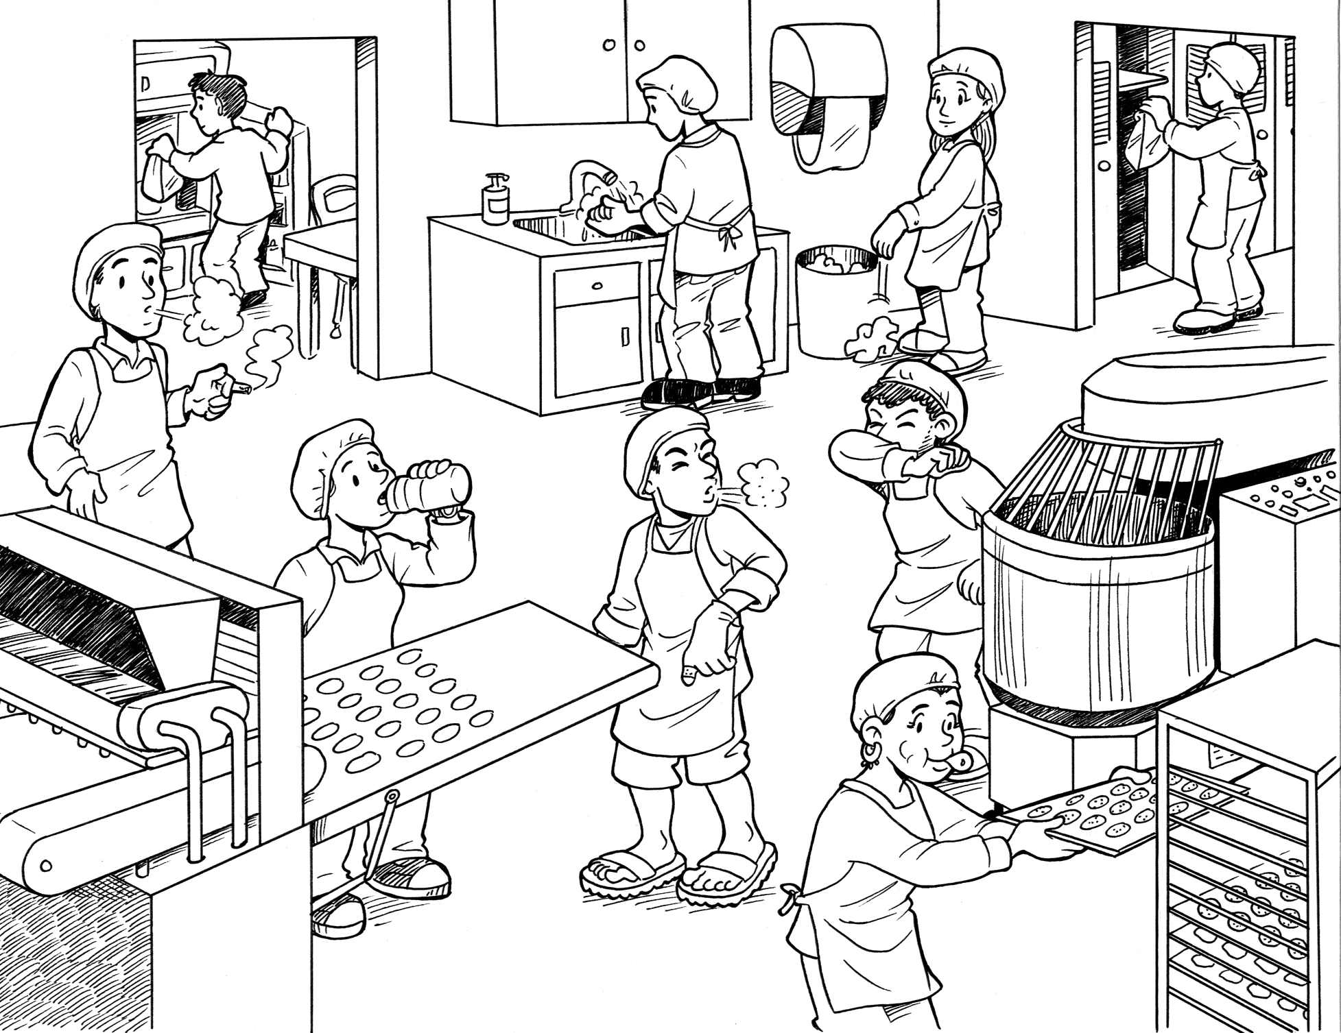

Slide 18
Practical application
Notes:
This is a good point to ask the participants for an example of an action that they practice as part of Good Personal Hygiene. Involve each member of the group in the discussion by use of questions.

Slide 19
On the job.....
Practice good hygiene
  What you wear
  What you do
  Hand washing too

Slide 20
Personal hygiene
Questions ?
Notes:
Summarize the learning concepts and ask for questions. Remember to thank them for their time. Tell them that these activities will be monitored.

