Slide 1
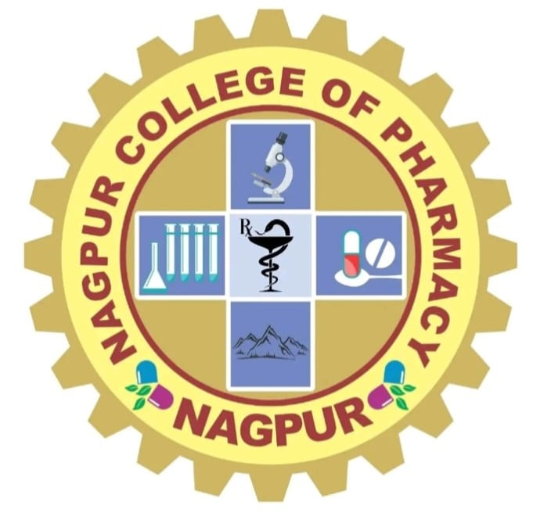
VITAMIN C (Ascorbic Acid)
Presented by- Guided by-
Ms. Payal T. Kawle Mrs. Sujata V. Wankhede
(B.Pharm final year)

Slide 2
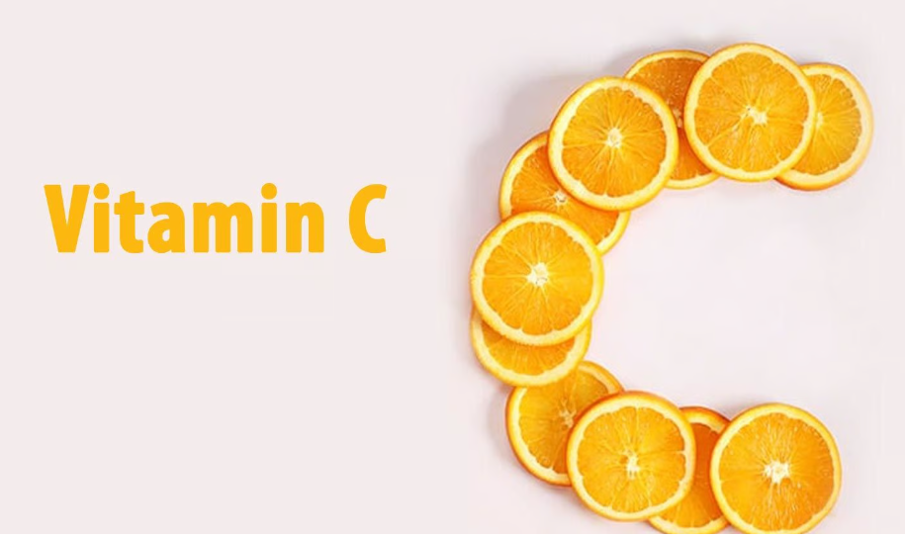
TOPIC

Slide 3
CONTENT
Introduction
Structure
Benefits of vitamin C
Sources
Functions of vitamin C
Symptoms and
Side effects of Ascorbic acid

Slide 4
Introduction :-
Viatmin C, also known as ascorbic acid and L- ascorbic acid, is a vitamin found in food and used as a dietary supplement.
Was discovered in 1912, isolated in 1928, and first made in 1933.
It is water- soluble vitamin.
Occurs as a white or slightly yellow crystal or powder with a slight acidic taste.
On exposure to light, it gradually darkens.
In the dry state, it is reasonably stable in air, but in solution it rapidly oxidizes.
Ascorbic acid (viamins C) is freely soluble in water, sparingly soluble in alcohol; Insoluble in chloroform, in ether, and in benzene.

Slide 5
Structure:-
Scientific Name:- Ascorbic Acid
Chemical formula:-C₆H₈O₆
Other common names:-Ascorbic acid or Ascorbate Or Hexuronic acid Or Cevitamic acid
Appearance:-White to slightly yellowish crystalline powder, practically oderless, with a strong acidic taste.
Melting Point :-About 190℃
Boiling Point:-553℃
Solubility in water:-330g/L;Dissolves well in water to give mildly acidic solution.

Slide 6
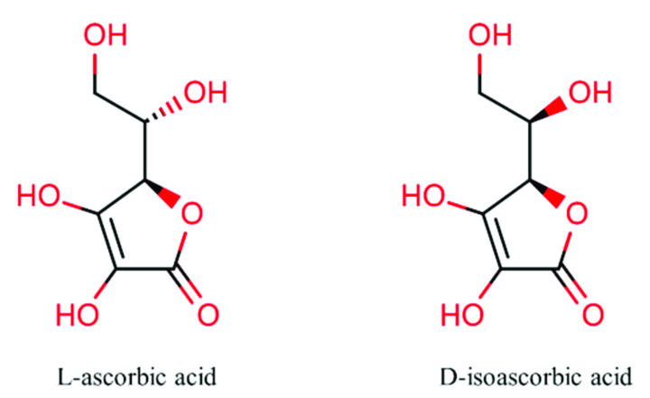
Structure of Ascorbic acid (L-ascorbic acid & D-isoascorbic acid)

Slide 7
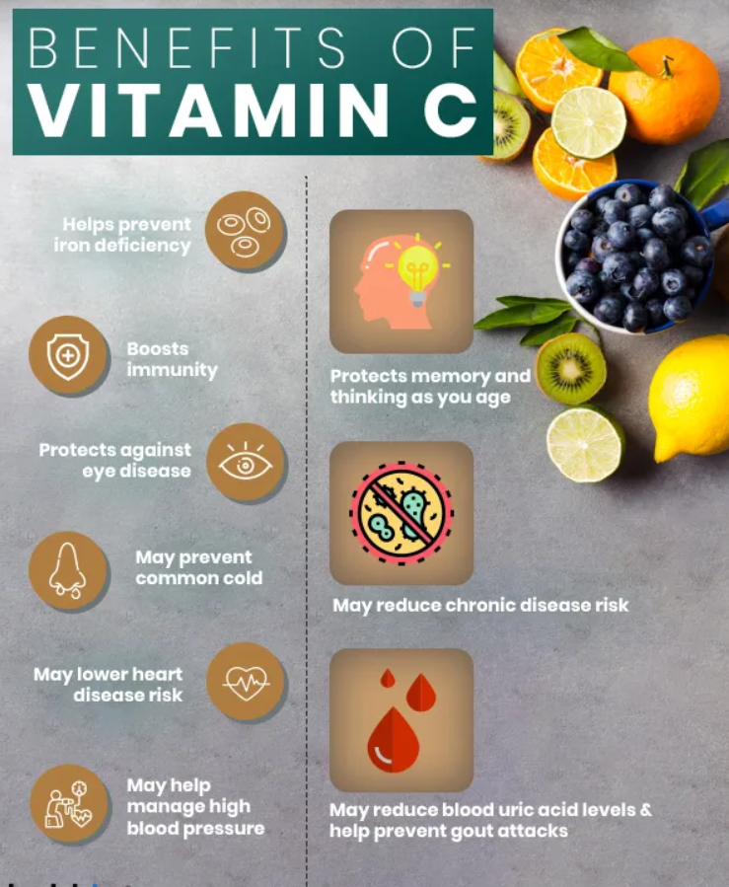
Benefits of vitamin C
Essential in growth and repairment of tissues
Need to form important proteins that are used to make skin, tendons, ligaments and blood vessels.
Heal wounds and forms the scar tissue.
Repairs and maintans cartilage, bones and teeth.
Aids in the absorption of iron.
Contributes to improve the immune defense system of the body.

Slide 8
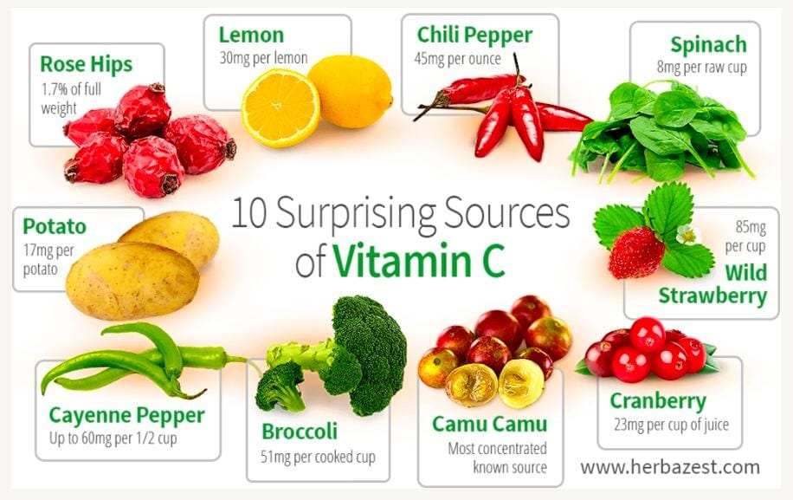
Sources:-
The main dietary sources of vitamin C are leafy vegetables and fruits, especially citrus fruits like amia, guaua, lemom, strawberries, tomatoes, spinach and potatoes.
Cereals contain no vitamin C.
Animals tissues and dairy products are very poor sources.

Slide 9
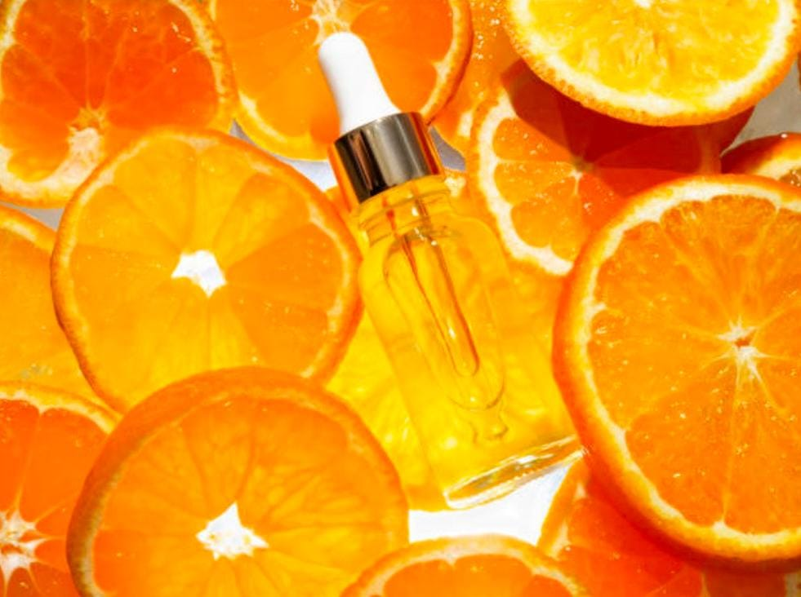
Functions of Vitamin C (Ascorbic acid ):-
Oxidation of tyrosine and phenylalanine
Formation of hydroxyproline,
Preventing depolymerization of collagen
Important in hemopoiesis
Synthesis of collagen, carnitine, hormone and amino acids
Essential for wound healing
Facilitates recovery from burns
Supports immune function
Facilitates the absorption of iron.

Slide 10
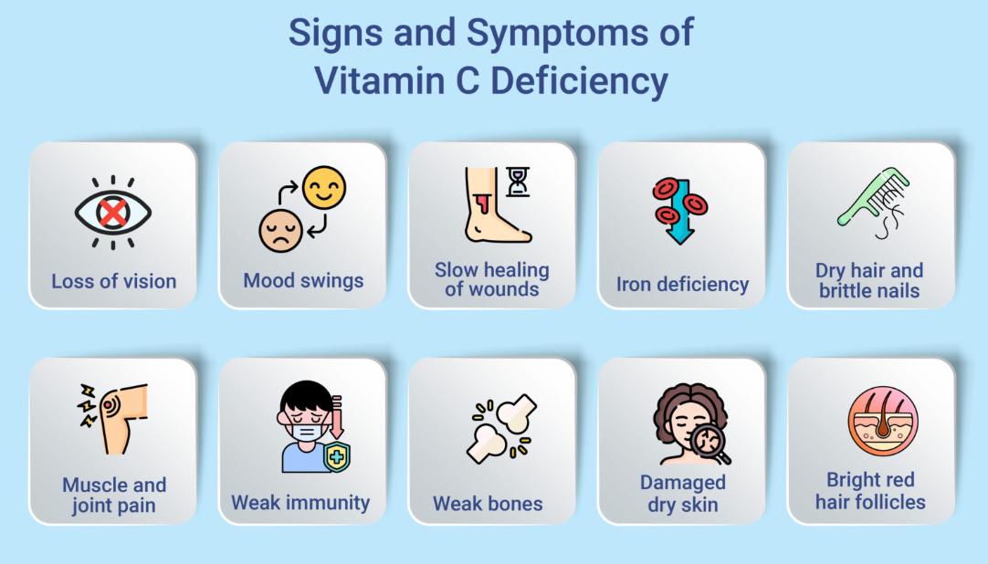
symptoms
Scurvy
Anemia
Bleeding of gums
Decreased wound-healing rate
Dry and splitting hair
Swollen and painful joints
Weakened tooth enamel

Slide 11
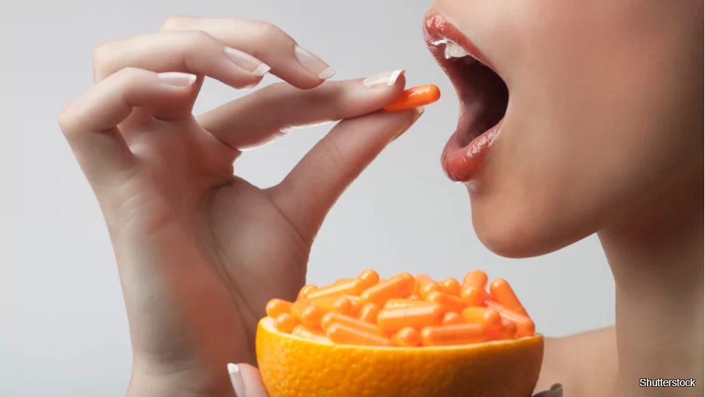
Side Effects of Ascorbic acid
Ascorbic acid is a water-soluble vitamin and is safe for most people when taken in recommended doses. However, as with any vitamin and supplement, there is protential for side effects.
The most common side effects of ascorbic acid includes :
Headache
Nausea
Diarrhea
Stomach cramps
These side effects are usually mild and resolve on their own within a few days.

Slide 12
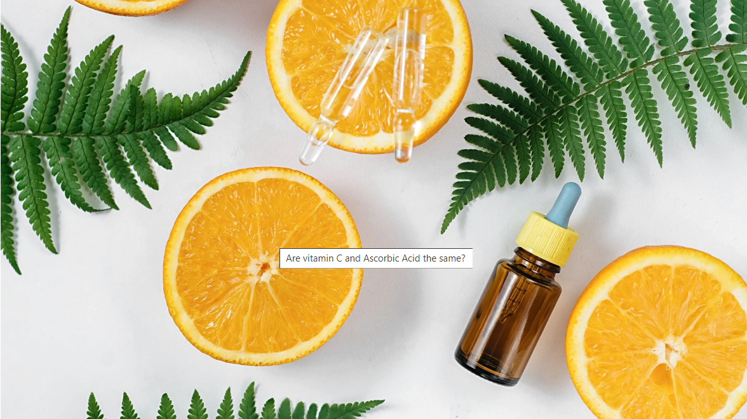
Cont………
Rare but serious side effects can occurs, such as :
Kidney stones
Gout
Sever allergic reaction

Slide 13
Thank you !

