Slide 1
Comparative Performance Analysis of PHP MVC Frameworks
Corey Black - B01651145
BSc (Hons) Web & Mobile Development Computing Honours Project (COMP10034) Supervisor: Dr Pablo Salva Garcia Moderator: Mr Sajjad Bagheri University of the West of Scotland February 2026

Slide 2
Research Problem & Contribution
Research Problem
Limited rigorous, controlled empirical evaluation of PHP framework-level performance.
Comparative findings are often fragmented and methodologically inconsistent.
Framework selection is frequently influenced by ecosystem popularity rather than reproducible performance analysis.
Research Gap
Many comparative studies rely on non-equivalent implementations.
Runtime and environmental configurations are often inconsistent.
Micro-benchmarks frequently lack representative CRUD workload realism.
Controlled studies using functionally equivalent, real-world implementations remain limited.
Research Contribution
Establishes a controlled, reproducible experimental framework for evaluating framework-level architectural performance.
Isolated architectural overhead through single independent variable design.
Provides empirically grounded evidence to support informed, evidence-based framework selection.

Slide 3
Aim and Objectives
Aim
To empirically evaluate and compare the architectural performance characteristics of four major PHP MVC frameworks under controlled, functionally equivalent conditions.
Objectives
Implement functionally equivalent CRUD-based applications in Laravel, Symfony, CodeIgniter and Yii.
Establish a standardised experimental environment (PHP 8.2.12, Apache, MariaDB) with controlled runtime configuration.
Design and execute reproducible benchmarking scenarios using Apache JMeter and Locust.
Measure response time (mean, P95), throughput, and memory utilisation under defined concurrency levels.
Analyse performance differences in relation to framework architecture (middleware depth, service container overhead, ORM abstraction).

Slide 4
Research Methodology & Experimental Design
Dependant Variables (Performance Metrics)
Research Approach
Controlled Variables
Controlled experimental benchmarking study.
Single independent variable: PHP MVC framework (Laravel, Symfony, CodeIgniter, Yii).
Functionally equivalent CRUD applications to isolate architectural overhead.
Identical database schema and fixed dataset size.
PHP 8.2.12 runtime and consistent Apache/MariaDB configuration.
Debugging disabled; production-equivalent settings applied.
Identical workload definitions and concurrency levels.
Response time (mean, P95 tail latency).
Throughput (requests per second).
Resource utilisation (CPU and memory consumption).

Slide 5
Benchmarking Framework & Workload Design
Benchmarking Tools
Workload Design
Load Configuration
Apache JMeter – controlled load generation.
Locust – scripted, behaviour-driven workload simulation.
Multiple repeated runs per framework for statistical stability.
Standardised CRUD endpoints (Create, Read, Update, Delete).
Identical request payloads and fixed dataset size.
No application-level caching enabled.
Defined concurrency levels: 1, 10, 50, 100 users.
Controlled ramp-up periods and warm-up phase.
Percentile-based analysis (P95) from aggregated results.

Slide 6
Experimental Environment & System Configuration
Runtime & Configuration Controls
Hardware & OS
Software Stack
memory_limit = 128M
max_execution_time = 30
OPcache enabled
display_errors = Off
Debug mode disabled across all frameworks
Production-equivalent settings applied
No framework-specific performance optimisations
Dependencies frozen for entire benchmarking phase
Windows 11 Home (Version 25H2, Build 26200.7623)
AMD Ryzen 7 5800X (8-Core Processor)
32GB DDR4 RAM
Localhost benchmarking environment
XAMPP 3.3.0
Apache 2.4.58 (Win64)
PHP 8.2.12 (Thread Safe)
MariaDB 10.4.32 (InnoDB, utf8mb4)
Composer 2.2.25

Slide 7



Standardised Application Architecture
Presentation Layer
Web Server Layer
Application Layer
Data Layer
MariaDB
JSON
Response
Client
Framework Router
Apache
Controller
Model / ORM
Request Processing Overhead
Framework-level routing resolution
Middleware stack traversal
Service container resolution overhead
Data Abstraction Overhead
ORM abstraction layer execution
Query builder -> SQL generation
Connection pooling via PDO
Response Serialisation Overhead
Model hydration / object mapping
JSON serialisation
HTTP status + header composition

Slide 8
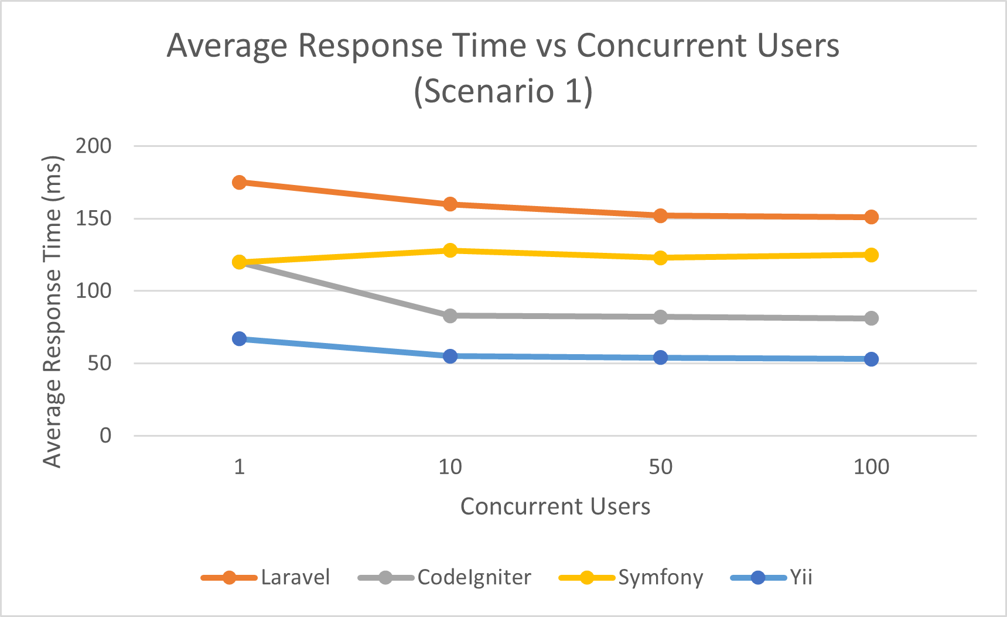
Scenario 1 – Average Response Time Scaling (1-100 Users)
Key Findings
Yii achieved the lowest mean response time decreasing from 67ms (1 user) to 53ms (100 users).
CodeIgniter reduced from 120ms to 81ms under scaling, demonstrating efficient request handling.
Laravel decreased from 175ms to 151ms, but maintained the highest baseline latency.
Symfony remained between 120-125ms under scaling conditions.
No non-linear or exponential degradation observed up to 100 concurrent users.

Slide 9
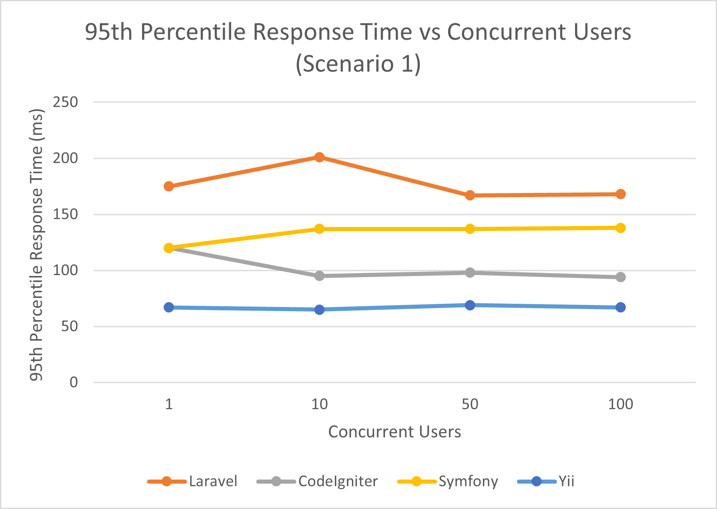
Scenario 1 – Tail Latency (95th Percentile)
Key Findings
Laravel peaked at 201ms P95 under 10-user concurrency, indicating higher tail variability.
Symfony maintained consistent but elevated P95 values (137-138ms).
CodeIgniter stabilised between 94-98ms P95 under scaling.
Yii maintained the lowest and most stable P95 (65-69ms).
Stable P95 suggests predictable request pipeline performance under load.

Slide 10
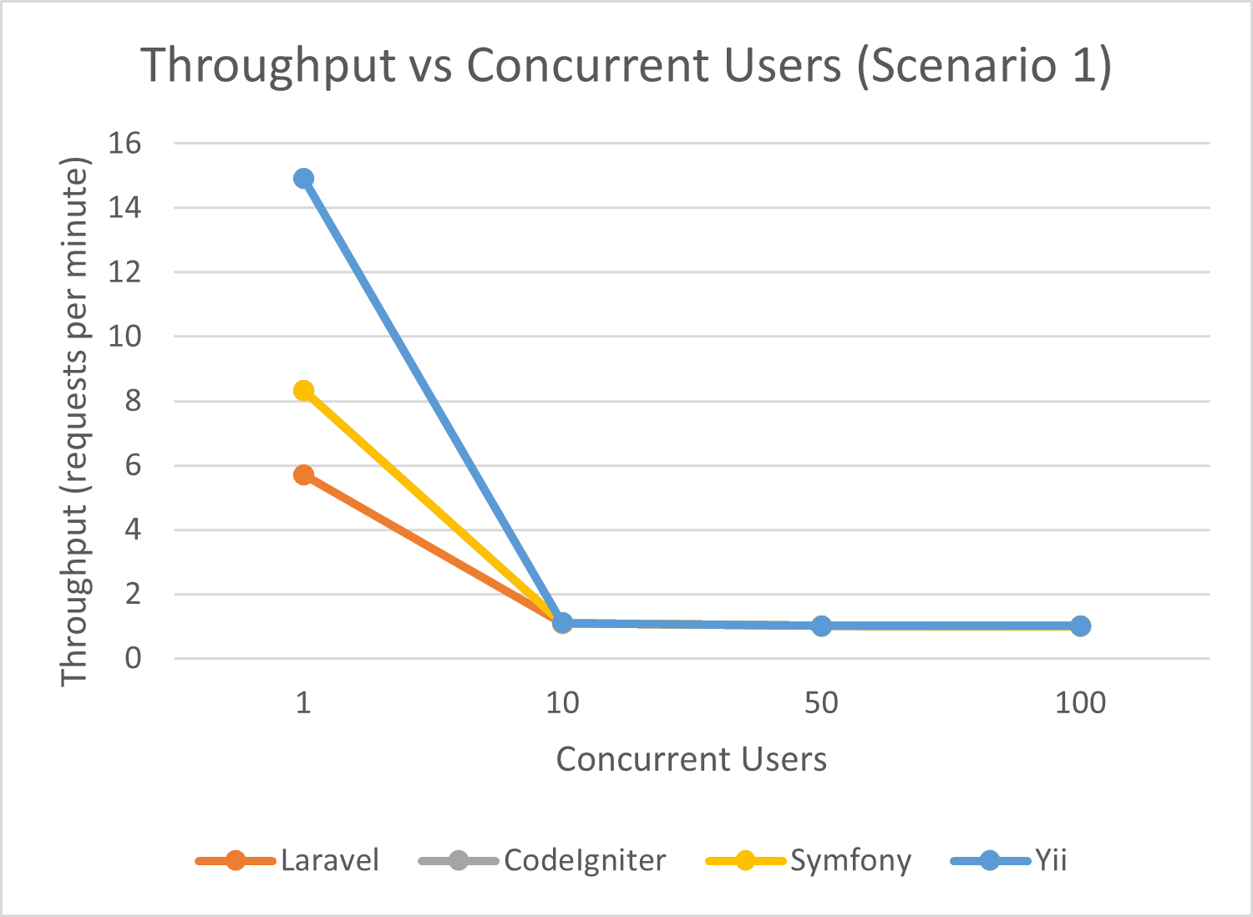
Scenario 1 – Throughput Scaling Behaviour
Key Findings
At single-user load, Yii achieved the highest throughput (14.9 req/min), compared to Laravel (5.7 req/min).
Under 10+ concurrent users, throughput converged across frameworks (~1.0-1.1 req/min).
Similar throughput patterns under scaling suggest environmental saturation rather than framework-specific collapse.
No framework demonstrated exponential throughput degradation.

Slide 11
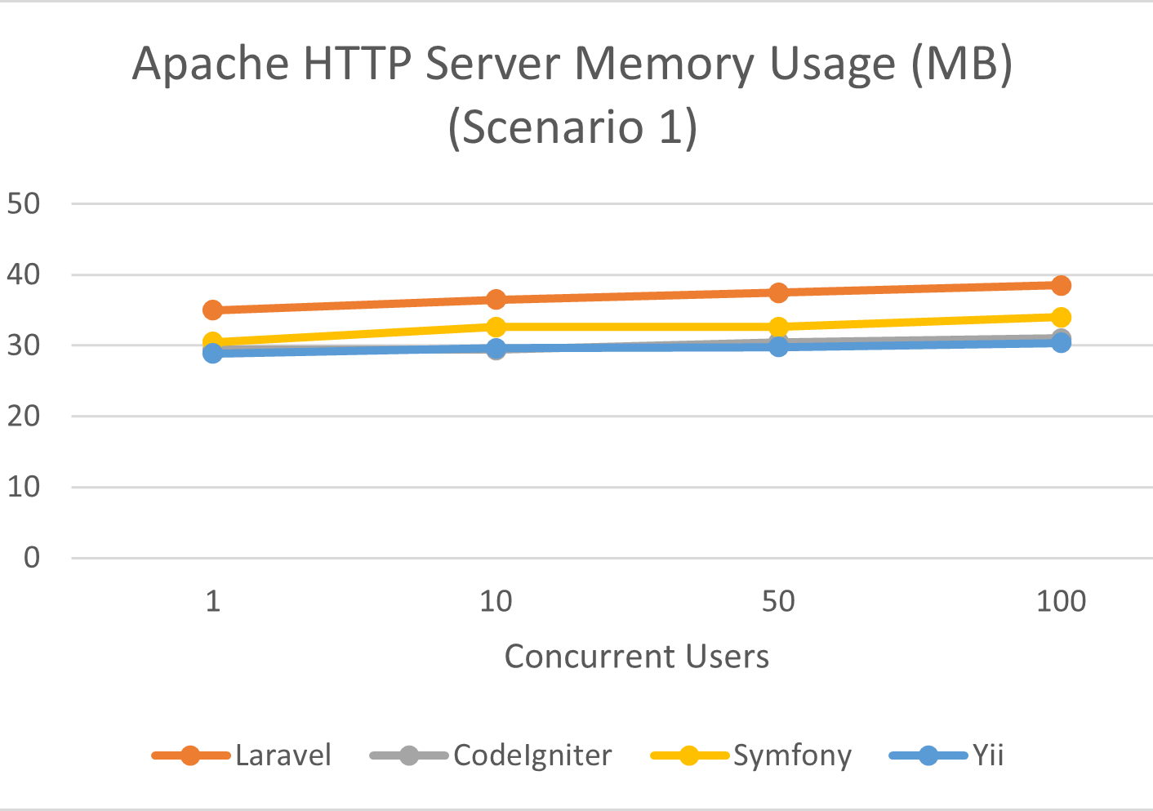
Scenario 1 – Memory Efficiency Comparison
Key Findings
Laravel consumed the highest memory footprint, increasing from ~35MB to ~38MB under scaling.
Yii maintained the lowest memory usage (~29~30MB) across all concurrency levels.
CodeIgniter remained stable around 30-32MB, demonstrating lightweight execution.
Symfony exhibited moderate memory overhead (~31~33MB).
Memory growth remained linear, with no abnormal allocation spikes.

Slide 12
Scenario 1 – Comparative Performance Summary
Framework | Avg RT @100 Users | P95 RT @10 Users | Memory @ 100 Users | Overall Profile
Laravel | 151ms | 201ms | ~38MB | Feature-rich, higher overhead
Symfony | 125ms | 137ms | ~33MB | Structured, moderate overhead
CodeIgniter | 81ms | 95ms | ~32MB | Lightweight
Yii | 53ms | 65ms | ~30MB | Balanced, lowest overhead
Under controlled read-heavy conditions, Yii and CodeIgniter demonstrated substantially lower latency and memory overhead than Laravel and Symfony.

Slide 13
Architectural Factors Influencing Performance
Middleware & Request Pipeline Depth
Laravel and Symfony implement layered middleware stacks and deeper request pipelines.
Additional traversal and resolution steps increase baseline latency.
CodeIgniter and Yii follow a more direct execution path with fewer abstraction layers.
Service Container & Dependency Resolution
Dynamic dependency injection in Laravel and Symfony introduces runtime resolution overhead.
ORM Abstraction Overhead
Eloquent (Laravel) and Doctrine-style ORM patterns introduce abstraction cost during query execution.
CodeIgniter and Yii demonstrated lower overhead in equivalent CRUD operations.
Caching and Lazy Loading Mechanisms
Yii’s lazy loading and internal optimisations likely contributed to improved latency stability.
Reduced unnecessary object instantiation lowers memory footprint.
Framework Philosophy Trade-Offs
Feature-rich frameworks prioritise extensibility and maintainability.
Lightweight frameworks prioritise execution efficiency and lower runtime overhead.

Slide 14
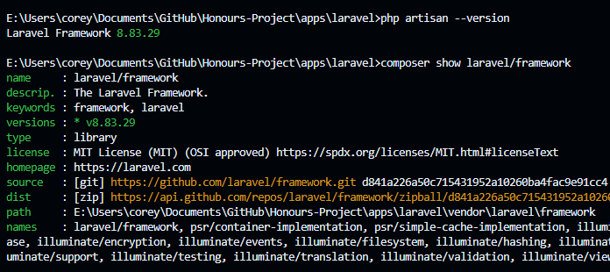
Qualitative Developer Experience Comparison
Implementation Workflow
Official Composer distributions used for all frameworks.
Projects structured within unified /apps directory inside single Git repository.
Identical CRUD logic implemented using each framework’s native MVC conventions.
Schema & Data Consistency
Single shared MariaDB schema definition.
Identical table structure, indexes, and seed dataset applied across all frameworks.
No framework-specific schema extensions introduced.
Operational Observations
Setup complexity comparable across frameworks.
Primary differences emerged at architectural runtime level, not installation stage.
Variations in developer ergonomics (CLI tooling, configuration verbosity, ORM abstraction depth).

Slide 15
Practical Implications for Framework Selection
Performance-Critical or Resource-Constrained Environments
Yii and CodeIgniter demonstrated lower latency and memory usage under read-heavy workload conditions.
Suitable for high-traffic APIs or limited-resource hosting environments.
Enterprise-Scale and Modular Systems
Symfony’s structured component architecture supports maintainability and extensibility.
Appropriate where long-term scalability and modular design outweigh raw performance.
Rapid Development and Ecosystem Support
Laravel provides extensive tooling, developer ergonomics, and ecosystem maturity.
Trade-off observed between abstraction richness and runtime efficiency.
Performance vs Maintainability Trade-offs
Lightweight frameworks prioritise execution efficiency.
Feature-rich frameworks prioritise architectural flexibility and developer productivity.
Framework selection should align with application requirements, not popularity.

Slide 16
Limitations and Threats to Validity
Controlled Local Testing Environment
Benchmarks conducted in a non-production local environment.
Results may differ under distributed or cloud-based deployments.
Single Workload Type (Read-Heavy CRUD)
Scenario 1 focuses on read-dominant access patterns.
Write-heavy or compute-intensive workloads may produce different behaviour.
No Advanced Optimisation Techniques Applied
Default framework configurations used.
Production-level tuning (caching layers, reverse proxies, OPcache optimisation) not explored.
Limited Concurrency Range
Concurrency evaluated up to 100 users.
Higher-scale stress testing may reveal different scalability characteristics.
Framework Version and Runtime Dependency
Results are specific to tested PHP version and framework releases.
Future updates may alter performance characteristics.

Slide 17
Conclusion and Objective Evaluation
Objective 1 – Develop Functionally Equivalent Applications ✔
CRUD applications implemented in Laravel, Symfony, CodeIgniter and Yii.
Identical REST endpoints and database schema.
Objective 2 – Standardised Experimental Environment ✔
PHP 8.2.12, Apache 2.4.58, MariaDB 10.4.32.
Debug disabled, OPcache enabled.
No framework-specific optimisations.
Objective 3 – Reproducible Benchmarking ✔
Apache JMeter + Locust.
Controlled concurrency (1-100 users).
Multiple repeated runs.
Objective 4 – Performance Measurement ✔
Mean response time.
P95 tail latency.
Throughput scaling.
Memory usage.
Objective 5 – Architectural Analysis ✔
Middleware depth examined.
Service container overhead evaluated.
ORM abstraction impact analysed.
Current Stand-Point ✔
Under controlled read-heavy conditions, Yii demonstrated the most balanced overall performance profile, followed closely by CodeIgniter.

Slide 18
Thank you
Corey Black
B01651145

