Slide 1

Presentation on
Linux
G:\stat book\Masters~M.Sc\Sohan_Bioinformatic_HPC\linux all pdf

Slide 2
What is shell?
Shell is small program the user uses for executing the commands.
shell
kernel
Hardware

Slide 3
Terminal immulator
Prompt :
[kawsar@stat ~]$
  user name: kawsar
  Host name: stat
  Workinng-directory: ~
  User previllage: for common user $ and super user or root user or administrator user #.

Slide 4
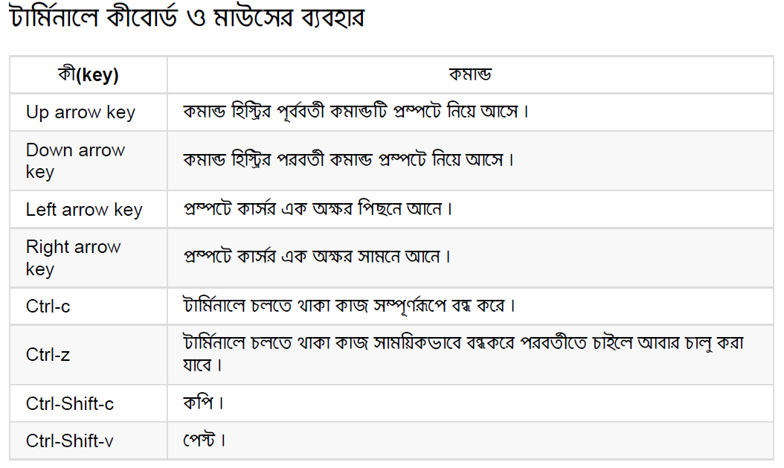

Slide 5
Command
Such as: date, cal, etc
Types of command:
Program: date, cal, vlc etc also a program
Shell Builtin: type
Shell Function:
alias: alias k=‘cd /home/kawsar/Desktop/bioinformatics’
      k

Slide 6
Some basic command
type: type cp, type type etc
which: which ls >>> /bin/ls
help: known about details,,, help cd
--help: known about uses rule,,, cp --help
man: man<manual,,, man cp

Slide 7
Navigation
Root Directory:
Path:
    Absolute path: /home/kawsar/Desktop/stat/python.pdf
    Relative path: ~/Desktop/stat/python.pdf
    Rule of pathname: (i) case sensitive and (ii) no require spaces
    Move directory to directory : pwd , ls , cd ~ etc

Slide 8
ls
ls /bin/ , ls /cd /home/kawsar/Desktop/ etc
ls -l for details about file or directory
ls –lt arranged by the modification date of directory or file
ls -lt --reverse for reversely arranged
ls –a show all file or directory hidden or unhidden
ls –A show all file without ./ and ../ file
… … … see the book for details

Slide 9
Long option details
-rwxrwxrwx 1 me root 2498111 Jul 10 11:31 01. Blowin' In The Wind.ogg
File permission
# of hard link
user
group
File size
File name
File modification time stamp

Slide 10
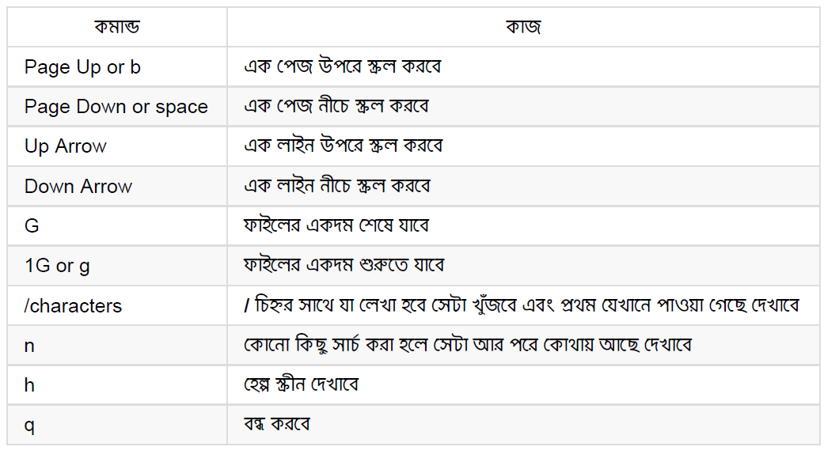
About file
less: less /bin/ read details about /bin

Slide 11
Link
Two types of link
  Symbolic link: world wide link. Package link for upodate
  lrwxrwxrwx 1 me root 2498111 Jul 10 11:31 01. Blowin' In The Wind.ogg
  Hard link: (i) Link to same file system.
          (ii) No require for directory link

Slide 12
            Linux file system:

Slide 13
Ch-2: Manipulation
Wildcards
Make file and directory:
  For directory: mkdir dir.Name
    Ex. mkdir stat or mkdir stat{1..10}
  For file: touch file.name
    Ex. touch file or touch file{1..10}

Slide 14
File copy: cp source.item destination item
  Ex. cp file file2
  cp file /home/kawsar/Desktop/Bio/
Same as directory copy
For details about copy
          cp –help|less
          or
          Go to pdf

Slide 15
Manipulation
Move: mv source.item detination.item
Remove: rm item
rm *.html >>> rm * .html
Hard link: ln file link
Soft link: ln -s item link

Slide 16

[kaswar@kawsar ~] $
Thanks!

