Slide 1
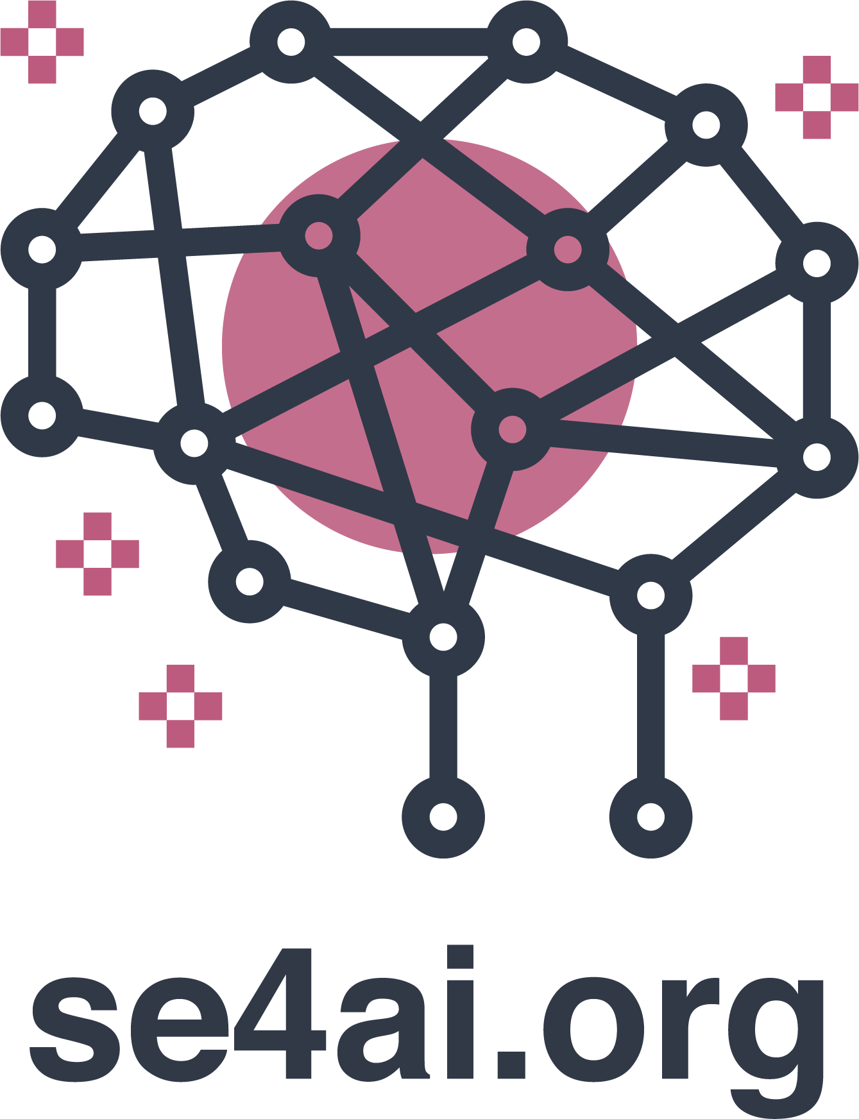

FoodBridge
Agentic AI for Food Waste Redistribution · CREATE-a-Thon

Slide 2

Identification of Problem and Stakeholders
Societal problem our agentic system addresses
Problem: Restaurants, cafeterias, and grocery stores discard edible food while many people in Toronto face food insecurity.
Gap: Municipal organic waste is high, yet surplus food rarely reaches shelters in time due to coordination friction.
Stakeholders: Donors (restaurants/grocers), shelters & community kitchens, volunteer drivers, public health inspectors (Dinesafe), high-need communities.
Data: Toronto Dinesafe health inspections + Canada Biomass municipal organic waste inventory (+ optional GDELT food-security signals).

Slide 3
Ethical Considerations
Ethical issues and how FoodBridge addresses them
Safety & liability → Pass-only Dinesafe donors; reject crucial (C) infraction history.
Fairness in allocation → Small-organization recipients prioritized in matching queue.
Transparency → Each agent logs decision steps (rule, input, outcome) in the dashboard.
Privacy → Aggregate need data only; no individual beneficiary tracking.
Small org exclusion → Quota-style priority prevents large hubs from dominating pickups.
Environmental tradeoffs → Route optimizer vs. random routing disclosed; split runs if >25 km.
Accountability → Ethics Guardian enforces human coordinator approval before dispatch.

Slide 4
Proof-of-Concept: Multi-Agent Architecture
Seven specialized agents, orchestrated with transparent decision logs
Surplus Estimator — predicts daily kg surplus from Biomass + establishment type
Need Prioritizer — ranks regions using GDELT + Biomass organic-waste signals
Ethics & Donor Scout — screens Dinesafe Pass-only donors
Matcher — pairs donors to nearest high-need shelters; fairness tiers
Logistics Planner — nearest-neighbor pickup/delivery route
Timing Negotiator — auto-negotiates evening pickup windows
Ethics Guardian — final fairness audit & approval gate
Deliverables: FastAPI web app (map + audit trail), CLI, REST API — github.com/kawsarahmedbhuiyan/food-bridge

Slide 5
Scalability & Impact
How readily could this scale across industries and regions?
Geographic: Replace Dinesafe with any city's inspection open data; Biomass grids cover Canada.
Technical: Modular agents — plug in live inventory APIs, OR-Tools routing, or SMS negotiation.
Operational: Web dashboard + /api/plan for food-bank CRM and volunteer dispatch integration.
Impact: Less edible waste to landfill, faster rescue windows, documented ethical decisions.
Live demo: uvicorn web.app:app → select region → Run planning → map, matches, route, schedule.

