Slide 1
CSE 499A · SENIOR DESIGN PROJECT I
Cross-Dataset Generalization and Robustness
of Deepfake Detection
A Leave-One-Out Study with Explainability and Statistical Validation
KS
Kawser Sikder
TA
Tasneem Abdullah Aurnobb
Modelling · transfer study · robustness · ablation
Data pipeline · leakage-safe splitting · statistics
Supervised by Dr. Riasat Khan
Department of Electrical and Computer Engineering
North South University, Dhaka, Bangladesh
Final Presentation · September 2026
Notes:
[BOTH PRESENTERS — 0:00-0:40]
Kawser: Good morning. Our project is "Cross-Dataset Generalization and
Robustness of Deepfake Detection" — a leave-one-out study with explainability
and statistical validation. I am Kawser Sikder.
Tasneem: And I am Tasneem Abdullah Aurnobb. We were supervised by Dr. Riasat
Khan of the ECE department.
Kawser: I will take the introduction, the model, and the transfer and
robustness results. Tasneem will take the literature, the data pipeline, and
the statistical validation.
Total target: 11 minutes.

Slide 2
INTRODUCTION & MOTIVATION
A detector that works in the lab, not in the wild
Face manipulation software is now cheap, free and consumer-grade. A convincing forgery can be built from a handful of public photographs on a single graphics card.
Published detectors report accuracy above 99% — but almost always on the same corpus they trained on. That number hides a collapse.
OBJECTIVE
Not to add another point of in-domain accuracy, but to quantify how much of a detector's skill transfers, to explain why it does not, and to test whether the standard remedies work.
WHAT WE BUILT
THE GAP WE MEASURED
1
A deliberately compact detector
0.9942
0.7650
One fixed EfficientNet-B0 backbone, 5.3 M parameters, held constant across every experiment.
in-domain AUC
Celeb-DF
unseen corpus
(leave-one-out)
2
A protocol designed to expose failure
Three public corpora, every ordered pair, and a three-way leave-one-out test on a corpus never seen.
3
a generalization gap of 0.229
An explanation, not just a number
Grad-CAM reduced to statistics, degradation ladders, and bootstrap confidence intervals.
Cross-Dataset Generalization and Robustness of Deepfake Detection
2 / 19
Notes:
[KAWSER — 0:40-1:50]
Face manipulation is no longer a research curiosity, it is a consumer
capability. Free software plus a handful of public photographs plus one
graphics card gives you a convincing forgery, and those forgeries are used for
non-consensual imagery, financial fraud and political disinformation.
The defensive response has been automatic detection, and on the standard
benchmarks it looks solved — modern detectors report over ninety-nine percent.
That success is misleading, because a detector is only useful on a manipulation
method it has never encountered, produced by a tool that did not exist when it
was trained.
So our objective was deliberately not to add another point of in-domain
accuracy. It was to measure how much skill actually transfers, to explain why
it does not, and to test whether the standard fixes work.
The headline is on the right: 0.9942 in-domain on Celeb-DF, 0.7650 on a corpus
the model never saw. A gap of 0.229. The rest of this talk is about that gap.

Slide 3
INTRODUCTION & MOTIVATION
Four questions, one fixed backbone
The backbone is held identical in every experiment, so every difference we report is attributable to data or protocol — never to capacity.
Q1
Q2
Q3
Q4
How far does skill
transfer?
Why does it fail?
Is the transferred
signal robust?
Does augmentation
actually generalize?
All six ordered corpus pairs, plus a three-way leave-one-out test on a corpus never seen in training.
Grad-CAM reduced from an illustration to three scalars, compared in- and out-of-domain on identical images.
Recompression, blur, rescaling and noise ladders applied identically to every model on the same videos.
Corruption types withheld from training, judged by a 2 000-replicate paired bootstrap rather than by eye.
Gap up to 0.229
Attention leaves the face
13.3% survives JPEG q10
0 of 6 significant
Cross-Dataset Generalization and Robustness of Deepfake Detection
3 / 19
Notes:
[KAWSER — 1:50-2:40]
We framed the work as four questions.
One — how far does skill transfer? We measure all six ordered pairs between
three corpora, and then a harder three-way leave-one-out test: train on two,
test on the unseen third.
Two — why does it fail? We reduce Grad-CAM from a picture to three numbers, so
attention drift becomes a measurement rather than an illustration.
Three — is the transferred signal robust? We apply recompression, blur,
rescaling and noise ladders to every model on the same held-out videos.
Four — does augmentation actually generalize? We withhold corruption types from
training entirely and judge the benefit with a two-thousand-replicate paired
bootstrap.
The answers are in the white strips, and I will come back to each one. The
critical design decision is at the top: the backbone never changes. So every
difference we report is due to data or protocol, and never to model capacity.

Slide 4
LITERATURE REVIEW
Three lines of recent work
01
02
03
Establishing the benchmarks
Attacking it by architecture
Fixing the methodology
Rössler et al., ICCV 2019
Qian et al., ECCV 2020
Yan et al., NeurIPS 2023
FaceForensics++: four manipulation methods at three compression levels. XceptionNet reaches high in-domain accuracy that falls sharply once quality drops.
F³-Net moves into the frequency domain: spectral traces are more stable across generators than pixel texture.
DeepfakeBench re-implements fifteen detectors under one protocol and shows much of the reported difference comes from inconsistent evaluation.
Haliassos et al., CVPR 2021
Li et al., CVPR 2020
LipForensics uses temporal mouth dynamics to reach 0.824 on unseen Celeb-DF.
Hendrycks & Dietterich, ICLR 2019
Celeb-DF. Their key finding is negative: detectors scoring above 0.98 on older corpora fall to ≈0.65 on Celeb-DF.
The corruption-robustness methodology this project borrows, including holding corruption types out of training so robustness is separable from memorization.
Shiohara & Yamasaki, CVPR 2022
Self-blended images — forgeries synthesized from a single pristine image generalize better than real ones, reaching 0.932.
Dolhansky et al., 2020
DFDC at industrial scale — the winning challenge entry reaches only 0.65 on an unseen test set.
The benchmark itself exposed the transfer problem.
Specialized signals beat generic CNNs on transfer.
Protocol, not architecture, explains many published gaps.
Cross-Dataset Generalization and Robustness of Deepfake Detection
4 / 19
Notes:
[TASNEEM — 2:40-3:40]
The literature divides into three lines.
The first established the benchmarks. FaceForensics++ gave four manipulation
methods at three compression levels. Celeb-DF followed with a negative finding
that directly motivates our project: detectors scoring above 0.98 on older
corpora drop to about 0.65 on Celeb-DF. DFDC reproduced that at industrial
scale — the winning challenge entry reached only 0.65 on an unseen test set.
The second line attacks generalization through architecture and training
signal. F-cubed-Net argues spectral traces survive across generators better
than pixel texture. LipForensics uses temporal mouth dynamics for 0.824 on
unseen Celeb-DF. Self-blended images reach 0.932 by synthesizing forgeries from
a single pristine image.
The third line is methodological. DeepfakeBench re-implemented fifteen
detectors under one protocol and showed much of the reported difference between
methods comes from inconsistent evaluation rather than from the methods.
Hendrycks and Dietterich supply the corruption methodology we borrow — crucially
including the idea of holding corruption types out of training.

Slide 5
LITERATURE REVIEW
Five gaps this project addresses
Reading those three lines together, the same weaknesses recur.
G1
Leave-one-out is rarely posed
Cross-dataset transfer is almost always reported pairwise. The harder question — train on two corpora, test on an unseen third — is seldom asked.
OUR RESPONSE We run all three leave-one-out folds.
G2
Robustness and generalization are studied apart
A deployed detector faces an unseen manipulation and social-media recompression at the same time. The literature studies them separately.
OUR RESPONSE We degrade the out-of-domain models.
G3
Robustness is tested on the corruptions used for augmentation
Which cannot distinguish a genuinely robust model from one that has memorized a fixed set of distortions.
OUR RESPONSE We withhold corruption families entirely.
G4
Results are point estimates without intervals
A few hundred videos, no confidence intervals — so one- or two-point differences get treated as real when they are indistinguishable from noise.
OUR RESPONSE Every difference carries a 2 000-replicate bootstrap CI.
G5
Splits are formed per frame, not per identity
Frames of one video are near-duplicates. A per-frame split leaks the same face across the boundary and inflates every downstream number.
OUR RESPONSE Union–find identity grouping with zero-overlap assertions.
Cross-Dataset Generalization and Robustness of Deepfake Detection
5 / 19
Notes:
[TASNEEM — 3:40-4:40]
Reading those three lines together, five gaps recur, and each one shaped a
design decision in our project.
First, cross-dataset transfer is almost always reported pairwise. The harder
leave-one-out question is rarely posed, so we run all three folds.
Second, robustness and generalization are studied separately, even though a
deployed detector meets both at once. So we degrade the out-of-domain models,
not just the in-domain ones.
Third — and this is the important one — robustness evaluations overwhelmingly
test on the same corruption families used for augmentation. That cannot
distinguish a robust model from one that memorized a fixed set of distortions.
We withhold corruption families completely.
Fourth, results are reported as point estimates on a few hundred videos with no
confidence intervals. Every difference we report carries a two-thousand-replicate
bootstrap interval.
Fifth, and most mundane: splits are often formed per frame rather than per
identity. Frames from one video are near-duplicates, so that leaks the same
face across the split boundary and inflates every number downstream. Our
identity grouping is the reason our numbers are trustworthy, and I will show
how it works in a moment.

Slide 6
METHODOLOGY
Complete system pipeline
Four stages. One backbone. Every stage is held fixed so that data and protocol are the only variables.
DATA
SPLIT
TRAIN
EVAL
Ingestion & identity recovery
Leakage-safe splitting
Frame-level training
Evaluation suite
Three corpora: Celeb-DF (v2), FF++, DFDC
Pre-extracted crops → 224×224, ImageNet norm
Per-corpus path parsing: frame → video ID
Union–find identity grouping (FF++)
GroupShuffleSplit 70 / 15 / 15 on group
Zero-overlap assertion on group and video
Domain-balanced cap: 30 000 images / source
Weighted sampler + augmentation ladder
EfficientNet-B0, ImageNet-init, 5.3 M params
AdamW · warm-up + cosine · AMP · EMA
Class-weighted binary cross-entropy
Video-level pooling: mean of ≤ 32 frames
In-domain test + 3×3 transfer matrix
Leave-one-out: train on two, test on unseen third
Grad-CAM attention displacement (3 scalars)
Degradation ladders + 2 000-replicate bootstrap
→
→
→
Identity grouping is the stage that matters most: it collapses 2 000 FaceForensics++ videos into 500 identity groups, so one face can never appear on both sides of a split.
Cross-Dataset Generalization and Robustness of Deepfake Detection
6 / 19
Notes:
[TASNEEM — 4:40-5:20]
This is the complete pipeline, and it runs in four stages.
Data ingestion takes three video corpora as pre-extracted face crops, resizes
everything to 224 by 224 with ImageNet normalization, and then does the
critical step — it parses every frame path back to a video identifier and runs
a union-find pass to recover subject identity.
Splitting is done on those identity groups, not on frames, with an assertion
that fails the build if any group appears on both sides. We cap each source at
thirty thousand images so no corpus dominates.
Training is a single EfficientNet-B0, ImageNet-initialised, five-point-three
million parameters, with AdamW, warm-up plus cosine annealing, mixed precision
and an exponential moving average. Frame scores are pooled into one decision
per video.
Evaluation is the part we built the project around: in-domain testing, the full
three-by-three transfer matrix, the leave-one-out protocol, Grad-CAM reduced to
three scalars, and degradation ladders judged by bootstrap.
Note the line at the bottom — identity grouping collapses two thousand
FaceForensics++ videos into five hundred identity groups. That single stage is
why our numbers are trustworthy.

Slide 7
METHODOLOGY
Datasets and preprocessing
229 977 face crops over 8 909 videos. Photometric preprocessing is deliberately minimal — the protocol is the variable under study, not the pipeline.
Corpus | Videos | Face crops | Frames / video | Forged | Split / note
Celeb-DF (v2) | 6 528 | 65 381 | 10.0 | 86.4% | 980-video held-out split
FaceForensics++ | 2 000 | 39 949 | 20.0 | 50.0% | 300-video split · 500 identity groups
DFDC | 381 | 124 647 | 327.2 | 80.1% | train_sample subset · only 58 test videos
Total | 8 909 | 229 977 | — | — | three independent sources
PREPROCESSING — IDENTICAL FOR EVERY MODEL
Fixed-stride frame sampling
→
Face detection + box expansion
→
Square crop → 224 × 224
→
Channel-wise ImageNet normalisation
STATED LIMITATION DFDC is the train_sample subset
STATED LIMITATION Our FF++ copy holds one manipulation method
Its 58-video test split is small enough that any DFDC-specific confidence interval is wide — and we report it as uninformative rather than quietly using it.
Exactly 1 000 forged folders and no method name anywhere in the directory tree, so all FF++ figures here describe one manipulation, not the four-method benchmark.
Cross-Dataset Generalization and Robustness of Deepfake Detection
7 / 19
Notes:
[TASNEEM — 5:20-6:00]
The three corpora supply just under two hundred and thirty thousand face crops
over eight thousand nine hundred videos. Celeb-DF is the largest by video
count, DFDC is the densest per video at three hundred and twenty-seven frames
each, and FaceForensics++ is the only balanced one at fifty percent forged.
Preprocessing is deliberately minimal and identical for every model —
fixed-stride sampling, face detection with box expansion, a square crop to
224 by 224, and ImageNet normalization. We kept it minimal on purpose so that
the evaluation protocol is the variable under study, not the pipeline.
Two limitations we state up front rather than bury. First, our DFDC portion is
the train_sample subset, and its fifty-eight-video test split is small enough
that any DFDC-specific confidence interval is uninformative — we say so rather
than quietly using it. Second, the FaceForensics++ copy available to us
contains a single manipulation method, not four, so all our FF++ figures
describe one manipulation. Both of these bound what we claim.

Slide 8
METHODOLOGY
Leakage-safe identity-grouped splitting
Frames from one video are near-duplicates. Split them per frame and near-identical images land on both sides of the boundary — inflating every score that follows.
THE FACEFORENSICS++ TRAP
THE FIX — UNION–FIND OVER SHARED IDENTITY TOKENS
A forged clip is synthesized from two named real clips, so its folder name encodes both source identities:
u ~ v ⟺ N(u) ∩ N(v) ≠ ∅
Two videos join the same group if they share any numeric identity token. We take the transitive closure of that relation, then split on the resulting groups.
588_556_crops
588_crops
556_crops
forged — train
real — test
real — test
𝒢(Dᵢ) ∩ 𝒢(Dⱼ) = 𝒱(Dᵢ) ∩ 𝒱(Dⱼ) = ∅, i ≠ j
Split on video and the network learns to recognise the individual 588 rather than the manipulation.
asserted on every experiment — the build fails if it is violated
2 000
500
70 / 15 / 15
0
FaceForensics++ videos
identity groups after union–find
train / val / test, on groups
identity overlap, asserted
This work located a frame-level leak in an earlier measurement of ours and changed a headline number. It is the reason the figures in this talk are trustworthy.
Cross-Dataset Generalization and Robustness of Deepfake Detection
8 / 19
Notes:
[TASNEEM — 6:00-6:45]
This slide is the methodological core of the project, and it is where our
supervisor pushed us hardest.
Frames from one video are near-duplicates. If you split per frame, near-identical
images land on both sides of the boundary and every score inflates.
FaceForensics++ has a subtler version of the same trap, on the left. A forged
clip is synthesized from two named real clips, and the folder name encodes both.
So folder 588_556_crops is built from real videos 588 and 556. If you split on
video, the forged clip can sit in training while the real 588 sits in test —
and the network learns to recognise the individual, not the manipulation.
The fix is on the right. Two videos join the same group if they share any
numeric identity token; we take the transitive closure with union-find and
split on the resulting groups. We then assert zero overlap on both groups and
videos, and the build fails if it is ever violated.
The effect is the strip at the bottom: two thousand FaceForensics++ videos
collapse to five hundred identity groups. This work found a frame-level leak in
an earlier measurement of ours and changed a headline number — which is exactly
why we trust the figures I am about to hand back to Kawser.

Slide 9
METHODOLOGY
Network and training configuration
EfficientNet-B0 — roughly a quarter of the XceptionNet that dominates this literature — held fixed across all six models.
BACKBONE
IDENTICAL FOR EVERY MODEL
SIX MODELS, IDENTICAL SETTINGS
EfficientNet-B0
Optimiser
AdamW
3 single-source — one corpus each
3 two-source — each omitting one corpus entirely
Every measured difference is therefore attributable to data or protocol, not to capacity
5.3 M
15.95 MB
1 × T4
LR / weight decay
1 × 10⁻⁴
parameters
checkpoint
Kaggle GPU
Schedule
1 warm-up epoch + cosine
Batch / resolution
64 @ 224²
SQUEEZE-AND-EXCITATION GATE
Precision
mixed (AMP)
z_c = (1/HW) Σ U_i,j,c , s = σ(W₂ swish(W₁z))
Every block recalibrates channels using global context. That gate matters here because it makes the network's reliance on globally distributed texture explicit — which is exactly what our explainability study probes.
Grad clipping
unit-norm
EMA decay
0.999
THREE AUGMENTATION LADDERS
Sampler
weighted
baseline
mild JPEG q40–100, downscale 0.4–0.9, blur σ ≤ 2.0
TRAINING OBJECTIVE
ℒ = −(1/N) Σ w_yᵢ [ yᵢ log σ(zᵢ) + (1−yᵢ) log(1−σ(zᵢ)) ]
Split (on groups)
70 / 15 / 15
narrow
the same three families hardened — q10–95, σ ≤ 3.0
Max epochs / patience
12 / 4
single logit head, class-weighted binary cross-entropy
Seed
42, all generators
broad
adds WebP q10–95 and Gaussian noise σ 5–25 on top
Cross-Dataset Generalization and Robustness of Deepfake Detection
9 / 19
Notes:
[KAWSER — 6:45-7:25]
The backbone is EfficientNet-B0, chosen for a parameter budget roughly a
quarter of the XceptionNet that dominates this literature — five-point-three
million parameters, a sixteen-megabyte checkpoint, trained on a single Tesla T4
in a Kaggle notebook.
One architectural detail matters for later. Every block carries a
squeeze-and-excitation gate that recalibrates channels using global context.
That makes the network's reliance on globally distributed texture explicit,
which is precisely what our Grad-CAM study probes.
The head is a single logit trained with class-weighted binary cross-entropy,
because the corpora have very different class balances.
The middle column is the configuration, and the important word is "identical".
AdamW, one warm-up epoch then cosine, mixed precision, EMA at 0.999, seventy
fifteen fifteen on identity groups, seed forty-two everywhere. Six models —
three single-source and three two-source, each omitting one corpus entirely —
all trained under exactly these settings.
The only thing we ever vary is the augmentation ladder on the bottom right:
baseline, narrow, and broad. So when a number moves, it is the data or the
protocol that moved it.

Slide 10
METHODOLOGY
Decision rule, metrics and evaluation protocol
DECISION RULE — DETECTION IS A CLAIM ABOUT A VIDEO
TWO DERIVED QUANTITIES CARRY THE ARGUMENT
p(v) = 1/(2|ℱ(v)|) Σ [ σ(f(x)) + σ(f(flip(x))) ]
Generalization gap
Retained signal
Δgen(d) = AUCin(d) − AUCLOO(d)
ρ = (AUCdeg − 0.5) / (AUCclean − 0.5)
Mean frame probability over at most 32 sampled frames, with horizontal-flip test-time augmentation.
what a model scores on its own data minus what it scores on a corpus it never saw
robustness on a scale comparable across models of different clean strength — 0.5 is chance, not zero
WHY NOT F₁-OPTIMAL THRESHOLDING?
EVALUATION PROTOCOL
Celeb-DF is 86.4% forged. The F₁-optimal threshold collapses to ≈0, labels every video forged, and still reports recall 1.000 and "accuracy" 0.864 — exactly the majority-class rate, carrying no information.
A
In-domain + 3×3 transfer matrix
Every single-source model scored on every corpus, using the entire target corpus off-diagonal.
B
Three-way leave-one-out
Each two-source model scored on the corpus withheld from its training set entirely.
τ* = arg min |FPR(τ) − FNR(τ)|
all threshold metrics reported at the equal error rate, with balanced accuracy
C
Degradation + bootstrap
Fixed ladders on identical held-out videos; 2 000-replicate paired bootstrap, significant only if the interval excludes zero.
Primary metric is AUC — threshold-free, and therefore insensitive to the class imbalance that differs across corpora. Implemented in PyTorch with timm; all randomness seeded at 42.
Cross-Dataset Generalization and Robustness of Deepfake Detection
10 / 19
Notes:
[KAWSER — 7:25-8:05]
Two things on this slide decide whether the numbers mean anything.
First, detection is a claim about a video, not a frame. So we pool: the video
score is the mean frame probability over at most thirty-two frames, with
horizontal-flip test-time augmentation.
Second, the operating point. This mattered more than any modelling decision we
made. Celeb-DF is eighty-six point four percent forged at the video level. If
you pick the threshold that maximises F1 — which early work did, and which we
did at first — it collapses to approximately zero and labels every single video
forged. You then report recall of one-point-zero-zero-zero and an accuracy of
0.864, which is exactly the majority-class rate and carries no information at
all. So we report every threshold metric at the equal error rate instead, with
balanced accuracy.
On the right, two derived quantities carry the whole argument. The
generalization gap is what a model scores on its own data minus what it scores
on a corpus it never saw. Retained signal measures robustness relative to
chance rather than to zero, so it is comparable across models with different
clean strength.
Our primary metric throughout is AUC, because it is threshold-free and so
insensitive to the class imbalance that differs across these three corpora.

Slide 11
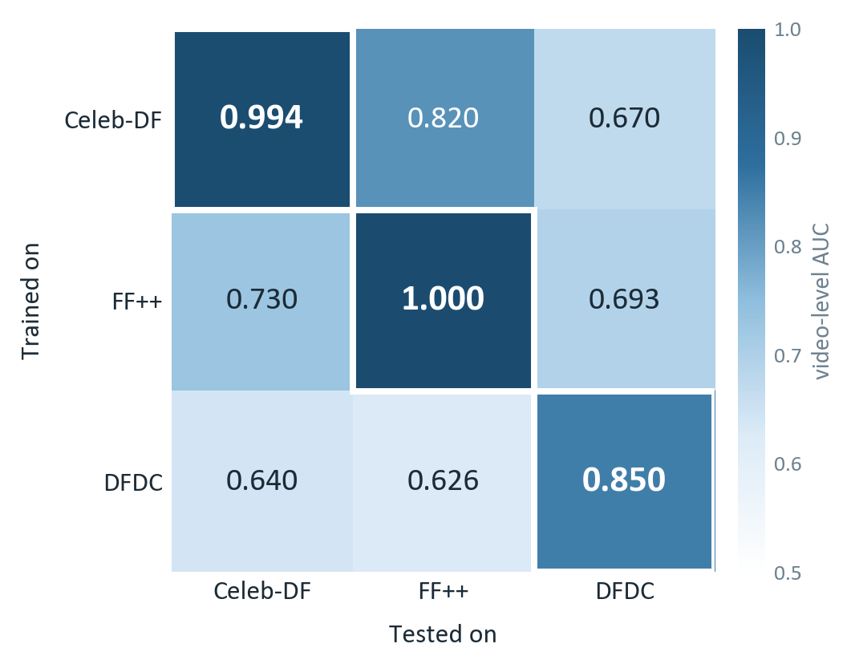
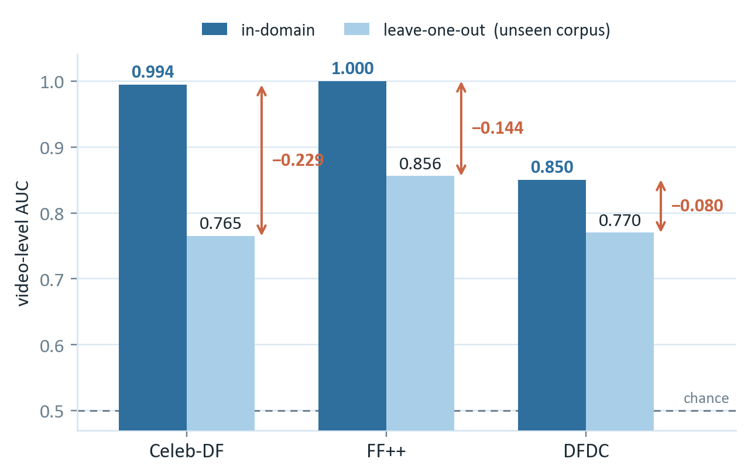
RESULTS & DISCUSSION
Cross-dataset transfer collapses
READING 1
In-domain is close to solved
0.9942 on Celeb-DF and 0.9998 on FF++, at equal error rates of 0.029 and 0.013 — under identity-grouped splitting that forbids a face from appearing on both sides.
READING 2
Transfer collapses
Every off-diagonal cell falls between 0.626 and 0.820. The worst is close to chance for a balanced target. Both readings are true.
The matrix is asymmetric
Multi-source narrows, never closes
The operating point mattered more than any model choice
A Celeb-DF model scores 0.8196 on FF++, but an FF++ model returns only 0.7302 on Celeb-DF — training on higher-quality forgeries transfers downward more readily than the reverse.
Adding a second training corpus helps in three of three directions (+0.0348, +0.0364, +0.0767) — but the gains stay small against the 0.2292 gap they are meant to close.
Re-computing at the equal error rate corrects Celeb-DF's leave-one-out "accuracy" from 0.864 to 0.701 and DFDC's from 0.811 to 0.698.
Cross-Dataset Generalization and Robustness of Deepfake Detection
11 / 19
Notes:
[KAWSER — 8:05-8:50]
This is the central measurement, and it points in two opposite directions —
both of which are true.
The left heatmap is the single-source transfer matrix. Read the diagonal:
in-domain detection is close to solved, 0.9942 on Celeb-DF and 0.9998 on
FaceForensics++, at equal error rates of two-point-nine and one-point-three
percent. And remember that is under identity-grouped splitting, so it is not a
leak.
Now read off the diagonal. Every single cell falls between 0.626 and 0.820, and
the worst is close to chance for a balanced target. The middle chart shows the
same thing under the harder leave-one-out protocol: 0.994 down to 0.765 on
Celeb-DF — a gap of 0.229.
Three things follow, along the bottom. First, the matrix is asymmetric: a
Celeb-DF model gets 0.8196 on FF++, but an FF++ model gets only 0.7302 back on
Celeb-DF. Training on higher-quality forgeries transfers downward more easily
than the reverse. Second, adding a second training corpus helps in all three
directions, but by only three to eight points against a gap of twenty-three —
it narrows the gap, it does not close it. Third, as I said, the operating point
mattered more than any modelling decision: moving to the equal error rate
corrects Celeb-DF's leave-one-out accuracy from 0.864 down to 0.701.

Slide 12
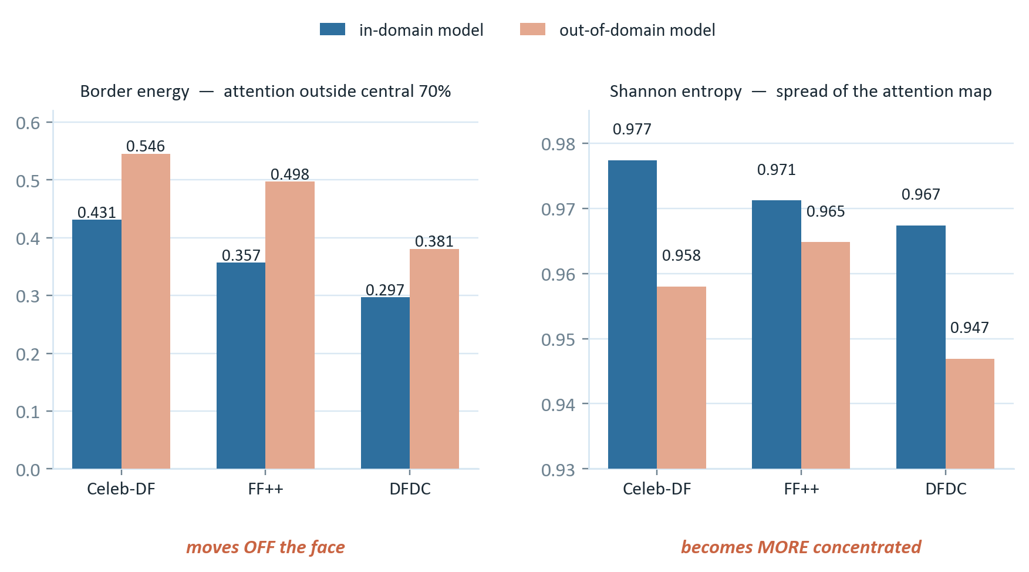
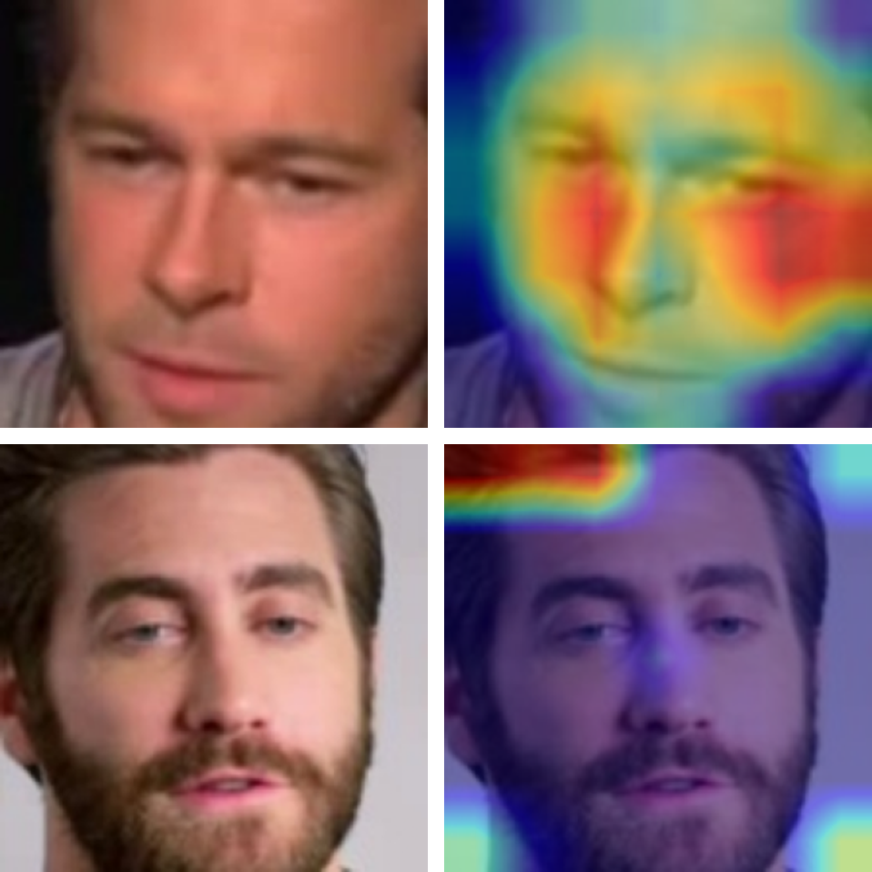
RESULTS & DISCUSSION
Explainability: where attention goes out of domain
Grad-CAM reduced from an illustration to three scalars per map — so attention drift becomes a number, measured on identical images.
Grad-CAM overlays
Correctly-classified Celeb-DF forgeries: attention sits on the central face region.
Out of domain the same architecture keeps this confident appearance while the mass moves toward mouth, chin and neck.
THE MECHANISM BEHIND THE GAP — NOT A RESTATEMENT OF IT
+26.5% to +39.3%
0.9774 → 0.9580
mouth · chin · neck
Border energy rises
Entropy falls
Centre of mass drifts
Attention outside the central 70% of the crop increases in every corpus: 0.4315→0.5456, 0.3573→0.4976, 0.2970→0.3809.
The map becomes MORE concentrated, not more diffuse — in all three corpora. The model is not hedging.
FF++ moves furthest, from 0.450 to 0.622 vertically. Attention leaves the face and settles below it.
The out-of-domain model is not confused or hedging. It is confidently attending to the wrong region — so its confidence carries no warning that it has failed.
Cross-Dataset Generalization and Robustness of Deepfake Detection
12 / 19
Notes:
[KAWSER — 8:50-9:30]
This is our explainability result, and it supplies a mechanism rather than
restating the gap.
The trick is to stop treating Grad-CAM as a picture. We reduce each map to
three scalars — normalized centre of mass, Shannon entropy, and border energy,
which is the fraction of activation outside the central seventy percent of the
crop — and we compare each in-domain expert against its leave-one-out
counterpart on identical images.
The left chart is border energy. When a model is out of domain, its attention
measurably leaves the face — up twenty-six-and-a-half percent on Celeb-DF,
thirty-nine percent on FF++, twenty-eight percent on DFDC.
The right chart is the subtler and more interesting result. Entropy also
*falls* out of domain, in all three corpora. Falling entropy means the map is
becoming more concentrated, not more diffuse.
Put those together, and it is the line at the bottom. The out-of-domain model
is not confused, and it is not hedging. It is confidently attending to the
wrong region. Which means its confidence score carries no warning whatsoever
that it has failed — and for a deployed detector that is the dangerous failure
mode, not simply a lower score.

Slide 13
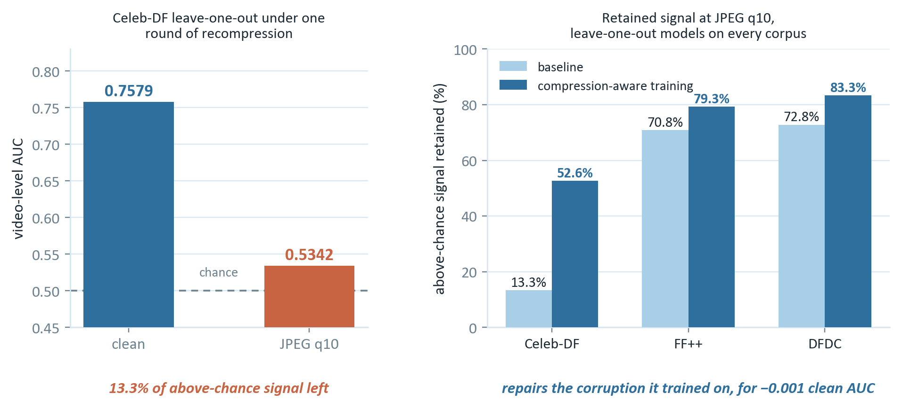
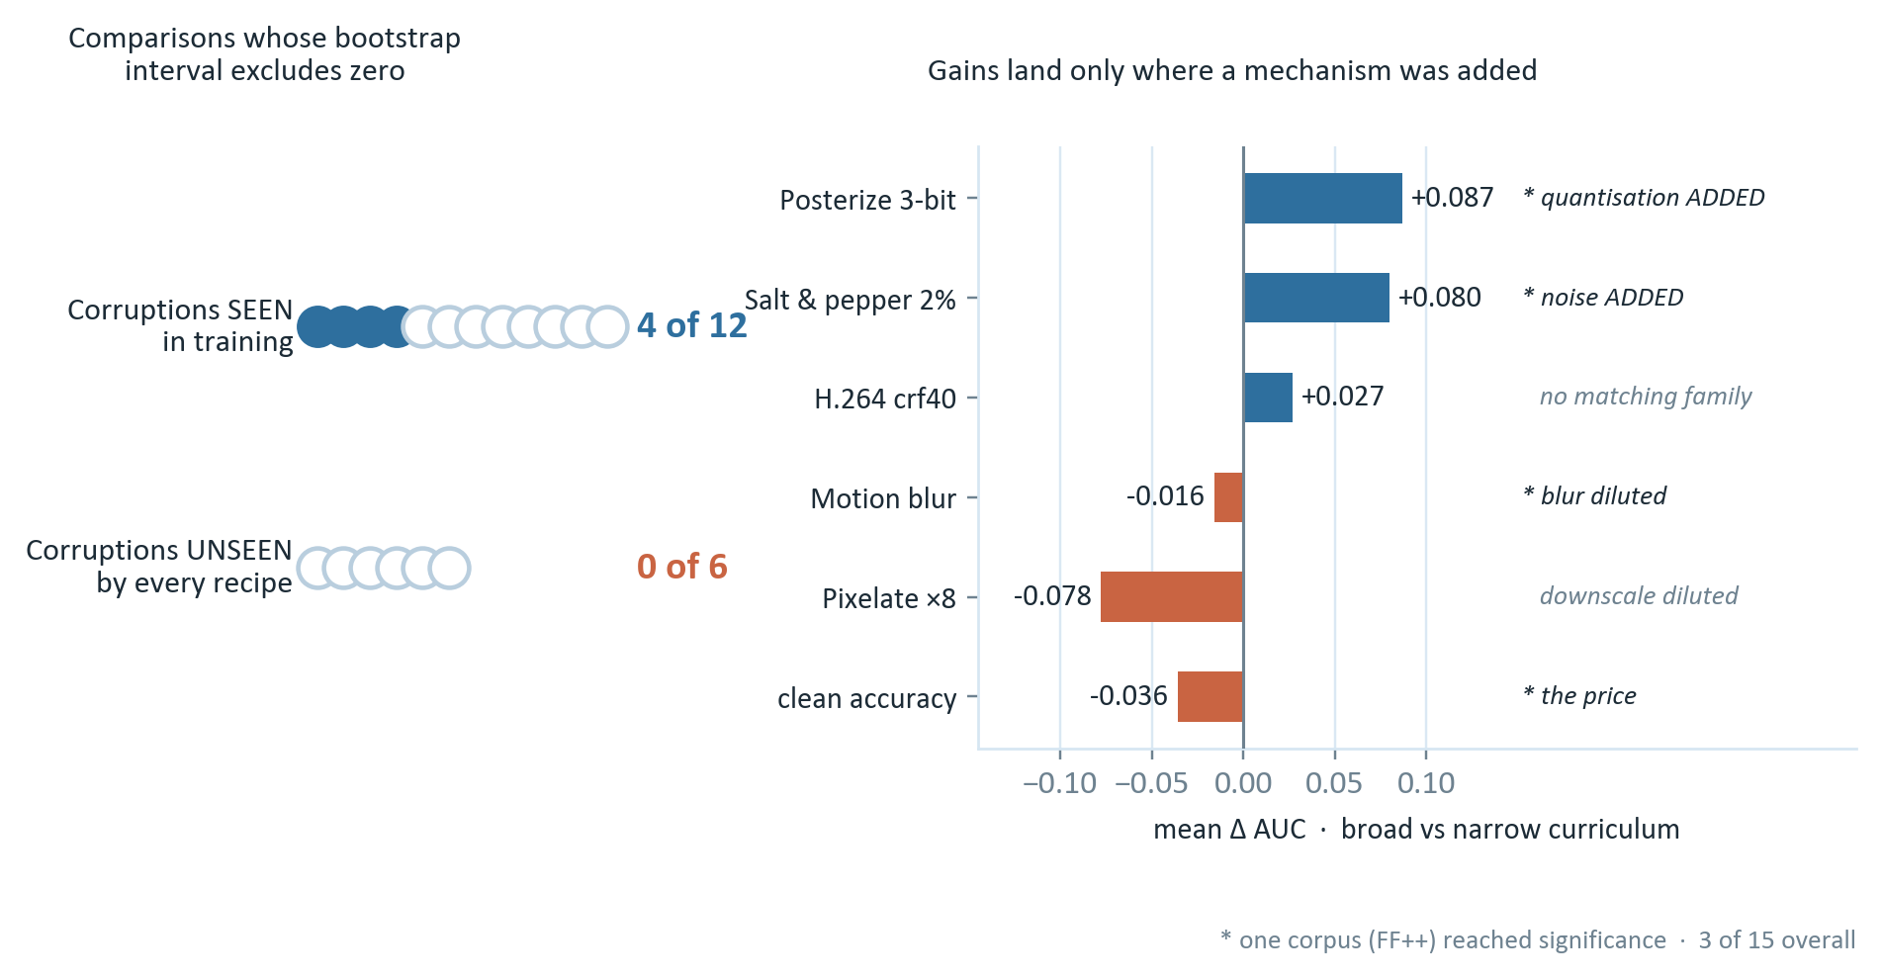
RESULTS & DISCUSSION
Robustness and statistical validation
The transferred signal proved not merely weaker, but fragile — and the obvious remedy repairs only what it trained on.
In-domain models retain 83.2%, 93.8% and 99.3% at the same JPEG q10 — so the cross-corpus gap is not a compression artefact. Compression-aware training teaches the model the specific corruptions in its augmentation set, not robustness as a general property.
Cross-Dataset Generalization and Robustness of Deepfake Detection
13 / 19
Notes:
[KAWSER hands to TASNEEM mid-slide — 9:30-10:15]
KAWSER (top half):
Degrading every model on identical held-out videos answered two questions at
once.
First, do the near-perfect in-domain scores just rest on codec fingerprints? No
— the in-domain models retain eighty-three, ninety-four and ninety-nine percent
of their above-chance signal at JPEG quality ten. So the cross-corpus gap is
not a compression artefact.
But the transferred signal is another matter entirely, on the top left. The
leave-one-out Celeb-DF model falls from 0.7579 to 0.5342 under a single round
of social-media-grade recompression. That retains thirteen-point-three percent
of its above-chance signal — which is, effectively, chance. This is the most
consequential deployment finding in the project, because an unseen manipulation
and one round of recompression co-occur in essentially every realistic upload.
The top right shows the obvious remedy working: compression-aware training
lifts Celeb-DF from thirteen to fifty-three percent retained, for a clean-AUC
cost of just minus zero-point-zero-zero-one. Almost free. So — problem solved?
TASNEEM (bottom half):
No, and this is where the statistics matter. We ran a two-thousand-replicate
paired bootstrap on per-video predictions, and split the corruptions into ones
the model saw in training and ones it did not.
On the left: four of twelve seen comparisons reach significance. But zero of
six unseen comparisons do. Not one. The benefit does not generalize.
We then asked whether widening the curriculum changes that answer, on the
right. It does not, and it tells us why. The gains land only where a matching
physical mechanism was added to training — posterization inherits from WebP
quantization, salt-and-pepper from Gaussian noise. Where a family was diluted,
performance drops. H.264, the one mechanism absent from every training set, is
null throughout.
So augmentation capacity behaves as an approximately zero-sum budget. It
transfers by mechanism, not by breadth — and widening it is not free, costing a
significant minus zero-point-zero-four-seven of clean accuracy.

Slide 14
RESULTS & DISCUSSION
Ablation study — and what actually helped
Each row adds one technique to the row above, on a fixed EfficientNet-B0 backbone. AUC is measured on the corpus held out from training.
# | Configuration | Id. | Multi | Heavy | Broad | EER | Crop | Ens. | Celeb-DF | FF++ | DFDC
1 | Single-source (in-domain reference) | ✓ | × | × | × | ✓ | × | × | 0.9942 | 0.9998 | 0.8504
2 | Leave-one-out, F₁-optimal threshold | ✓ | ✓ | × | × | × | × | × | 0.7650 | 0.8559 | 0.7700
3 | … equal-error-rate threshold | ✓ | ✓ | × | × | ✓ | × | × | 0.7650 | 0.8559 | 0.7700
4 | … + heavy (compression-aware) augmentation | ✓ | ✓ | ✓ | × | ✓ | × | × | 0.7644 | 0.8417 | 0.7641
5 | … + broad augmentation (WebP, noise) | ✓ | ✓ | ✓ | ✓ | ✓ | × | × | 0.7058 | 0.8352 | 0.7795
6 | … + crop-quality filtering | ✓ | ✓ | ✓ | ✓ | ✓ | ✓ | × | 0.7823 | 0.8623 | 0.7748
7 | … + rank-averaged ensemble of four checkpoints | ✓ | ✓ | ✓ | ✓ | ✓ | ✓ | ✓ | 0.8314 | 0.8665 | 0.7396
Row 1 is the in-domain reference and is not comparable with rows 2–7, which are scored on a corpus never seen in training. ✓ present, × absent.
Rows 2 and 3 are the same model
Row 7 is also a caution
Two interventions cost nothing
Identical predictions — only the threshold moves. Row 2 reports the highest F₁ in the table (0.9269) while being the least useful configuration in it. Any component grid can be gamed by the operating point, which is why AUC is our primary metric.
Ensembling gives the best Celeb-DF and FF++ figures in the table but loses on DFDC, falling to 0.7396 from 0.7700, because two weak members drag the rank average down. A grid invites the reading that more ticks are better. That row is the counterexample.
Rank-averaging four checkpoints already on disk reaches 0.8314 against a best single model of 0.7650 — a gain of +0.066, the largest single improvement measured in the project. Crop-quality filtering adds +0.0173.
Cross-Dataset Generalization and Robustness of Deepfake Detection
14 / 19
Notes:
[TASNEEM — 10:15-10:50]
The ablation is in component form: each row adds one technique to the row
above, on the same fixed backbone, and the AUC columns are measured on the
corpus held out from training.
Read the Celeb-DF column downwards and you get the whole project in one
sequence. The in-domain reference is 0.9942. Holding a corpus out drops it to
0.7650. Neither augmentation ladder recovers any of that on clean data, and the
broad ladder costs a further 0.059. Crop-quality filtering returns 0.017, and
rank-averaged ensembling returns 0.066 — the largest single gain in the study.
But two rows should be read against each other rather than in sequence, and
they are the reason we distrust ablation grids.
Rows two and three are the same model on the same predictions. They differ only
in where the decision threshold sits. Row two reports the highest F1 in the
entire table, 0.9269, while being the least useful configuration in it —
because that threshold labels every video forged. Any component grid can be
gamed by the operating point.
Row seven carries a second caution. Ensembling gives our best Celeb-DF and FF++
numbers, but it *loses* on DFDC because two weak members drag the rank average
down. A grid like this invites the reading that more ticks are better. Row seven
is the counterexample.

Slide 15
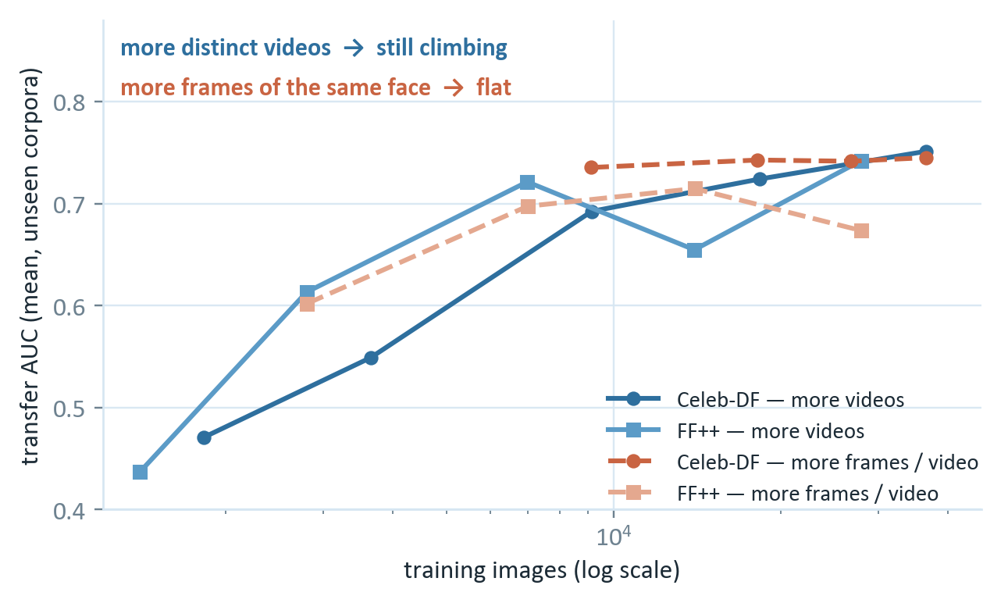
RESULTS & DISCUSSION
Architectural extensions and data scaling
Augmentation is a closed route, so the remaining levers act on the architecture, the objective, or the data budget.
# | Configuration | Train imgs | Celeb-DF | FF++ | DFDC | Mean
1 | Leave-one-out reference (Table I) | 60 000 | 0.7650 | 0.8559 | 0.7700 | 0.7970
2 | … diversity-balanced frame budget | 18 600 | 0.7833 | 0.8384 | 0.7748 | 0.7988
3 | … + dual-stream RGB and DCT | 18 600 | 0.8143 | 0.8788 | 0.7491 | 0.8141
4 | … + domain-adversarial training | 18 600 | 0.7394 | 0.8665 | 0.6980 | 0.7680
5 | … + Grad-CAM spatial regulariser | 18 600 | 0.7853 | 0.8570 | 0.7362 | 0.7928
THE CLEANEST RESULT IN THE REPORT
✓
Frequency stream works — the one lever that moved
A second stream on a learnable DCT decomposition of the same crop raises transfer by a mean of +0.015 and reaches 0.8788 on FF++ — the highest cross-corpus figure anywhere in this study, from ONE model rather than the four-checkpoint ensemble it beats. It costs only 139→153 s per epoch.
✗
Domain-adversarial training is null — it converged and still lost
The source classifier was driven to chance (objective ≈ ln 2), which is its stated goal. Transfer still fell by a mean of −0.031. What separates Celeb-DF from DFDC is not a nuisance factor to be removed — it is part of what the detector was using.
Identity and scene diversity is the binding constraint — not raw frame count
Grad-CAM supervision is null at −0.006
+0.280 / +0.305
+0.010 / −0.041
✗
20× more training VIDEOS at a fixed frame budget — and both curves still climbing
a comparable increase in total images spent on more FRAMES per video
The penalty dominated the objective (0.42 vs 0.02) and the model still never matched the expert's map. It constrains border energy but leaves concentration free — so attention returns to the face while the map stays over-concentrated.
Ten frames of one thousand people teach generalization. One thousand frames of ten people do not.
Cross-Dataset Generalization and Robustness of Deepfake Detection
15 / 19
Notes:
[TASNEEM — 10:50-11:25]
Augmentation turned out to be a closed route, so we tested four interventions
that act on the architecture or the objective instead. Three findings survive.
The one that worked is row three: a dual-stream network. A second stream
consumes a learnable discrete-cosine decomposition of the same crop, and each
band is inverted back to image space so the frequency features stay spatially
aligned. It raises transfer by a mean of +0.015 and reaches 0.8788 on
FaceForensics++ — the highest cross-corpus number anywhere in this study, and
it comes from one model rather than the four-checkpoint ensemble it beats.
Two are null, and both are informative. Domain-adversarial training achieved
its stated objective — it drove the source classifier to chance — and still
lost 0.031 of transfer. So the corpus difference it removed was partly signal.
Grad-CAM supervision is null at −0.006 even though the penalty dominated the
objective, because it constrains where attention sits but not how concentrated
it is.
But the cleanest result in the report is on the right. Multiplying training
videos twentyfold at a fixed frame budget raises transfer by +0.280 and +0.305,
and both curves are still climbing at the largest budget we could test.
Spending a comparable number of images on more frames per video instead gains
+0.010 and actually regresses by −0.041.
The interpretation is direct: ten frames of a thousand people teach
generalization. A thousand frames of ten people do not. That single finding
sets our capstone plan.

Slide 16
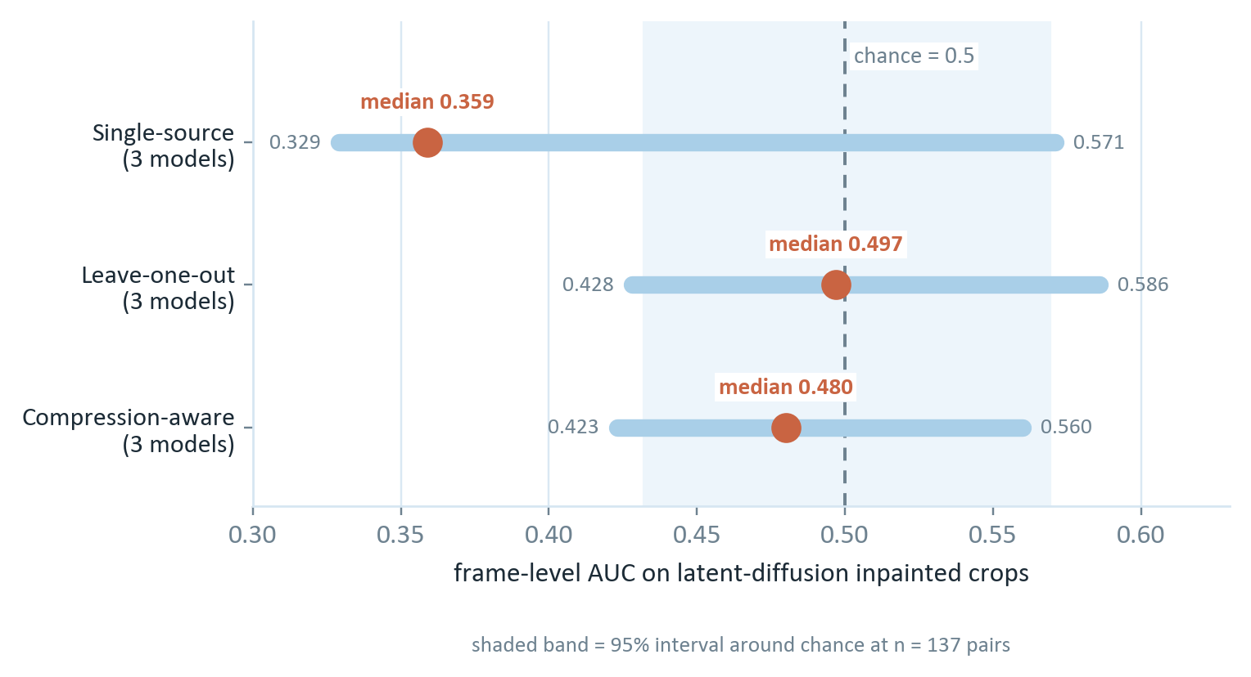
RESULTS & DISCUSSION
Comparison with published work
Work | Backbone / method | Params | FF++ in-domain | Celeb-DF in-domain | FF++ → Celeb-DF
Rössler et al. [2] | XceptionNet | 22.9 M | 0.957 ᵃ | — | —
Li et al. [1] | XceptionNet (c23) | 22.9 M | — | — | 0.653
Qian et al. [5] | F³-Net | 46.7 M | 0.933 ᵇ | — | —
Zhao et al. [18] | Multi-attentional EfficientNet-B4 | 19.0 M | 0.993 | — | 0.674
Haliassos et al. [6] | LipForensics (temporal) | — | — | — | 0.824
Shiohara & Yamasaki [7] | Self-blended images | 19.0 M | — | — | 0.932
Yan et al. [8] | XceptionNet, unified protocol | 22.9 M | — | — | 0.737
This work | EfficientNet-B0, single-source | 5.3 M | 0.9998 ᶜ | 0.9942 | 0.7302
This work | EfficientNet-B0, leave-one-out | 5.3 M | 0.8559 | 0.7650 | —
A PROBE BEYOND THE PUBLISHED TABLE
Latent diffusion: the starkest result
Every corpus in this study predates latent diffusion. We edited real Celeb-DF test crops with a diffusion inpainting model, so each forgery is the diffusion edit of its own real counterpart.
ᵃ accuracy at c23 (high quality), not AUC. ᵇ c40 (low quality). ᶜ our FF++ copy holds one manipulation method, so this is reported for completeness rather than as a competitive claim.
1
In-domain is not a capacity problem
Our in-domain results match published Xception and EfficientNet-B4 numbers on a backbone roughly a quarter of their size.
Four of nine checkpoints are INVERTED
2
Our baseline sits squarely in the standard-CNN band
They do not merely fail — they rank the diffusion forgery as more authentic than the real photograph it was made from. A diffusion decode is smooth; our corpora's forgeries are GAN and graphics composites that ADD high-frequency artefacts. A generator that removes them inverts the detector.
0.7302 is consistent with 0.653 for XceptionNet [1] and 0.737 under the unified protocol of [8]. Specialized methods remain ahead — temporal cues at 0.824, self-blending at 0.932. That gap defines the frontier we did not attempt to cross.
3
Three of our evaluations have no counterpart above
The three-way leave-one-out protocol, robustness of transfer on identical images, and the seen-versus-unseen corruption split with bootstrap intervals are rarely reported at all.
Cross-Dataset Generalization and Robustness of Deepfake Detection
16 / 19
Notes:
[KAWSER — 11:25-12:00]
Three observations from the comparison table on the left.
First, our in-domain results match the published Xception and EfficientNet-B4
numbers on a backbone roughly a quarter of their size. So in-domain detection
is not a capacity problem.
Second, our cross-corpus baseline sits squarely in the standard-CNN band. Our
0.7302 is consistent with the 0.653 reported for XceptionNet and the 0.737
under the unified protocol of DeepfakeBench. Specialized methods remain well
ahead — temporal cues at 0.824, self-blended training at 0.932 — and that gap
defines the frontier this project did not attempt to cross.
Third, three of our evaluations have no counterpart in that table because they
are rarely reported: the three-way leave-one-out protocol, robustness measured
on transfer rather than in-domain, and the seen-versus-unseen corruption split
with bootstrap intervals. One caveat throughout — cross-corpus numbers vary by
protocol, so these are "in the same range as", not exact comparisons.
Now the right side, which is the starkest result in the project. Every corpus
we used predates latent diffusion. So we built a probe: we take real Celeb-DF
test crops and edit them with a diffusion inpainting model, so each forgery is
the diffusion edit of its own real counterpart.
Across all nine checkpoints the median AUC is 0.480 against a chance value of
0.5. And four are inverted — below the chance interval. Those detectors do not
merely fail to spot the diffusion forgery. They rank it as more authentic than
the real photograph it was made from.
The mechanism is visible in the crops. A diffusion decode is smooth, while the
Celeb-DF original carries sensor noise and codec texture. Our models learned on
GAN and graphics composites that *add* high-frequency artefacts — so a
generator that systematically removes them inverts them completely.

Slide 17
CONCLUSION
What survives contact with unseen data — and what does not
0.229
13.3%
0 / 6
+0.280
generalization gap, in-domain
to an unseen corpus
of above-chance signal left after
one round of recompression
unseen-corruption comparisons
reaching significance
transfer gain from 20× more
training videos — still climbing
Generalization
Explainability
In-domain detection is close to solved at 0.9942 and 0.9998. Against a genuinely unseen corpus the same architecture falls to 0.765–0.856. Multi-source training narrows the gap in three of three directions without closing it.
Out of domain, attention moves off the face by 27–39% in border energy while becoming MORE concentrated. The model is confidently attending to the wrong region, and its confidence carries no warning of failure.
Robustness & statistics
What actually moved the number
The transferred signal is fragile, not merely weaker. Compression-aware training repairs that almost free — but a 2 000-replicate bootstrap shows zero of six unseen comparisons significant. Augmentation transfers by physical mechanism, not by breadth, and widening it costs clean accuracy.
The two largest effects needed no architectural change: rank-averaged ensembling at +0.066, and training-video diversity at +0.280 to +0.305. Of four architectural levers tried, only the frequency stream helped, reaching 0.8788 on FF++.
THREE LIMITATIONS BOUND ALL OF THIS
Our FaceForensics++ copy contains one manipulation method, not four.
At n = 58, every DFDC confidence interval is uninformative.
Every conclusion concerns a single convolutional backbone.
Notes:
[BOTH — 12:00-12:40]
KAWSER:
To conclude. We set out to measure honestly how much of a detector's laboratory
performance survives contact with data it has never seen, and to explain what
is lost.
In-domain detection is close to solved — but against a genuinely unseen corpus
the same architecture falls to between 0.765 and 0.856, a gap of up to 0.229.
Grad-CAM supplies the mechanism: attention leaves the face while becoming more
concentrated, so the detector is confidently wrong and its confidence gives no
warning.
The transferred signal is fragile, not merely weaker — one round of
recompression leaves thirteen percent of it. Compression-aware training repairs
that specific failure almost for free, but the bootstrap shows the benefit does
not generalize: zero of six unseen comparisons significant. Augmentation
transfers by physical mechanism, not by breadth.
TASNEEM:
And the finding we regard as most useful is what did move the number. The two
largest effects we measured needed no architectural change at all: rank-averaged
ensembling at plus zero-point-zero-six-six, and training-video diversity, which
moved transfer by up to plus zero-point-three-zero-five and was still climbing.
Three limitations bound everything we have said, and we state them plainly: our
FaceForensics++ copy holds one manipulation method rather than four; at
fifty-eight test videos every DFDC interval is uninformative; and every
conclusion here concerns a single convolutional backbone.

Slide 18
FUTURE WORK
The plan for the semester break and CSE 499B
We act on what the data identifies as blocking — not on what was merely left untried.
01
02
Replace the two deficient corpora
Develop the frequency direction that works
Because the data-scaling study shows video diversity is the binding constraint on transfer — not model capacity, and not augmentation.
Of the four architectural levers we tried, the frequency stream is the only one that moved the number — this is no longer a preference between open options.
Ingest the full four-method FaceForensics++ distribution from the official source, removing our single-manipulation limitation
Expand DFDC until its confidence intervals become informative (n = 58 is the reason three of our tables carry no DFDC claim)
Add latent-diffusion material as a TRAINING source, not only as a probe — since no detector we hold survives it, and four of nine are inverted by it
Extend the dual-stream RGB + DCT network that already reached 0.8788 on FF++, the best cross-corpus figure in this study
Add the temporal cues it does not cover — the literature's strongest transfer results (0.824, 0.932) come from temporal and blending signals
Validate both under the seen-versus-unseen protocol established here, with bootstrap intervals on every reported difference
ALREADY IMPLEMENTED, AWAITING COMPUTE BUDGET
An explicit concentration term
A composited diffusion probe
The engineering result we keep
Our Grad-CAM regulariser was null because it constrains WHERE attention sits but not HOW concentrated it is. Adding a concentration penalty to the same objective is the obvious follow-up. Implemented; not yet run.
Our inpainting pipeline decodes the whole latent, so smoothing extends beyond the edited region. Compositing the unedited pixels back separates the generator's rendering from its manipulation.
A diversity-balanced frame budget matched the leave-one-out reference on 31% of the training images. Every 499B experiment will use it, which is why rows 3–5 above train in under two hours.
Cross-Dataset Generalization and Robustness of Deepfake Detection
18 / 19
Notes:
[TASNEEM — 12:40-13:10] (trim this slide first if running long)
For the capstone in CSE 499B we will act on what the data identifies as
blocking, rather than on what we simply left untried.
Two primary directions. First, we replace the two deficient corpora with
official-source material: the full four-method FaceForensics++ distribution,
and an expanded DFDC until its intervals become informative. And we will add
latent-diffusion material as a training source and not just as a probe, since
no detector we currently hold survives it. The justification is our own
data-scaling result — video diversity, not capacity and not augmentation, is
the binding constraint.
Second, we develop the frequency-domain direction that Section III-H shows
works, and add the temporal cues it does not cover, validating both under the
seen-versus-unseen protocol we established here. And I want to stress that this
is no longer a preference between open options. Widening the corruption
curriculum buys transfer only to neighbouring mechanisms, and of the four
alternatives we tried, the frequency stream is the one that moved the number.
Along the bottom, three items are already implemented and only await compute
budget — including the concentration term that our null Grad-CAM result points
directly at.

Slide 19
REFERENCES
References and acknowledgement
[1]
Y. Li, X. Yang, P. Sun, H. Qi, and S. Lyu, “Celeb-DF: A large-scale challenging dataset for DeepFake forensics,” CVPR, 2020, pp. 3204–3213.
[10]
M. Tan and Q. V. Le, “EfficientNet: Rethinking model scaling for convolutional neural networks,” ICML, PMLR vol. 97, 2019, pp. 6105–6114.
[2]
A. Rössler, D. Cozzolino, L. Verdoliva, C. Riess, J. Thies, and M. Nießner, “FaceForensics++: Learning to detect manipulated facial images,” ICCV, 2019, pp. 1–11.
[11]
R. R. Selvaraju, M. Cogswell, A. Das, R. Vedantam, D. Parikh, and D. Batra, “Grad-CAM: Visual explanations from deep networks via gradient-based localization,” ICCV, 2017, pp. 618–626.
[3]
B. Dolhansky et al., “The DeepFake Detection Challenge (DFDC) dataset,” arXiv:2006.07397, 2020.
[12]
J. Hu, L. Shen, and G. Sun, “Squeeze-and-excitation networks,” CVPR, 2018, pp. 7132–7141.
[4]
F. Chollet, “Xception: Deep learning with depthwise separable convolutions,” CVPR, 2017, pp. 1251–1258.
[13]
I. Loshchilov and F. Hutter, “Decoupled weight decay regularization,” ICLR, 2019.
[5]
Y. Qian, G. Yin, L. Sheng, Z. Chen, and J. Shao, “Thinking in frequency: Face forgery detection by mining frequency-aware clues,” ECCV, 2020, pp. 86–103.
[14]
I. Loshchilov and F. Hutter, “SGDR: Stochastic gradient descent with warm restarts,” ICLR, 2017.
[6]
A. Haliassos, K. Vougioukas, S. Petridis, and M. Pantic, “Lips don’t lie: A generalisable and robust approach to face forgery detection,” CVPR, 2021, pp. 5039–5049.
[15]
B. Efron and R. J. Tibshirani, An Introduction to the Bootstrap. Chapman & Hall/CRC, 1993.
[7]
K. Shiohara and T. Yamasaki, “Detecting deepfakes with self-blended images,” CVPR, 2022, pp. 18 720–18 729.
[16]
A. Paszke et al., “PyTorch: An imperative style, high-performance deep learning library,” NeurIPS, vol. 32, 2019, pp. 8026–8037.
[8]
Z. Yan, Y. Zhang, X. Yuan, S. Lyu, and B. Wu, “DeepfakeBench: A comprehensive benchmark of deepfake detection,” NeurIPS Datasets and Benchmarks Track, 2023.
[17]
R. Wightman, “PyTorch image models (timm),” GitHub repository, 2019.
[9]
D. Hendrycks and T. Dietterich, “Benchmarking neural network robustness to common corruptions and perturbations,” ICLR, 2019.
[18]
H. Zhao, W. Zhou, D. Chen, T. Wei, W. Zhang, and N. Yu, “Multi-attentional deepfake detection,” CVPR, 2021, pp. 2185–2194.
ACKNOWLEDGEMENT
Our largest debt is to our faculty advisor, Dr. Riasat Khan, Department of Electrical and Computer Engineering, North South University. He pressed us to stop reporting accuracy within a single corpus and ask what survives when the data changes, and he insisted our splits be formed on subject identity rather than on frames — a correction that exposed a leak in an earlier measurement and changed a headline number. He was also the reason the negative results stayed in. We also thank the research groups behind FaceForensics++, Celeb-DF and DFDC for making their data publicly available.
Cross-Dataset Generalization and Robustness of Deepfake Detection
19 / 19
Notes:
[BOTH — 13:10-13:30]
Kawser: Those are our references — the corpora, the backbone and Grad-CAM
papers, and the methodological work on benchmarking and corruption robustness.
Tasneem: And we want to close on the acknowledgement. Our largest debt is to
Dr. Riasat Khan. He pressed us early to stop reporting accuracy within a single
corpus and to ask the harder question of what survives when the data changes,
which became the central question of the report. He insisted that our splits be
formed on subject identity rather than on individual frames — and that
correction exposed a leak in an earlier measurement of ours and changed a
headline number.
He was also the reason the negative results stayed in. It is tempting to report
the augmentation recipe that worked and quietly drop the six comparisons that
showed no reliable benefit. He took the opposite view: that a result which
fails to generalise is still a measurement.
We also thank the groups behind FaceForensics++, Celeb-DF and DFDC.
Kawser: Thank you. We are happy to take questions.

