Slide 1
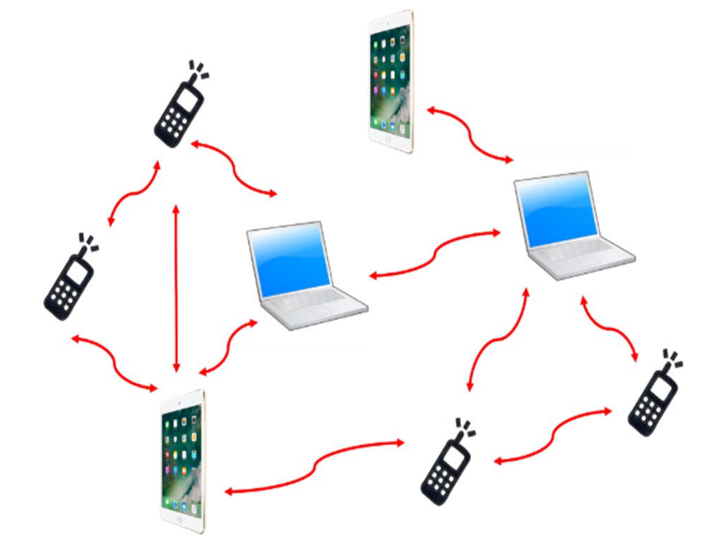
An Effective Multiple Paths Congestion Control AODV
Kawshik Kumar Paul
1705043
Undergrad Student
Dept of CSE, BUET

Slide 2
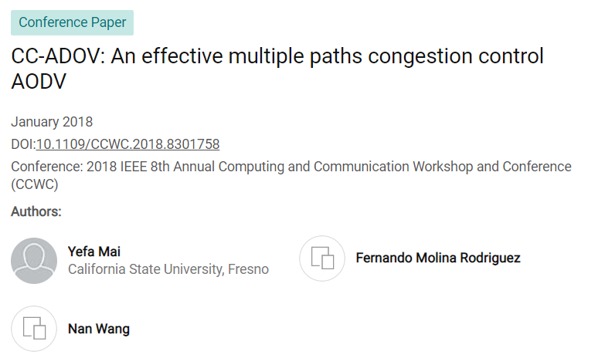
https://www.researchgate.net/publication/323562880_CC-ADOV_An_effective_multiple_paths_congestion_control_AODV
https://ieeexplore.ieee.org/document/8301758

Slide 3
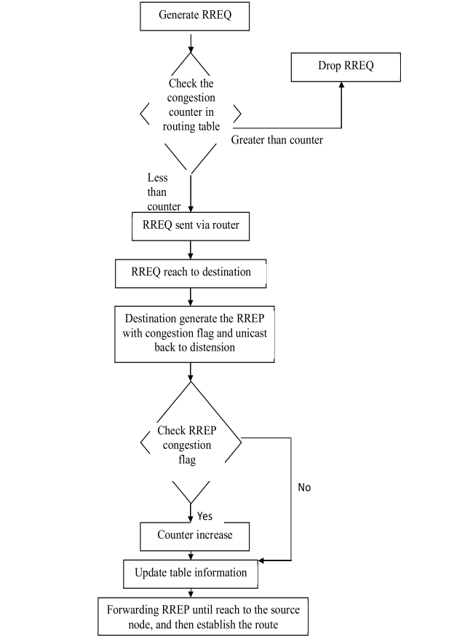
CC-AODV Flowchart

Slide 4
Project Update 2

Slide 5
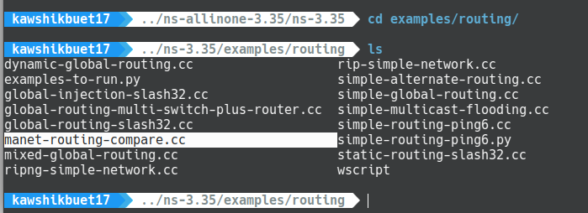
File Reference

Slide 6
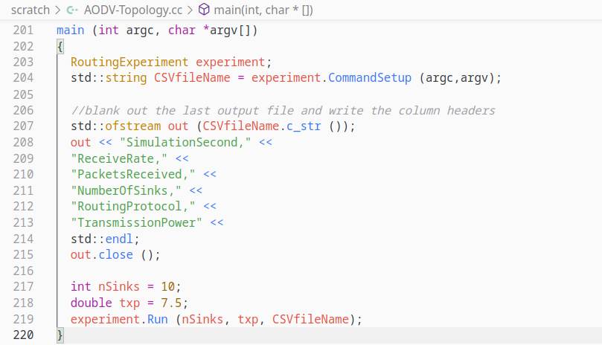
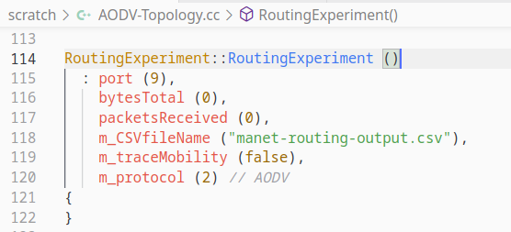
Main Function

Slide 7
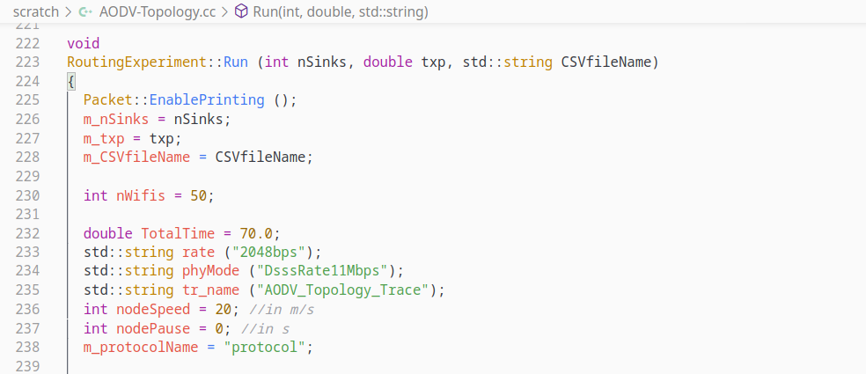
Set Simulation Time and Params

Slide 8
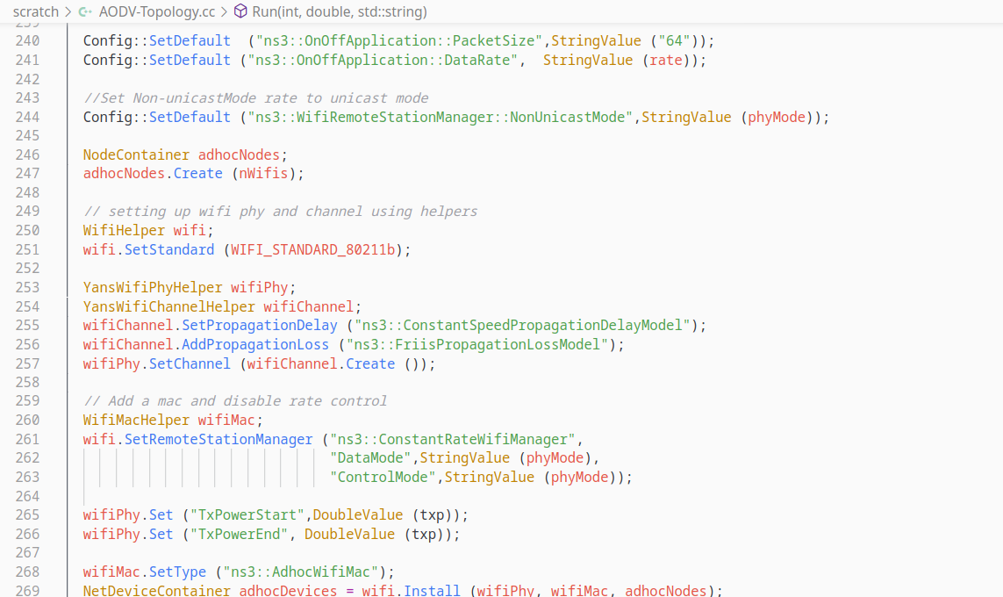
Creating adhocNodes and adhocDevices

Slide 9
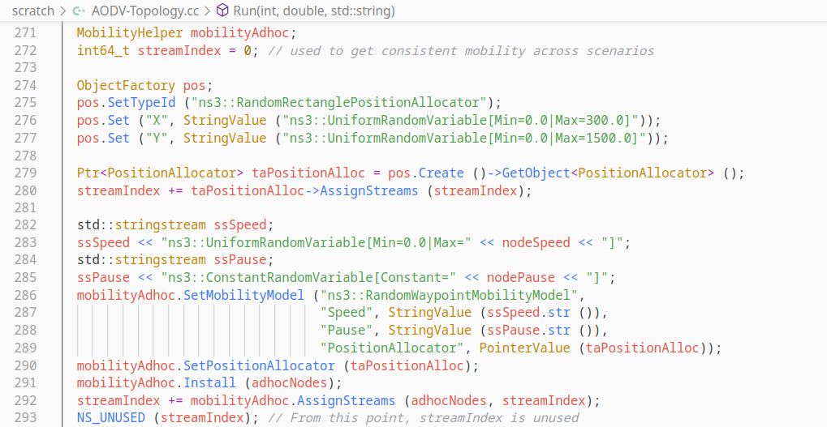
Set Mobility

Slide 10
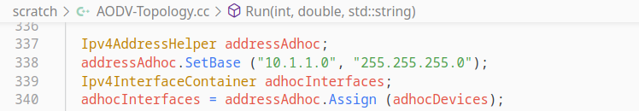
Adding Network Address

Slide 11
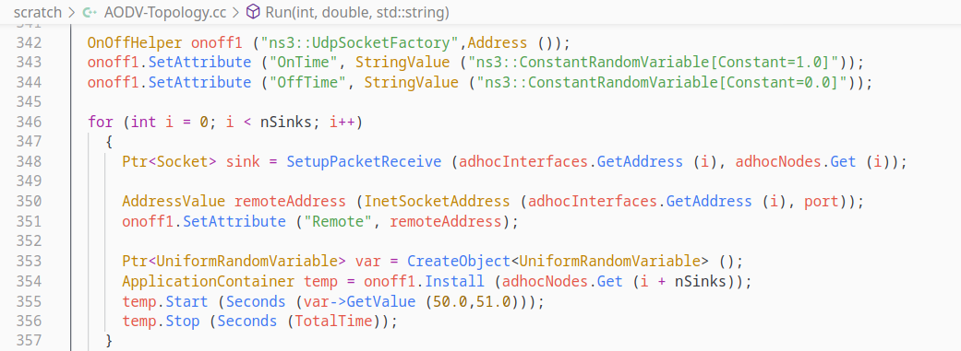
Packet Send Receive

Slide 12
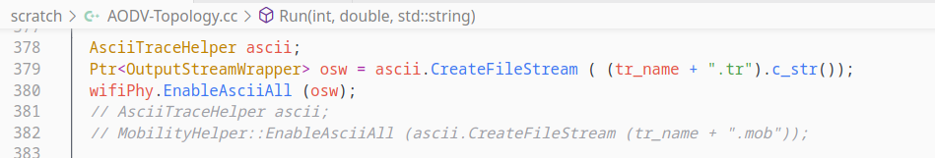
.tr file generating

Slide 13
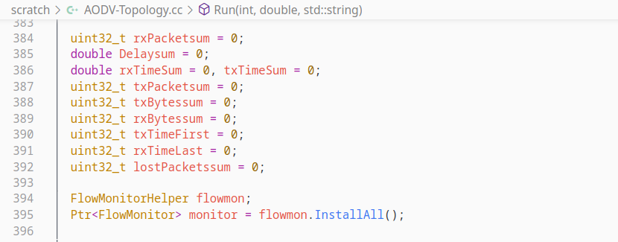
Flow Monitor

Slide 14
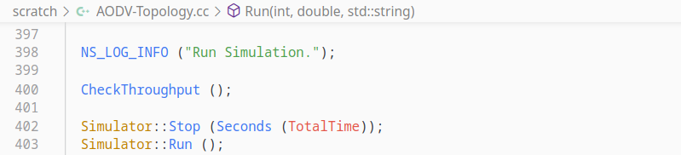
Run Simulation

Slide 15
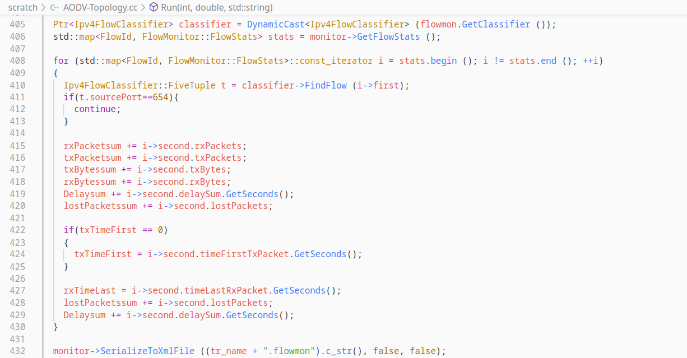
Calculating Flow Packet Properties

Slide 16
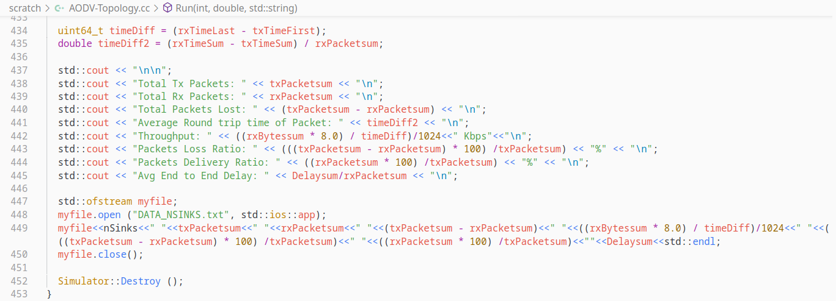
Getting Output and Store in a File

Slide 17
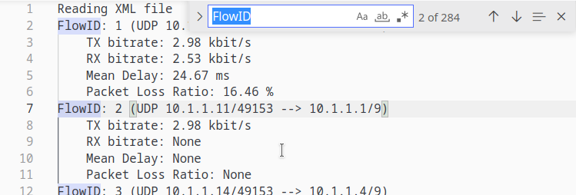
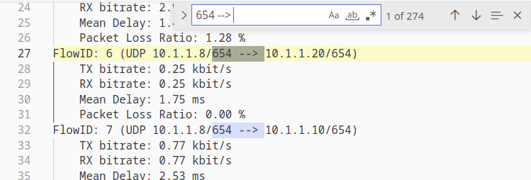
Flow (For nSinks=10)

Slide 18
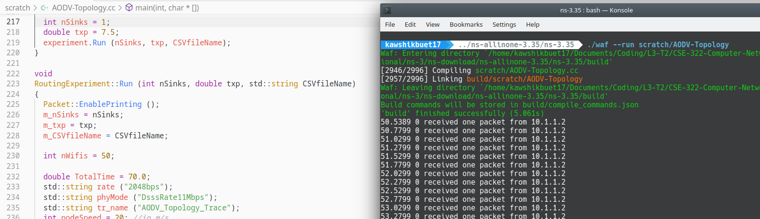
Running Code (nSinks=1)

Slide 19
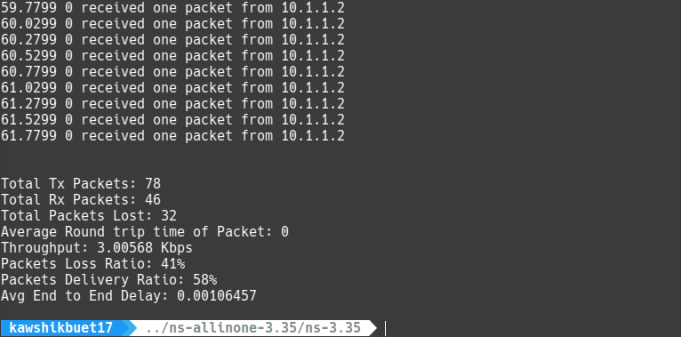
Demo Output for nSinks=1

Slide 20
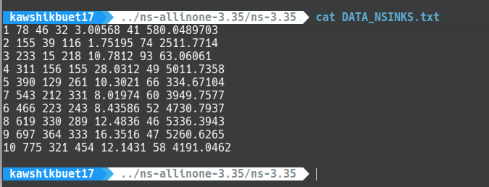
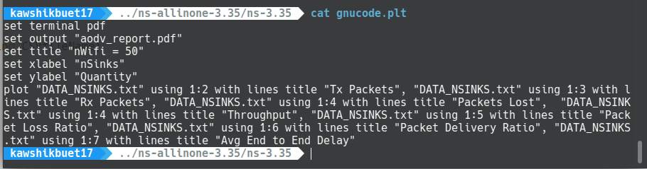
Generate Data and Plot

Slide 21
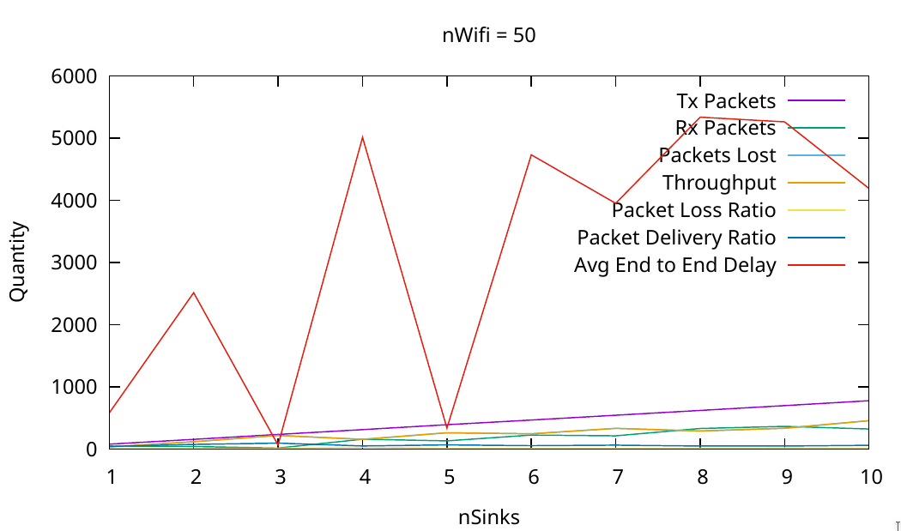
Plot Graph 1

Slide 22
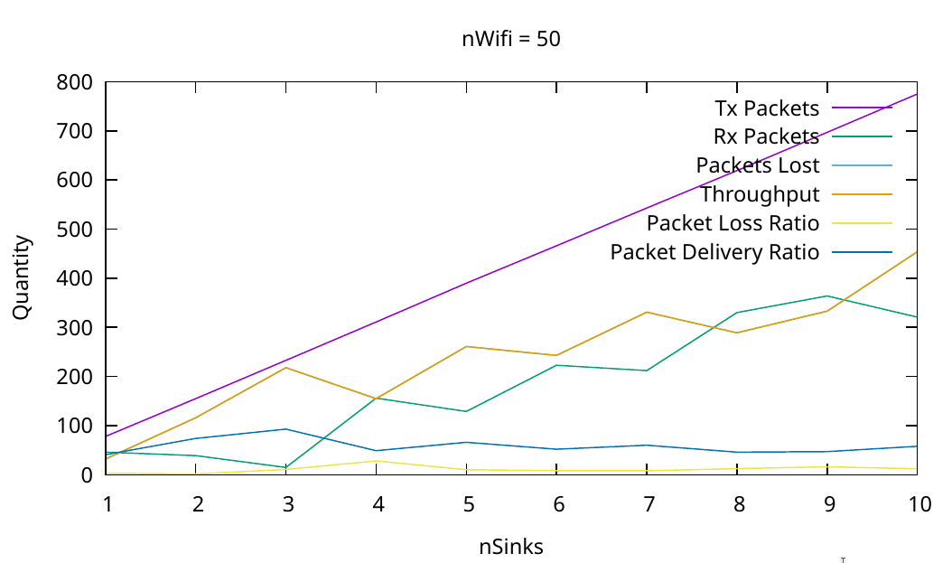
Plot Graph 2 (Without E2E Delay)

Slide 23

Thank You

