Slide 1
Installation of ORACLE 11g Release 2 on Windows and connection with Navicat

Slide 2
Steps of installation
Step 1 : Creating an OTN account
Step 2 : Downloading Oracle 11g
Step 3 : Unzipping Oracle
Step 4 : Installing and Configuring Oracle

Slide 3
Step 1 : Creating an OTN account
Applicable if you want to download the oracle 11g by yourself
Go to http://www.oracle.com/index.html and register for an account of your own.

Slide 4
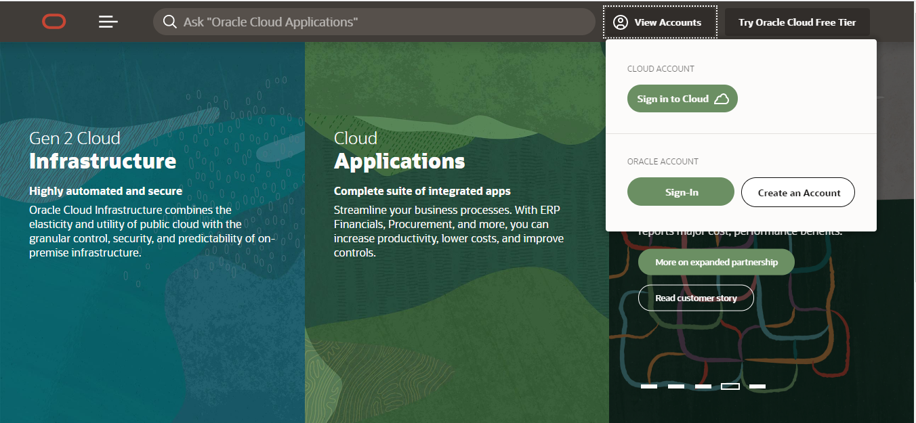

Slide 5
Step 2: Downloading Oracle 11g
Go to the following link
http://www.oracle.com/technetwork/database/enterprise-edition/downloads/index.html?ssSourceSiteId=ocomen
and scroll down to find the screenshot in the next slide

Slide 6
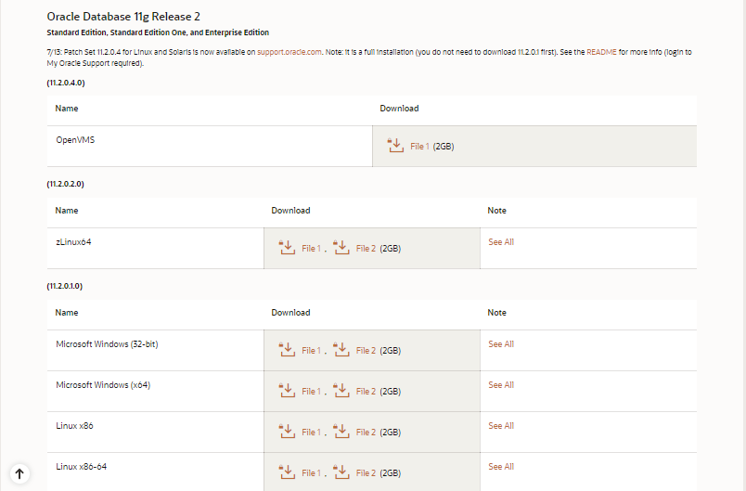

Slide 7
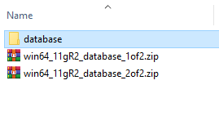
Step 3: Unzipping
Download both File 1 and File 2 as per your windows version
Unzip File-1
You will have a folder named “database”

Slide 8
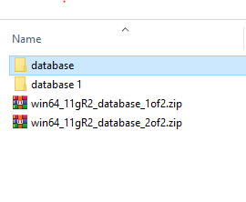
Step 3: Unzipping
Rename it to “database 1” as unzipping the 2nd file will produce a folder name “database” too
File 2
File 1

Slide 9
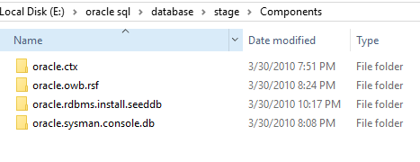
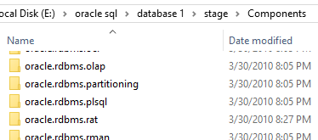
Step 3: Unzipping
Copy everything from database/stage/components/
to database1/stage/components/

Slide 10
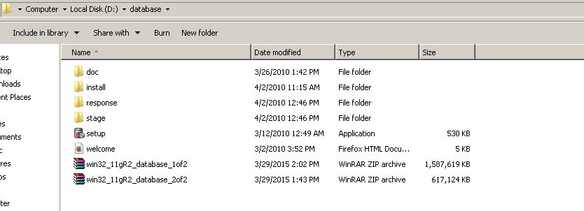
Step 4: Installation
Click on the setup icon to start installation

Slide 11
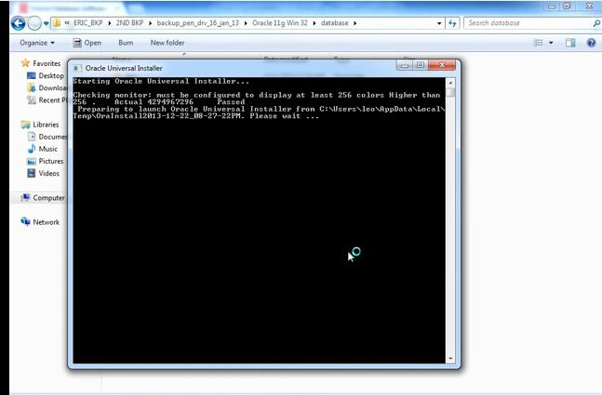
Step 4 : Installation contd.
Installation starts with this window:
If any warning about environment is shown just ignore and continue

Slide 12
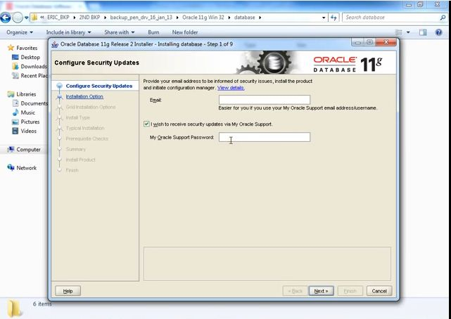
Step 4: Installation Contd.
Give your OTN account username and password here if you want update and then next :
Unmark the tick if you don’t want update

Slide 13
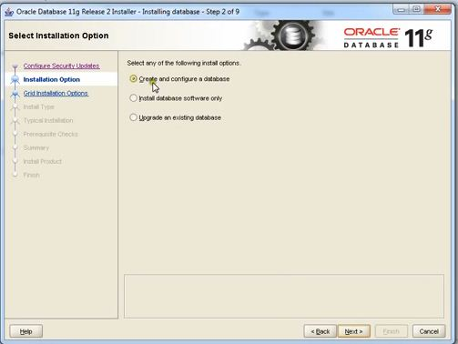
Step 4: Installation Contd.
Choose the create and configure database option and then next:

Slide 14
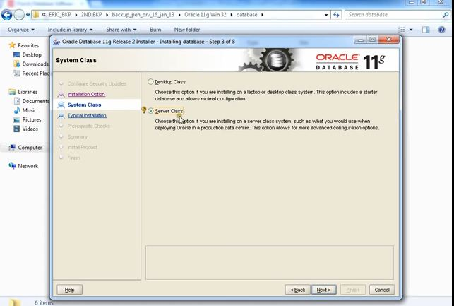
Step 4: Installation Contd.
Choose Server Class and next:

Slide 15
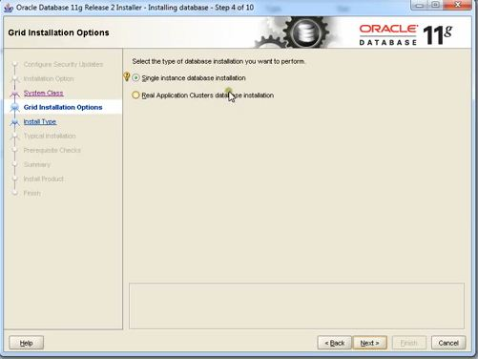
Step 4: Installation Contd.
Select Single Instance option as grid installation options and press next

Slide 16
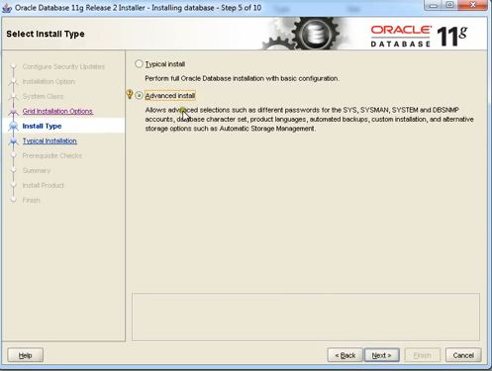
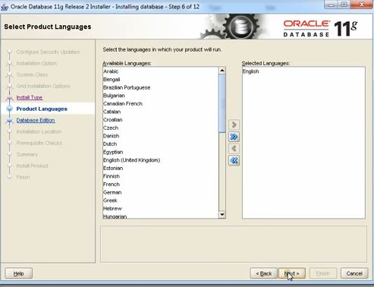
Step 4 : Installation Contd.
Select Advanced Install as install type and then next and later select language

Slide 17
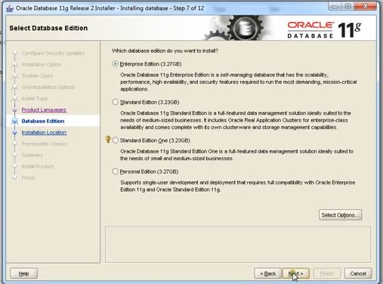
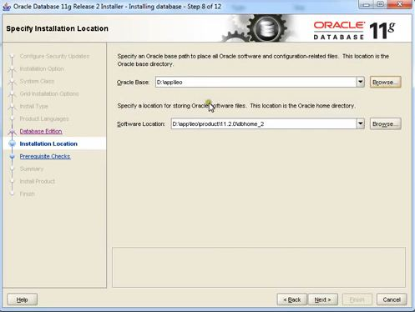
Step 4: Installation Contd.
Select Enterprise Edition and next, select path as your choice otherwise continue

Slide 18
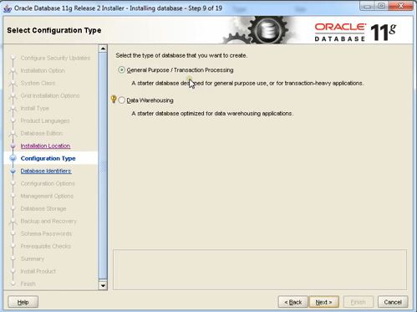
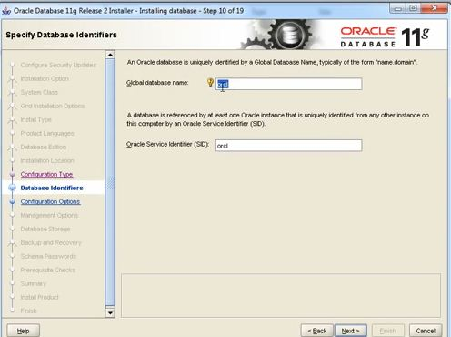
Step 4: Installation Contd.
Select General Purpose as configuration type, continue and set globaldb name if you choice to ; by default set to orcl

Slide 19
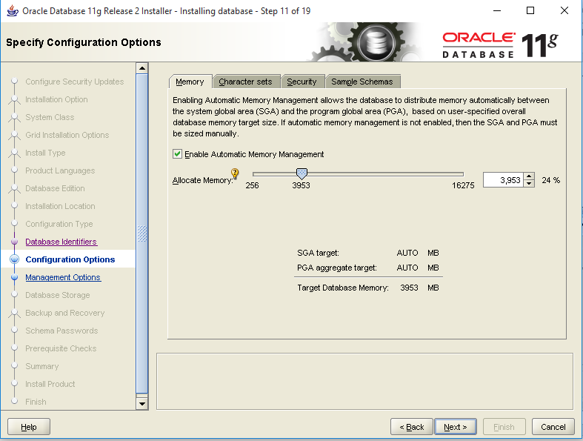
Step 4: Installation Contd.
Set Memory Limit. Do not press Next

Slide 20
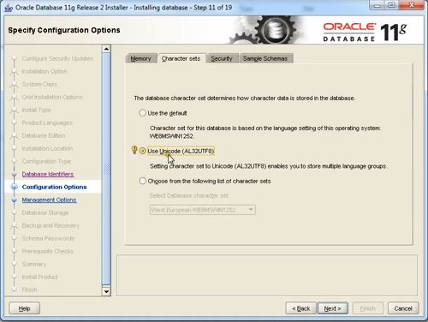
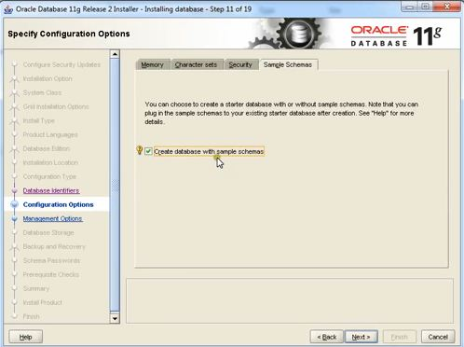
Step 4: Installation Contd.
In the next tabs set the character set as unicode and enable the sample schemas , click next

Slide 21
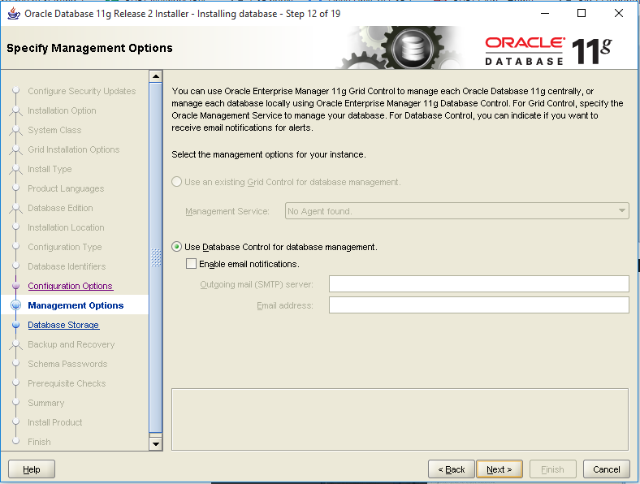
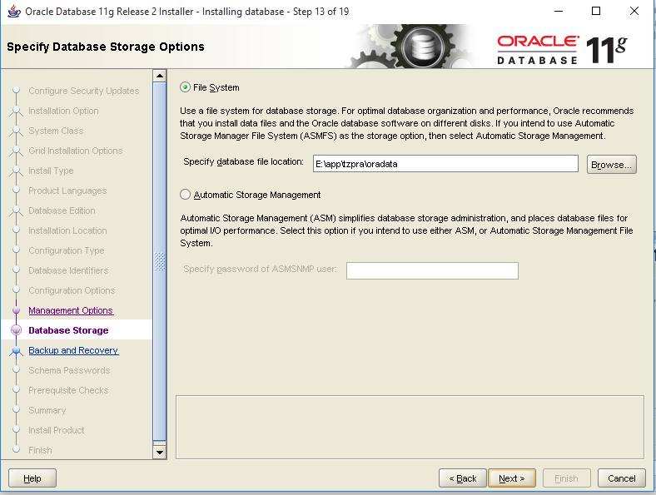
Step 4: Installation Contd.
Click Next and Next

Slide 22
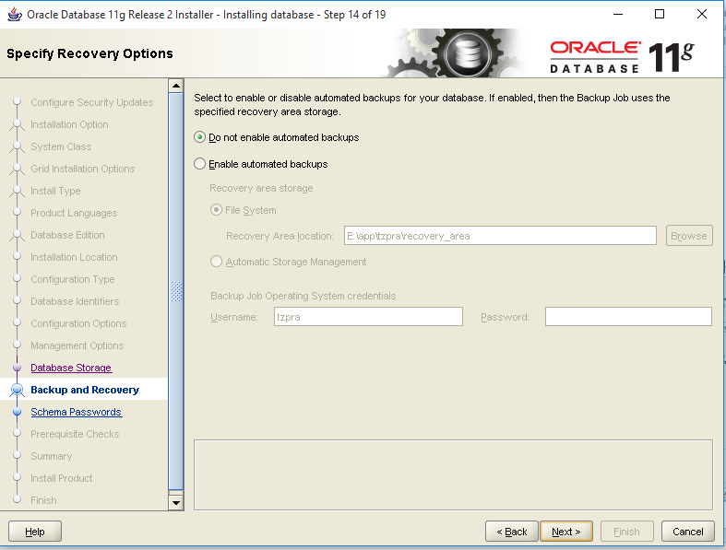
Step 4: Installation Contd.
Specify if you want backup or not

Slide 23
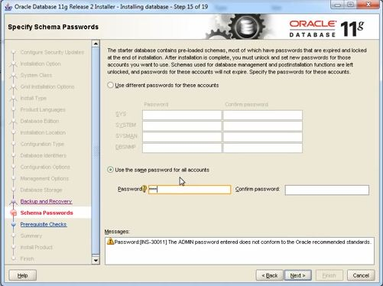
Step 4: Installation Contd.
Select use the same password for all account for your management facility set the password and confirm it and then continue
Then it will automatically do some prerequisite checks and you can check the summary and press finish

Slide 24
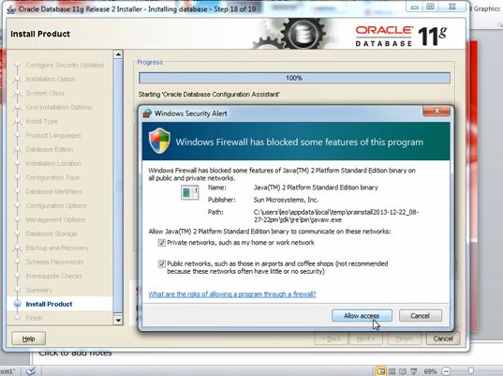
Step 4: Installation Contd.
The system will ask for access to two files; you have to just allow them

Slide 25
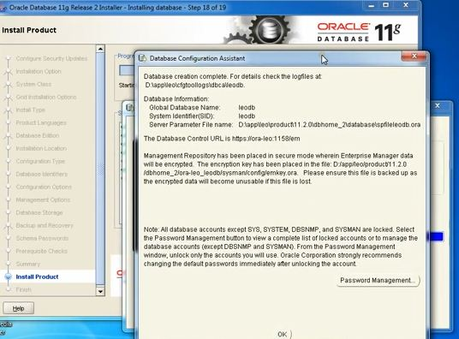
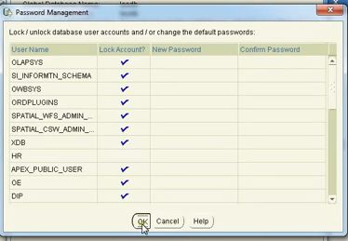
Setting Up
A database assistant window will appear and by selecting password management configure as required(Unlock HR) then press OK for both and then close

Slide 26
Setting Up
Then go to start menu
oracle-oradb11g_home 1,
Run “SQL Plus”
Enter username and password(as set during installation)

Slide 27
Setting Up
If login fails then try
Username: SYSTEM
Password: password you have set earlier
When prompted type
alter user hr identified by password

Slide 28
Using SQL Plus in Lab
First go to SQL plus and connect to system with
username: sys as sysdba
password: 123
Then give the following command:
alter user hr identified by hr account unlock;
Then test the connection with following command:
connect hr
When prompted for password give 'hr' as input.
If it displays connection successful , then connection is set up properly.

Slide 29
Connecting with Navicat
Download and Install Navicat from the link below
https://www.navicat.com/en/download/navicat-premium

Slide 30
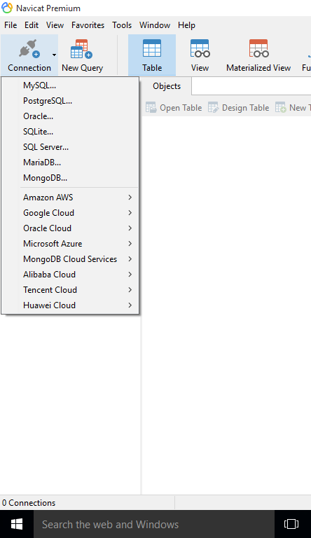
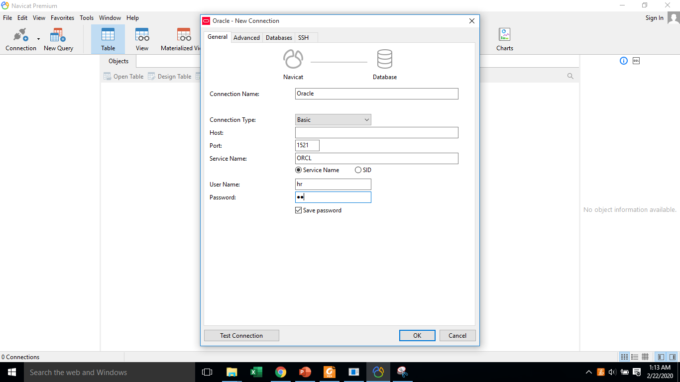
Connecting Navicat with Oracle HR
Test connection. If successful, click ok.
Global username set by you during installation. Default ORCL

Slide 31
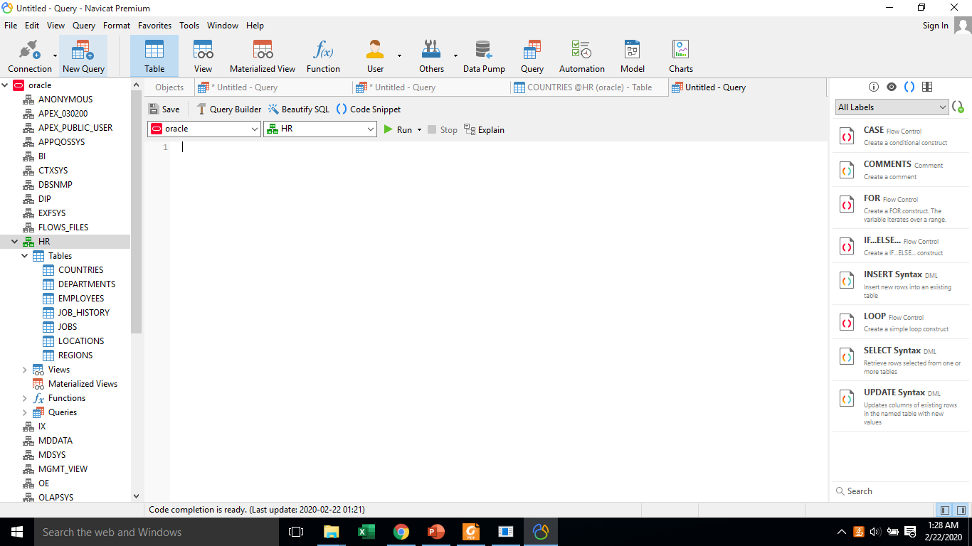
Writing Queries
Click “New Query” and start writing queries

Slide 32
Reference
https://www.youtube.com/watch?v=APZbgF_vnBI
Guideline to uninstall
http://www.rebellionrider.com/how-to-uninstall-oracle-database-12c-rebellionrider/

