Slide 1
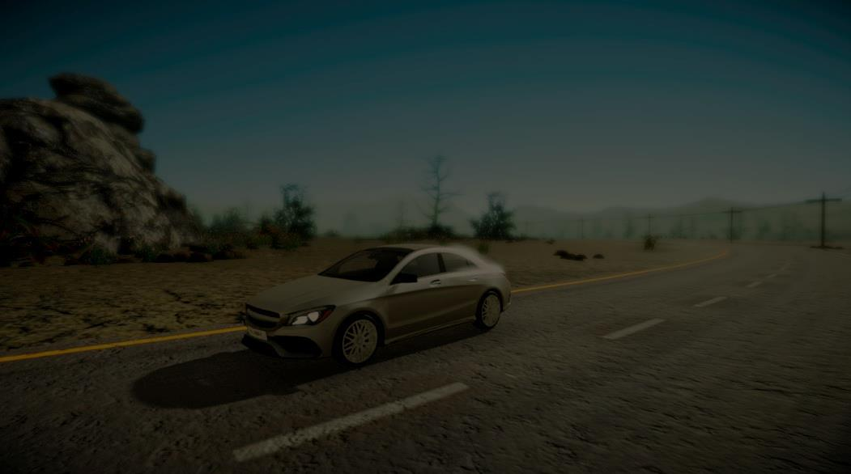
Asphalt A feature rich Self driving car simulation
A PROJECT BY:
Md. Afridi Kayal

Slide 2





Made with

Slide 3

A brief introduction

Slide 4

What is a Neural network ?
Neural network is a computer system which is modelled on the ‘Human Brain’
Just like a human brain, a neural network has neurons which are responsible for triggering certain actions
Neural networks are not intelligent from the beginning. Training them is the part of ‘Machine Learning’. There are several ways of training a neural network. The best fit for a self driving car simulation may be a genetic algorithm.

Slide 5
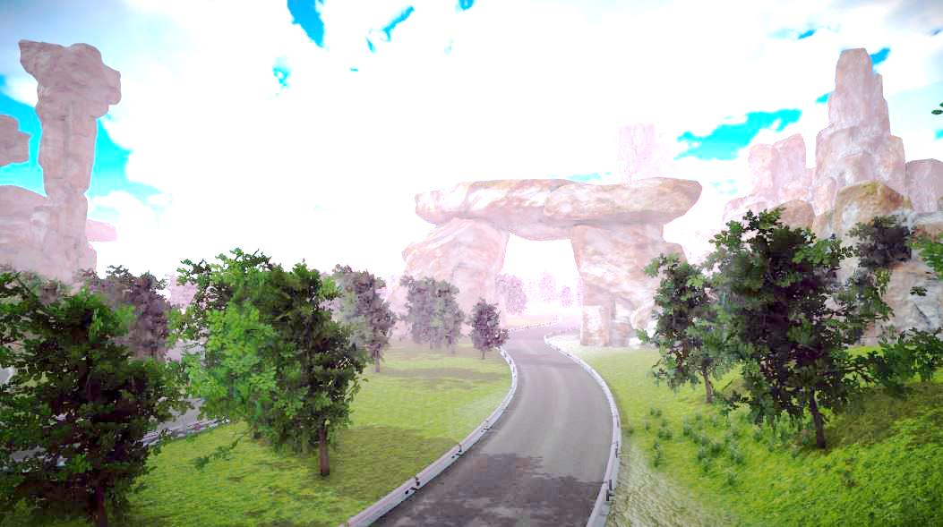
Genetic algorithm for training
This algorithm is based on Darwin’s theory of evolution which states that all species of organisms arise and develop through the natural selection of small, inherited variations that increase the individual's ability to compete, survive, and reproduce.
Five stages of the execution of this algorithm are:
Initialization
Selection
Production of next generation
Heuristics
Termination

Slide 6
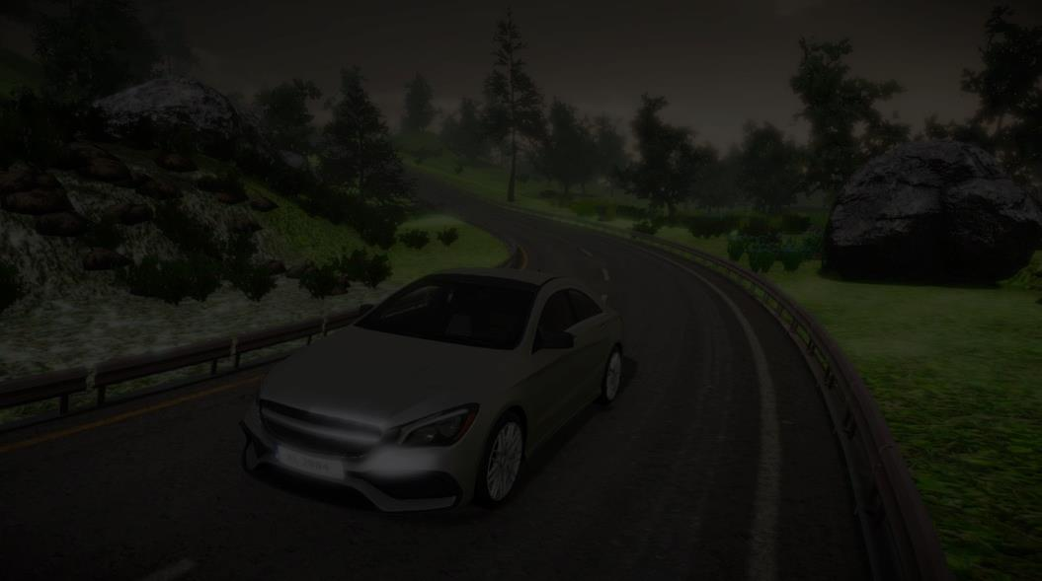
putting it together

Slide 7
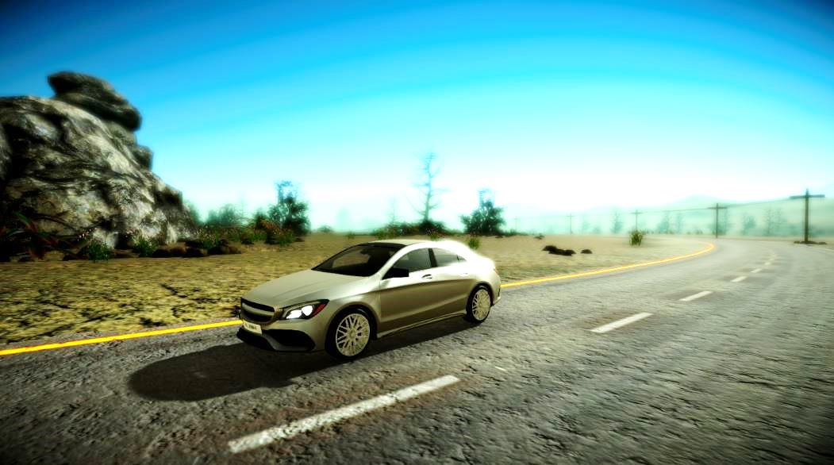
The neural network of our car
The car in the simulation has a neural network with 4 Layers including Input/Output:
1st layer has 6 Neurons with 5 distance sensors and a speed sensor as input.
1st hidden layer (2nd layer) has 32 neurons.
2nd hidden layer (3rd layer) has 16 neurons.
4th layer (Output layer) has 2 neurons. A horizontal and a vertical axis.

Slide 8

What about training? Here comes the trainer
We have implemented a trainer that trains the car’s neural network using genetic algorithm. This is how it works:
Each generation has 20 genomes (neural network weights). Starting with random values, the trainer provides a bias to the networks and puts them on track.
With the output calculated using the weights and sensor inputs, the car drives itself.
Upon failure, next genome is triggered and the car is reset.
After each generation, best genomes according to some heuristics are selected for breeding and producing next generation. This process goes on.

Slide 9
Saving the data
Genetic algorithms are obviously not very optimal and they depend upon heuristics used to calculate fitness of genomes.
Still, the training process is lengthy and guarantees no optimal solution in every session as the weights and biases are assigned randomly.
Keeping this problem in mind, we have included a saving feature. Binary (.ndat) files are simple serialized objects which store the weights and biases of a session. Whenever a good data is encountered, the user can save it. The .ndat can be collected from (“../My Documents/AI Car/Saves/*.ndat)
The saved networks can be used in auto-drive mode

Slide 10
Getting familiar with ui

Slide 11
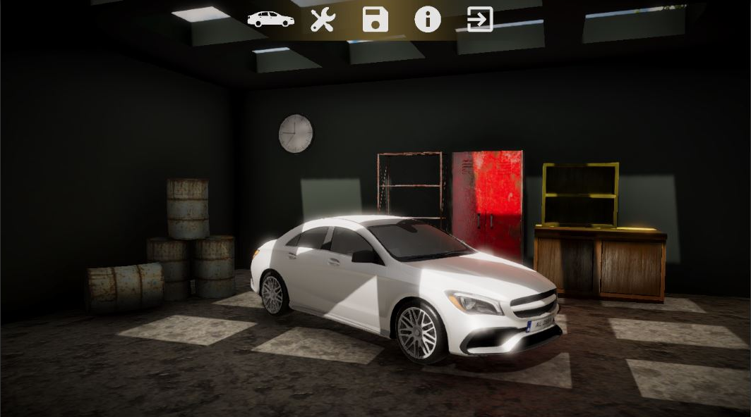
The User Interface - Main menu
Session
Settings
Save manager
About app
Quit

Slide 12
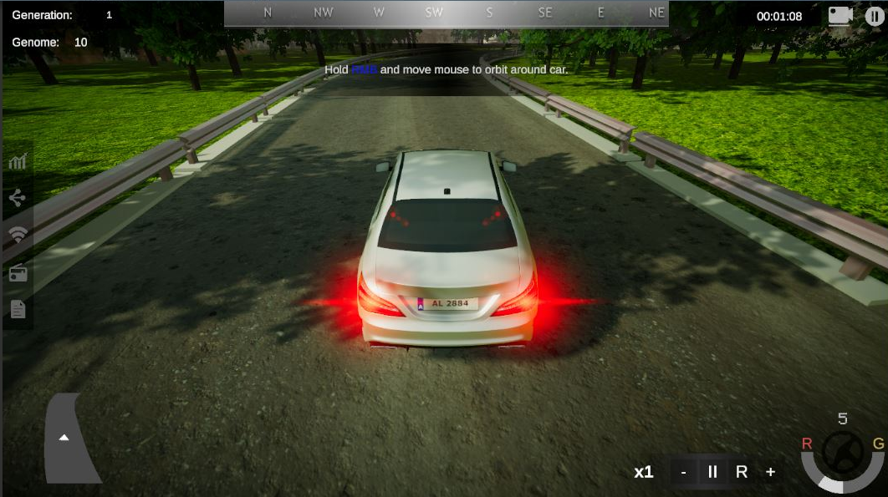
The User Interface - Simulation
Current generation and genome
Compass
Notification bar
Session timer
Camera angles [C]
Pause [Esc]
Mini map
Window panel
Timescale panel
Speed/Input meter

Slide 13
Sub - systems (Primary features)

Slide 14
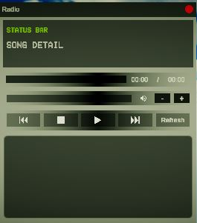
Windows
Windows are the base of all sub-systems (except analyzer in main menu)
We used this approach so that the user can see the car perform as well as track it’s data without interruption
Hide button
Drag zone
Example window – Radio (Captured from simulation)

Slide 15
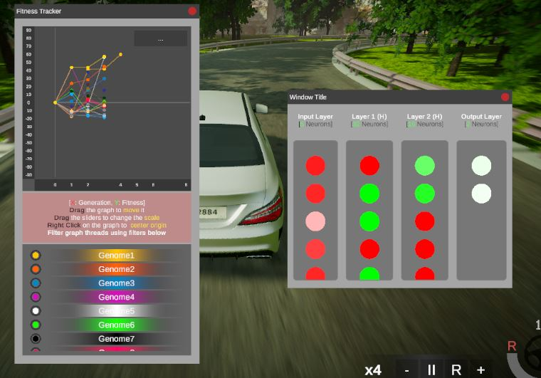
Fitness tracker
It’s a compact graph system which maps the fitness scores of each generation
Sample viewer
Axes scale
(Drag to change)
Genome Filters
Fitness tracker
(Captured from simulation)

Slide 16
Network visualizer
As the name suggests, this sub-system provides a live feed of the reactions of the neurons due to the current neural network computations.
RED - values are normalized minimum (Unexcited State)
GREEN - values are normalized maximum (Fully excited state)
WHITE - values are neutral
Input layer
Hidden layer 1
Hidden layer 2
Output layer
Network visualizer
(Captured from simulation)

Slide 17
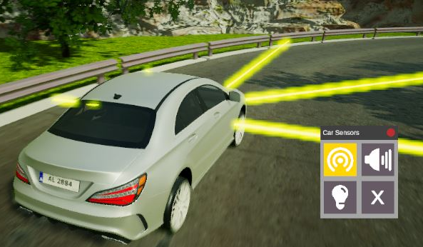
Sensor visualizer
This module provides visual feed of the various sensors/controls provided in the car
Disable all
Horn (Ambient feature)
Distance sensors
Head lights (Ambient feature)
Sensor visualizer
(Captured from simulation)

Slide 18
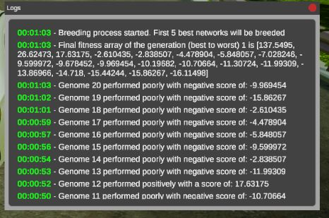
Genration logs
Logs are useful to keep track of the past.
Logs are textual comments made on the performance of a genome in a generation.
Generation logs window
(Captured from simulation)

Slide 19
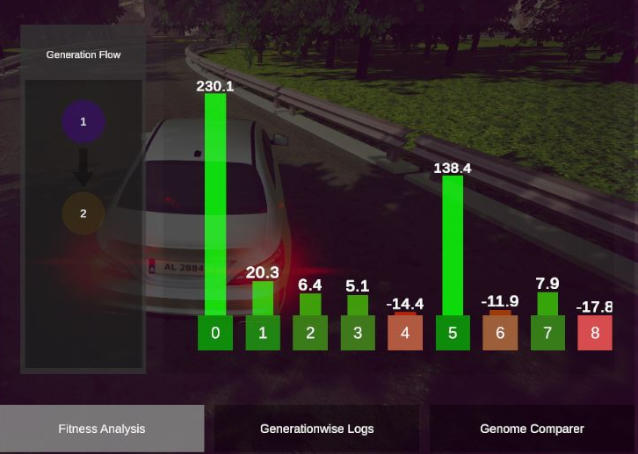
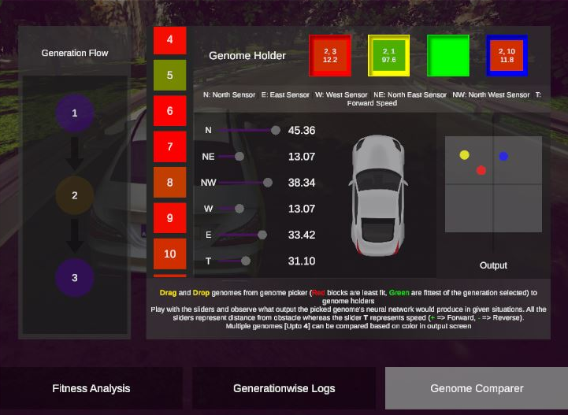
Analytics
This sub-system provides a deeper peek on a test genome’s performance. This is the only analytic part which can be used only when the simulation is paused.
The following features are part of analytic section:
Fitness analysis
Generation-wise logs
Genome comparer
Fitness analysis
(Captured from simulation)
Genome comparer
(Captured from simulation)

Slide 20
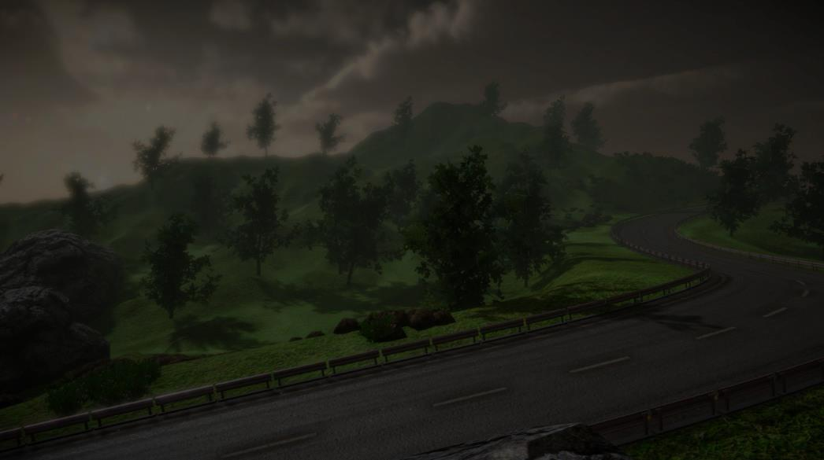
Drive - modes

Slide 21
3 modes to choose from
There are 3 modes available from the main menu when starting a session:
Training mode (Start a training session)
Auto-drive mode (Requires a saved .ndat)
Manual drive mode (Drive the car yourself)

Slide 22
locations

Slide 23
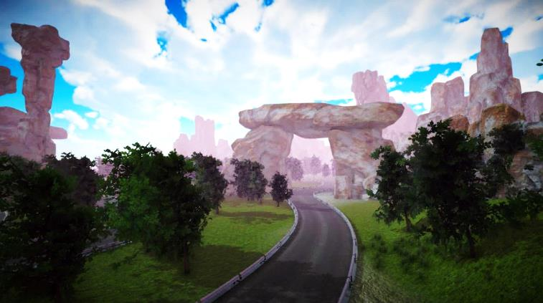


3 Locations to choose from
There are 3 locations included in the base simulation. This can be extended without completely replacing the software. All drive modes are available for each.

Slide 24
Design and extras (Secondary features)

Slide 25
Radio
Training process is lengthy and takes quite some time even at 4X speed.
Radio is an ambient feature included in the simulation.
Users can save their songs in “../My Documents/AI Car/Media” and press refresh in radio window to load their songs.
(currently only supports .ogg due to engine’s limitations)
Control Panel
Refresh
Songs list
Radio - Window
(Captured from simulation)

Slide 26
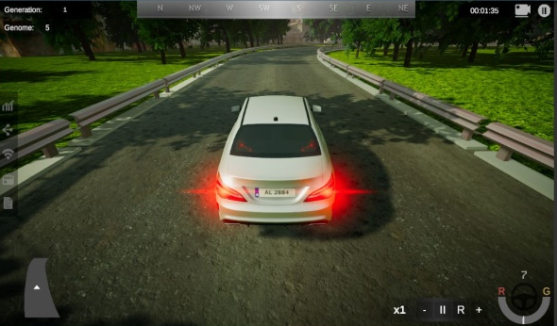
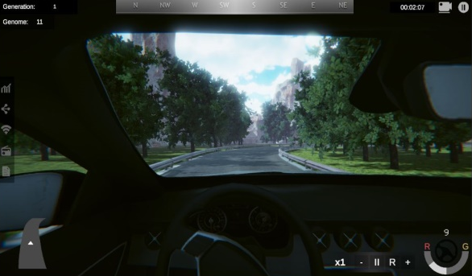
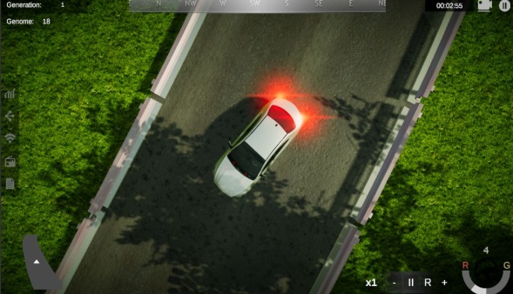
3 camera angles to choose from
There are 3 camera angles included in the simulation. All angles are available in all locations and modes,
Chase Camera
First Person Camera
Overhead Camera

Slide 27
The conclusion

Slide 28
The simulation is packed with so many features. It can be best used for studying the behaviour of genetic algorithm. The neural data files can be used in real life models too as the base of a self driving car which can be further improved by adding more algorithms
The simulation is moreover created in a very modular way so no two subsystems are dependednt on each other. This means can any algorithms can be tested on the simulation as a developer and not just neural network and genetic algorithm.
Modular system enables us to make changes in the game even after final build (expansion pack).
Nvidia’s PhysX engine provides accurate results. We even had to program anti roll wheel bars for both the axles of the vehicle. The output is thus closely related to a real life car and with just correct parameters as well, we can use the saved data in real life.

Slide 29
FIN Thank you for watching

