Slide 1
Video Content Prediction
Prediction of Number of Likes

Slide 2
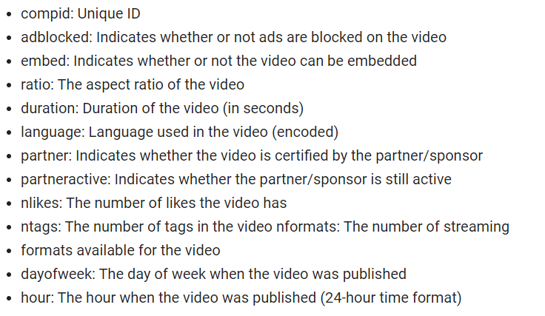
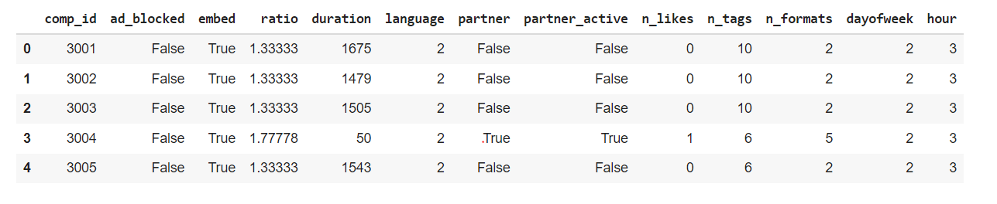
Here’s how my data looks like
Data Dictionary

Slide 3
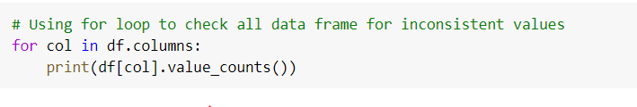
Firstly I did regular procedures as with all datasets. I did .info to see value types, checked if there’s any duplicates or missing values. There isn’t any. Next, I used for loop to see all value counts. That is one of my favourite approaches, because it really gives a good understanding what is going on in the data set with just two code lines.

Slide 4
Next, I’m dropping some columns. I decided to drop ad_blocked
since all values are False and I am also dropping partner_active
because I have a column partner which already giving an information about partner.

Slide 5
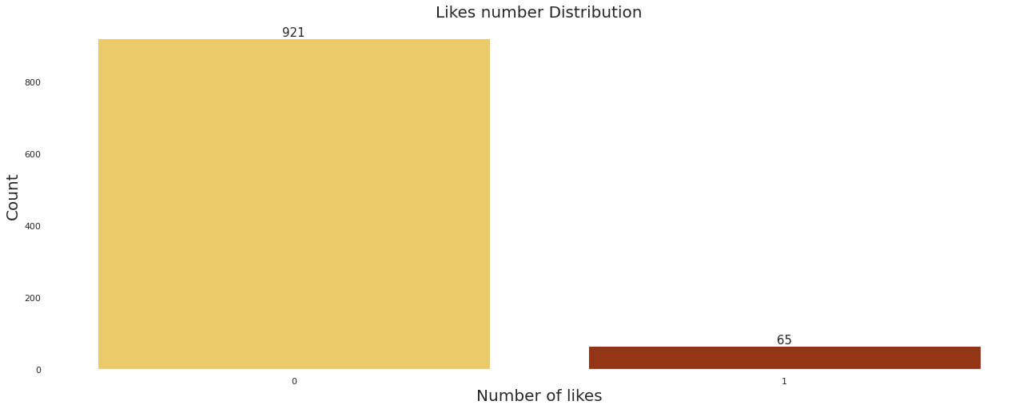
Next I am exploring the n_likes column, since it is my target. I grouped The visualization below show Number of Likes distribution. We can see now, that there’s a bigger amount of videos with no likes comparing to the ones, that have any likes, therefore I’m going to group Number of likes into 0 likes and all others.

Slide 6
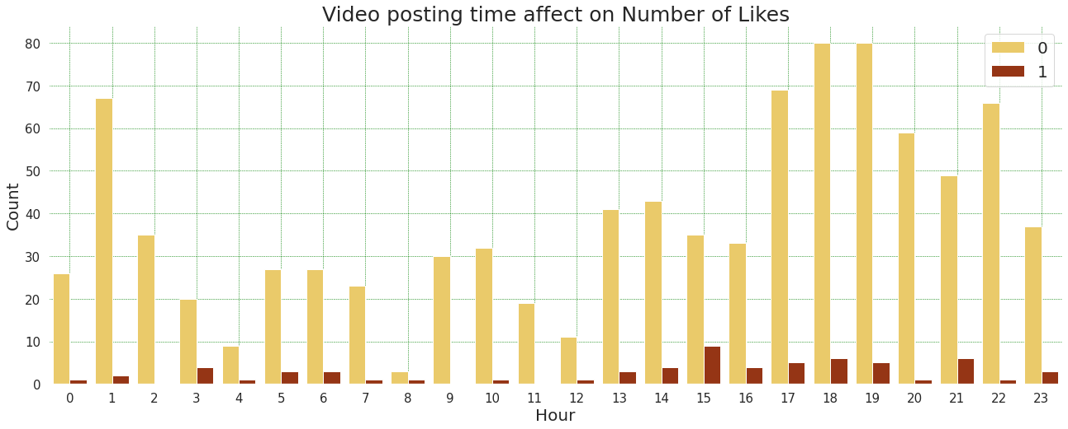
df['n_likes'] = df['n_likes'].replace([2, 3, 6], 1)
df.head()
Next I am creating a countplot with seaborn to see how hour of posting the video affect number of likes.
sns.set(rc={'figure.figsize':(22,8), 'axes.facecolor':'white'})
sns.countplot('hour', hue='n_likes', data=df,
palette='afmhot_r');

Slide 7
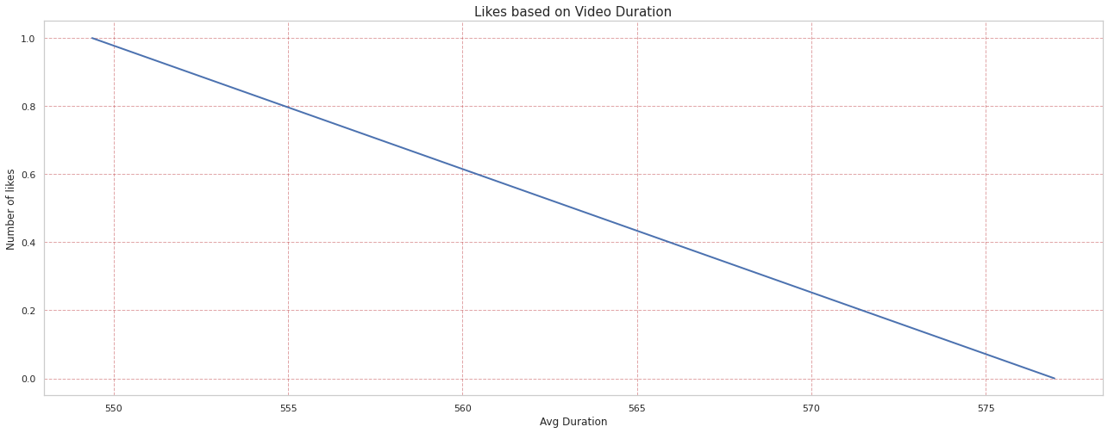
Then I am checking how duration of the video affects number of likes. Per below above we see that with growth of duration video likely to not get any likes.
sns.set_style("whitegrid")
drt = df.groupby('n_likes')['duration'].mean().reset_index(name = 'Avg Duration').sort_values('Avg Duration', ascending = False)
plt.plot(drt['Avg Duration'], drt['n_likes'], linewidth=2);

Slide 8
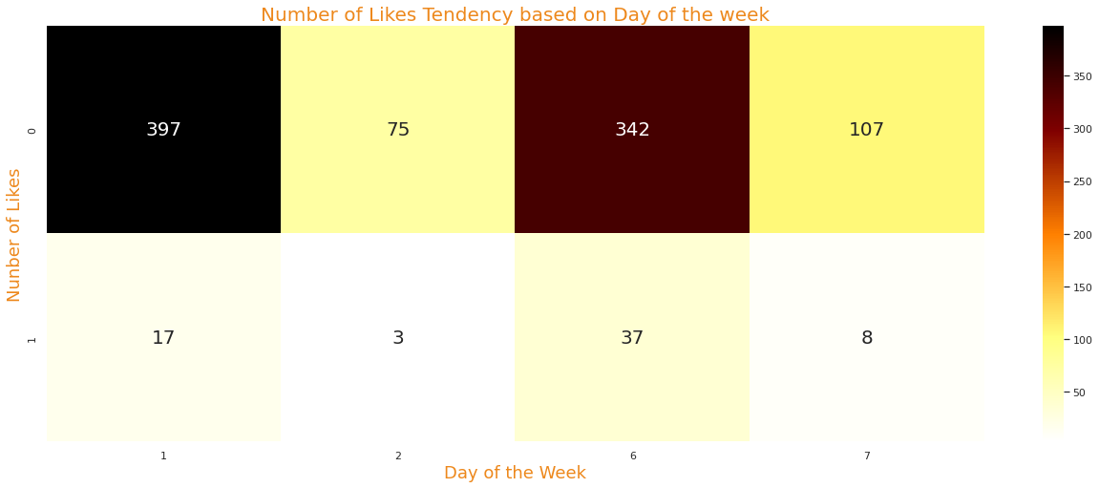
Then I am looking on Day of week affection on Likes.
# Grouping by dayofweek and likes
dof =(
df
.groupby('n_likes')
.dayofweek
.value_counts()
.unstack()
.fillna(0)
)
dof
sns.heatmap(dof,
cmap='afmhot_r',
annot=True,
fmt='.0f',
annot_kws={
'fontsize':20
});
Based on this heatmap, videos have more chances on receiving 0 likes on 1st day of the week (Sunday) and 6th day (Friday), however there's high chance on getting likes on 6th day as well.

Slide 9
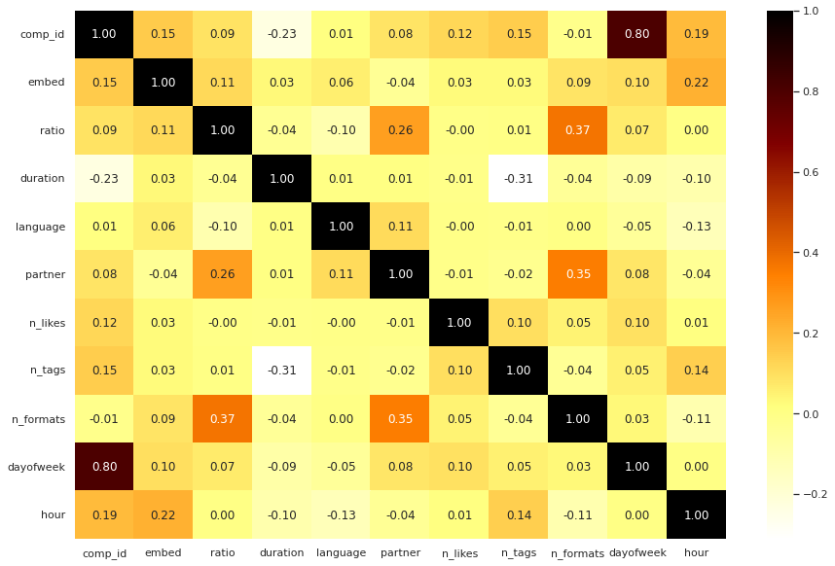
Then I am binarizing other column in my data set, so I can see correlations between all the values.
# Binarize other bool values in columns
a = df['embed'].astype(int)
b = df['partner'].astype(int)
df['embed'] = a
df['partner'] = b
df.info()
# Heatmap showing correlations
fig, ax = plt.subplots(figsize=(15,10))
sns.heatmap(df.corr(), cmap = 'afmhot_r', annot=True, fmt='.02f', ax=ax)

Slide 10
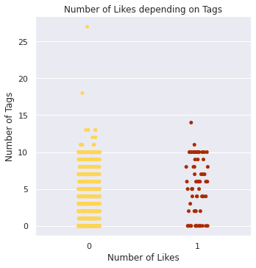
Lastly I’m checking how Number of likes affected by Tags.
sns.set(rc={'figure.figsize':(15,20)})
sns.catplot(x = 'n_likes', y = 'n_tags', data = df,
palette="afmhot_r")
sns.set_style("whitegrid")
Per this visualization, most of values are concentrated between 0 and 10 tags. There’s some with 18 Tags and more then 25, which are probably outliers.

