Slide 1

INF2003 Database Systems Group Project
Group 13
Lim Xiang Wei Alex | 2201541
Timothy Tan Zhe Xu | 2203235
Tan Kai Yang | 2200869
Zaw Wana | 2201190
Roy Teong Ying Jun | 2200507

Slide 2
Team Contributions
Project Sections | Contributor(s)
Non-relational database | Timothy
Relational database | Kai Yang
Integration of databases | Zaw
App Logic | Zaw & Alex
Front-End (GUI) | Zaw & Roy

Slide 3
Why HappyHub ?
In a era marked by rapid advancements, increasing responsibilities, and global challenges,
The importance of mental health has never been more apparent
Happy Hub introduces a way for people to reflect and think about how they feel mentally
Source : https://www.straitstimes.com/singapore/476-suicides-reported-in-singapore-in-2022-98-more-than-in-2021

Slide 4
Project Objectives
Main Objectives
Gathering Datasets [ Kaggle etc. ]
Relational Database [ SQL ]
Non-relational Database [ NoSQL ]
Project Specific Objectives
Introduces a survey for anyone to fill in, comprises of common measures of happiness/fulfillment in life
Goal is to track and improve a user’s happiness.

Slide 5

Gathering Datasets Process
Why Kaggle ?
Vast and diverse collection of datasets from global contributors
Time and resource-efficient with pre-processed and cleaned datasets
Up to date data, important for us as we are dealing with real-time happiness data from multiple countries

Slide 6

SQL (Relational Database)
Why MySQL ?
Open Source and Cost-Efficient
Widely-used and Familiarity
Easy to integrate with other technologies
Basic CRUD Functions
Allows user to register for a account (create)
Allow registered user to see their history (read)
Allow users to customise their user accounts (update)
Give them a happiness index score based on their survey

Slide 7

NoSQL (Non-Relational Database)
Why MongoDB ?
To allow anonymous users to submit their responses
Retrieve their history of submitted surveys
Give them a happiness index based on their survey
Provide tips and tricks on how they can improve their happiness
Used aggregations on Kaggle datasets to come manipulate the data into multiple charts to give users a visualisation of the world happiness index

Slide 8
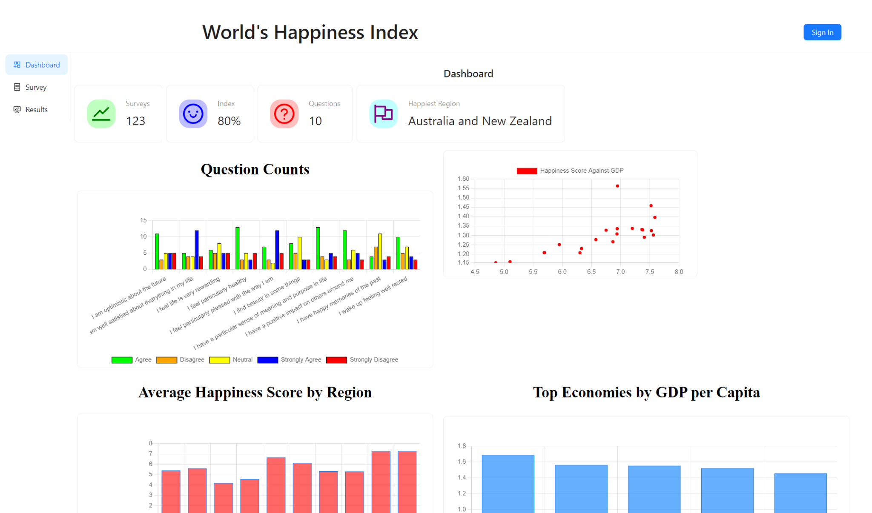
Additional features - Dashboard
Happy Hub comes with a dashboard on the overall happiness of the world
Keep track of happiest countries, and other happiness metrics!

Slide 9
Additional features - Happiness Advice
Different advice will be shown to user when the user views his survey results
If the user has a low rating on any happiness indicator, a random advice will be shown.
For example, if the user does not wake up feeling well rested, advice on how to wake up feeling more well rested will be shown.
Our goal is for the user to be more aware of what they are unhappy about, and make changes to them.

Slide 10
App Demo

Slide 11
Thank You

