Slide 1
Hierarchical SOM Based IDS on KDD Benchmark
Master’s Thesis Defense of
Hilmi Güneş Kayacık

Slide 2
Intrusion Detection Systems
“Burglar alarms”
Categories
  Monitored resources
  Detection method
Problems
  Speed
  Accuracy
  Adaptation

Slide 3
Objectives
Develop a hierarchical SOM based IDS
A data driven approach.
Minimum a priori information.

Slide 4
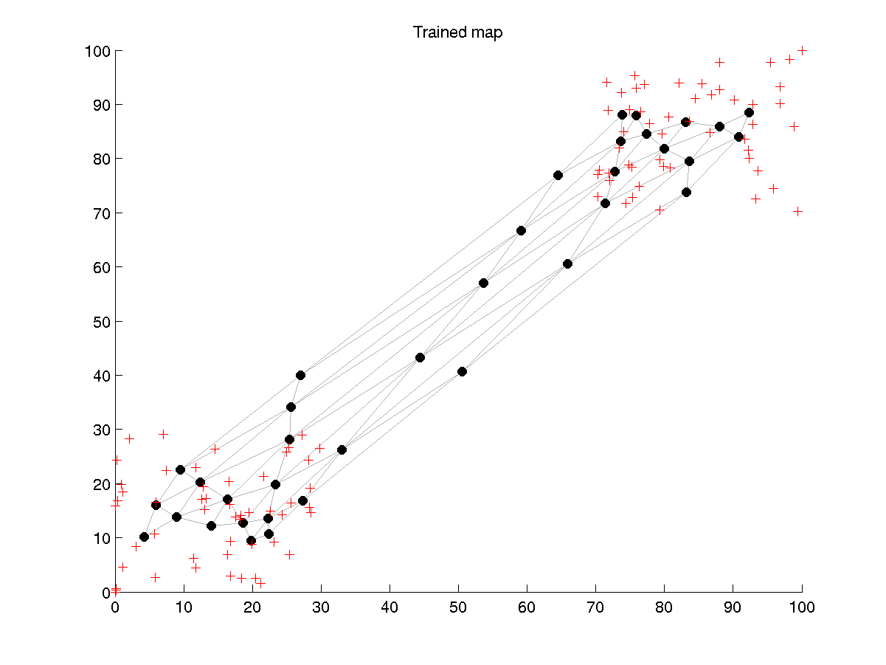
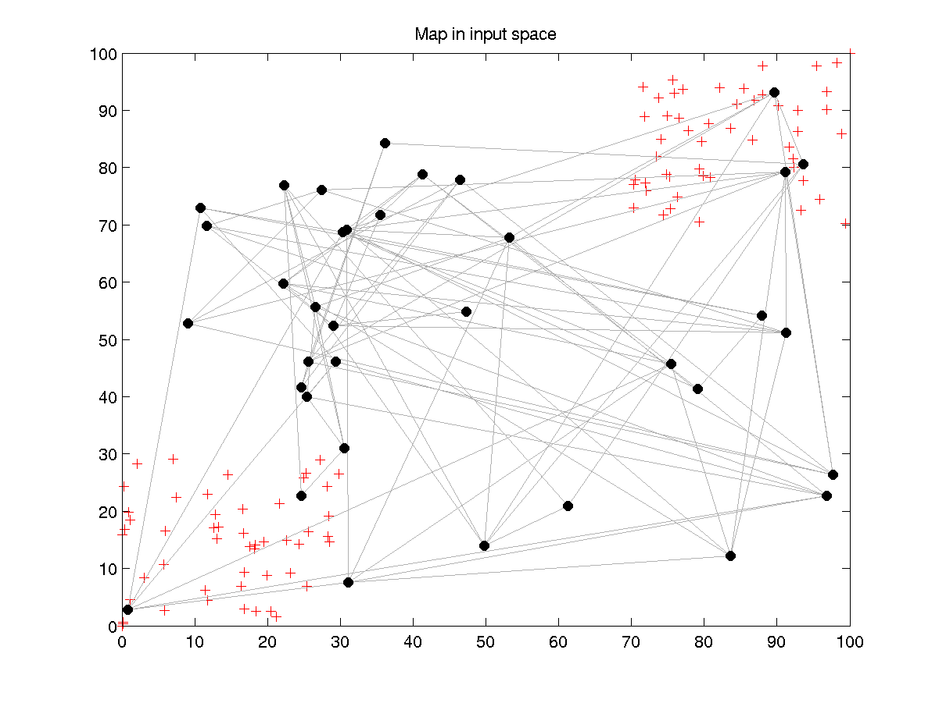
Self Organizing Maps

Slide 5
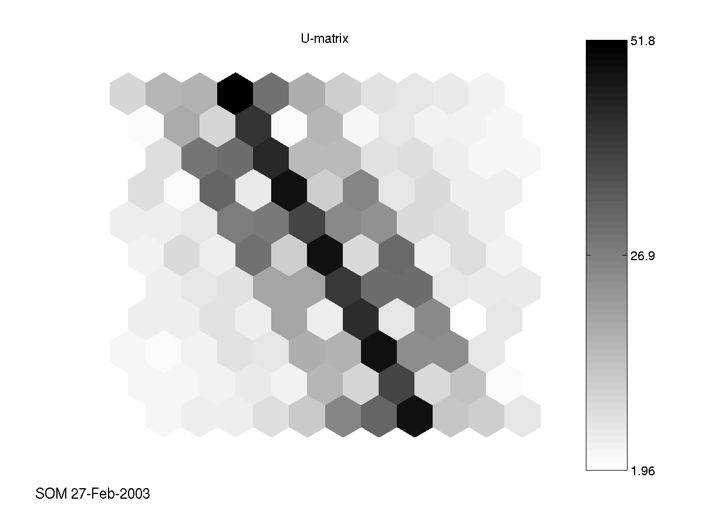
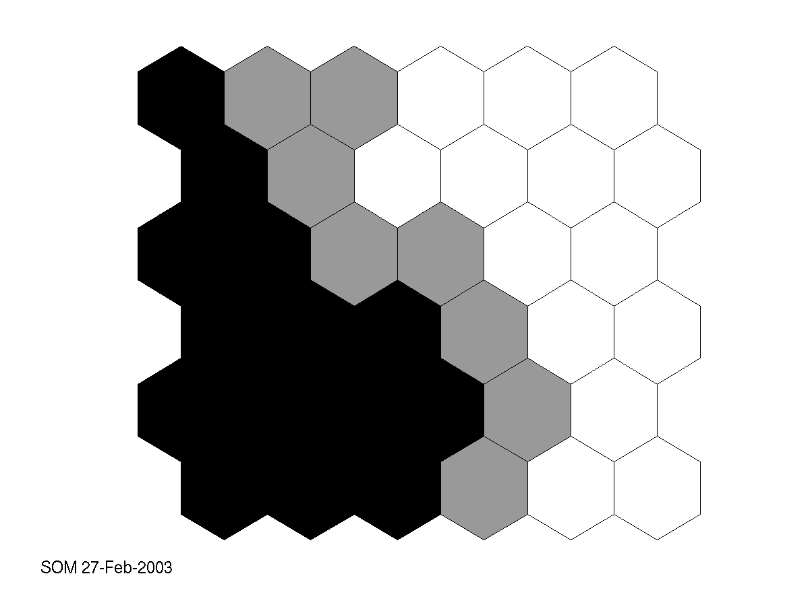
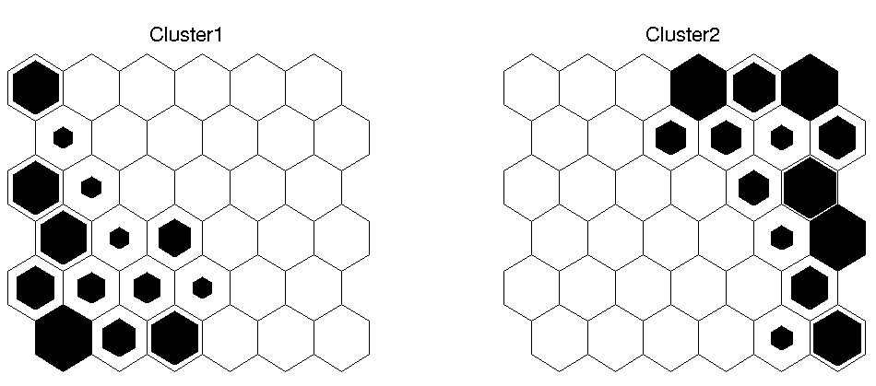
SOM (Visualizations)

Slide 6
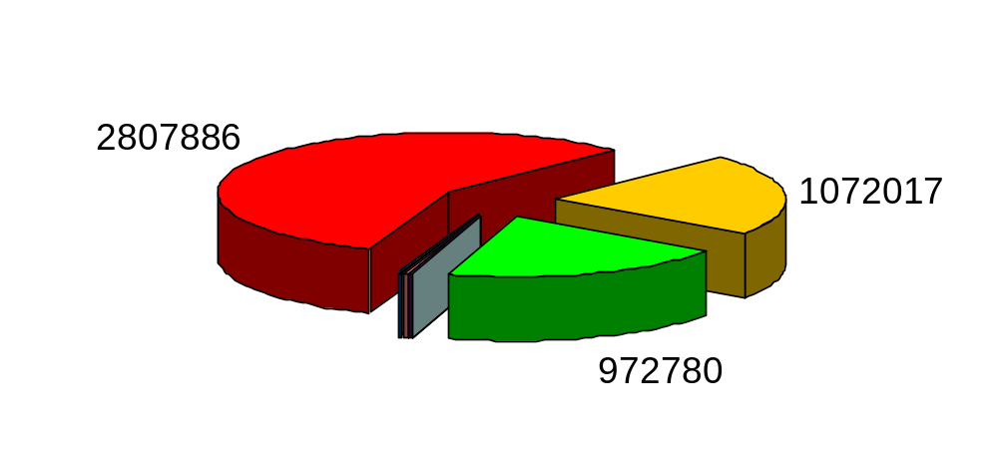
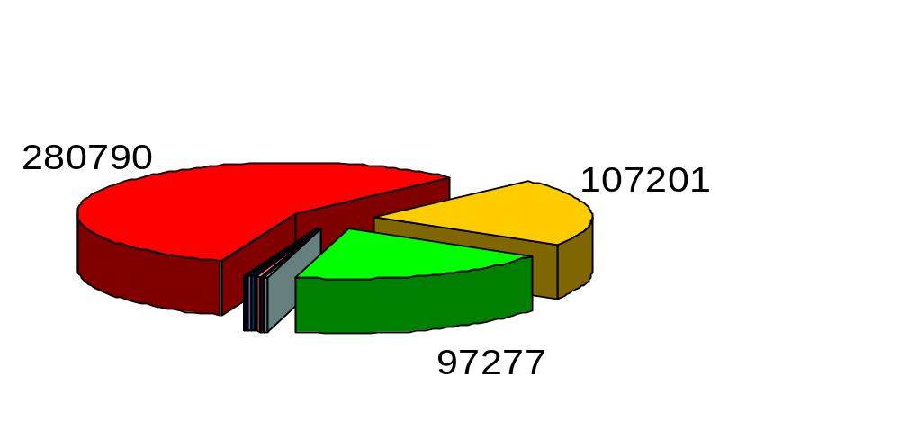
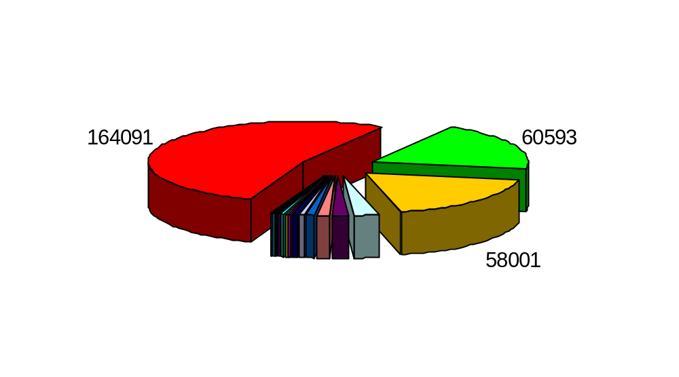
KDD 99 Dataset
KDD Dataset
10% KDD Dataset
Corrected

Slide 7
Hierarchical SOM Architecture
2nd Level Pre-Processing
Duration
Protocol
Service
Flag
Src. Bytes
Dst. Bytes
1st Level Pre-Processing
KDD 99 Dataset

Slide 8
1st Level
Character values are mapped to integers.
Temporal relationships are encoded.
0: TCP
1: UDP
2: ICMP
TCP
UDP
Tap3
TCP
x₁= [1 0 0]
ICMP
UDP
Tap2
TCP
ICMP
ICMP
Tap1
Example Tap interval =1 (employed = 4)
Example Number of Taps = 3 (employed = 20)
UDP
UDP

Slide 9
1st Level
Character values are mapped to integers.
Temporal relationships are encoded.
0: TCP
1: UDP
2: ICMP
TCP
UDP
Tap3
TCP
x₁= [1 0 0]
ICMP
UDP
Tap2
x₂= [0 2 1]
TCP
ICMP
ICMP
Tap1
Example Tap interval =1 (employed = 4)
Example Number of Taps = 3 (employed = 20)
UDP
UDP

Slide 10
1st Level
Character values are mapped to integers.
Temporal relationships are encoded.
0: TCP
1: UDP
2: ICMP
TCP
UDP
Tap3
TCP
x₁= [1 0 0]
ICMP
UDP
Tap2
x₂= [0 2 1]
TCP
x₃= [2 1 0]
ICMP
ICMP
Tap1
Example Tap interval =1 (employed = 4)
Example Number of Taps = 3 (employed = 20)
UDP
UDP

Slide 11
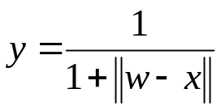
2nd Level
2nd Level SOM
2nd level dataset instance
y
w
1st Level SOMs
…
x
A 1st level dataset instance

Slide 12
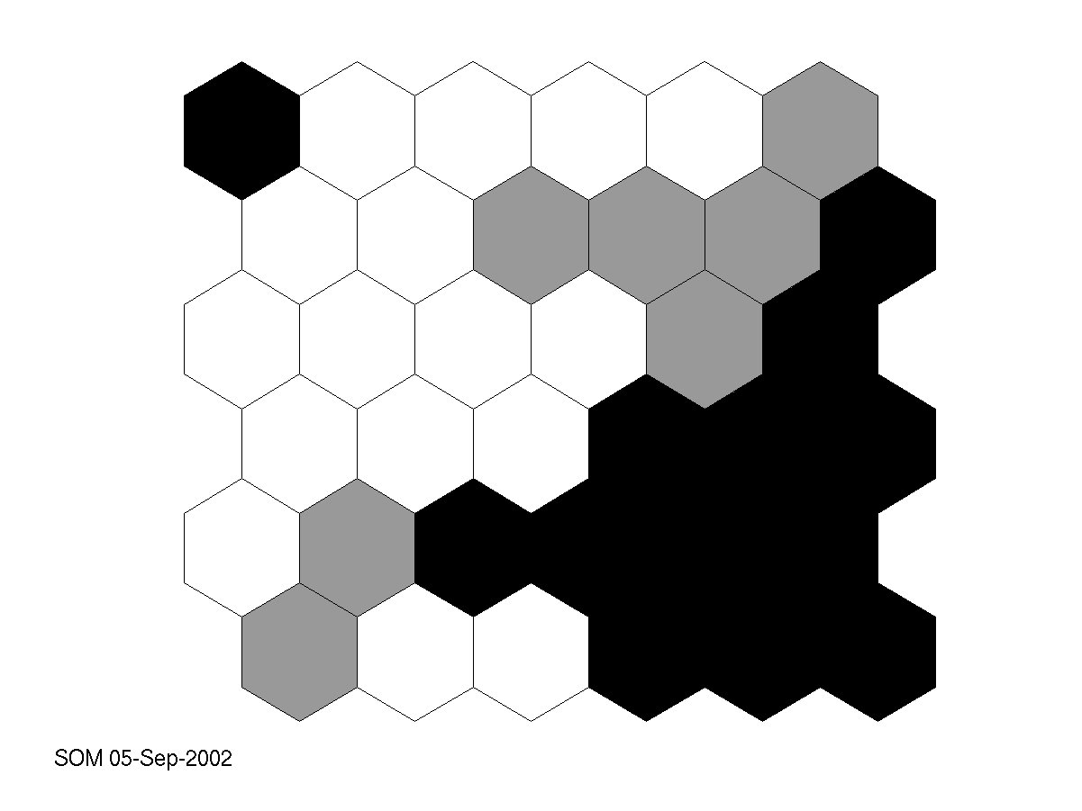
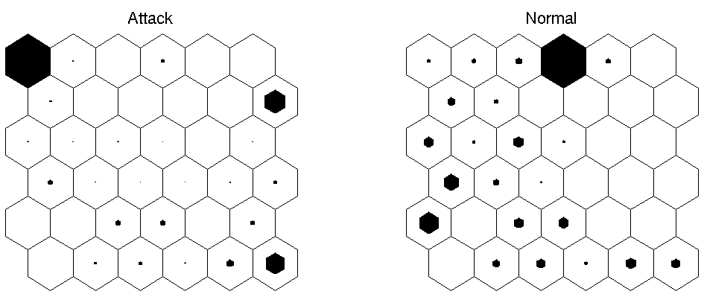
2nd Level

Slide 13
3rd Level
3rd level SOM
for Neuron4
2nd level SOM
Neuron4 wins for:
2000 normal
3000 attack
2nd level dataset

Slide 14
Training Set Biases
Objective: to determine the effect of training set composition.
Three training sets are formed from 10%KDD.
  Entire 10% KDD (System 1)
  Only normal connections (System 2)
  50% normal / 50% attack (System 3)

Slide 15
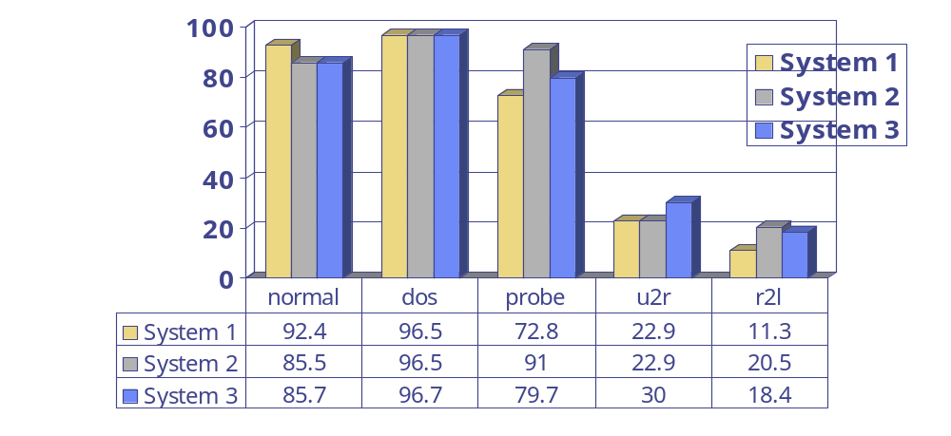
Training Set Biases
Results on ‘corrected’ test set

Slide 16
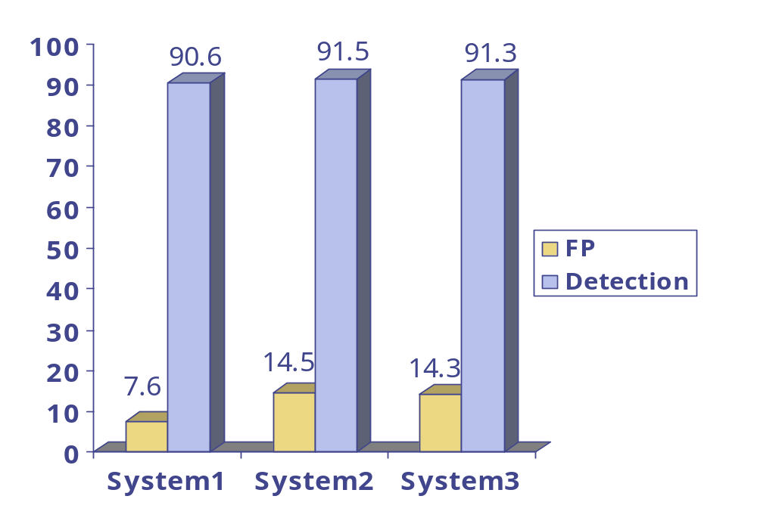
Training Set Biases
Good detection rates
Best FP → System 1

Slide 17
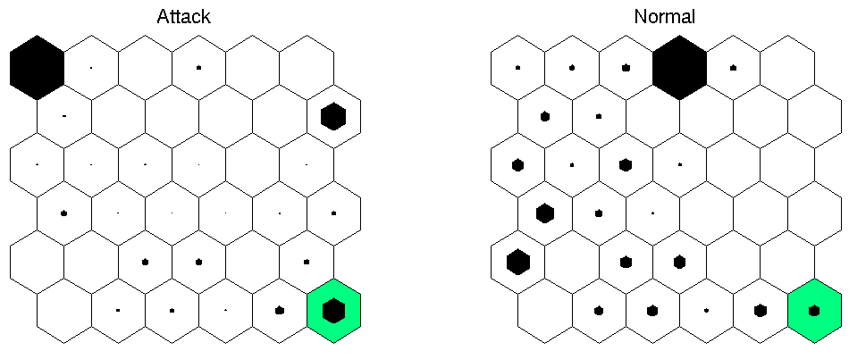
Third Level Maps
Objective: To separate attacks from normal connections.

Slide 18
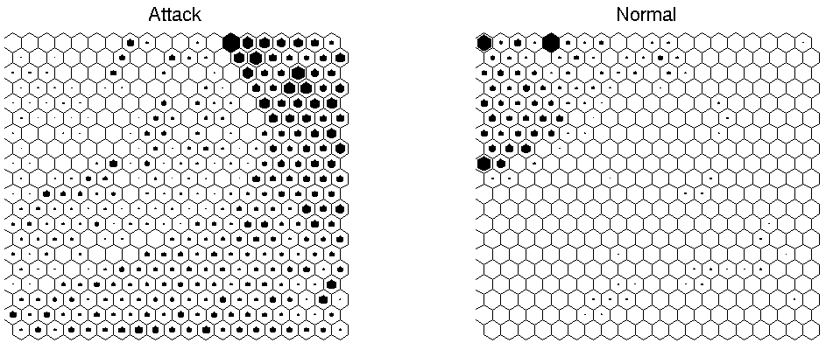
Third Level Maps
Third level map separates attacks from normal connections.

Slide 19
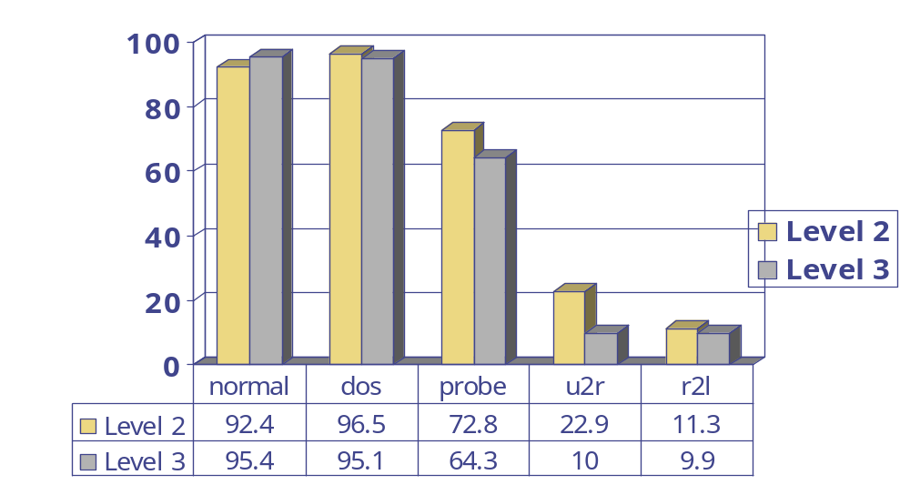
Third Level Maps
Results on ‘corrected’ test set

Slide 20
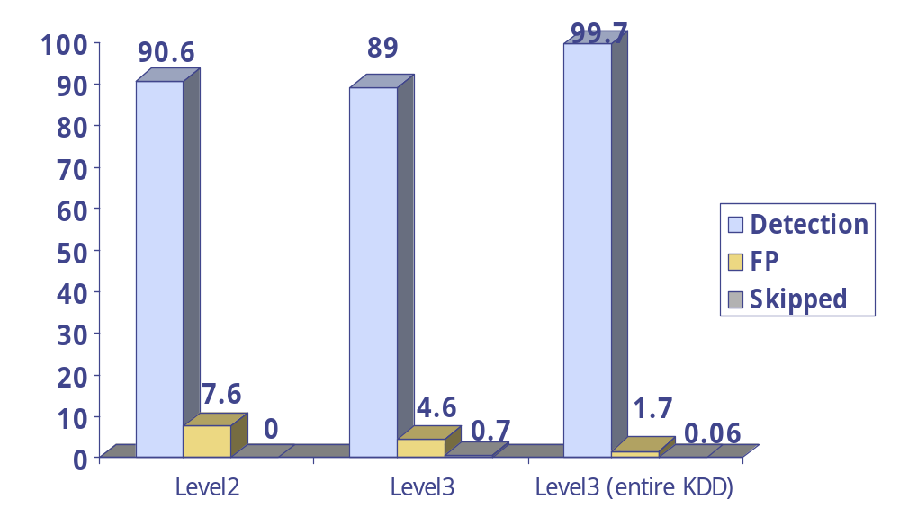
Third Level Maps
Level 3 reduces FP rate

Slide 21
Comparisons
 | Detection | FP
Clustering | 93 | 10
K-NN | 91 | 8
SVM | 98 | 10
SOM | 89 | 4.6
Other KDD based approaches.
All utilize 41 features.
 | Normal | Dos | Probe | U2R | R2L
Winner | 99.5 | 97.1 | 83.3 | 13.2 | 8.4
SOM | 95.4 | 95.1 | 64.3 | 10 | 9.9

Slide 22
Feature Contribution
Objective: To determine each feature’s contribution to detection process.
Block 6 inputs of each feature one at a time.
Train six 2nd level maps.
6
6
6
6
6
6

Slide 23
Feature Contribution
 | Normal | Dos | Probe | U2R | R2L | FP | Detection
Baseline | 92.4 | 96.5 | 72.8 | 22.9 | 11.3 | 7.6 | 90.6
Duration | 97.7 | 96.2 | 58.6 | 4.3 | 1.8 | 2.3 | 89
Protocol | 55.9 | 96.6 | 50.5 | 5.7 | 27.4 | 44.10 | 91.2
Service | 99.1 | 94.3 | 28.3 | 0 | 0.7 | 0.9 | 87.1
Flag | 97.2 | 95.5 | 35.8 | 1.4 | 0.8 | 2.8 | 88.3
Src. Bytes | 98.5 | 95.5 | 36.1 | 0 | 0.9 | 1.5 | 88.3
Dst. Bytes | 98.6 | 95.5 | 36.1 | 0 | 0.8 | 1.4 | 88.3

Slide 24
Conclusions
A system capable of learning attack and normal behavior.
Good performance compared with other learning algorithm approaches.
Minimum a priori information utilized.

Slide 25
Future Work
Data
  Collection: Problems with DARPA datasets
  Summarization: Problems with Bro
Distributed approach
  “Sensors” monitoring different nodes
Optimizations on SOM
  Detection optimizations
  Training optimizations

Slide 26
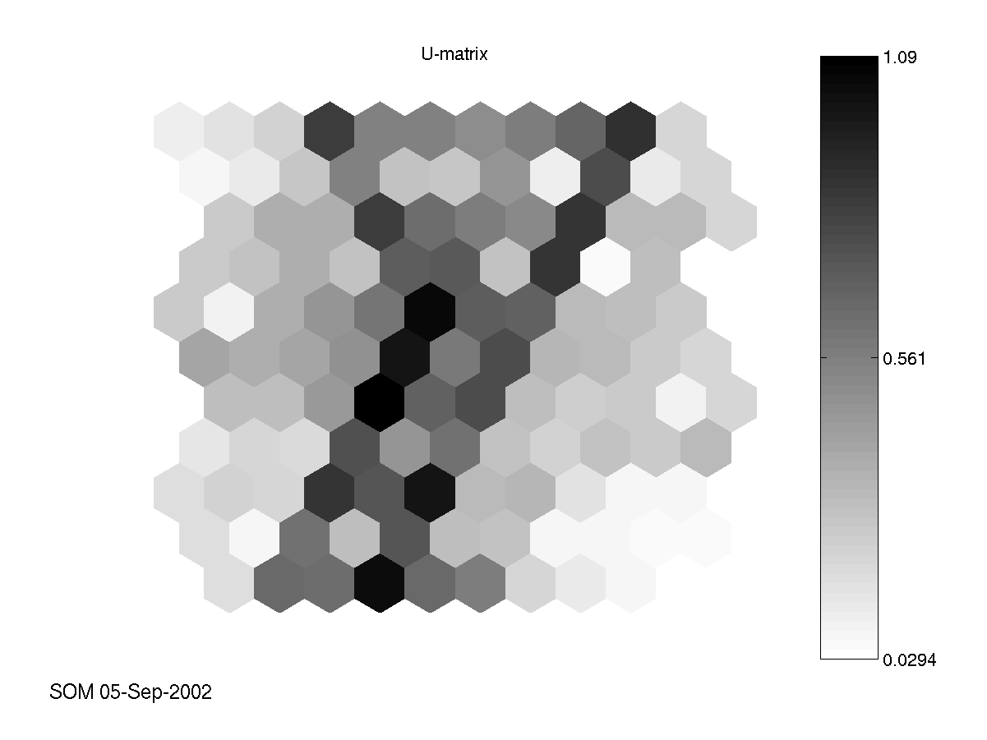
System 1

Slide 27
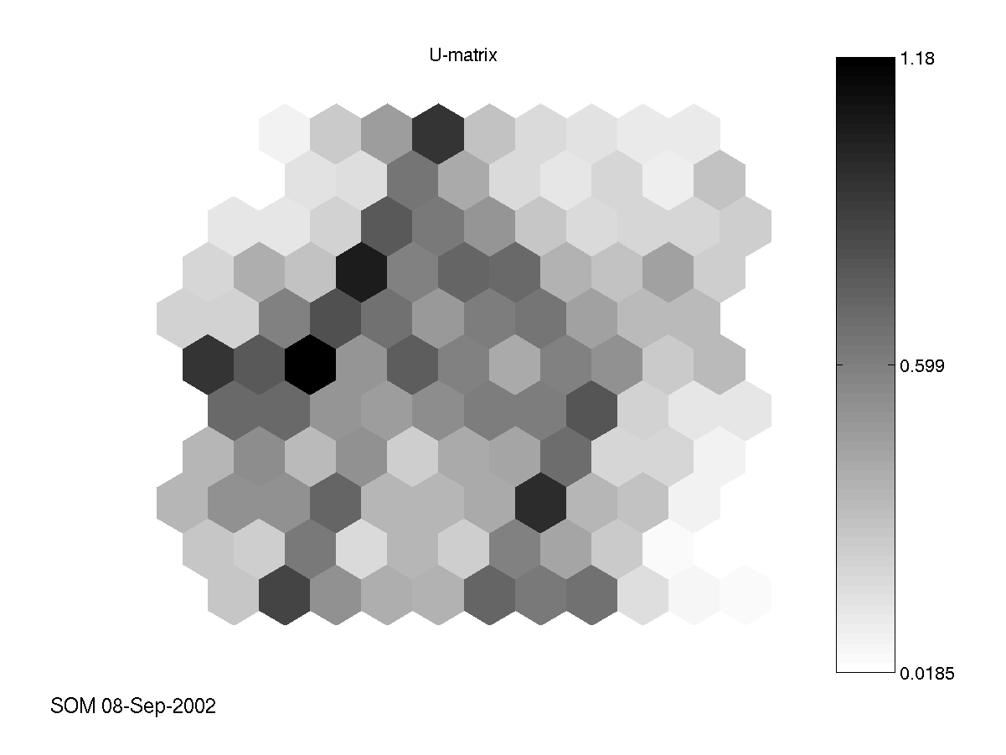
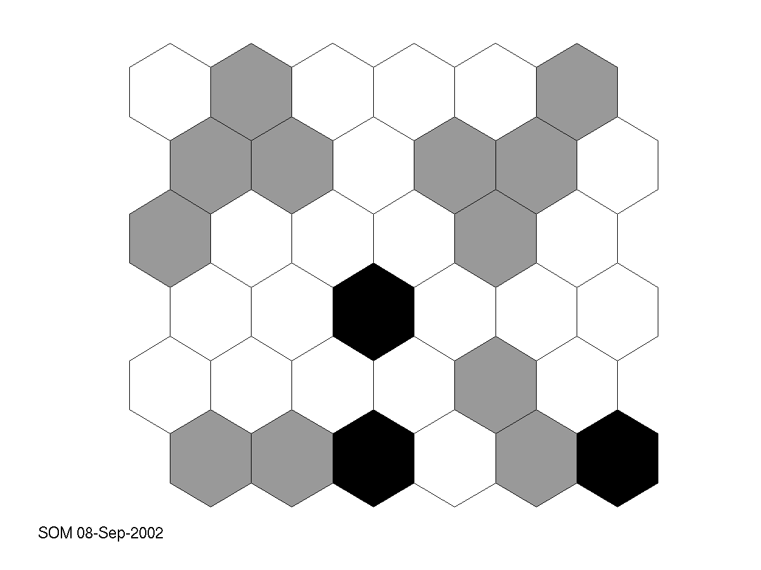
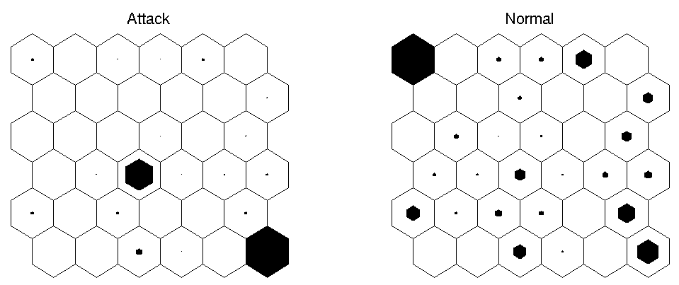
System 2

Slide 28
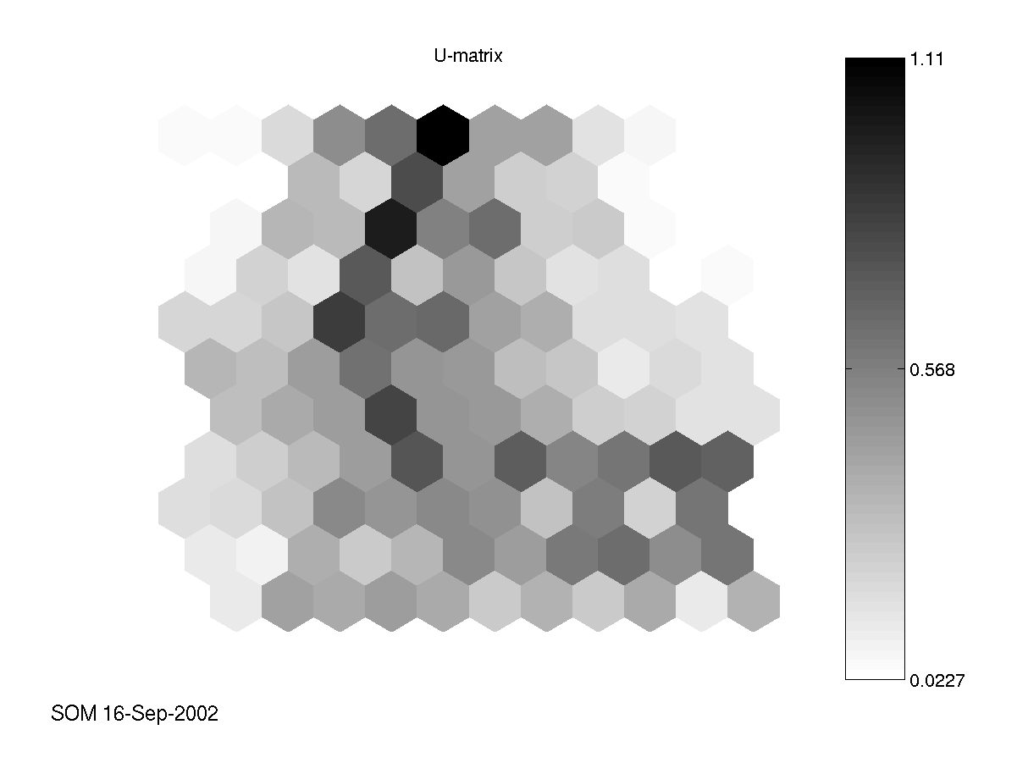
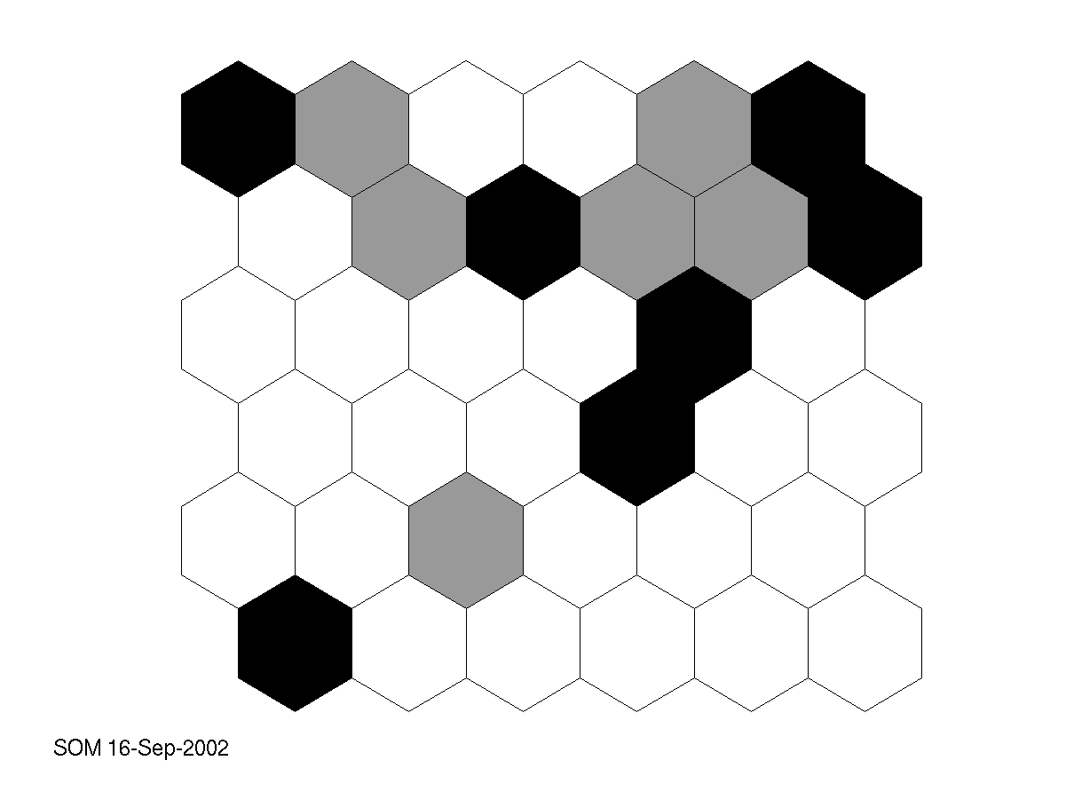
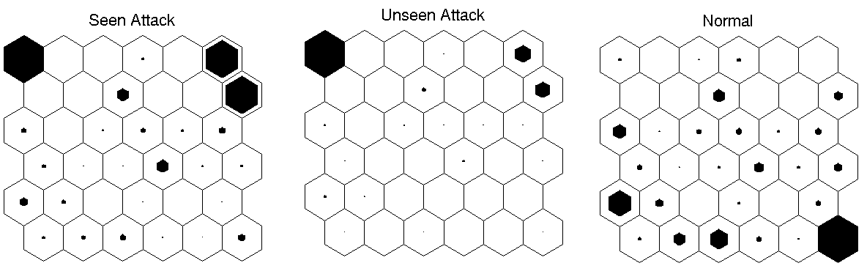
System 3

Slide 29
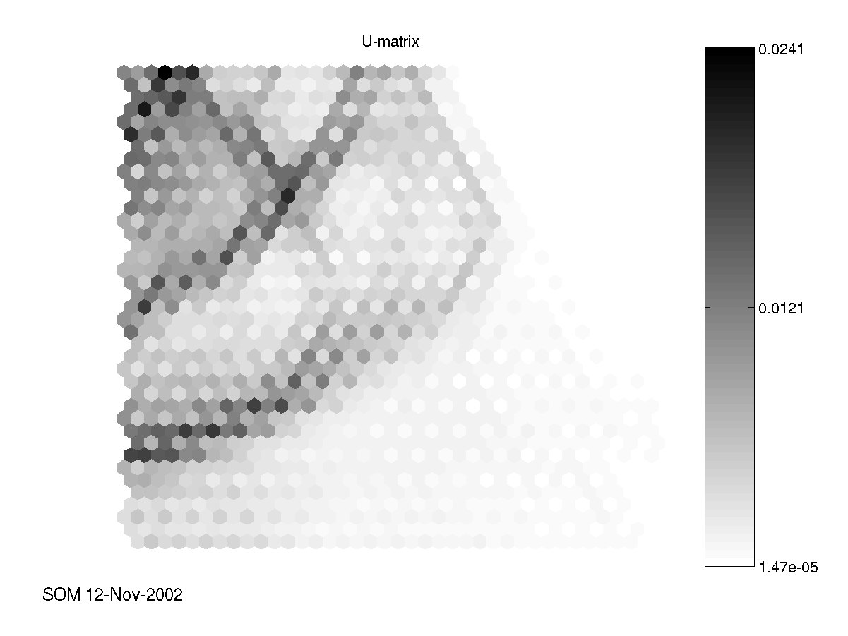
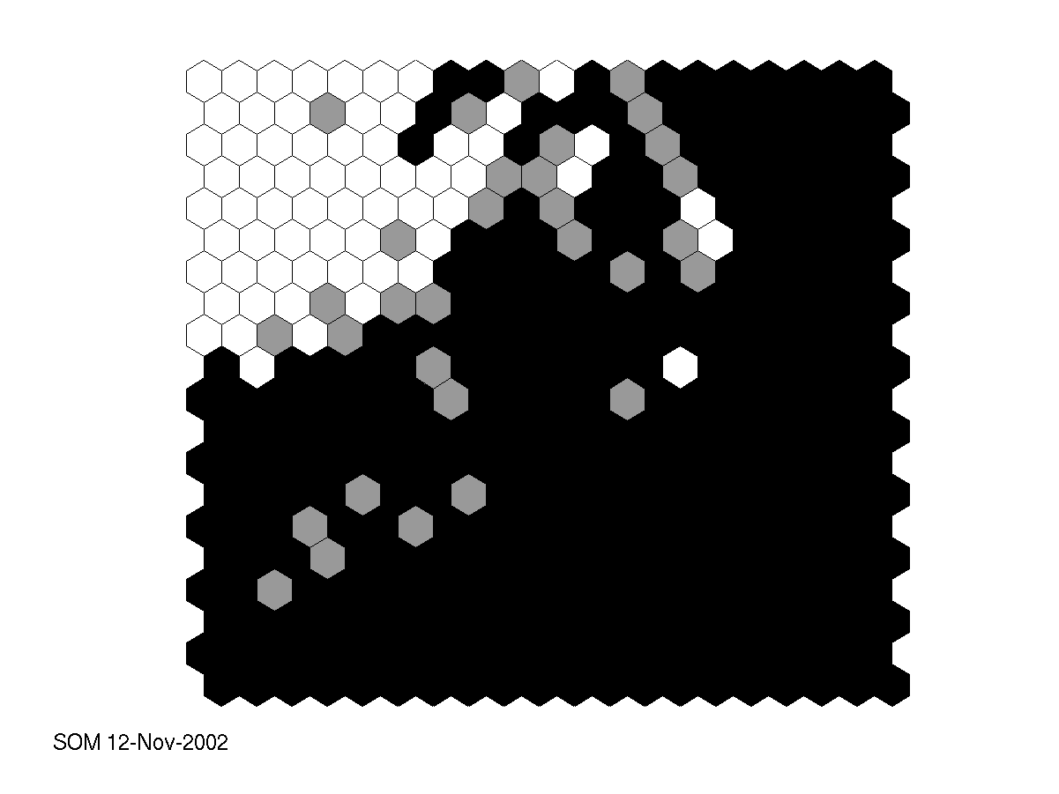
Neuron 36 (Detailed)

Slide 30
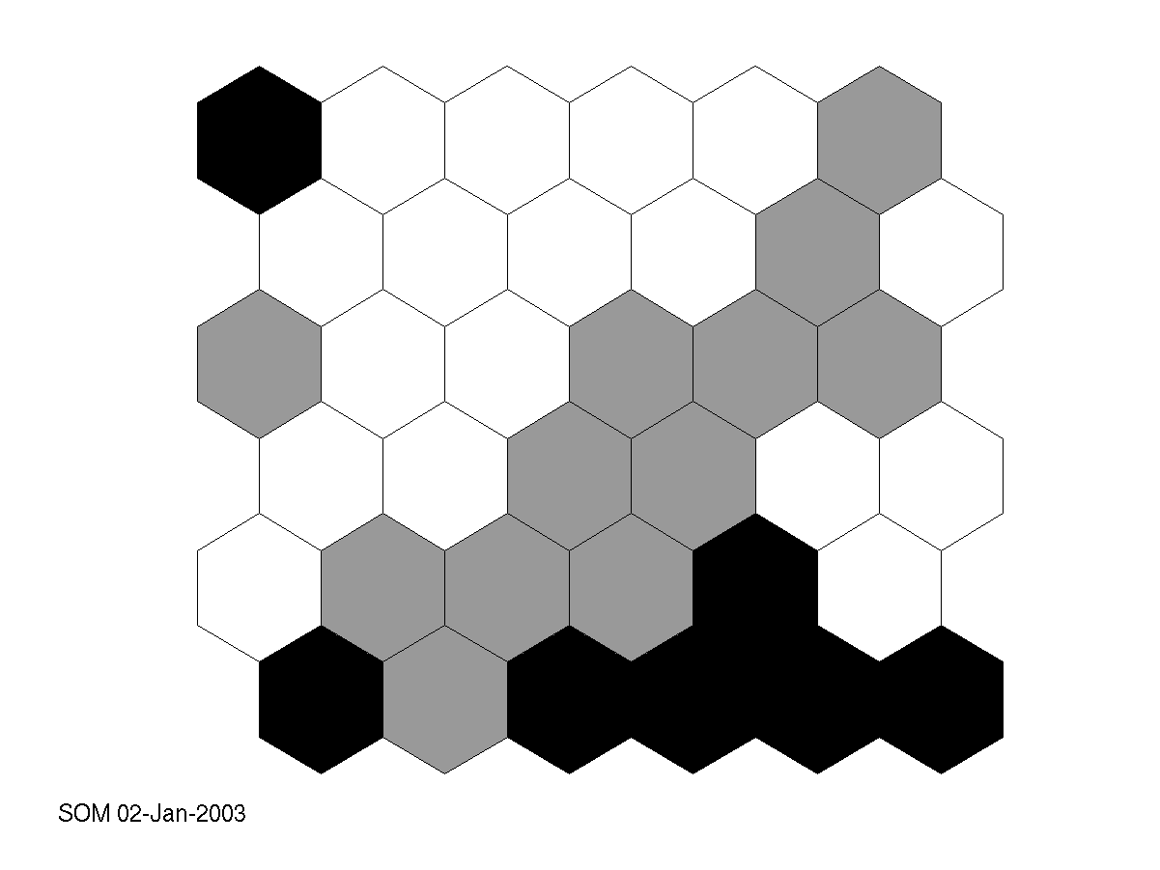
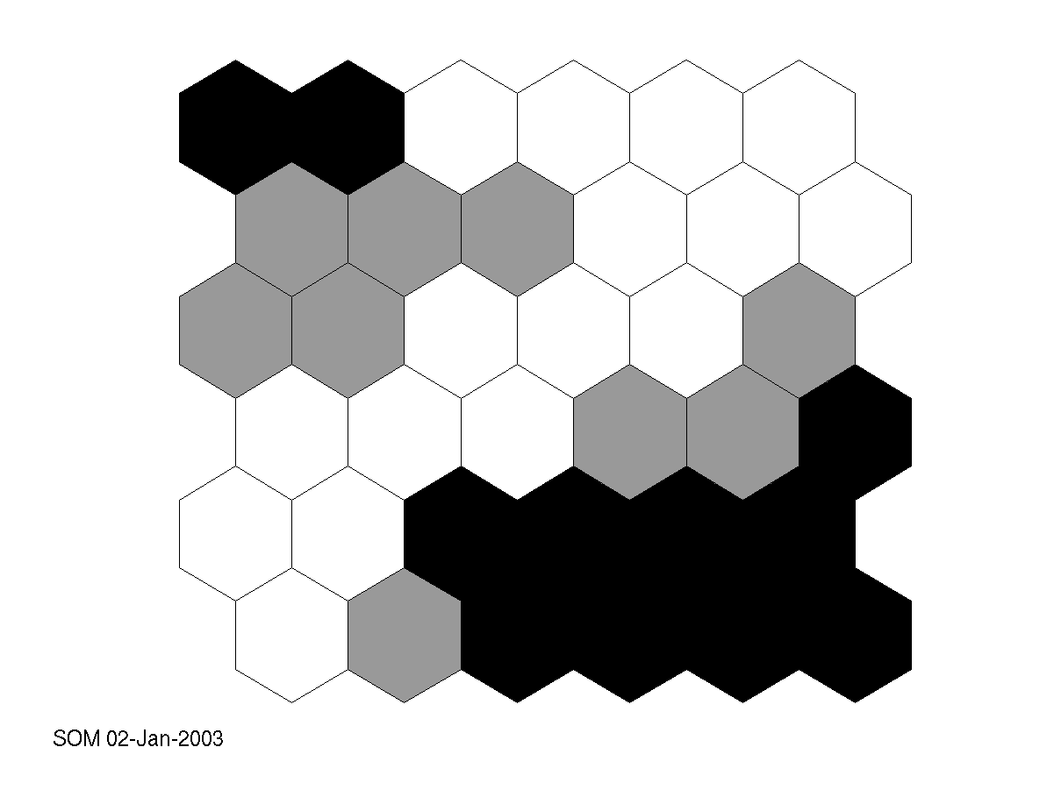
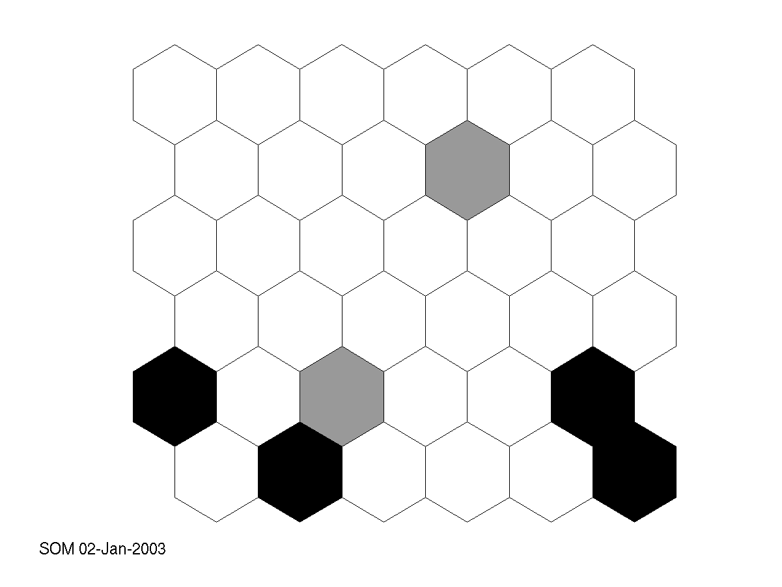
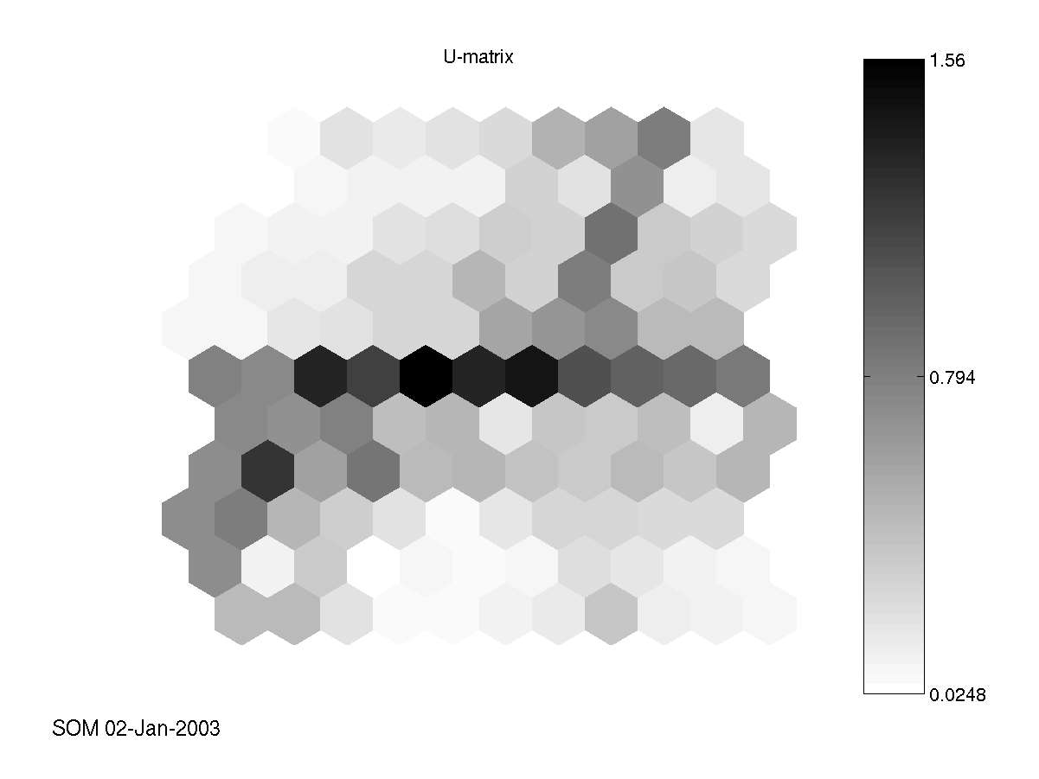
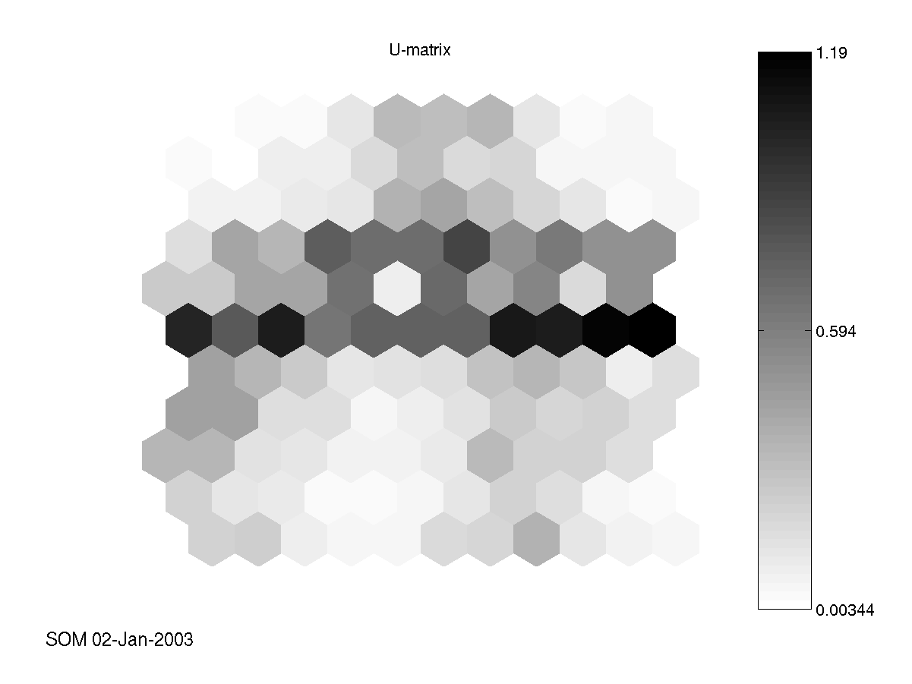
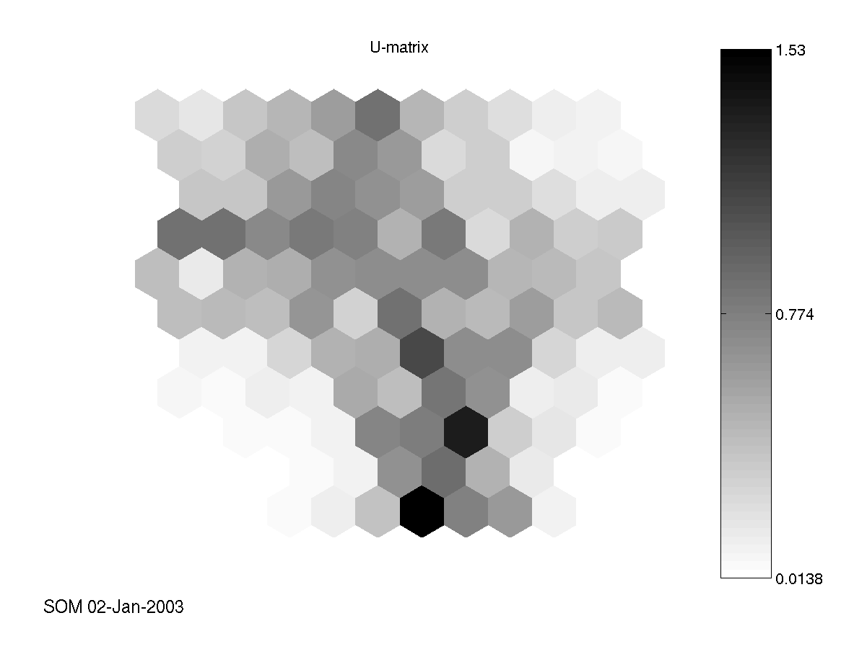
Duration Protocol Service

Slide 31
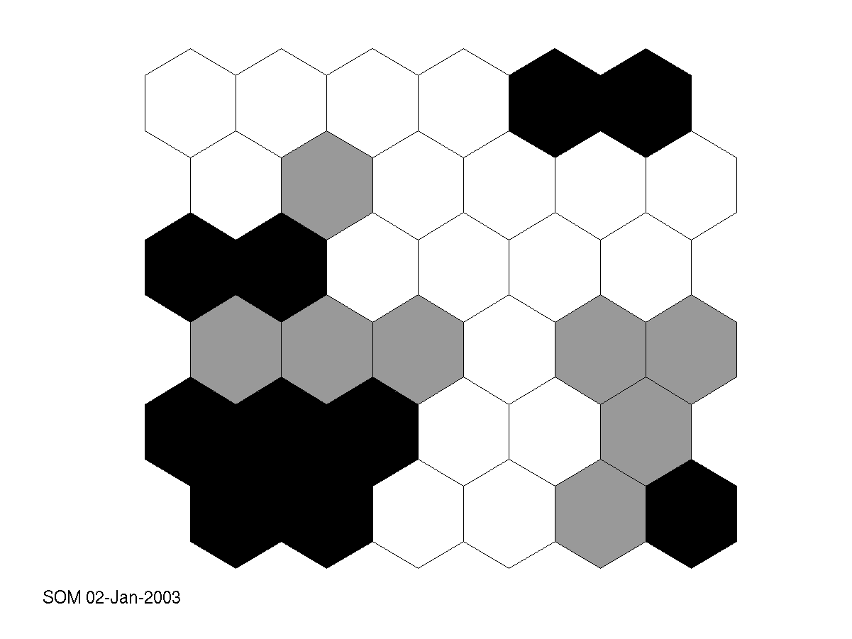
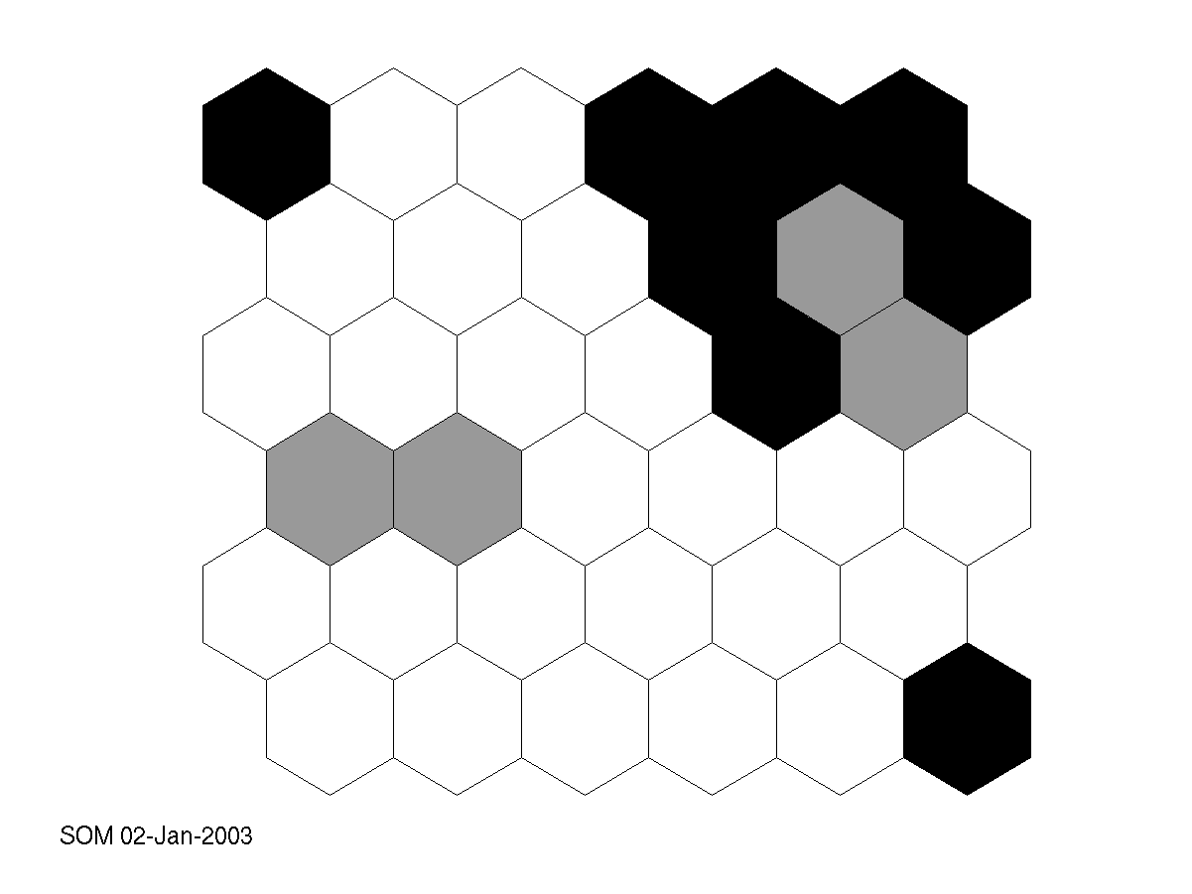
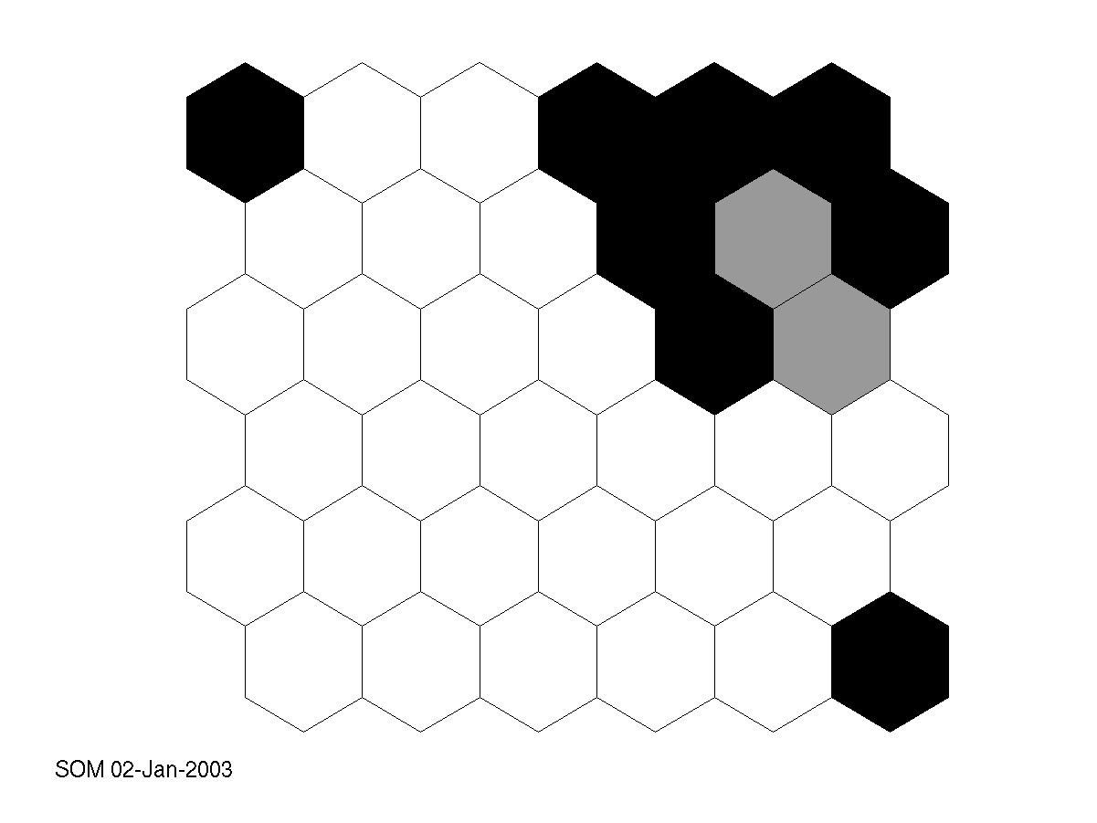
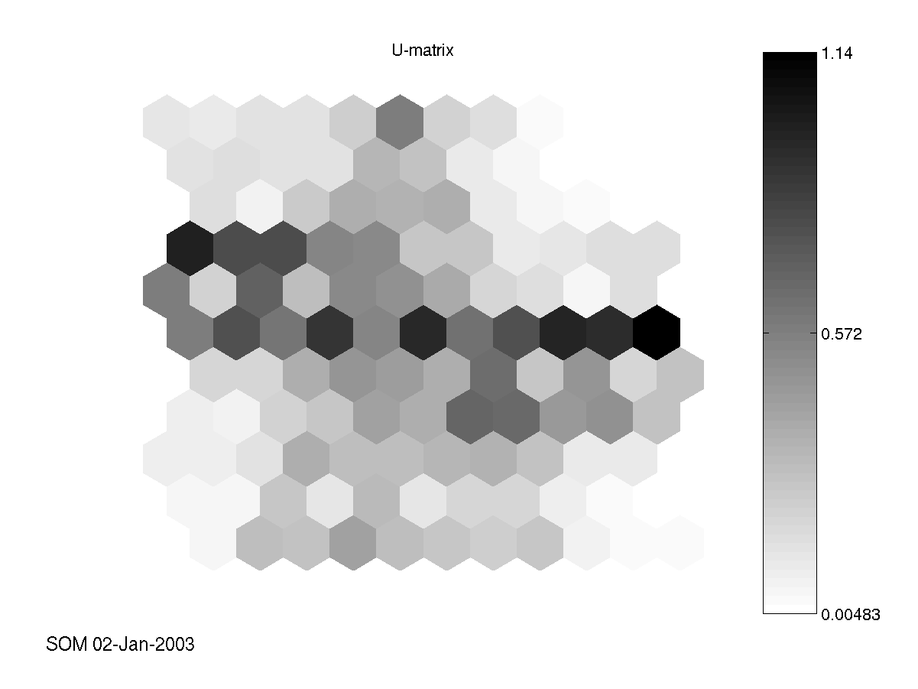
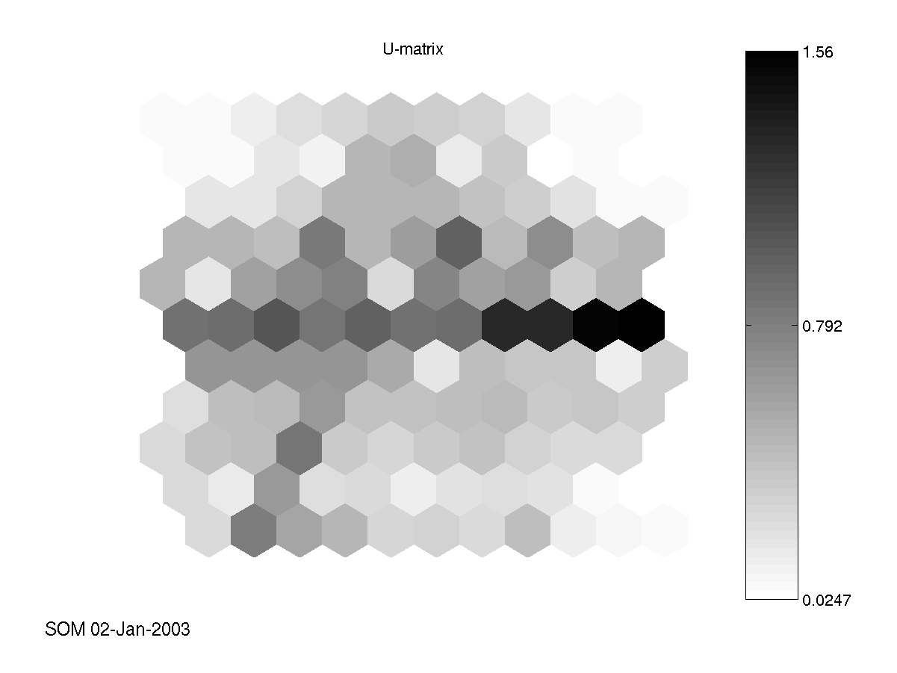
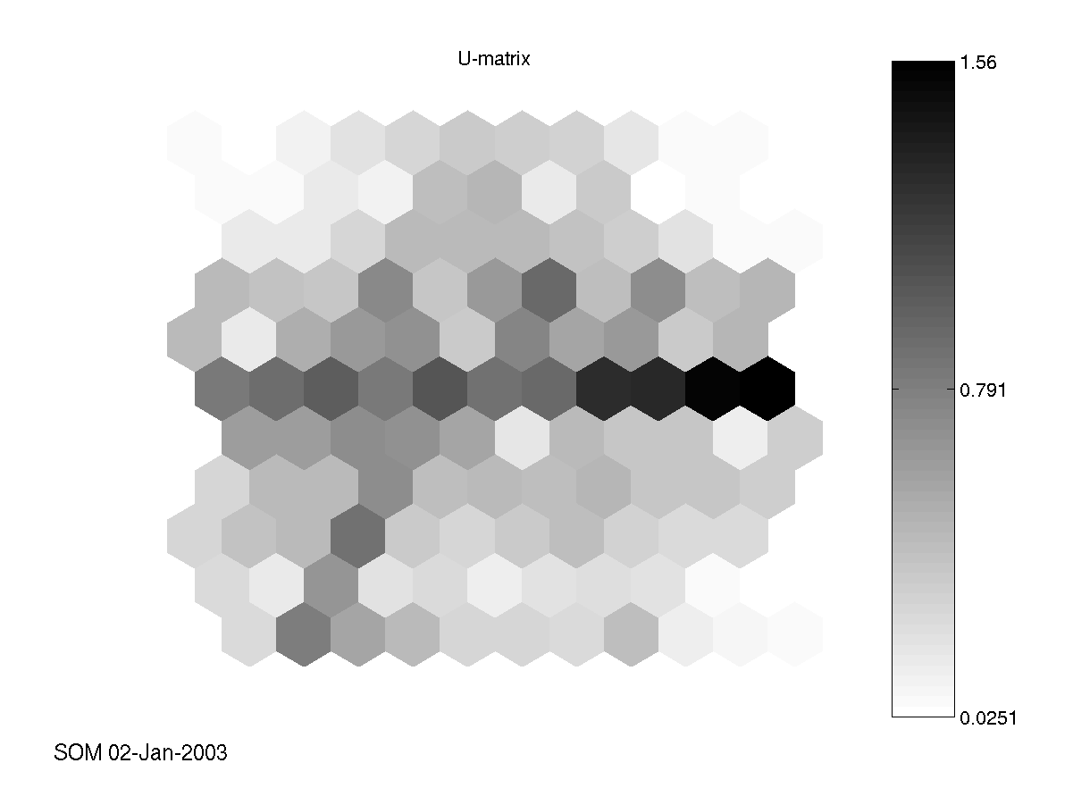
Flag S.Bytes D.Bytes

