Slide 1
A Literature Survey of IDS Benchmarking Efforts
Gunes Kayacik
Technical Report CSTR 030600 at:
http://nzheywood-4.cs.dal.ca/papers/

Slide 2
Introduction & Motivations
Our experience.
It is a major undertaking.
Defining goals.
Reviewing the previous efforts.
  Traffic generation (non IDS).
  IDS “benchmark.”

Slide 3
Data Generation
(in a Nutshell)
Attacks
  Exploit databases
  Security mailing lists
  Honeypots
Normal usage
  On the fly
  Record & replay
  Analyze & Synthisize
Fairly easy… find a buggy server, write exploit code.
Gets more difficult but also more scientific

Slide 4



Traffic Modeling (non IDS)
Holds over a wide range of environments
File Size Popularity Request Size
Search for invariant features.
Fit a model to the features.
Combine the features.
Generate the output.
Output

Slide 5
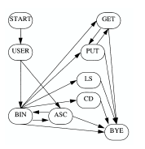
User Modeling (non IDS)
Earlier efforts ignore the content.
Employed in Surge, GenSyn.
Markov Models (Depends on last action)
  (new, save, continue) = At c: (0.2, 0.3, 0.5)
  Finite State Automata?
Petri Nets (Memory perspective)
T
From [1]

Slide 6
Honeypot
“Luring hackers to a system and then analyzing their activities from the start” – HoneyNet Project
Small amount of good data.
Data control and capture?
Prevent hackers from using the honeypot.

Slide 7
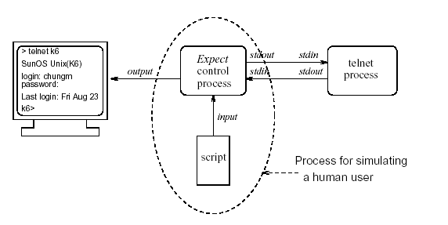
UC Davis
Normal usage = Background noise.
Aims to test the IDS on different load conditions on one host.
7 attacks.
Expect based
From [2]

Slide 8
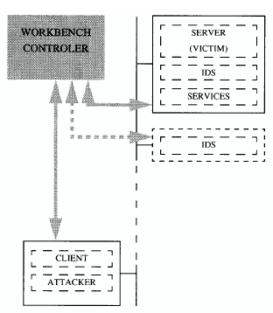
IBM Test Bed
Normal Usage = Record & Replay
Limited to FTP
9 FTP attacks
Central Control
From [1]

Slide 9
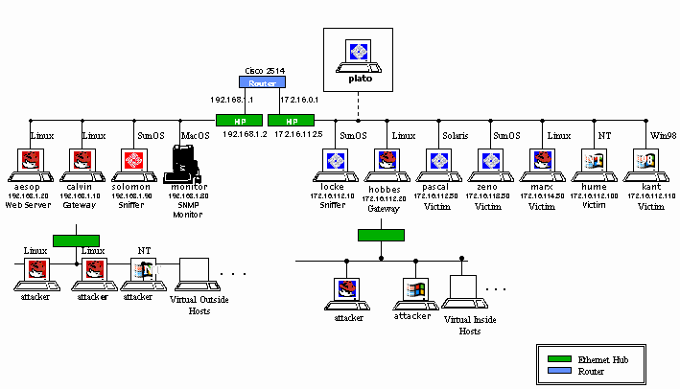
DARPA

Slide 10
DARPA
Normal Usage: Analyze & Modeling?
Attacks: 57 types of attacks!
Pros:
  Wide coverage (attack / normal)
  Data for off-line evaluation.
Cons:
  Refer to the technical report and John McHugh’s paper.

Slide 11
Last Words
Shortcomings
Determine our goals
  Modeling
  Validation
  Frequent and comprehensive documentation
  Repeatable
  Wide coverage

Slide 12
References
[1] An experimentation Workbench for Intrusion Detection, IBM Research Report.
[2] A Methodology for Testing Intrusion Detection Systems.
All references are listed in the technical report.

Slide 13
Self Similarity
From http://math.bu.edu/DYSYS/chaos-game/node5.html

