Slide 1
On the Capability of an SOM Based Intrusion Detection System
H. Günes Kayacık
Nur Zincir-Heywood
Malcolm I. Heywood
(To appear in the Proceedings of the International Joint Conference on Neural Networks 2003)

Slide 2
Introduction & Objectives
Intrusion detection?
Problems
  Speed
  Accuracy
  Adaptation
Objectives
  Minimum a priori information.
  A data driven approach.
  Develop a hierarchical SOM based IDS

Slide 3
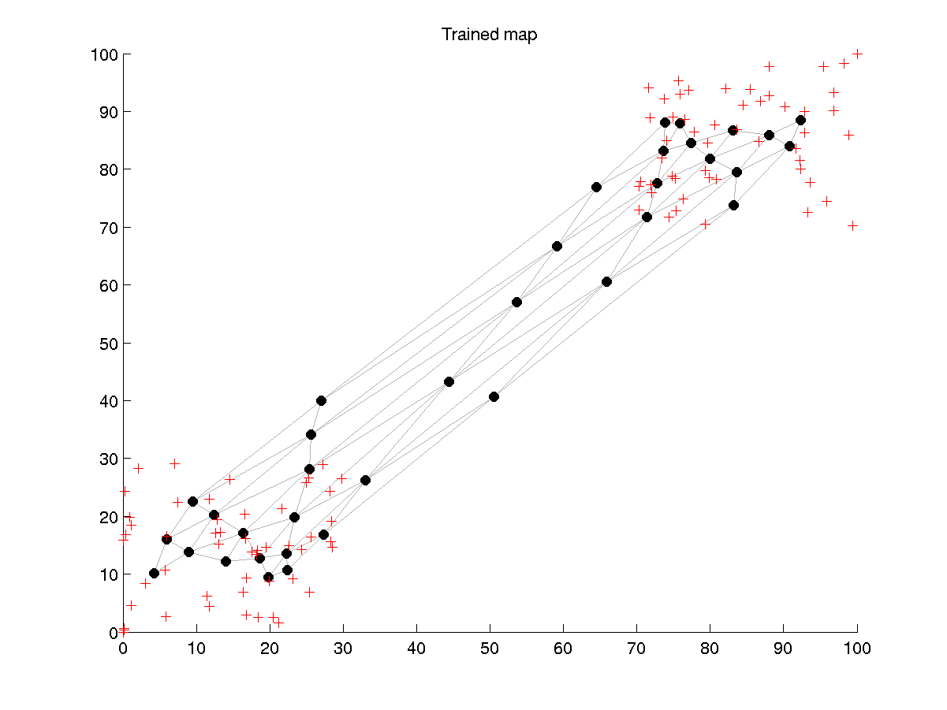
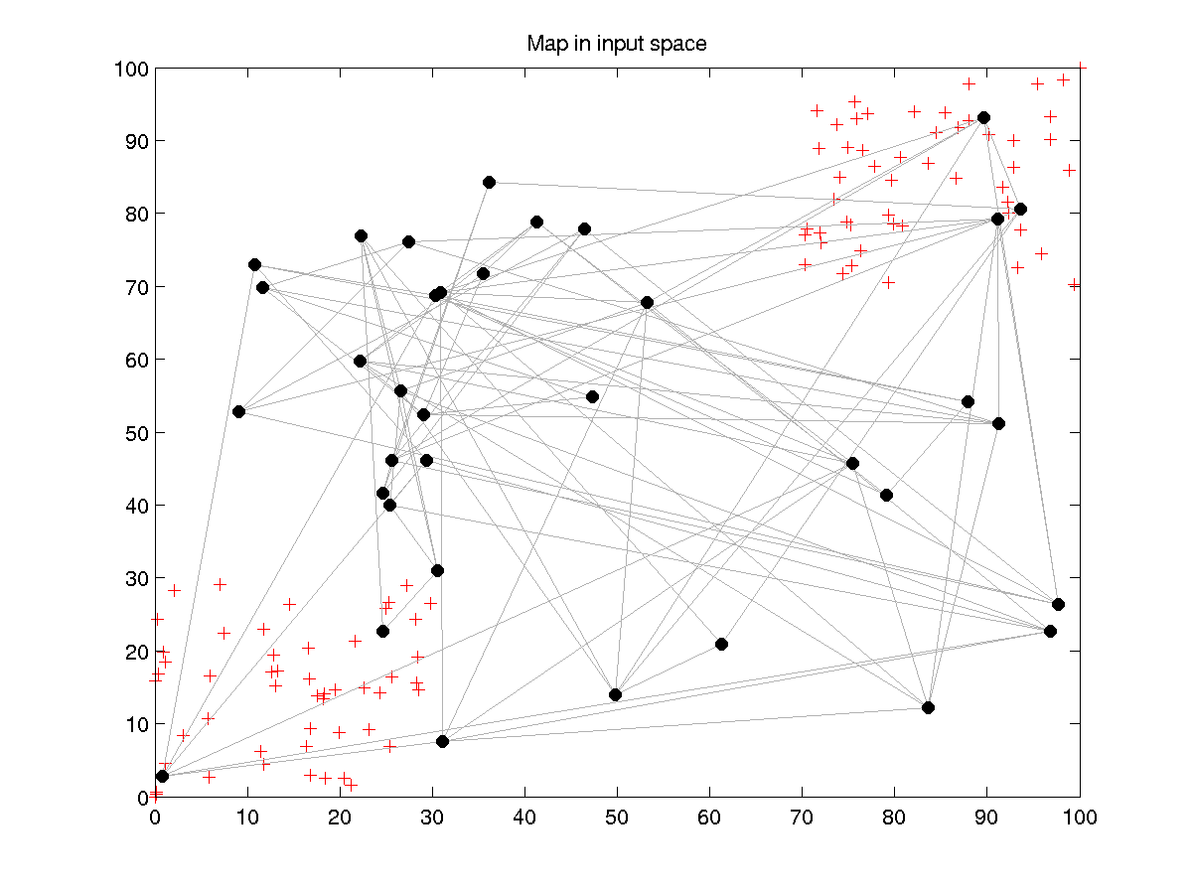
Self Organizing Maps

Slide 4
Hierarchical SOM Architecture
2nd Level Pre-Processing
Duration
Protocol
Service
Flag
Src. Bytes
Dst. Bytes
1st Level Pre-Processing
KDD 99 Dataset

Slide 5
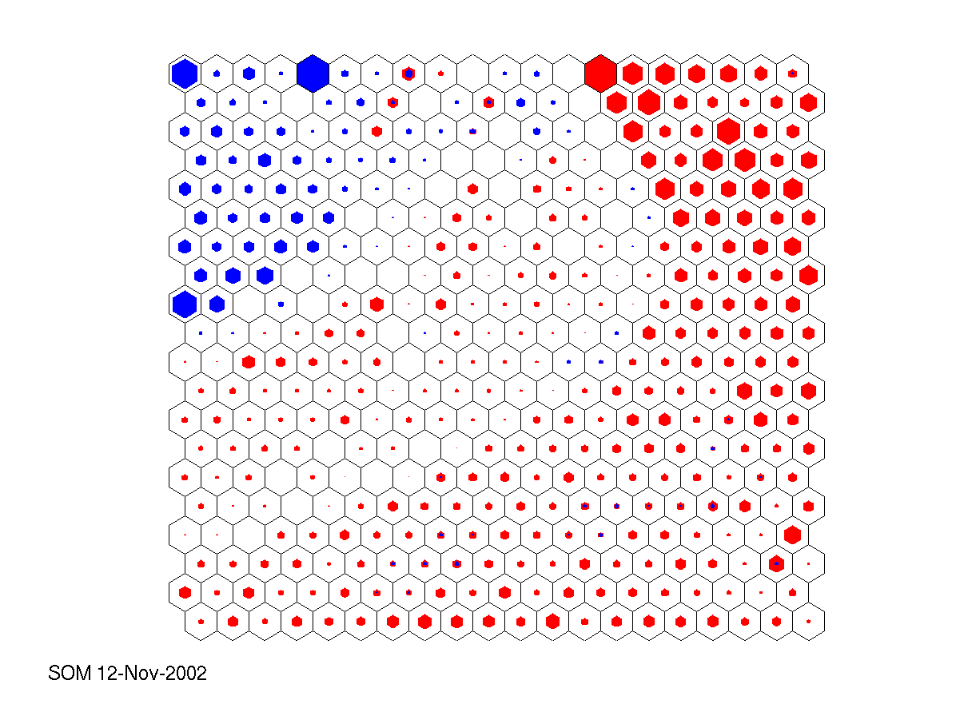
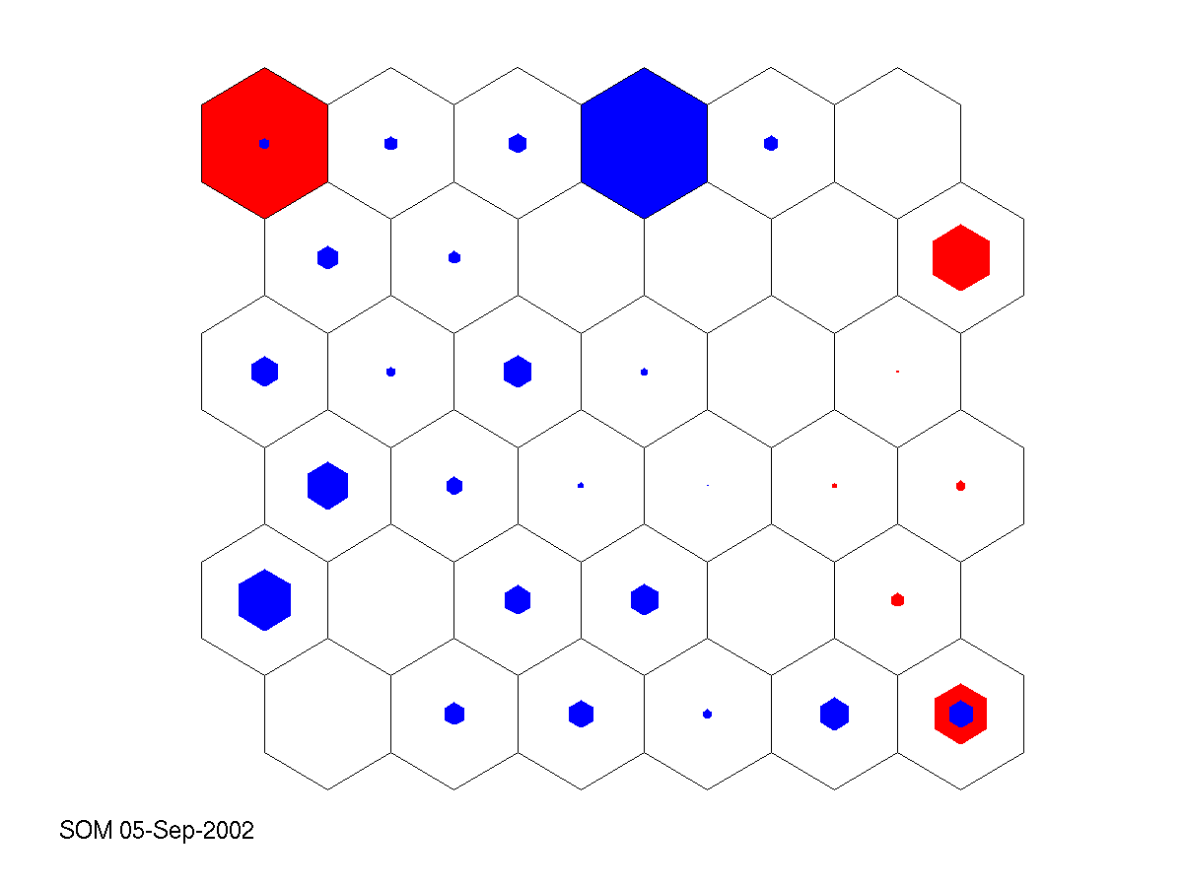
2 vs. 3 Level
 | False Alarm | Detection
Level 2 | 7.6% | 90.6%
Level 3 | 4.6% | 89.0%
Clustering | 10.0% | 93.0%
K-NN | 8.0% | 91.0%
SVM | 10.0% | 98.0%

Slide 6
Conclusions & Future Work
A system capable of learning attack and normal behavior.
Good performance compared with other learning algorithm approaches.
Minimum a priori information utilized.
Future Work
  Data Collection
  Distributed Detection
  SOM optimization

Slide 7
Additional Slides

Slide 8
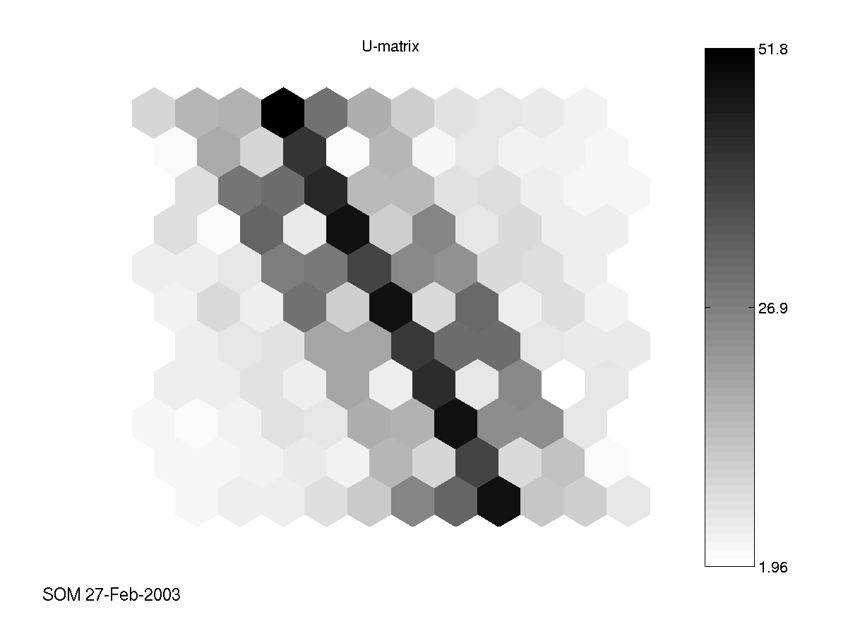
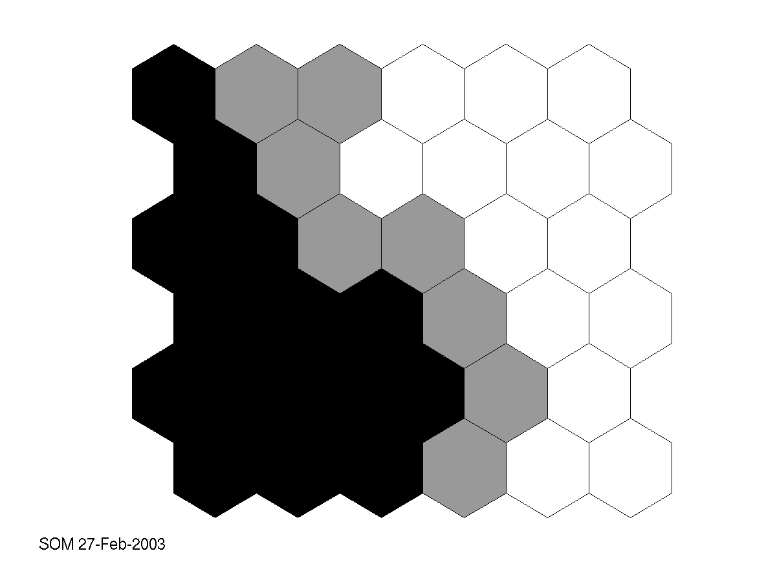
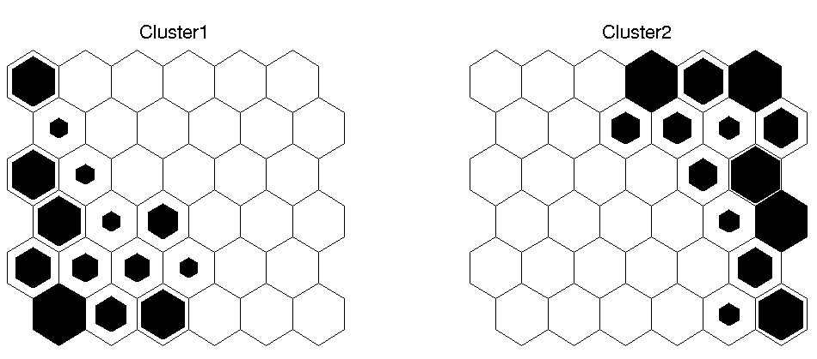
SOM (Visualizations)

Slide 9
KDD 99 Dataset
KDD Dataset
10% KDD Dataset
Corrected

Slide 10
1st Level
Character values are mapped to integers.
Temporal relationships are encoded.
0: TCP
1: UDP
2: ICMP
TCP
UDP
TCP
TCP
x₁= [1 0 0]
UDP
ICMP
UDP
TCP
TCP
ICMP
ICMP
ICMP
UDP
Example Tap interval =1 (employed = 4)
Example Number of Taps = 3 (employed = 20)
UDP
UDP

Slide 11
1st Level
Character values are mapped to integers.
Temporal relationships are encoded.
0: TCP
1: UDP
2: ICMP
TCP
UDP
UDP
TCP
x₁= [1 0 0]
TCP
ICMP
UDP
ICMP
x₂= [0 2 1]
TCP
UDP
ICMP
ICMP
TCP
Example Tap interval =1 (employed = 4)
Example Number of Taps = 3 (employed = 20)
UDP
UDP

Slide 12
1st Level
Character values are mapped to integers.
Temporal relationships are encoded.
0: TCP
1: UDP
2: ICMP
TCP
UDP
TCP
TCP
x₁= [1 0 0]
ICMP
ICMP
UDP
UDP
x₂= [0 2 1]
TCP
TCP
x₃= [2 1 0]
ICMP
ICMP
ICMP
Example Tap interval =1 (employed = 4)
Example Number of Taps = 3 (employed = 20)
UDP
UDP

Slide 13
2nd Level
2nd Level SOM
2nd level dataset instance
y
w
1st Level SOMs
…
x
A 1st level dataset instance

Slide 14
3rd Level
3rd level SOM
for Neuron4
2nd level SOM
Neuron4 wins for:
2000 normal
3000 attack
2nd level dataset

Slide 15
Third Level Maps
Results on ‘corrected’ test set

Slide 16
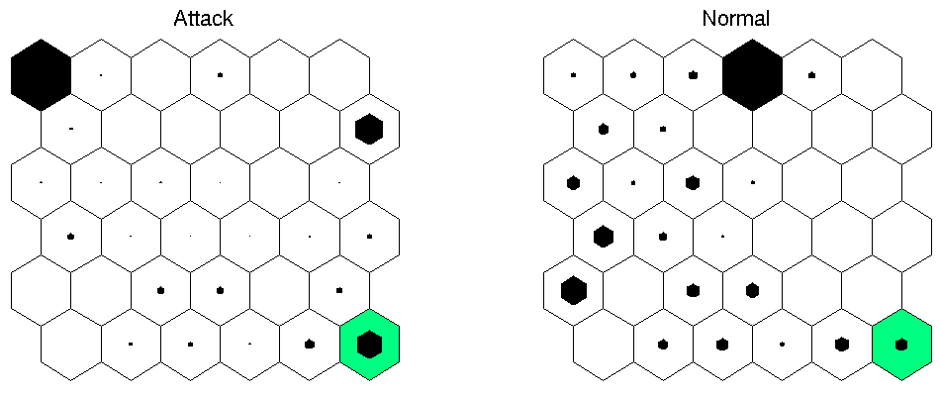
Third Level Maps
Objective: To separate attacks from normal connections.

Slide 17
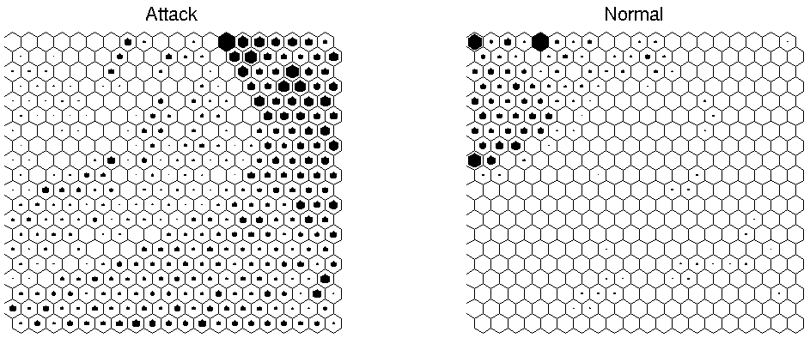
Third Level Maps
Third level map separates attacks from normal connections.

Slide 18
Comparisons
 | Detection | FP
Clustering | 93 | 10
K-NN | 91 | 8
SVM | 98 | 10
SOM | 89 | 4.6
Other KDD based approaches.
All utilize 41 features.
 | Normal | Dos | Probe | U2R | R2L
Winner | 99.5 | 97.1 | 83.3 | 13.2 | 8.4
SOM | 95.4 | 95.1 | 64.3 | 10 | 9.9

Slide 19
Third Level Maps
Level 3 reduces FP rate

Slide 20
Future Work
Data
  Collection: Problems with DARPA datasets
  Summarization: Problems with Bro
Distributed approach
  “Sensors” monitoring different nodes
Optimizations on SOM
  Detection optimizations
  Training optimizations

