Slide 1
A Case Study of Intrusion Detection Systems
Güneş Kayacık
Nur Zincir-Heywood
(To appear in proceedings of IM 2003, The Eighth IFIP/IEEE International Symposium on Integrated Network Management)

Slide 2
Intrusion Detection Systems
A system that monitors activity, tries to find suspicious patterns.
Roughly, two types:
  Host Based.
  Network Based.
From: A To: A
S
Y
N
http:////many///slashes///
IP
TCP
Content

Slide 3
Snort
Well known open source IDS.
Signature based.
“Lightweight.”
  Cross platform.
  Small system footprint.
  Easy to configure.
Performance & simplicity (libpcap).
Flexibility (signatures).
Alert tcp any any -> kayacik.cs.dal.ca 80(content:”cgi-bin/perl”)

Slide 4
Pakemon
An experimental “lightweight” NIDS.
Simpler than Snort.
Reassembles the packets like a Linux node.
Signature based.
Currently unmaintained.

Slide 5
Cisco IOS Firewall
Firewall with intrusion detection capabilities.
59 Basic signatures.
Performs packet inspection.
  (headers not the content).
Gathers connection state info.

Slide 6
Argus
General network management tool.
Track and report all network transactions.
Records attacks, not detects.

Slide 7
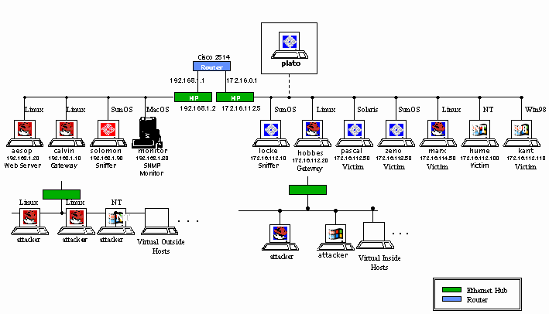
DARPA 99 Dataset
Remote to Local
User to Root
Probe
Data
DoS
Taken from MIT LL web site [1]

Slide 8
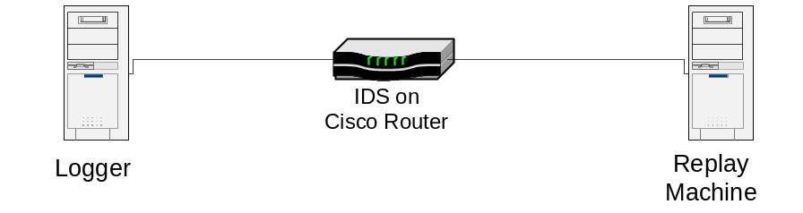
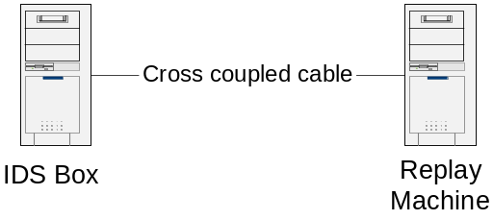
Test Environment
For Cisco IOS
  Two Pentium Pro 200 PCs + Cisco 3600
  Linux Mandrake 8.1, Cisco 3600 router with IOS v11
For Argus, Pakemon, Snort
  Two cross connected Pentium 133 PCs
  Linux Mandrake 8.1

Slide 9
Evaluation
How can we use this recorded traffic?
Definition of a log entry. (What is an entry?).
How do we match IDS logs with attacks?
Definition of confidence levels.

Slide 10
Confidence Levels
Source/ Attacker
IP Match
Destination/ Victim IP Match
Source/ Attacker port match
Destination/ Victim port Match
Level 1




Level 2



Level 3


Level 4

Example?

Slide 11
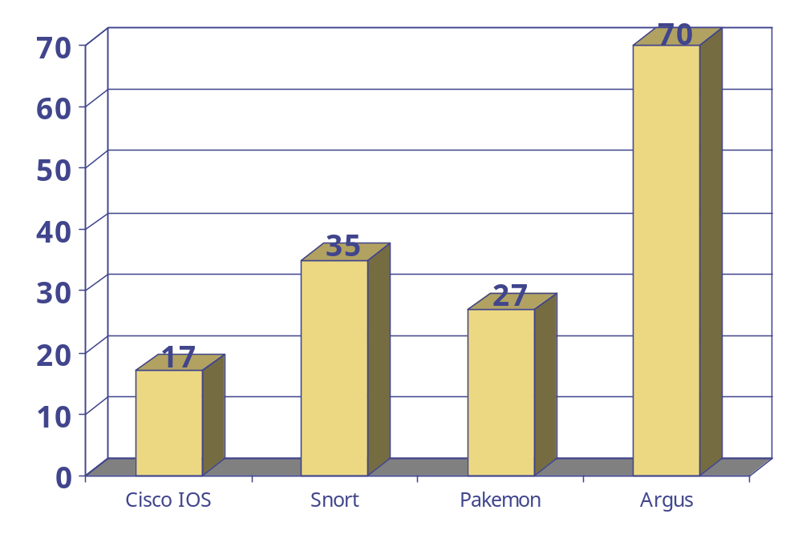
Total Detected Attacks

Slide 12
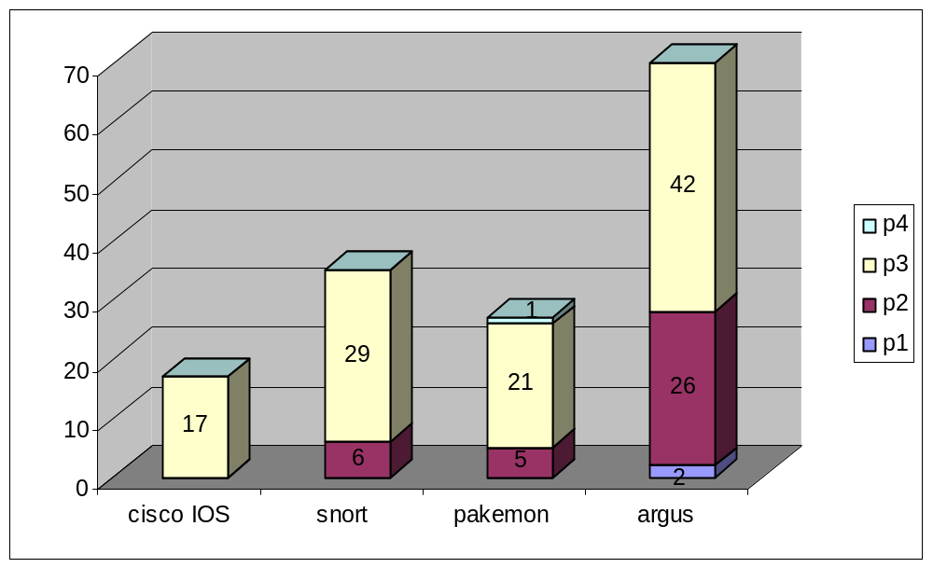
Confidence Levels

Slide 13
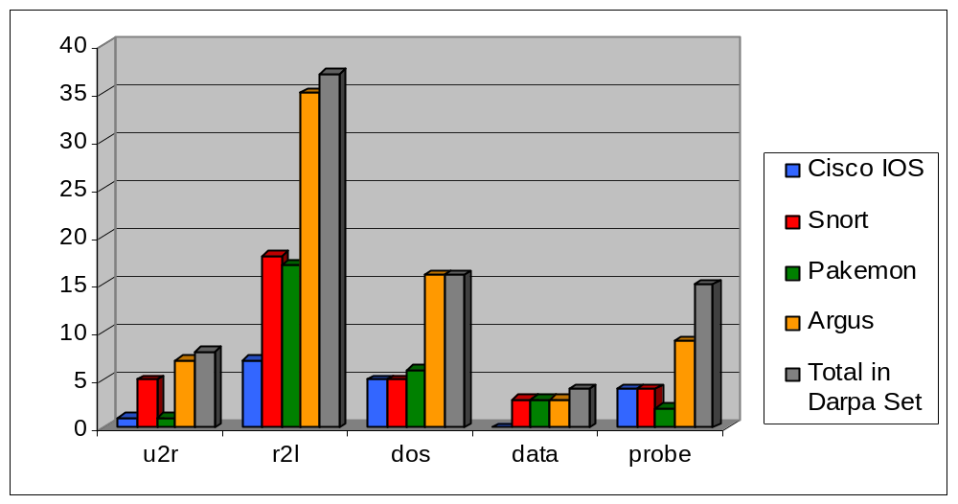
Detected / Recorded Attacks

Slide 14
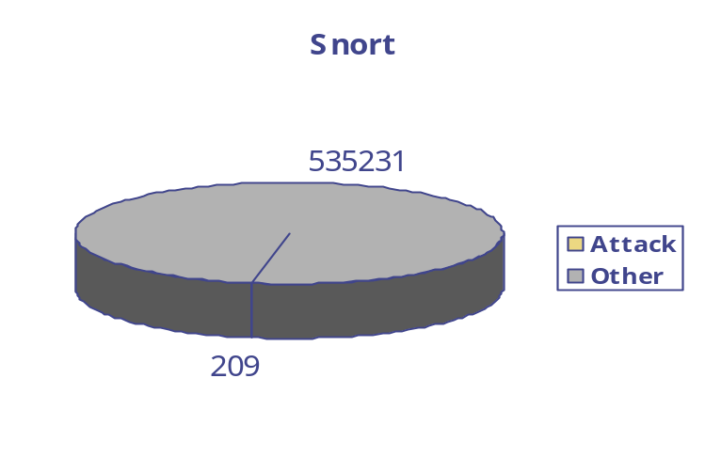
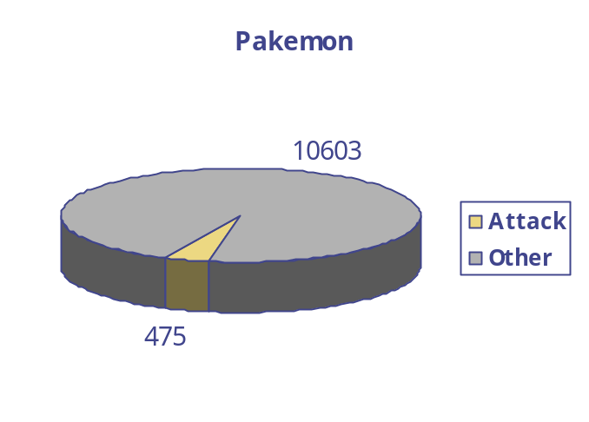
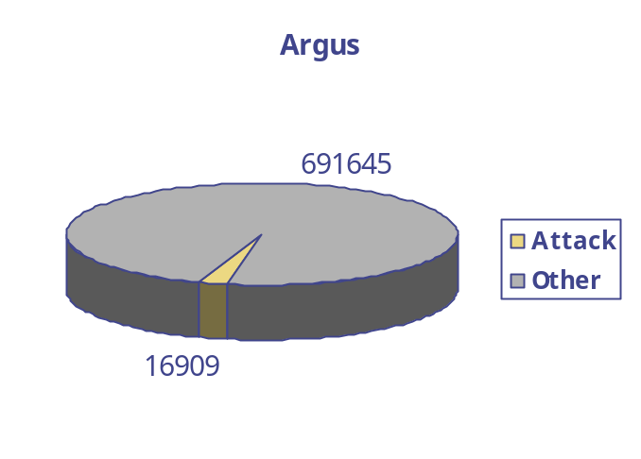
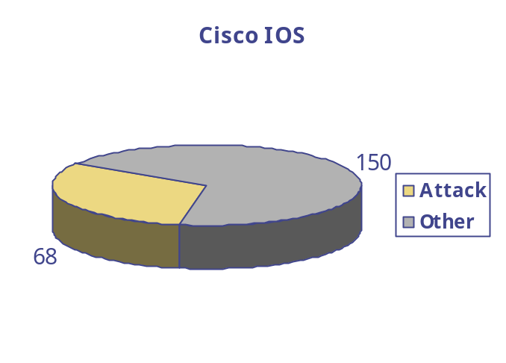
Log File Analysis

Slide 15
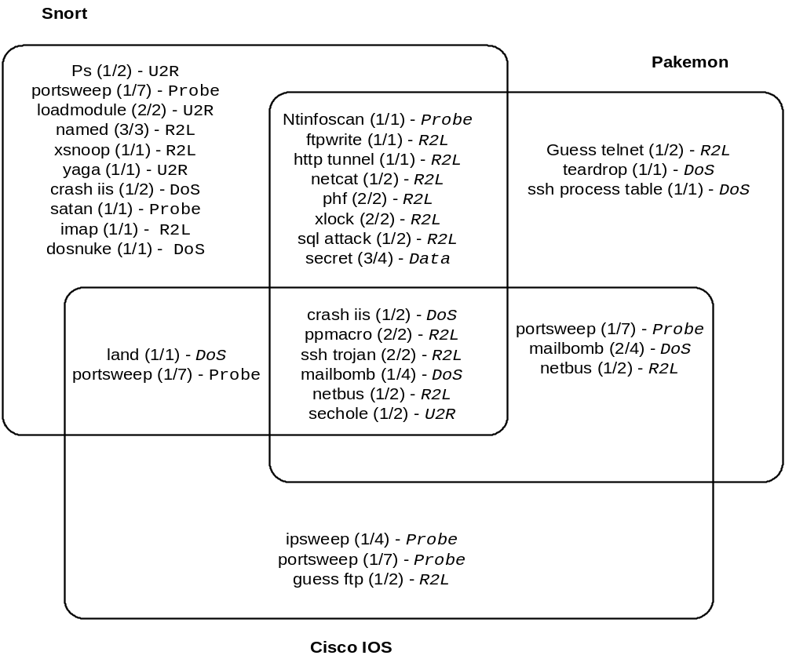
IDS Combined

Slide 16
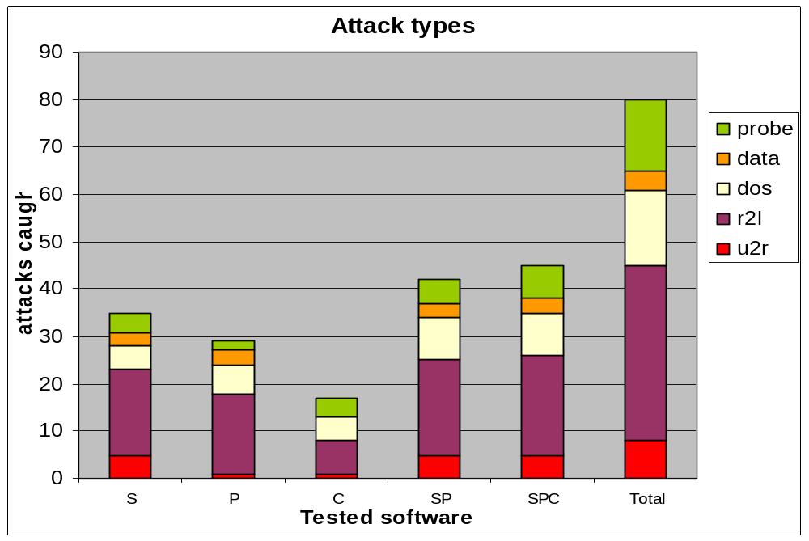
IDS Combined

Slide 17
Conclusion
Still some undetected attacks.
High false positive rate.
Need improvement on:
  Data collection.
  Data summarization.
  Data presentation.

Slide 18
References
[1] MIT Lincoln Lab web site, www.ll.mit.edu/IST/ideval
[2] Snort Web Site, www.snort.org
[3] Argus web site, www.qosient.com/argus
[4] Pakemon, www.sfc.keio.ac.jp/~keiji/backup/ids/pakemon/index.html

Slide 19
Matching
[**] [1:1287:2] WEB-IIS scripts access [**]
[Classification: access to a potentially vulnerable web application] [Priority: 2]
04/19-15:31:21.890192 172.16.118.70:17585 -> 172.16.112.100:80
TCP TTL:63 TOS:0x0 ID:33253 IpLen:20 DgmLen:468 DF
***AP*** Seq: 0xDFFBAF3A Ack: 0x98B41512 Win: 0x7D78 TcpLen: 20
ID: 41.161308
Date: 03/29/1999
Name: crashiis
Category: dos
Start_Time: 16:13:08
Duration: 00:00:05
Attacker: 172.016.118.070
Victim: 172.016.112.100
Username: n/a
Ports:
At_Attacker:
At_Victim: 80{1}
Back

Slide 20
Samples From IDS Logs
back
[**] WEB-MISC handler access [**]
  04/19-17:58:37.640119 172.16.112.100:3247 -> 208.2.204.3:80
  TCP TTL:127 TOS:0x0 ID:48775 IpLen:20 DgmLen:431 DF
  ***AP*** Seq: 0x13C09E3 Ack: 0xA193E8E2 Win: 0x2238 TcpLen: 20
Apr 22 12:39:34 detector pakemon: Too much data in TCP receive queue,from 135.13.216.191:23 to 172.16.112.149:6180
Apr 22 12:39:30 detector pakemon: Scan from 172.16.114.148. scan type: SYN
%IDS-4-TCP_SYN_ATTACK_SIG: Sig:3050:Half-Open Syn Flood - from 196.227.33.189 to 172.16.112.100

