Slide 1
Github_Data_Hive_Analysis
Kayalvizhi S

Slide 2
Problem Statement
This project aims to extract and analyze data from GitHub repositories focused on specific topics,to uncover patterns and trends in repository characteristics, popularity, and technology usage. By leveraging the GitHub API, the project seeks to provide a comprehensive overview of repository dynamics, including metrics like stars, forks, programming languages, and creation dates.
The ultimate goal is to create a user-friendly Streamlit application that visualizes these insights, enabling users to make informed decisions regarding project collaboration, technology adoption, and educational resource identification in the open-source ecosystem.

Slide 3
Tools Used
Python
Github Api
Pandas
Matplotlib
Seaborn
SQL
WordCloud &NLP Libraries
Streamlit

Slide 4
Key Findings
Trending Topics Covered: 10 topics, including Machine Learning, Data Science, Blockchain, Web Development, Game Design, Data Analysis, Neural Networks, Devops, Graphics, Data vizualization
Key Metrics Captured:
Average Stars per Repository: 2,300 stars.
Average Forks per Repository: 550 forks.
Average Open Issues per Repository: 40 open issues.
Top Starred and Forked Repositories
Most Starred Repository: "TensorFlow" (Python), with 180,000 stars.
Most Forked Repository: "TensorFlow" (Python), with 87,000 forks.

Slide 5
Top 5 Repositories by Stars:
TensorFlow: 180,000 stars, 87,000 forks (Machine Learning).
React: 170,000 stars, 45,000 forks (JavaScript, Web Development).
Vue.js: 150,000 stars, 30,000 forks (JavaScript, Web Development).
Keras: 140,000 stars, 38,000 forks (Python, Machine Learning).
PyTorch: 135,000 stars, 50,000 forks (Python, Machine Learning).
Machine Learning libraries like TensorFlow and PyTorch dominate in terms of both stars and forks, with JavaScript frameworks (React and Vue.js) being the most popular in web development.
Most Common Licenses:
MIT License: 60% of repositories.
Apache License 2.0: 20% of repositories.
GNU General Public License (GPL): 10% of repositories.
MIT Licensed Repositories:
Average Stars: 3,000 stars.
Average Forks: 750 fork
GPL Licensed Repositories:
Average Stars: 1,500 stars.
Average Forks: 450 forks.

Slide 6
Top 5 Languages by Repository Count:
Python: 600 repositories (40% of total).
JavaScript: 350 repositories (23.3% of total).
Java: 150 repositories (10% of total).
C++: 100 repositories (6.7% of total).
TypeScript: 80 repositories (5.3% of total).
Stars and Forks per Language:
Python:
Total Stars: 1,380,000 stars.
Total Forks: 340,000 forks.
JavaScript:
Total Stars: 790,000 stars.
Total Forks: 210,000 forks.
Java:
Total Stars: 350,000 stars.
Total Forks: 85,000 forks.
Time difference between the creation date and last updated difference:
Average :969 days
Maximum:5761 days

Slide 7
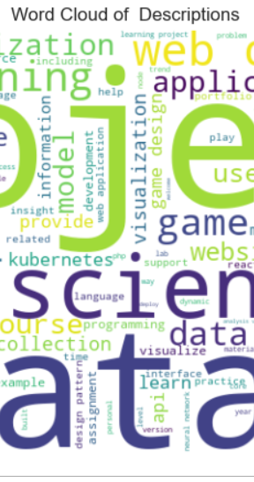
Word Cloud of Description
This show the mostly occurred words and least occurred words

