Slide 1

Bike rental management system
ITW project of semester 3

Slide 2


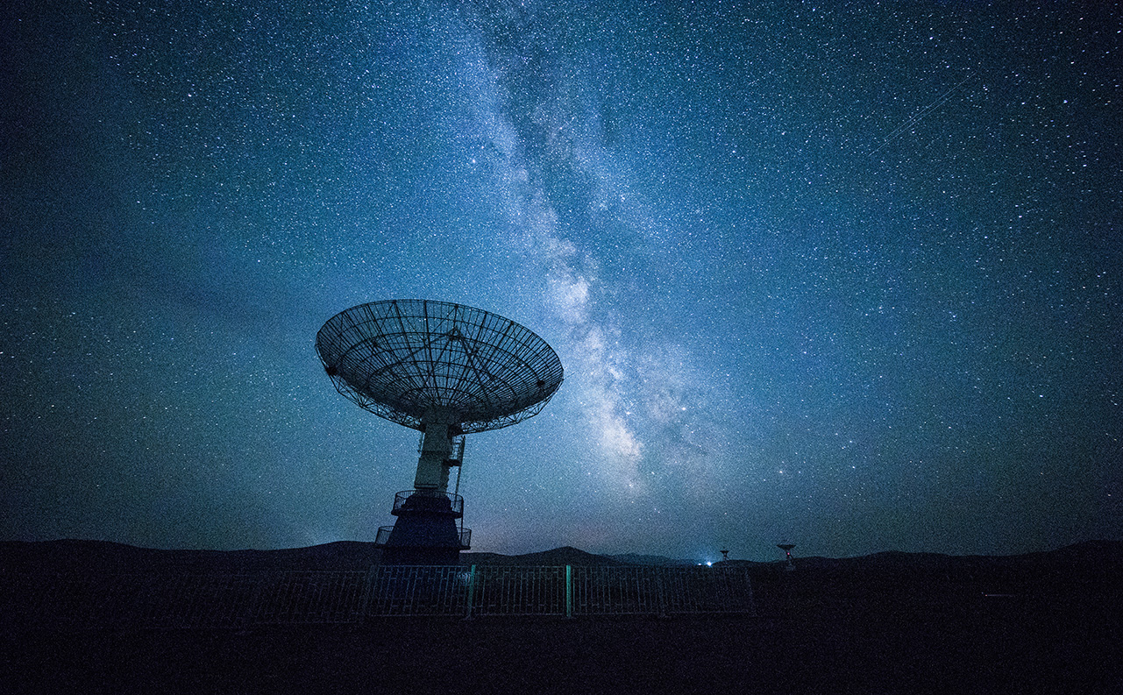
About the project :
The project is about the process of renting the bike on modern basis Which is managed with the help of Django as backend.
Bike rental had become one of the most environmentally friendly business that attract many tourists and local people so that they can easily able to do their work .

Slide 3
Home page
The home page contains search bar for bike model and city
The contents of the search bar are dynamically loaded from the database with the help of Django
The navigation on the top of the home page includes the home button ,about , bikes page button , login , Register .
It shows all available different bike models and the listing of the available cities and branches

Slide 4

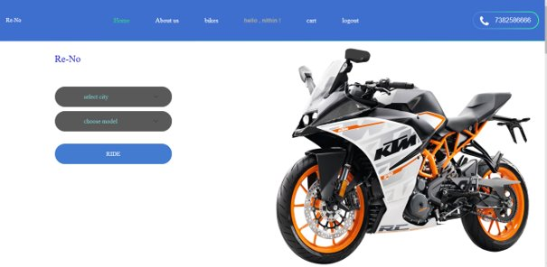

Slide 5

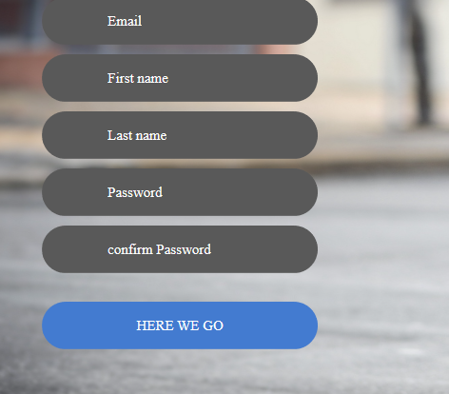
Register page :-
For registering any new user we have to give valid email address and password for future login purposes of that user .

Slide 6
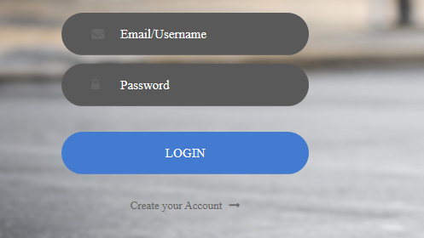

Login page :-

Slide 7
Bikes listing page:-
This page is about the availability of bikes in our view along with price , details of the particular bike .
It also contains search bar so that we can directly book the bike from this page .
This page directly linked with search bar of home page

Slide 8
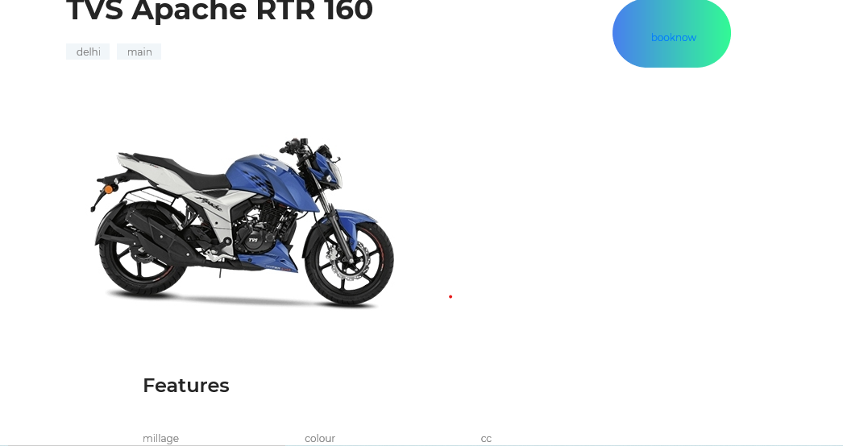
Booking Page :-
Contains the details of branch city and features of the particular bike and book now button so that it directly the bike.
It also contains the "return now "Option so that after that it shows the amount we have to pay based on the time

Slide 9
Cart page:-
It contains the details of the booked bikes of the current user .

Slide 10
Logout page :-
After log out the current user it automatically redirects to the homepage

Slide 11

Thank You!
18075028 – KAYALA NITHIN SAI
18075037 – MADHULIKA DAMOR
18075043- PENUBADI REDDY SUNIL

