Slide 1

SUPPLY CHAIN MANAGEMENT Aleyna Kaya 1700003936 Berk Hayta 1507010042 Ömer Yıldız 1600002687 Caner Küllük 1600003410
UNIQUE TEXTILE

Slide 2
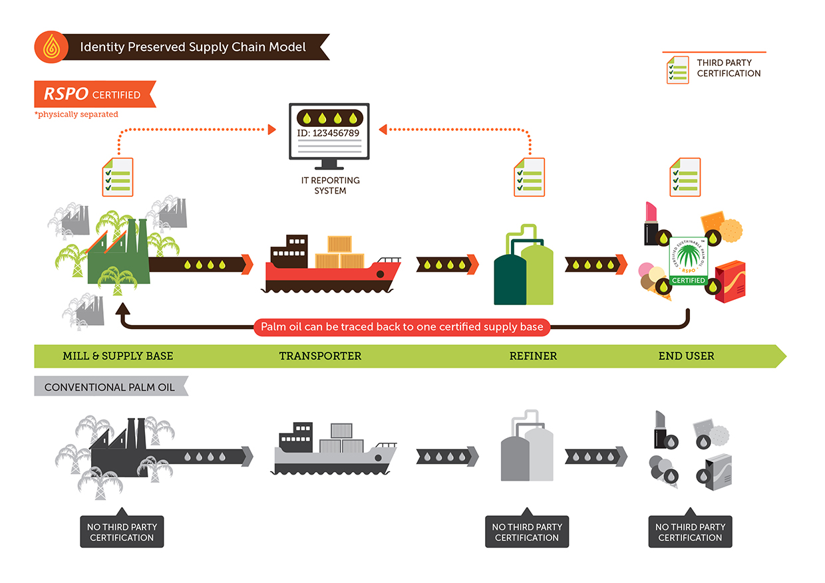
WHAT IS A SUPPLY CHAIN?
Consists of all stages involved, directly or indirectly, in fulfilling a customer request
SC includes manufacturers, suppliers, transporters, warehouses, retailers, and customers

Slide 3
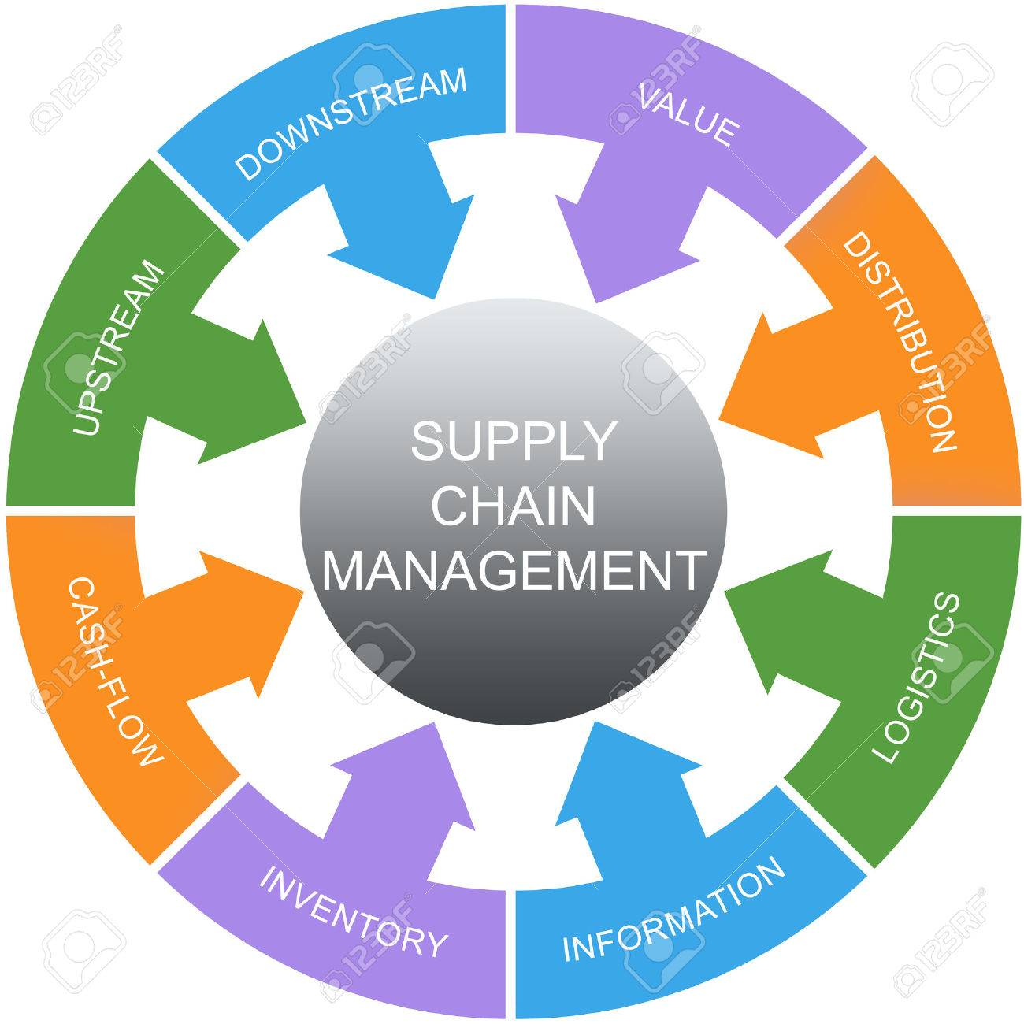
WHAT IS A SUPPLY CHAIN MANAGEMENT?
Supply Chain Management (SCM) is the management of the flow of goods and services and includes all processes that transform raw materials into final products.
SCM represents an effort by suppliers to develop and implement supply chains that are as efficient and economical as possible.

Slide 4

UNIQUE TEXTILE
Unique Textile was established in Beyoğlu in 2010 and it is a textile company that produces first quality women's clothing and unisex T-shirts.
Women's clothing is available in a variety of dresses, T-shirts, trousers and crop.
The raw materials of our products are cotton and polyester. We bring our cotton fabrics from Çorlu Hamboya factory and Polyester fabrics from Nilörme company.
We supply our accessories such as labels, zippers, buttons from Rudholm Accessories.

Slide 5
OUR MISSION & VISION
Mission: To be passionate in product quality, innovative in design. to contribute directly to the well-being of people wearing well-made, beautiful, comfortable original and perfectly processed clothes, and to establish a bond of feeling and trust with our customers. Our priority is to meet their demands.
Vision: For all textile manufacturers, small or large companies (dyeing, washing, pressing, color and texture, processing, evaluations, and implementation of custom sewing products to be the number 1 partner in the field of textile finishing services across Europe.

Slide 6
OUR STRATEGIES
The first strategy that we apply is knowing and meeting the customer needs. We conduct deep analysis of what customers expect from the products they purchase. In order to do that, we use our social media accounts effectively.
Our second strategy is preventing the global warming while using our resources. We show respect to our beautiful world. Therefore, we gain our customers’ and business partners’ love.
Our third strategy is expanding the product line to compete against other textile companies. By increasing our product line, we can increase our profit which can allow acquisitions of competitors.
Our other strategies can be listed as:
Improving logistics.
Developing an effective linkage between industry, academia, and R&D institutes.
Work in close collaboration with competitors.

Slide 7
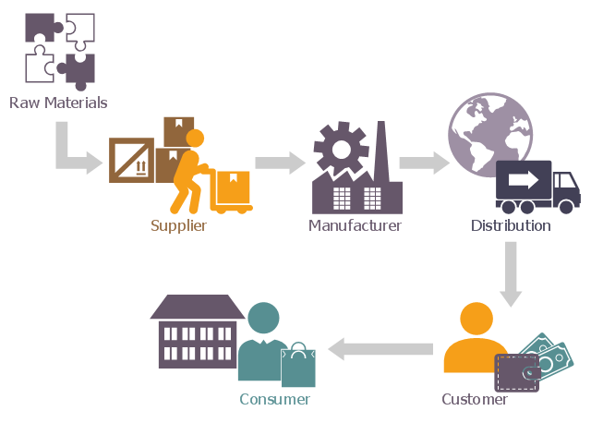
SUPPLY CHAIN NETWORK
We have divided our products into two main groups which are:
Women’s clothing
Unisex T-Shirts
Supply Chain In Unique Textile

Slide 8
ERP-MRP SYSTEMS
The order from the customer applied in ERP system.
ERP system and MRP system integrated with each other.
MRP System calculate automatically the kg of fabric required and
Number of accesuare requirement.
The orders passed to the necessary places.
After it is produced in factories, it comes to us with trucks.
The fabrics entering the warehouse.

Slide 9
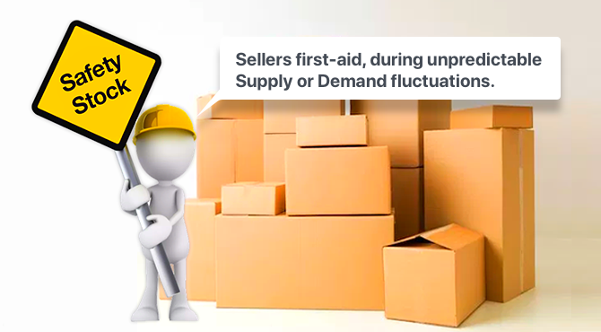
SAFETY STOCK
It is very important to deliver on time in order to increase customer satisfaction. Therefore, suppliers need to deliver fabrics on time. In some cases, there may be delays in the fabrics.
Our solution is safety stock. With a safety stock, delays can be avoided.
The company will be forecast customers monthly demand. According to this situation, they keep monthly stock.

Slide 10

FORECASTING
We are using ERP softwares. Unique Textile is known of using SAP Business One and SAP Integrated Business Planning programs.
Historical data is preferred when there is sufficient data to use. Unless it’s not sufficient, we try to make the most accurate forecasting with our studies.
In order to reduce the bullwhip effect, we are trying to fulfill the demands which will not create fluctuations.

Slide 11
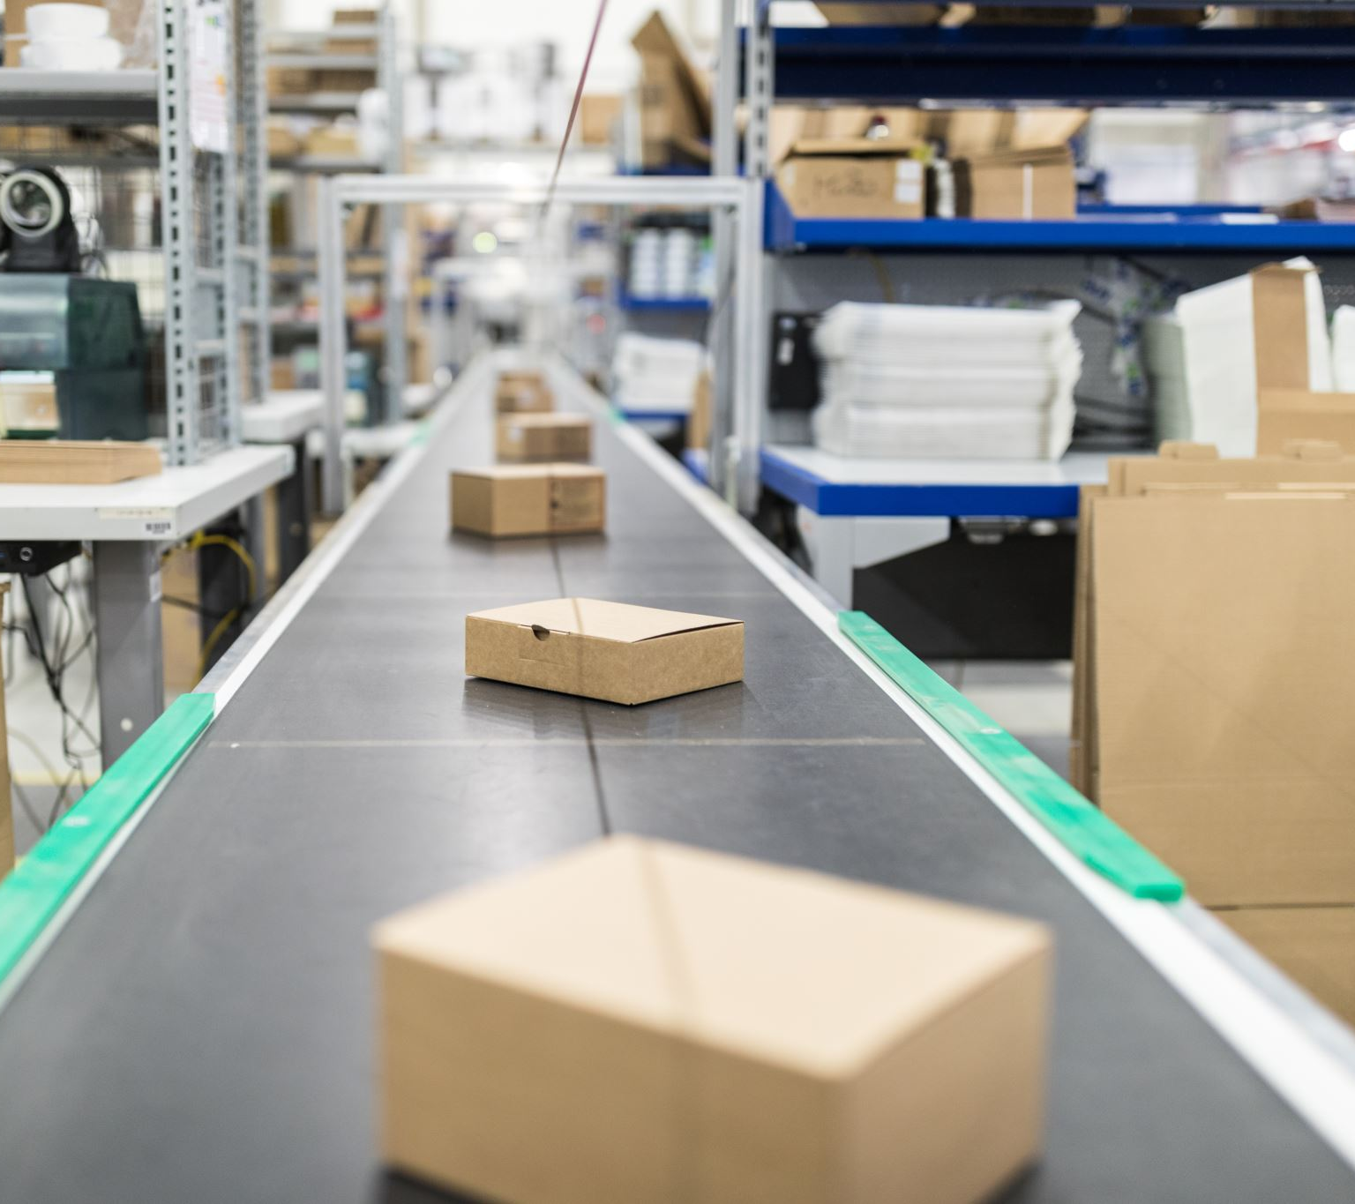
LOGISTICS
Outbound Logistics
Outbound logistics refers to the transportation, storage, and delivery systems that bring your products to your customers.
Outbound logistics is the way you bring your finished products to their destinations.
Unique supplies raw materials in its factories and transports finished products most efficiently to the brands.

Slide 12

LOGISTICS
Inbound Logistics:
Inbound logistics refers to the network that brings goods or materials to your business. Your inbound logistics network includes everything you need to transport, store, and deliver goods to your business from other suppliers.
The actual products that you bring into your business depend on what you do.
Unique includes raw materials processing stages, after the fabric processing, processes are finished, packaging processes are carried out and delivered to brand.

Slide 13
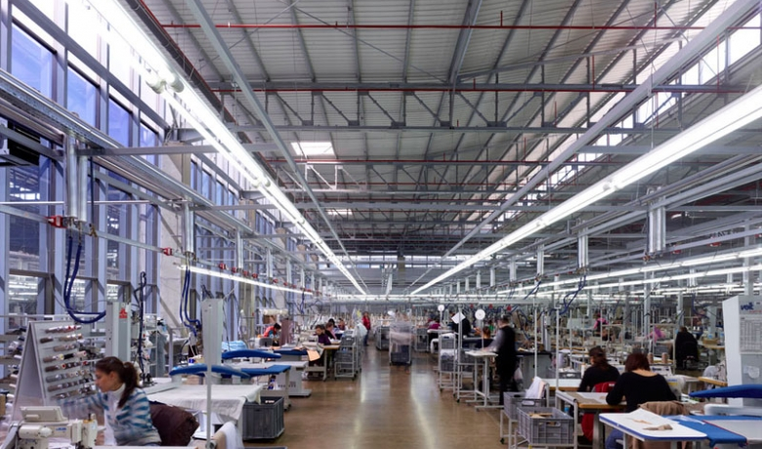
FACILITIES
Unique Textile has 4 factories, including Germany, Sweden, the Netherlands and Turkey.
The company is currently trading in 3 countries on the European continent.
In Turkey there is a production factory in Beyoğlu. Each factory has 100 employees.
Our goal is to spread to more continents, increase our sales and grow more day by day.

Slide 14
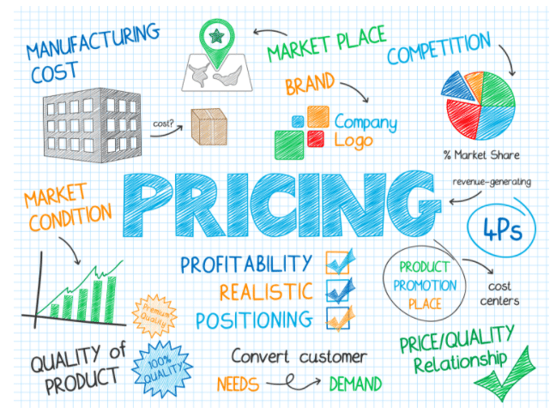
PRICING
Unique Textile is focused on the middle class when setting prices, and Unique Textile’s main goal is to produce strong and quality goods with suitable prices. In addition, we have entered into a price setting policy based on the prices of competing companies.
You still have to make sure the value to the customer is higher than your costs. Otherwise, you will lose money with every product you sell.
-Eric Dolansky

Slide 15

Thank you for listening to our presentation.

