Slide 1
CMPE 462 CEMİL UZUN
DENİZ KAYA – 150308003
MUHAMMED KAYA - 150302022

Slide 2
Step 1: Set up your environment.
Python 3
NumPy
Pandas
Scikit-Learn (a.k.a. sklearn)

Slide 3
Step 2: Import libraries and modules.
import numpy as np
import pandas as pd
from sklearn.model_selection import train_test_split
from sklearn import preprocessing
from sklearn.ensemble import RandomForestRegressor
from sklearn.pipeline import make_pipeline
from sklearn.model_selection import GridSearchCV
from sklearn.metrics import mean_squared_error, r2_score
from sklearn.externals import joblib

Slide 4
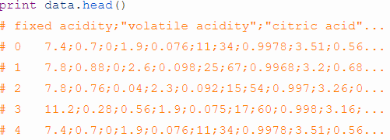
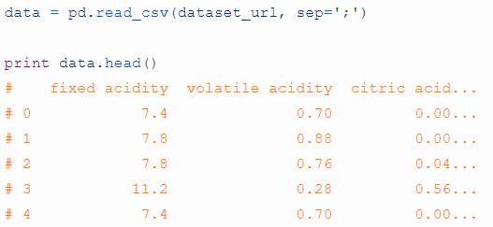
Step 3: Load red wine data.
http://mlr.cs.umass.edu/ml/machine-learning-databases/wine-quality/winequality-red.csv
We take values from a csv file and to dataframe using pandas library.

Slide 5
Here's the list of all the features:
quality (target)
fixed acidity
volatile acidity
citric acid
residual sugar
chlorides
free sulfur dioxide
total sulfur dioxide
density
pH
sulphates
alcohol

Slide 6
Step 4: Split data into training and test sets.
X_train, X_test, y_train, y_test = train_test_split(X, y,
test_size=0.2,
random_state=123,
stratify=y)
* we'll set aside 20% of the data as a test set for evaluating our model.

Slide 7
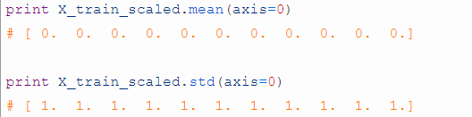
Step 5: Declare data preprocessing steps.
Standardization is the process of subtracting the means from each feature and then dividing by the feature standard deviations.

Slide 8
Here's how you do it:
scaler = preprocessing.StandardScaler().fit(X_train)
X_train_scaled = scaler.transform(X_train)
print X_train_scaled.mean(axis=0)
# [ 0. 0. 0. 0. 0. 0. 0. 0. 0. 0. 0.]
print X_train_scaled.std(axis=0)
# [ 1. 1. 1. 1. 1. 1. 1. 1. 1. 1. 1.]

Slide 9
Step 6: Declare hyperparameters to tune.
Our parameters that we used for tuning the model.
hyperparameters = { 'randomforestregressor__max_features' : ['auto', 'sqrt', 'log2'],
'randomforestregressor__max_depth': [None, 5, 3, 1]}

Slide 10
Step 7: Tune model using a cross-validation pipeline.
Cross-validation is a process for reliably estimating the performance of a method for building a model by training and evaluating your model multiple times using the same method.
Split your data into k equal parts, or "folds" (typically k=10).
Train your model on k-1 folds (e.g. the first 9 folds).
Evaluate it on the remaining "hold-out" fold (e.g. the 10th fold).
Perform steps (2) and (3) k times, each time holding out a different fold.
Aggregate the performance across all k folds. This is your performance metric.

Slide 11
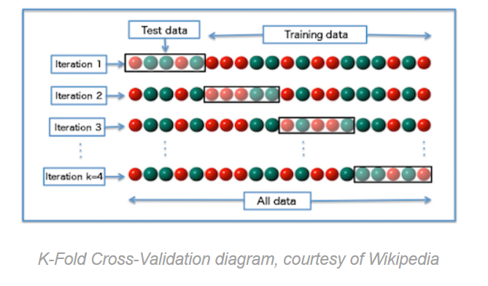

Slide 12
cross-validation "pipeline?"
Split your data into k equal parts, or "folds" (typically k=10).
Preprocess k-1 training folds.
Train your model on the same k-1 folds.
Preprocess the hold-out fold using the same transformations from step (2).
Evaluate your model on the same hold-out fold.
Perform steps (2) - (5) k times, each time holding out a different fold.
Aggregate the performance across all k folds. This is your performance metric.

Slide 13
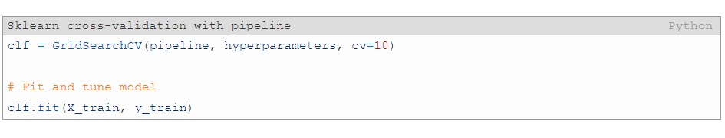

Slide 14
Step 8: Refit on the entire training set.
To increase the accuracy we refit the model.
print clf.refit

Slide 15
Step 9: Evaluate model pipeline on test data.
We are sending our test values to model and it returns predicted quality values.
y_pred = clf.predict(X_test)

Slide 16
imported earlier to evaluate our model performance.
To test our model’s performance we used mean squared error method.
print mean_squared_error(y_test, y_pred)
Result:
# 0.35461593750000003

