Slide 1
Dynatrace Advanced Training
Objective: Deep Dive into Advanced Features
<Presenter>, <Date>

Slide 2
Agenda
Session Stores
Why, When, and How?
Store Sessions for a Specific Timeframe
Store Specific PurePaths (recommended method)
Exporting Stored Sessions and Importing Sessions
Memory Diagnostics
Total Memory
Selective Memory
Thread Diagnostics
Thread dumps
Thread metrics

Slide 3
Session Storage
For extended storage of transaction level details
Exportable to external storage

Slide 4
Session Storage – Why?
Dynatrace captures a large amount of very granular details
While this information is very valuable, it is very expensive to store all this data
By Default, Dynatrace keeps up to 2 weeks of transactions /PurePaths
Due to volume of traffic and disk space, <Client Name> stores approx. 4-5 days of transactions/PurePaths
When performance issues are viewed in Dynatrace, this timeframe may not be long enough to fully evaluate the problem
Dynatrace allows you to store and export the transactions and granular details
Very useful when sharing information
Don’t even need a DT Server to view the data, just a Dynatrace Client on your desktop/laptop
Metric/Chart level detail is stored for a long period of time on our Performance Warehouse (Database)

Slide 5
Session Storage – When?
Triage sessions and performance improvement
The problem may be remedied with a restart, but you’d like to be able to evaluate for longer for permanent resolution
Pass the transactions to Dev to improve the application
Store transactions to compare after fix

Slide 6
Session Storage – How?
There are 2 ways to store sessions in <Client Name>’s implementation of Dynatrace
For a Specific Timeframe
Captures all PurePath and PureStack info for a system profile for the specified timeframe
While this ensures all relevant information is captured, the files can be very large
Specific PurePaths (PREFERED METHOD)
Only captures the PurePaths and related PureStack information that are selected
Won’t capture data from unrelated applications and files are much smaller

Slide 7
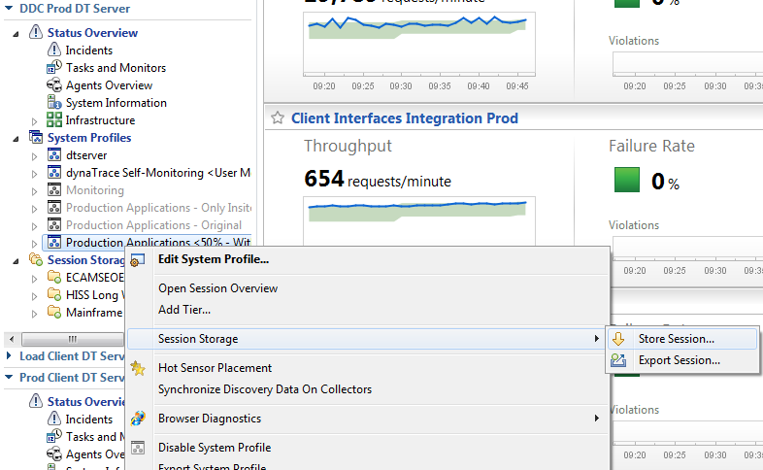
Storing Sessions for a Specific Timeframe
From the Cockpit list, right-click on the target system profile.
Click Session Store>Store Session

Slide 8
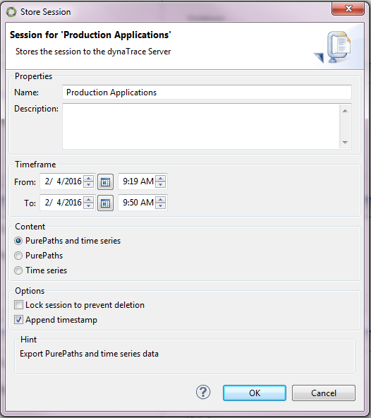
Storing Sessions for a Specific Timeframe
The following dialog box will appear enabling you specify a timeframe, label, and options to lock to prevent deletion and append a timestamp.

Slide 9
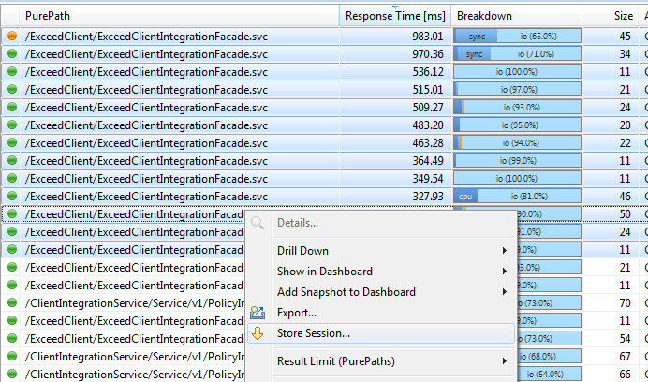
Storing Specific PurePaths
Shift-Click the PurePaths you would like to store, right click, and select Store Session.
The Store Session Dialog will appear like in the previous example, but without a timeframe as you’ve selected the specific PurePaths you’d like to store.

Slide 10
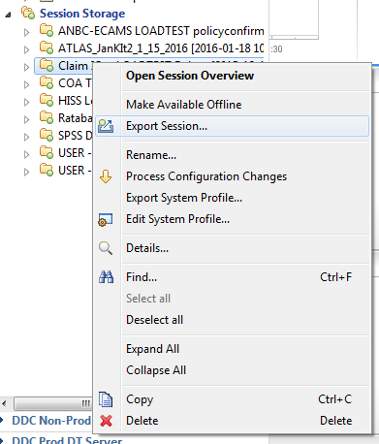
Exporting Stored Sessions
Once a session is stored, it will be available underneath the respective system profile and can be exported to external storage.
From the Cock pit, open Session Storage
Right click on the desired stored session and select Make Available Offline. This ensures all packages are included that allow the session to be viewed in a Dynatrace Client without a Dynatrace Server.
Simply hitting Export will allow you to save the session externally, but you will have to import it onto a Dynatrace Server to view it.
When prompted by the export dialog box, navigate to where the session will be saved and specify a file name.
Click export to create a compressed file with the .dts extension which can be viewed on any Dynatrace Client.

Slide 11
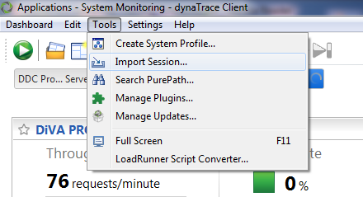
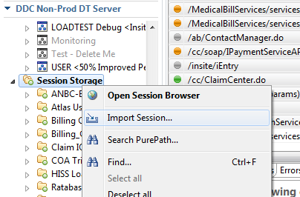
Importing Stored Sessions
Click the Tools menu at the top of the screen.
Select Import Session and browse to the desired session file. Once imported, the file will be available in a table in the Imported Sessions Dashlet.
Right-Clicking the imported session file provides a list of options for analyzing and manipulating the file.

Slide 12
Exercise
Go to the purepaths dashlet in non-prod
Select the top 10 slowest purepaths
Right click and click ‘Export’ to export the session
Import the session into Dynatrace
Notes:
Do a quick walkthrough of the exercise before asking others to do it

Slide 13
Questions on Session Storage?

Slide 14
Memory Diagnostics
For sophisticated memory analysis through both
Selective Memory and Total Memory dumps.

Slide 15
Total Memory
The Total Memory dashlet provides snapshot information about currently allocated object regardless of their connection to recorded PurePaths or configured memory rules. Total memory snapshots belong to one of the following 2 types:
Trending Snapshot: These contain information about classes, instance counts, and shallow sizes.
Caution: Memory Consumption Trending snapshots are less impacting than Deep Leak-Analysis, but they still will suspend the application several seconds for each snapshot that is taken. For trending, snapshots are taken periodically.
Deep Leak-Analysis Snapshot: The contain information about classes, the individual instances, references between individual instances GC Size.
Caution: Deep Leak- Analysis may take take several minutes and the application will be suspended in the meantime.

Slide 16
Create a snapshot
To create a snapshot, click Create Memory Snapshot in the lower pane. In the trending screenshot, memory usage falls a bit after the second auto-shot. This is because the user selected Create Memory Snapshot > General Options > Force Garbage Collection.
The upper pane of the dashlet displays all snapshots of the corresponding system-profile, grouped by Agents. By default, the table contains the following information for each snapshot:
Agent/Dump: Contains the name of the snapshot (it's creation time by default). Right-click and select Edit to change the snapshot name.
Labels: Snapshots can have custom labels assigned. To attach information to a snapshot, right-click and select Edit to assign or delete labels.
Locking State: Determines if you can delete the snapshot automatically if the server is running low on disk-space. Right-click and select Edit to change the locking state.
Type: The type of the memory snapshot, either Leak Analysis or Trending.
Status: The state of the snapshot, Finished, Finished (raw) or Not completed. A finished snapshot is ready for analysis, a raw-snapshot needs post-processing before you can analyze. A Not completed status indicates problems you discover while you create or post-process the memory snapshot.
Used Memory: The amount of allocated memory at the time the snapshot is created.

Slide 17
Snapshot Overview Tab
In case the overview contains a message that a potential native memory leak has been detected as depicted in the image below, the process-memory of the application is higher than 120 % of the maximum heap size of your VM.

Slide 18
Hotspots
The Hot Spots tab shows the potentially top interesting objects in the Memory Snapshot. A Hot Spot is an object that's difference between its own GC size and the maximum GC size of its child is high. A Hot Spot thus 'accumulates' a lot of other objects.
Note: Hot Spots are not ordered by their GC size but by the difference of their size to maximum size of an objects children.

Slide 19
Analysis Drill-Down
Within a Leak-Analysis snapshot the following drill-down analysis Dashlets are available for individual objects and usually also aggregated for classes. An aggregated analysis means that the corresponding analysis is done for multiple (or all) instances of a class. Use the context-menu on a class or instance for the following analysis Dashlets:
o Follow References - Direct
o Follow References - By Keep Alive
o Shortest Root Paths - Direct
o Shortest Root Paths - By Keep Alive
o Keep Alive Set
o Fields and Values

Slide 20
Exercise
Go to the total memory diagnostics dashlet
Analyze the hotspot and find the instance with the highest heap percentage
Notes:
Do a quick walkthrough of the exercise before asking others to do it

Slide 21
Selective Memory
Use the Selective Memory dashlet to create or open Selective Memory snapshots and analyze the instances in the snapshot. A selective memory dump uses memory sensor rules for instance-allocation book keeping. You get a list with all allocated instances for which you have created memory sensor rules.

Slide 22
Group by Allocation Time
Dynatrace groups instances by allocating class, allocation method, allocating line and their time of allocation. If the same class/method/line, within the same second, allocates multiple instances of a class, Dynatrace groups them into a single node to improve visibility. The following figure shows three ConcurrentReaderHashMap$Values nodes. The first shows the allocation of a single entry. The second shows the allocation of 13 entries within a single second. The third shows the allocation of a single instance.

Slide 23
Create Memory Rules from Selective Memory Content
To create method rules, use the context-menu on an allocating method node as shown in the figure below.

Slide 24
Compare Selective Memory Snapshots
This dashlet compares the instance counts and collections/maps classes size of the selected snapshots. You cannot compare individual collection/map instances by size. All instances of a specific class must be aggregated.

Slide 25
Exercise
Go to the selective memory diagnostics dashlet
Take 3 snapshots on 3 different agents, 1 minute apart.
Analyze a few snapshots over time and describe the trend
Notes:
Do a quick walkthrough of the exercise before asking others to do it

Slide 26
Questions on Memory Diagnostics?

Slide 27
Exercise
Open the total memory dashlet under the system profile, under ‘Diagnose Runtime’
Click on an existing total memory snapshot
Analyze and list the top two most greedy objects
Notes:
Do a quick walkthrough of the exercise before asking others to do it

Slide 28
Thread Diagnostics
For sophisticated thread analysis

Slide 29
Overview
Thread dumps provide a snapshot of all JVM/CLR threads. They are a powerful way of finding deadlocks, idle or busy thread pools, thread leaks, and more.
There are many advantages of thread dumps compared to JVM dumps:
o CPU time information is available.
o Multiple thread dumps can be compared.
o You can group threads by significant criteria.
o You can search for PurePaths where a specific thread is involved.
o To perform a thread dump, it is not necessary to start the VM in the console or redirect the output.
o Thread dumps can be triggered automatically.
While the thread information is collected, all threads are suspended to guarantee consistency of stack traces, states, and monitors.
Thread dumps can be persisted, searched, and grouped. You can schedule thread dumps. For example, you might trigger thread dumps at times when the load on the system under diagnosis is low, to ensure that there are no threads leaking, or to compare the CPU usage of different threads to previously created thread dumps.

Slide 30
Grouping threads
Thread state and thread group are the most common groupings. The following figure shows a thread dump taken from Eclipse under load.

Slide 31
Grouping threads
This figure shows that two threads are waiting for this monitor. It is unclear how long they have been waiting, but it is advisable to keep an eye on them. The methods are candidates for placing additional Sensors.

Slide 32
Comparing Thread Dumps
When the system under diagnosis appears to have random threading issues, it helps to examine all running thread.

Slide 33
Comparing Thread Dumps
The most active thread is Worker-2. It is updating the Subversion state of all project files. To find out what's taking so long, another thread dump is requested, as shown in the following figure.
Timer-1 also consumed a lot of CPU time, probably with Subversion. To learn more, you could place additional Sensor rules for the package org.tmatesoft.svn.core.

Slide 34
Limitations to thread dumps
Gathering monitor details on some Sun VMs is slow when threads are suspended. It is possible to disable thread suspension by adding the Agent option threaddumpsuspendthreads=false. However, with thread suspension disabled, monitor details might not match the thread states or stack traces.
CPU time is available only with JVM 5.0 and later.
Acquiring owned monitors under .NET is available only with .NET 4.5.

Slide 35
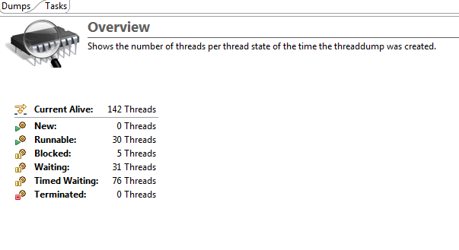
Overview Tab
Use the Threads dashlet to create or open thread dumps and analyze the thread stacks.
This view is divided into two areas. The upper area shows existing thread dumps for certain Agents. The bottom area shows information about the selected dump or the possibility to invoke a thread dump, if no dump is selected in the upper area.
Use the Tasks Tab to modify or add tasks that can automatically create periodic thread dumps.

Slide 36
Questions on Thread Diagnostics?

Slide 37
Exercise
Open the threads dashlet under the system profile, under ‘Diagnose Runtime’
Click on an existing thread dump
Analyze and list the top two most greedy threads
Notes:
Do a quick walkthrough of the exercise before asking others to do it

Slide 38
Final Questions?

Slide 39
Where do I find more info on <Tool Name>?
Insert email, links to client documentation, etc.

Slide 40
Performance management for the digital customer age

