Slide 1
Dynatrace Intermediate Training
Objective: View and Interpret Transaction Level Detail & UEM
<Presenter>, <Date>

Slide 2
Agenda
General Dashboard
PurePaths
Web Requests
Method and Response Time Hotspots
Database, Errors, and Exceptions
UEM
Visits
User Actions
User Experience Index
Navigating the Data
Timeframe and Filters
Drill Down
Exercises for comprehension of material

Slide 3
What are the General Dashboards?
Transactional and method level detail dashboard of Dynatrace for each application
Primarily utilized for root cause analysis

Slide 4

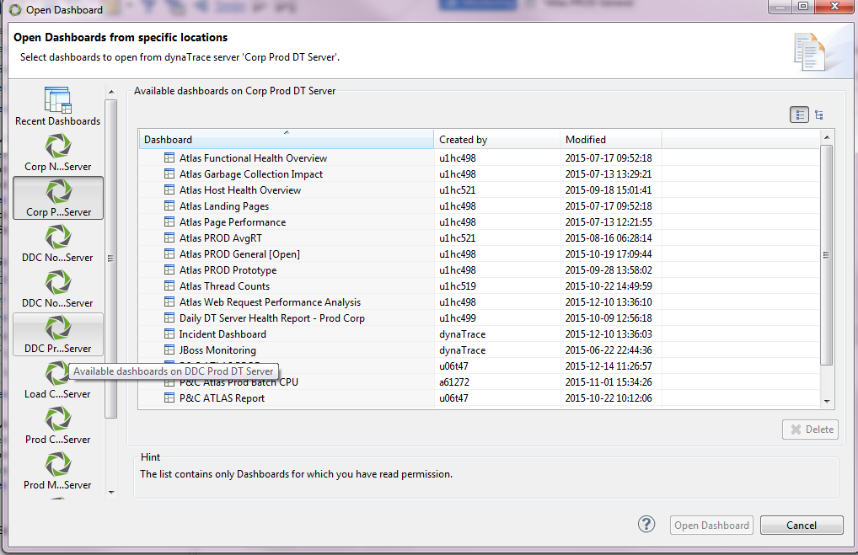
General Dashboard – How to Open
Find appropriate DT Server on Wiki
Click in table and type for quick search

Slide 5
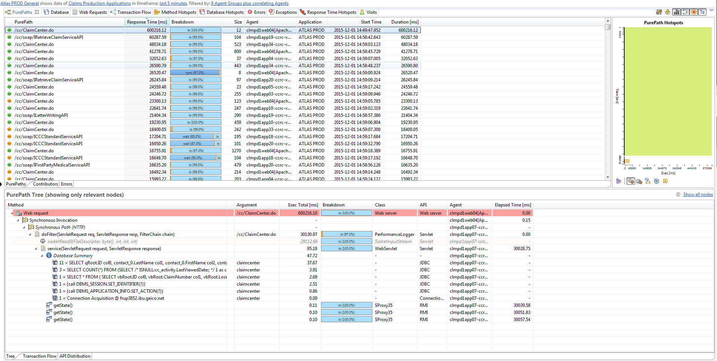
General Dashboard – PurePaths
Notes:
PurePaths are the end to end transactions, from the user, through the datacenter, which enable Dynatrace to provide transactional and method level detail into application performance.
Explain columns and method stack
Some things to note: hover over the column headers for details on the measures, sort by clicking column header, filter by typing
Green = Purepath completed successfully
Orange = PurePath contains an error
Red = Failed Transaction

Slide 6
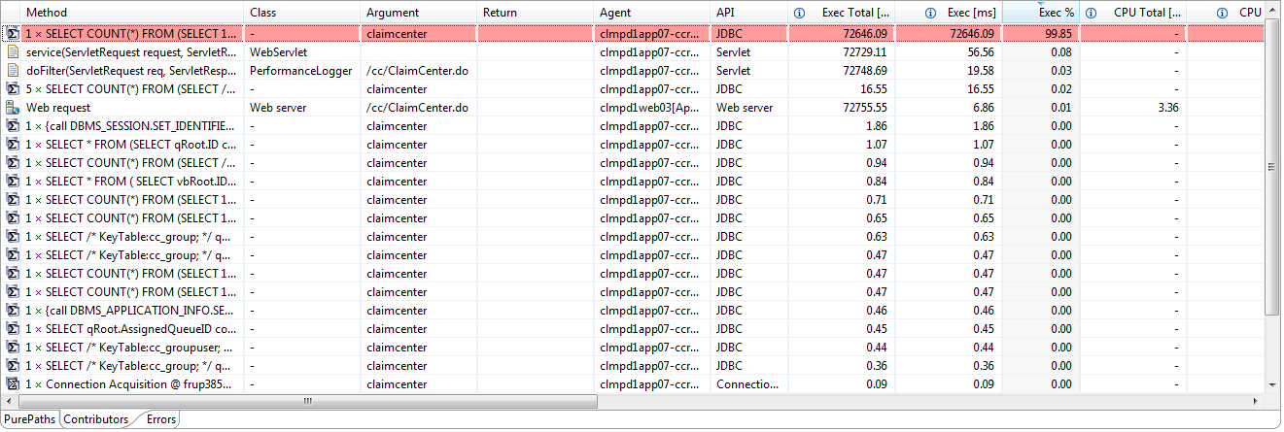
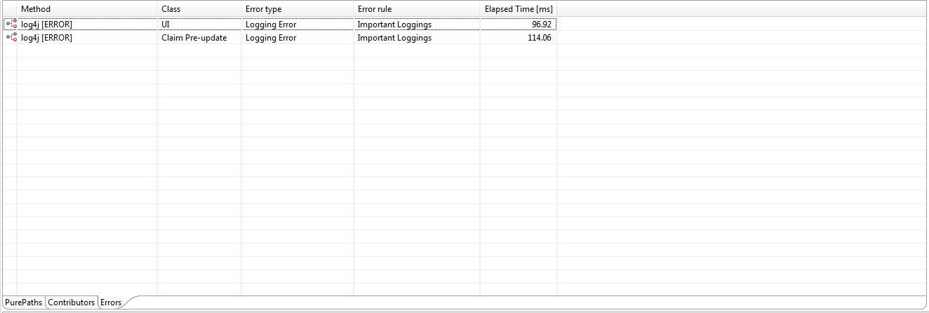
General Dashboard – PurePath Components
Select a PurePath
Hit contributors tab to see method breakdown
Hit errors to easily view all errors on PurePath

Slide 7
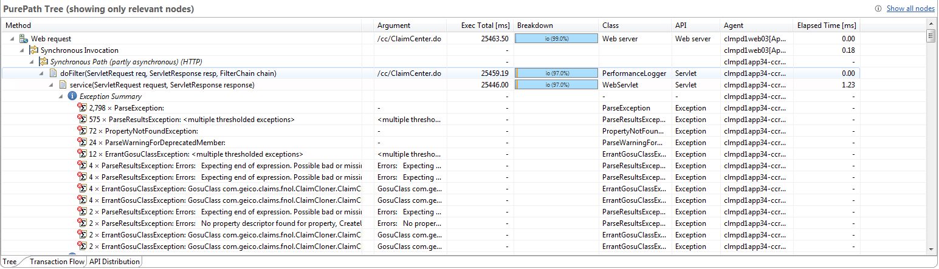
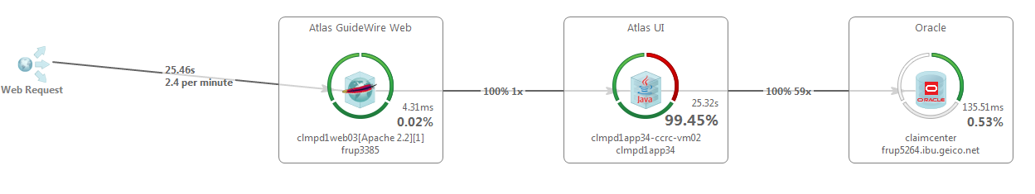
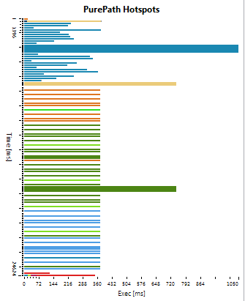
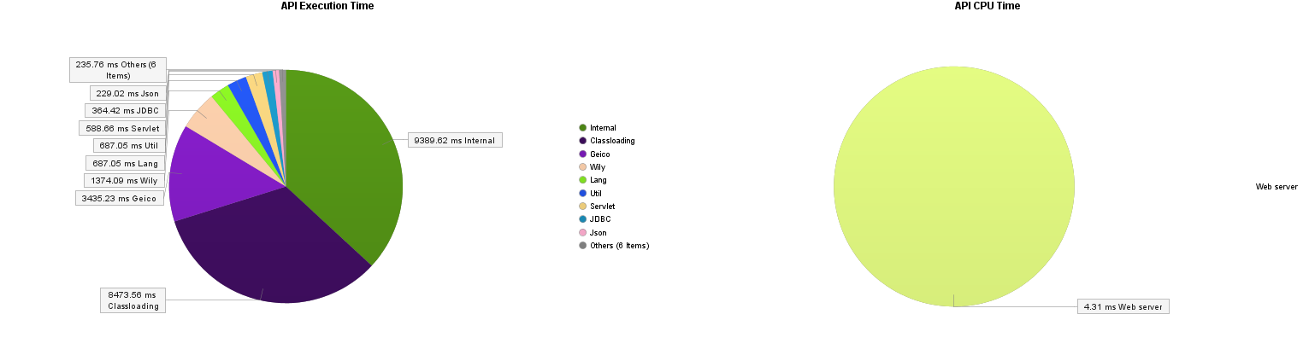
General Dashboard – PurePath Components
Select a PurePath
Tree tab for call stack of PurePath
Transaction flow for that PurePath
API Distribution
PurePath HotSpots
Exec, CPU Exec, Sync, Wait, Suspension

Slide 8
Exercise
Open the Dynatrace Client
Open a General Dashboard
Navigate to the PurePaths Dashlet
Analyze one of the highest response time PurePaths with Transaction Flow, HotSpots, Tree and other portions of the Purepaths Dashlet
Notes:
Do a quick walkthrough of the exercise before asking others to do it

Slide 9
Questions on PurePaths?

Slide 10
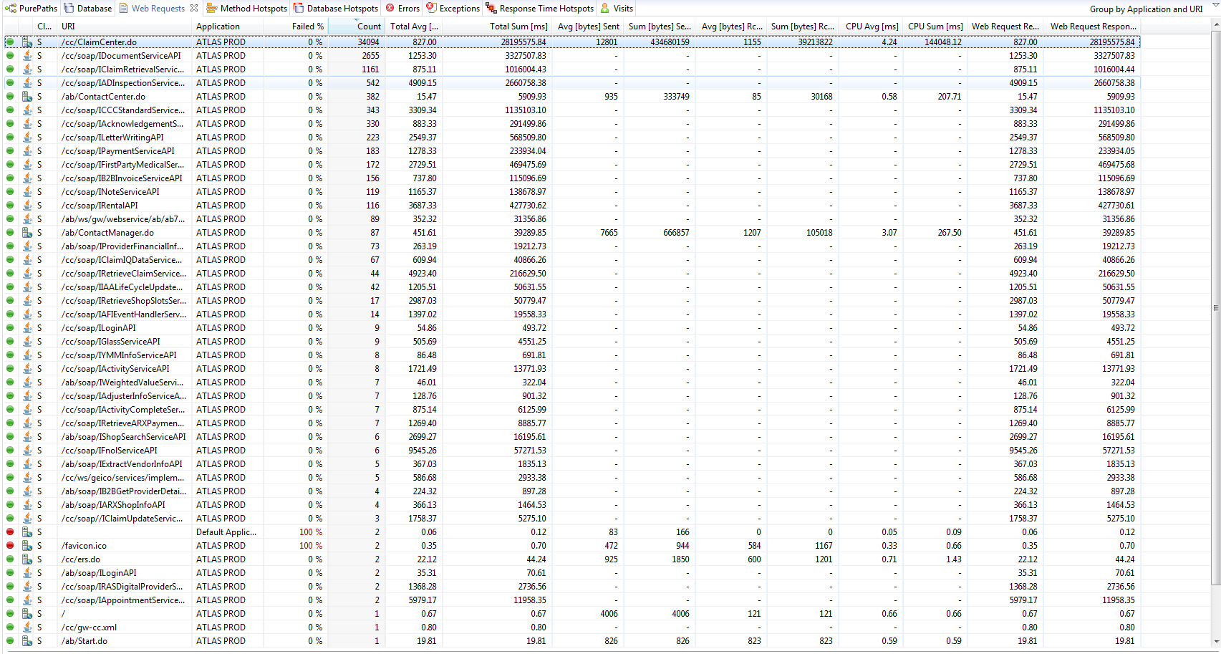
General Dashboard – Web Requests
Notes:
The Web Requests dashlet displays collected information about web requests for diagnosing and tuning software components that handle web requests like servlets and JSPs

Slide 11
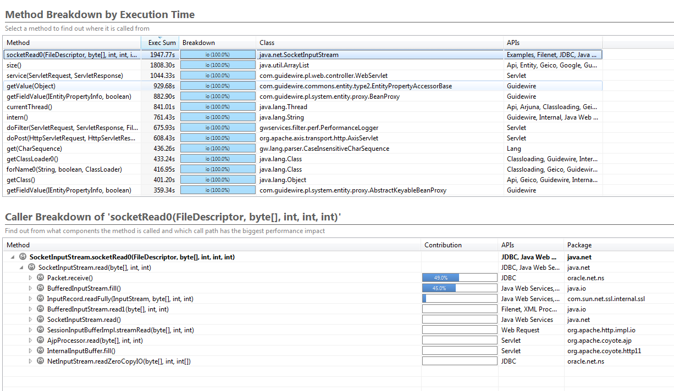
General Dashboard – Method Hotspots
Notes:
Click on a Method to see the caller breakdown, used to find problematic methods

Slide 12
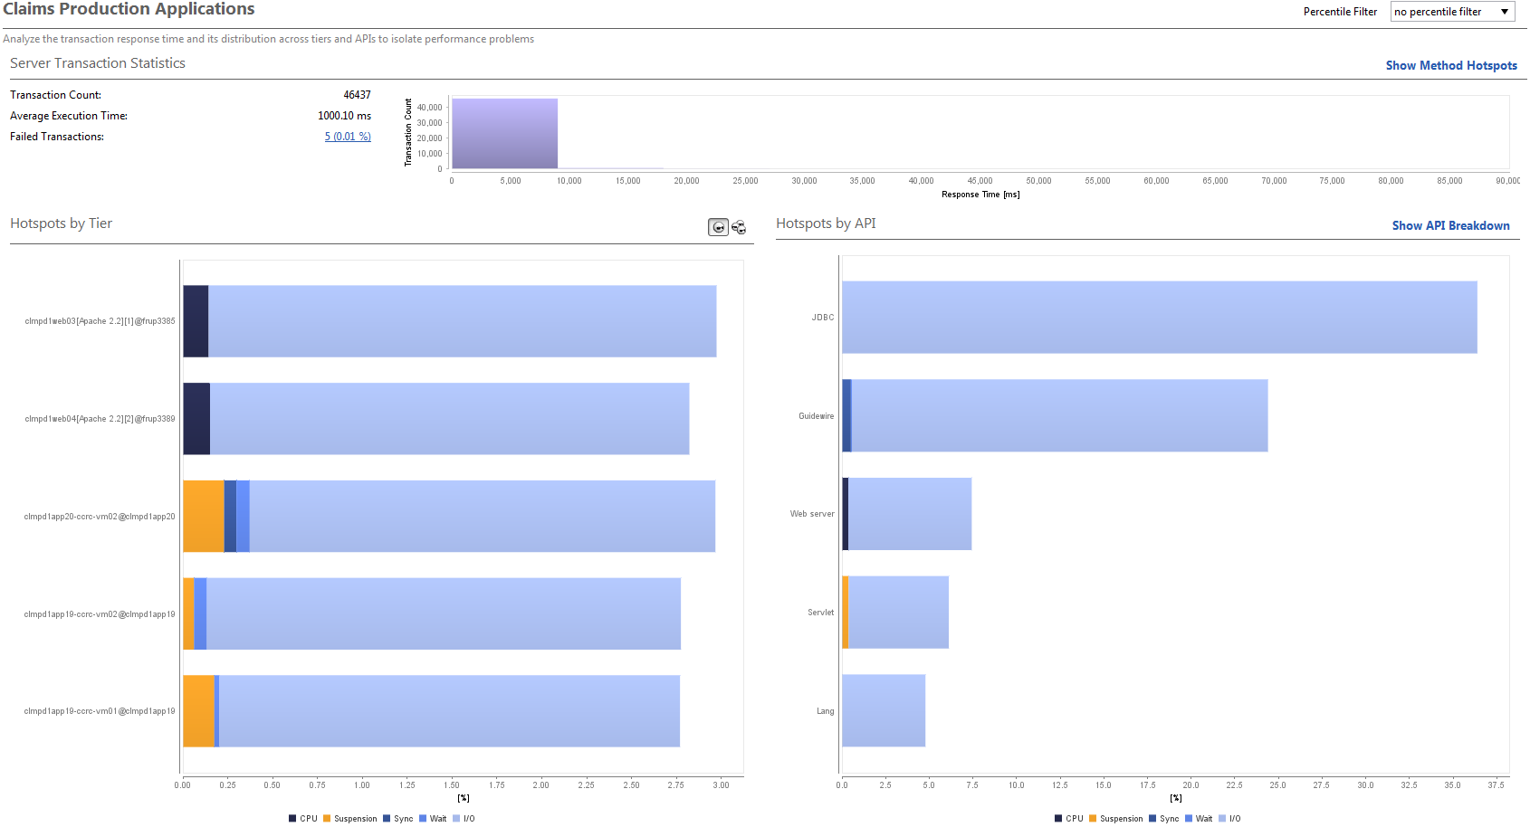
General Dashboard – Response Time Hotspots

Slide 13
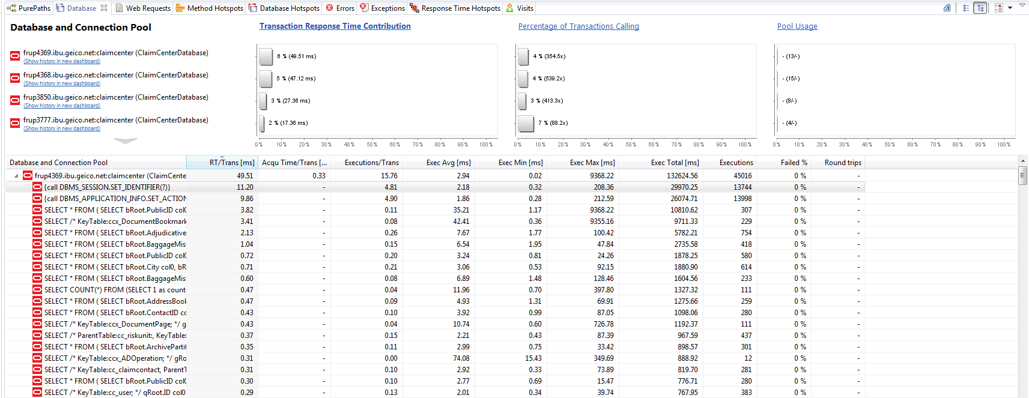
General Dashboard – Database

Slide 14
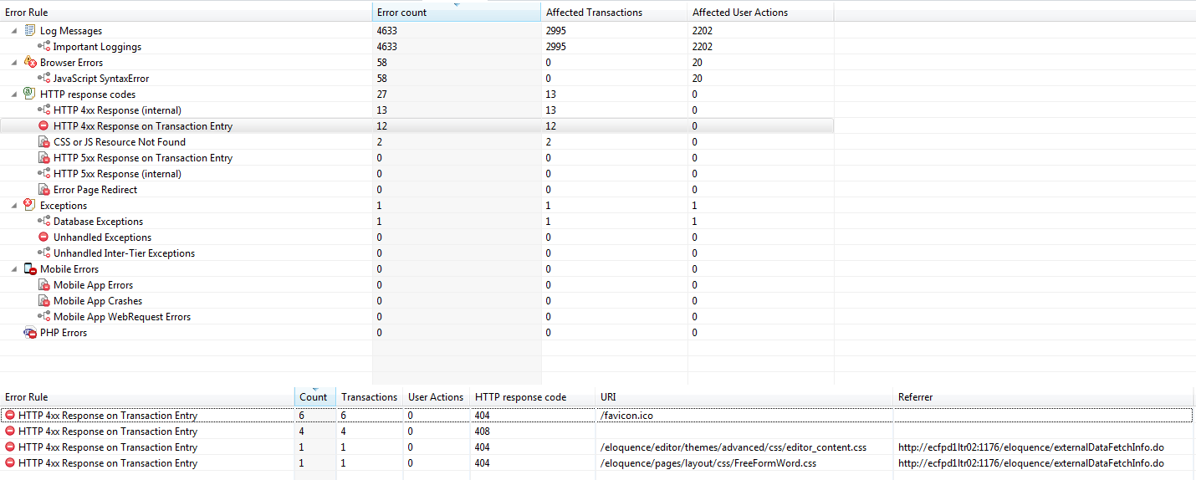
General Dashboard – Errors

Slide 15
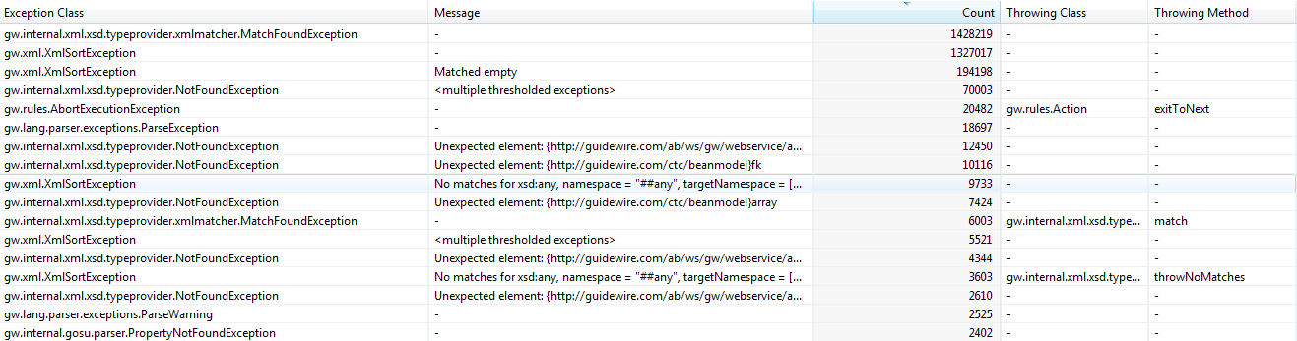
General Dashboard – Exceptions

Slide 16
Exercise
Open a General Dashboard
Navigate to the Web Requests, Errors, Exceptions, Database, or one of the HotSpot Dashlets
Are there any portions of the application that are slower than others?
Notes:
Do a quick walkthrough of the exercise before asking others to do it

Slide 17
Questions on PurePaths?

Slide 18
User Experience Management
Insight into End User’s experience of your application
Visits, Actions, Geographic, Browser

Slide 19
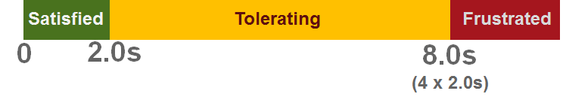
UEM – User Experience Index
Users have a Satisfying experience if:
No action failed
More than 50% of all actions were satisfying
Users have a Tolerating experience if their experience is neither frustrating nor satisfying, which means that:
Their last action was not frustrating or failed
Less than 50% of all actions were satisfying
More than 50% of all actions were at least tolerating
Users have a Frustrating experience if:
Their last action failed ("The Web site does not work - I'm leaving!")
Their last action was frustrated ("The Web site is too slow - I'm leaving!")
More than 50% of all actions were frustrating

Slide 20
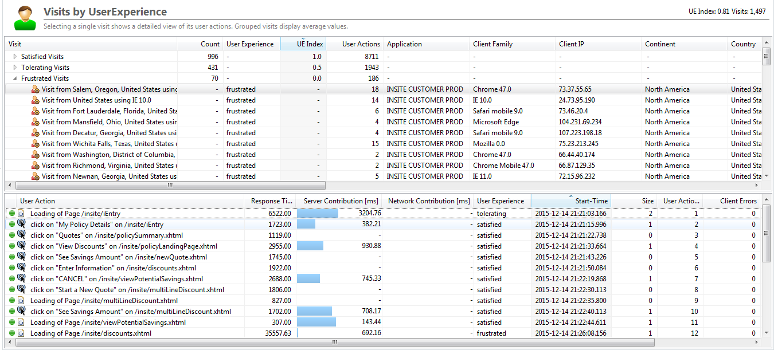
General Dashboard – Visits

Slide 21
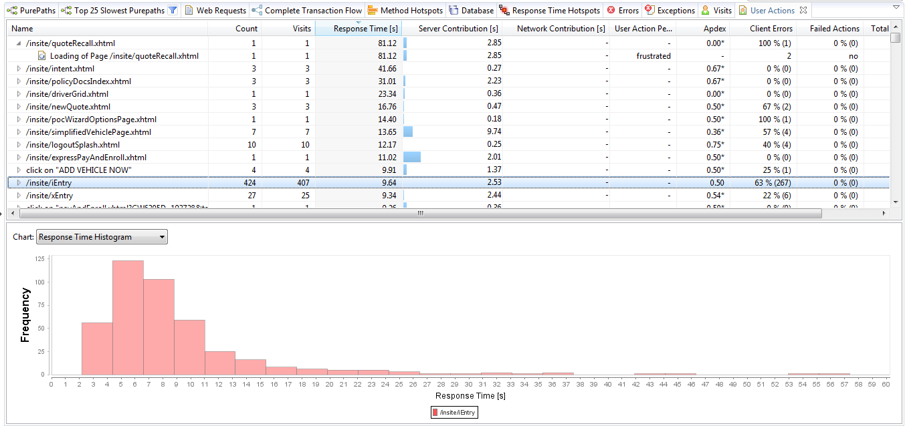
General Dashboard – User Actions

Slide 22
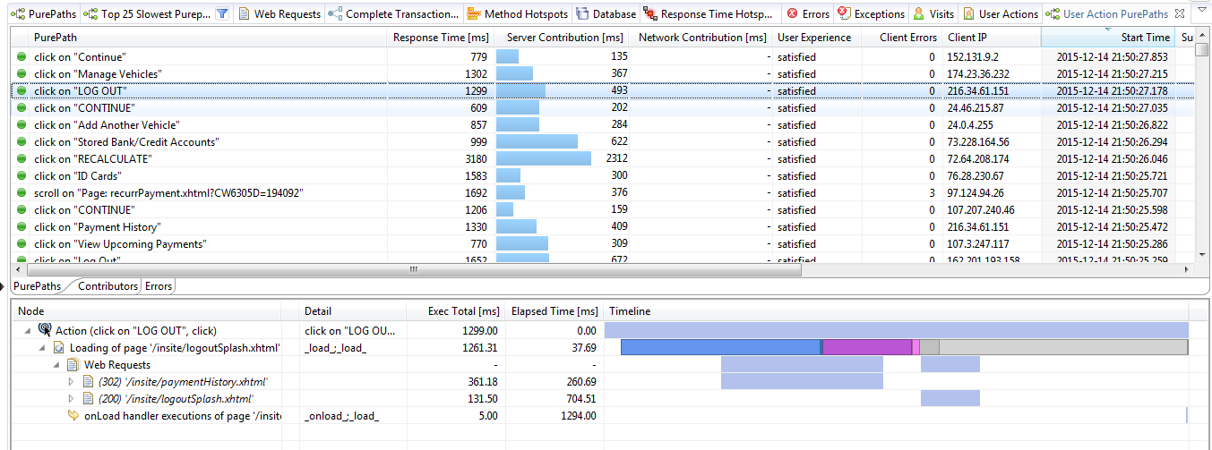
General Dashboard – User Action PurePaths

Slide 23
Exercise
Open the Cockpit
Navigate to Visits Dashlet
Find a tolerating or frustrated visit
Can you find why the user wasn’t satisfied?
Notes:
Do a quick walkthrough of the exercise before asking others to do it

Slide 24
Questions on UEM?

Slide 25
Navigating the Data
Dynatrace captures quite a large amount of data,
but how do you find the data you need?

Slide 26
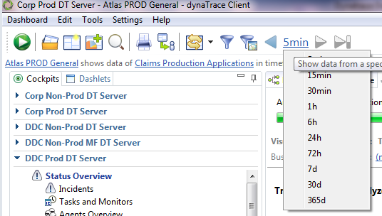
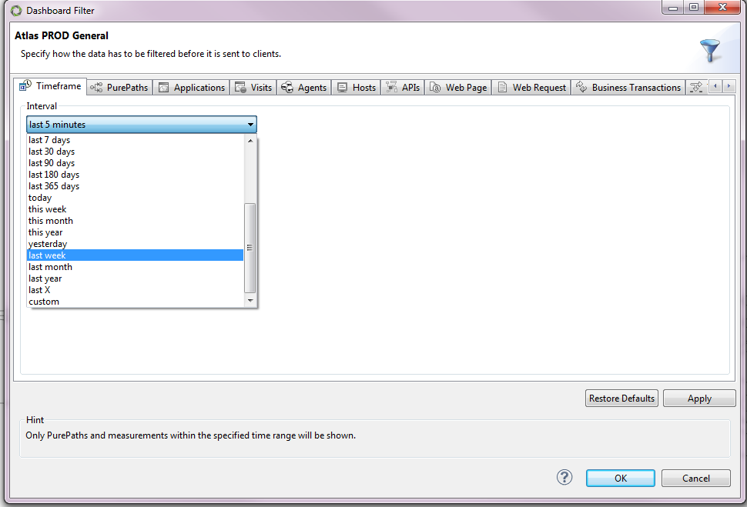

Timeframes
Notes:
Top Left: good for recent data
Bottom: click last 5 minutes to get to custom
Top Right: lots of time options with custom at bottom
Purepath and transactional data lasts in DT for less than 2 weeks (can store and export)
Metrics and charts last indefinitely but aggregate over time

Slide 27
Filters
Atlas PROD General – Dashboard Name
Claims Productions Application – System Profile of the Dynatrace Server
Last 5 Minutes – Timeframe
Application ‘ATLAS PROD’ – Application Defined by URI patterns
9 Agent Groups plus correlating Agents – The agents on the JVMs/.NET Process/ISS Server that we are monitoring and any agents these transactions follow to.
There are many more filters that can be added to a dashboard which can be added through the blue funnel filter button.

Slide 28
Drilling Down
The drill down feature is a powerful tool of Dynatrace used to isolate and view data in different ways.
This can be accomplished via right clicking on transactions, agent groups, web requests, visits etc. and selecting drill down, and selecting the new view you would like to see that data in.

Slide 29
Exercise
Open the Visits Dashlet
Drill down from Visit or User Action to find the root cause of frustrated or tolerating users
Open Transaction Flow Dashlet
Drill down from a tier that has slow response times or errors and find the root cause
Notes:
Do a quick walkthrough of the exercise before asking others to do it

Slide 30
Recap
General Dashboard
PurePaths
Web Requests
Method and Response Time Hotspots
Database, Errors, and Exceptions
UEM
User Experience Index
User Actions
Visits
Navigating the Data
Timeframe and Filters
Drill Down
Exercises for comprehension of material

Slide 31
Final Questions?

Slide 32
Where do I find more info on <Tool Name>?
Insert email, links to client documentation, etc.

Slide 33
Performance management for the digital customer age

