Slide 1
UPGRAD LEAD SCORE CASE STUDY
By:
Vinayak rane
Amar Rana
Ramya

Slide 2
CONTENTS
Problem Statement
Business Objective
Methodology for model preparation
Data Cleaning/Imputation
Exploratory Data Analysis
Dummy Variables selection
Train-Test Split
Model Building
Model Evaluation – Specificity/Sensitivity/Precision/Recall
Business recommendation

Slide 3
PROBLEM STATEMENT
X Education sells online courses to its customers
Company wants to increase the number of leads to join the courses
Company is looking to smoothen the process of identifying potential leads (Hot leads)
Company wishes to call only those leads who are potentially hot leads and hence needs to save time for other productive task

Slide 4
Business Objective
Lead wants to build a logistic regression model to assign a lead score between 0 and 100 to each of the leads which can be used by the company to target potential leads.
A higher score would mean that the lead is hot, i.e. is most likely to convert whereas a lower score would mean that the lead is cold and will mostly not get converted.
The CEO, in particular, has given a ballpark of the target lead conversion rate to be around 80%
the company reaches its target for a quarter before the deadline. During this time, the company wants the sales team to focus on some new work as well. So during this time, the company’s aim is to not make phone calls unless it’s extremely necessary, i.e. they want to minimize the rate of useless phone calls.

Slide 5
METHODOLOGY FOR MODEL PREPARATION
Data Cleaning, imputing and understanding the data
To check null values , ‘Select’ data and to find a solution to deal with such values
To check outliers in the data
Exploratory data Analysis
Creation of Dummy variables for categorical columns
Scaling of numerical variables
Building Logistic Regression Model
Model evaluation using confusion matrix, precision, recall, specificity.

Slide 6
DATA CLEANING & IMPUTATION
Total columns at initial = 37
Columns such as ‘City’, ‘Country’, ’Prospect Id’, ’Lead number’ are eliminated as there serve no enhancement in analysis
Eliminating all the ‘Asymmetric’ features as these contain more than 50% of null values
Reducing the data by removing all the rows which contain the ‘Select’ values in columns such as ‘Lead Profile’, ’Specialization’ and 'How did you hear about X Education'
Imbalance Ratio (convert_0/convert_1) = 0.96
At the end we left with 12 columns and 4535 rows for EDA

Slide 7
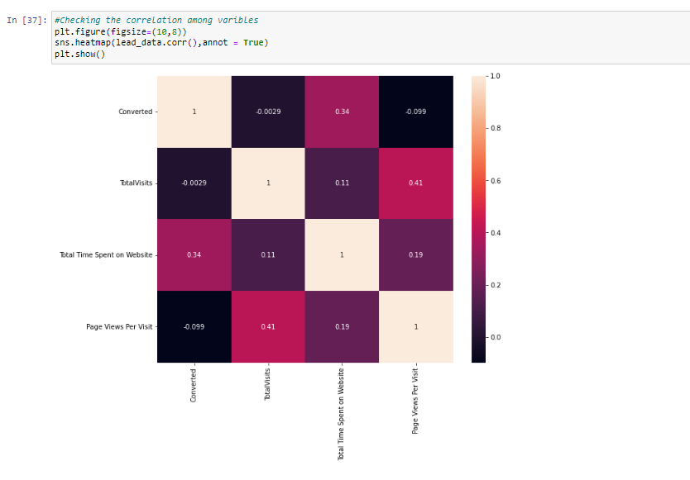
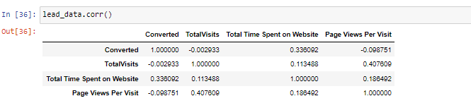
Exploratory Data Analysis (EDA)
‘TotalVisits’ has high co-relation with ‘Page Views Per Visit’
‘Total time spent on Website’ has a direct correlation with ‘Converted’ which is a target column

Slide 8
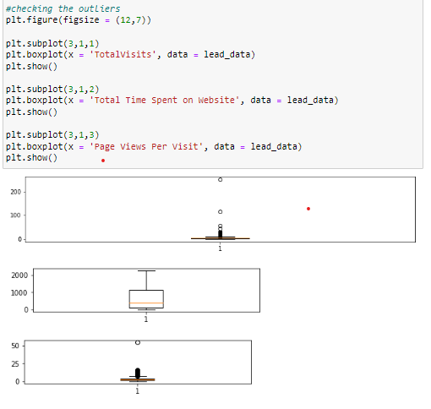
Exploratory Data Analysis (EDA) - Conti
In the boxplots,
we can see there are not much of the outliers in the numerical cols which can affect our observations

Slide 9
DUMMY VARIABLES SELECTION
Following are the categorical variable which are considered for creating dummy variables
'Lead Origin’,
'Lead Source’,
'Do Not Email’,
'Last Activity’,
'Specialization’,
'What is your current occupation’,
'A free copy of Mastering The Interview’,
'Last Notable Activity'

Slide 10
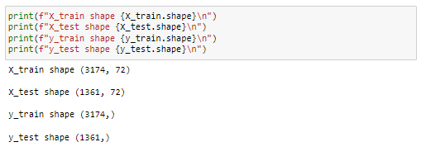
TRAIN TEST SPLIT
The data is split in the ratio of 70 (Train) to 30 (test)
Train data rows in total : 3174
Test data rows in total : 1361

Slide 11
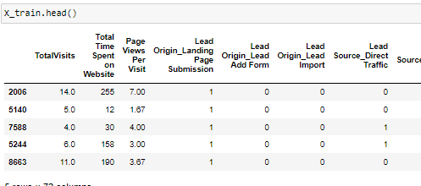
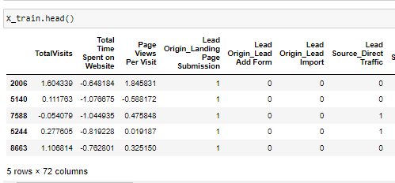
SCALING
Below are the numerical columns selected for scaling.
'TotalVisits’
'Total Time Spent on Website’
'Page Views Per Visit’
BEFORE AFTER

Slide 12
MODEL BUILDING
Model is build using Logistic Regression classification technique
Columns are eliminated using Recursive Feature Elimination (RFE)
Variance Inflation Factor and p-values are considered for further manual elimination of the columns
Max limit for VIF is 5 and for p-value is 0.005
Separate individual function for logistic model and Variance inflation Factor are written for the reusability
Recursively perform RFE and VIF to get best feature at the end for building model

Slide 13
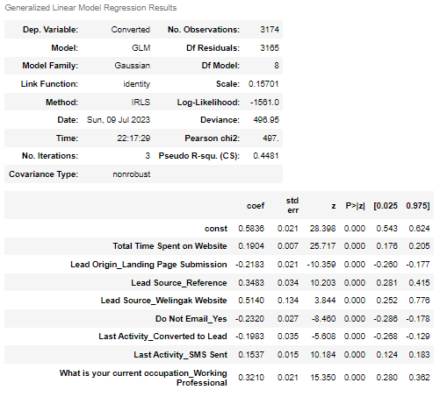
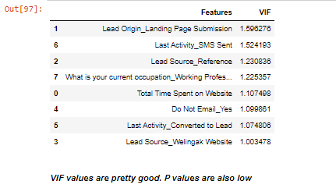
MODEL BUILDING - Conti

Slide 14
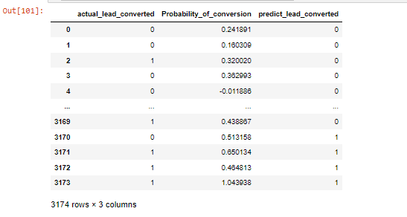
MODEL BUILDING - Conti
Prediction with cut off at 0.45 of final model is as below:

Slide 15
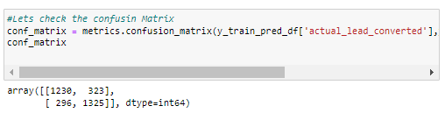
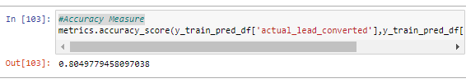
MODEL EVALUATION : Train data
Different measures are used to evaluate the model which includes
Confusion Matri
Accuracy > ~ 80% which is quite good.

Slide 16
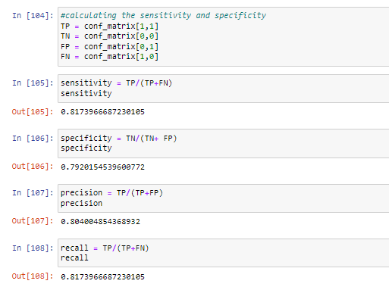
MODEL EVALUATION : Train data - Conti
Sensitivity > ~ 81%
Precision > ~ 80%
Specificity > ~79%
Recall > ~ 81%
We have got quite good values for sensitivity and specificity for threshold cut off at 0.45 with 80% of accuracy in train data which is quite good.

Slide 17
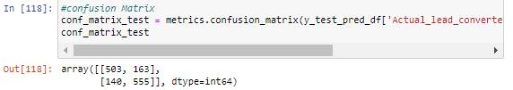

MODEL EVALUATION : Test data
Different measures are used to evaluate the model which includes
Confusion Matri
Accuracy > ~ 77% which is quite good.

Slide 18
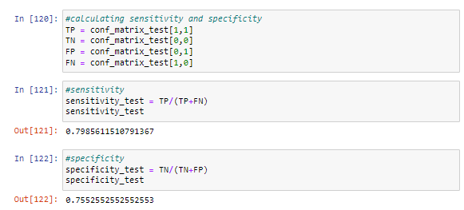
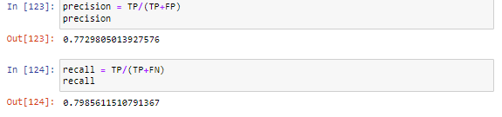
MODEL EVALUATION : Train data - Conti
Sensitivity > ~ 81%
Precision > ~ 80%
Specificity > ~79%
Recall > ~ 81%
we obtained sensitivity of 80% and specificity of 75% with current logistic regression model which is quite satisfactory with 77.78% of accuracy.

Slide 19
Business recommendation & Conclusion
X Education can make use of the following points in order to convert their leads into successful leads:
It is observed that those who working professionals are more prone to opt for the courses so business should focus on working professionals for lead
Those who visits the website and spend considerable amount of time there, can be approached to convert them into successful leads
Also, those are coming from source such as reference and Welingak website can also be taken into consideration for the successful lead, this applications should be treated as hot leads.
Business can max the number of leads generated by direct traffic and google
By closely looking at the data when the last activity is converted to Lead, then there are high chances of them getting converted into successful leads

