Slide 1
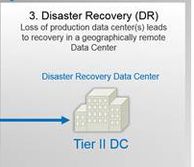







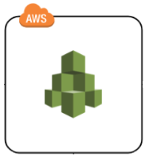





AWS Cloud
Internet Gateway
Field generated data being uploaded to the landing s3 Bucket
S3
Step Functions
Lambda
Lambda
Generated 2D and 3D Images being rendered to customer workstations
S3
SQS
Active Directory for SSO Integration in a shared Amazon VPC
AWS Organizations, Active Directory Connector
Production Account
Security Group,/ NACL
Load Balancer
Shared Services
AWS Organization Account to manage member accounts , Service Control Policies and AWS SSO
Amazon EC2 Instances
Customer On-premises Datacenter
Availability Zone
Availability Zone
Root Account
Public subnet
Public subnet
Central S3 bucket for all Flowlog, Application, AWS CloudTrail and AWS Config log files
Log Analytics solution using Kinesis streams/firehose/analytics, Elastrsearch, Kibana.
Incident Management/Monitoring using ServiceNow
Private subnet
Private subnet
Logging & Analytics
Security Account to Audit and address emergency security incidents
Amazon Guartduty, Config, IAM, SCP, SNS, Shield.
On-premise Active Directory
On premise viewing workstations
AWS Storage Gateway
RDS Multi-AZ Replication
Security

